Slide 1

Apache Spark Fundamentals
By
Hariharan

Slide 2
Apache Spark Fundamentals Agenda
Apache Hadoop
Spark overview
Spark execution model
Basic Spark programming Model
Install Spark
Scala
First Example
Second Example
Running Spark Examples
Your Turn!

Slide 3
Apache Hadoop

Slide 4
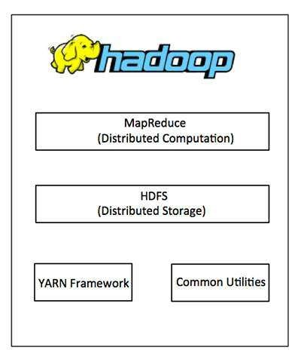
An overview of Apache Hadoop
Open source software framework for distributed data processing
Comes with Hadoop Distributed File System (HDFS)
Map/Reduce for data processing
YARN (Yet Another Resource Negotiator)

Slide 5
Map Reduce
A generic data processing model
Done through map step and reduce step
In map step, each data item is processed independently
In reduce step, map steps results are combined

Slide 6
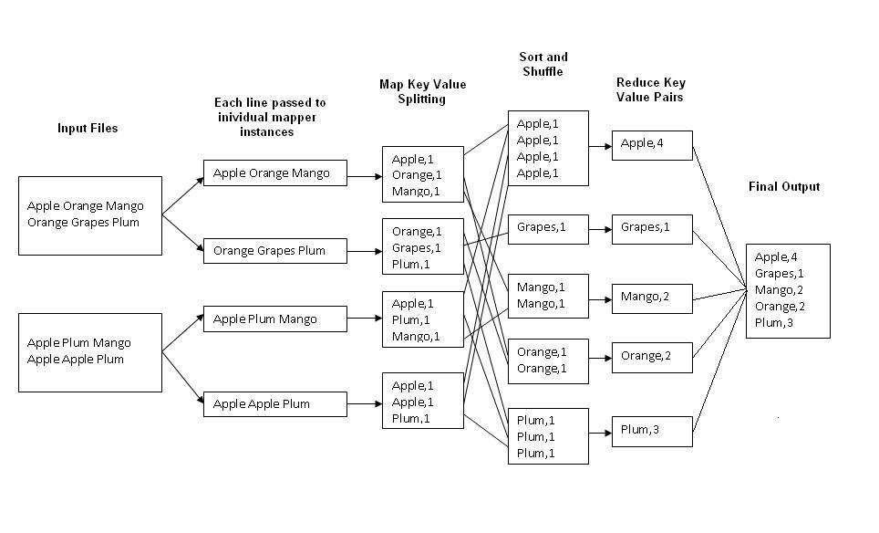
Word Count

Slide 7
MapReduce limitations
MapReduce use cases showed two major limitations:
difﬁcultly of programming directly in MR
performance bottlenecks, or batch not ﬁtting the use cases
The subsequent steps have to read from disk
In short, MR doesn’t compose well for large applications

Slide 8
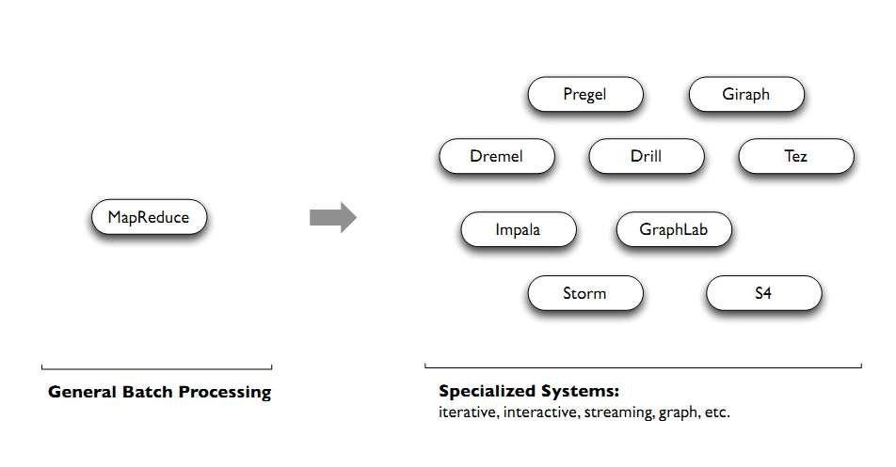
Therefore, people built specialized systems as workarounds…

Slide 9
Spark
Unlike the various specialized systems, Spark’s goal was to generalize MapReduce to support new apps within same engine
Two reasonably small additions are enough to express the previous models:
fast data sharing
general DAGs
This allows for an approach which is more efﬁcient for the engine, and much simpler for the end users

Slide 10
Spark Overview

Slide 11
Apache Spark Overview
A general framework for distributed computing that offers high performance for both batch and interactive processing
an in-memory big data platform that performs especially well with iterative algorithms
Originally developed by UC Berkeley starting in 2009 Moved to an Apache project in 2013
10-100x speedup over Hadoop with some algorithms, especially iterative ones as found in machine learning

Slide 12
Advantages of Spark
Runs Programs up to 100x faster than Hadoop MapReduce
Does the processing in the main memory of the worker nodes
Prevents unnecessary I/O operations with the disks
Ability to chain the tasks at an application programming level
Minimizes the number of writes to the disks
Uses Directed Acyclic Graph (DAG) data processing engine
MapReduce is just one set of supported constructs

Slide 13
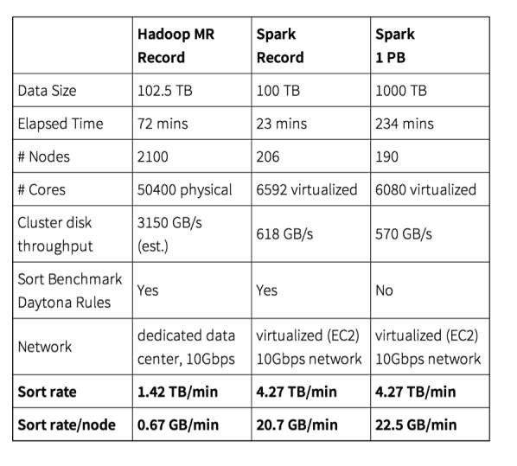
The petabyte sort record

Slide 14
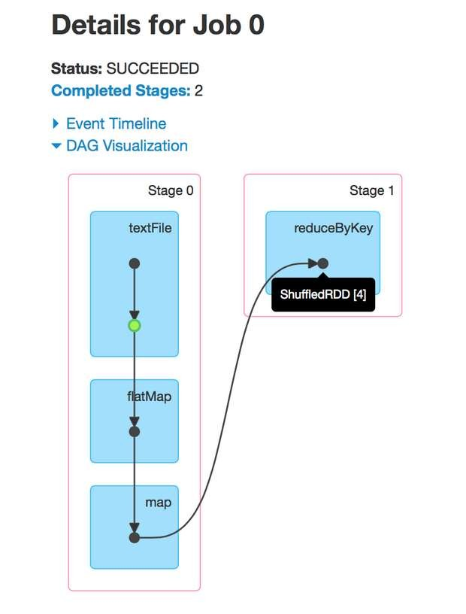
DAG
Stands for Directed Acyclic Graph
For every spark job a DAG of tasks is created

Slide 15
Spark APIs
APIs for
Java
Python
Scala
R
Spark itself is written in Scala
Percent of Spark programmers who use each language , In 2016
88% Scala, 44% Java, 22% Python
I think if it were done today, we would see the rank as Scala, Python, and Java

Slide 16
Spark Libraries
Spark SQL
For working withstructured data. Allows you to seamlessly mix SQL queries with Spark programs
Spark Streaming
Allows you to build scalable fault-tolerant streaming applications
MLlib
Implements common machine learning algorithms
GraphX
For graphs and graph-parallel computation

Slide 17
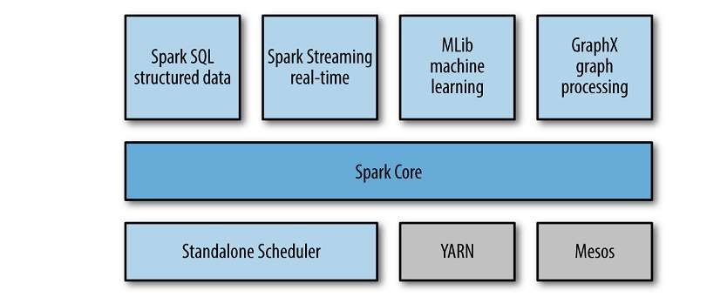
Spark Architecture

Slide 18
Spark
Runs
Locally
distributed a cross a cluster
Requires a cluster manager
Yarn
Spark Stand alone
Mesos
spark
Interactive shell
Data exploration
Ad-hoc analysis
Submit an application
is offten used alongside Hadoop’s data storage module, HDFS
can also integrate equally well with other popular data storage subsystems such as HBase, Cassandra,…

Slide 19
What is Spark Used For?
Stream processing
log files
sensor data
financial transactions
Machine learning
store data in memory and rapidly run repeated queries
Interactive analytics
business analysts and data scientists increasingly want to explore their data by asking
a question, viewing the result, and then either altering the initial question slightly or
drilling deeper into results. This interactive query process requires systems such as Spark that are able to respond and adapt quickly
Data integration
Extract, transform, and load (ETL) processes

Slide 20
Who Uses Spark?
Well-known companies such as IBM and Huawei have invested significant sums in the technology
a growing number of startups are building businesses that depend in whole or in part upon Spark
Spark founded Databricks
which provides a hosted end-to-end data platform powered by Spark
The major Hadoop vendors, including MapR, Cloudera and Hortonworks, have all moved to
support Spark alongside their existing products, and each is working to add value for their customers.
IBM, Huawei and others have all made significant investments in Apache Spark, integrating it into their own products and contributing enhance-ments and extensions back to the Apache project
Web-based companies like Chinese search engine Baidu, e-commerce operation Alibaba Taobao,
and social networking company Tencent all run Spark-based operations at scale, with Tencent’s
800 million active users reportedly generating over 700 TB of data per day for processing on a cluster of more than 8,000 compute nodes.

Slide 21
3 reasons to choose Spark
Simplicity
All capabilities are accessible via a set of rich APIs
designed for interacting quickly and easily with data at scale
well documented
Speed
designed for speed, operating both in memory and on disk
Support
supports a range of programming languages
includes native support for tight integration with a number of leading storage solutions in the Hadoop ecosystem and beyond
large, active, and international community
A growing set of commercial providers
including Databricks, IBM, and all of the main Hadoop vendors deliver comprehensive support for Spark-based solutions

Slide 22
Spark Execution Model

Slide 23
Spark execution model
Application
Driver
Executer
Job
Stage

Slide 24
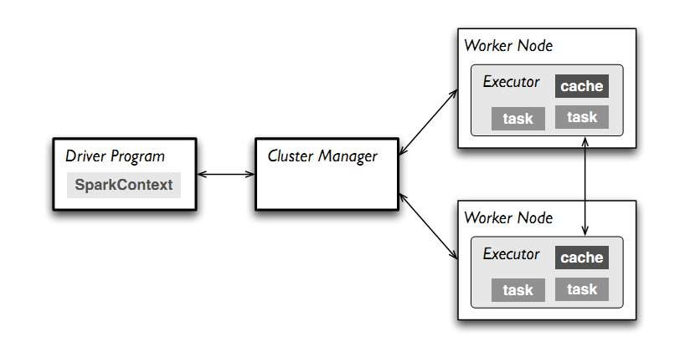
Spark execution model

Slide 25
Spark execution model
At runtime, a Spark application maps to a single driver process and a set of executor
processes distributed across the hosts in a cluster
The driver process manages the job flow and schedules tasks and is available the entire
time the application is running.
Typically, this driver process is the same as the client process used to initiate the job
In interactive mode, the shell itself is the driver process
The executors are responsible for executing work, in the form of tasks, as well as for storing any data that you cache.
Invoking an action inside a Spark application triggers the launch of a job to fulfill it
Spark examines the dataset on which that action depends and formulates an execution plan.
The execution plan assembles the dataset transformations into stages. A stage is a collection of tasks that run the same code, each on a different subset of the data.

Slide 26
Cluster Managers
Yarn
Spark Standalone
Mesos

Slide 27
Basic Programming Model

Slide 28
Basic Programming Model
Spark’s basic data model is called a Resilient Distributed Dataset (RDD)
It is designed to support in-memory data storage, distributed across a cluster
fault-tolerant
tracking the lineage of transformations applied to data
Efficient
parallelization of processing across multiple nodes in the cluster
minimization of data replication between those nodes.
Immutable
Partitioned

Slide 29
RDDs
Two basic types of operations on RDDs
Transformations
Transform an RDD into another RDD, such as mapping, filtering, and more
Actions:
Process an RDD into a result , such as count, collect, save , …
The original RDD remains unchanged throughout
The chain of transformations from RDD1 to RDDn are logged
and can be repeated in the event of data loss or the failure of a cluster node

Slide 30
RDDs
Data odes not have to fit in a single machine
Data is separated into partitions
RDDs remain in memory
greatly increasing the performance of the cluster, particularly in use cases with a requirement for iterative queries or processes

Slide 31
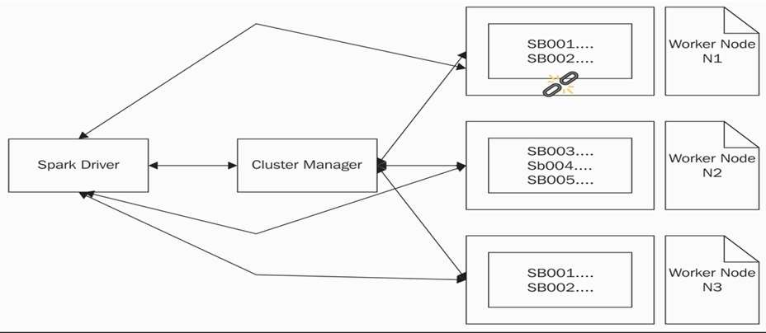
RDDs

Slide 32
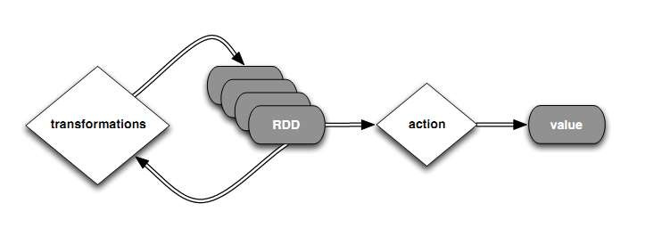
Transformations
Transformations are lazily processed, only upon an action
Transformations create a new RDD from an existing one
Transformations might trigger an RDD repartitioning, called a shuﬄe
Intermediate results can be manually cached in memory/on disk
Spill to disk can be handled automatically

Slide 33
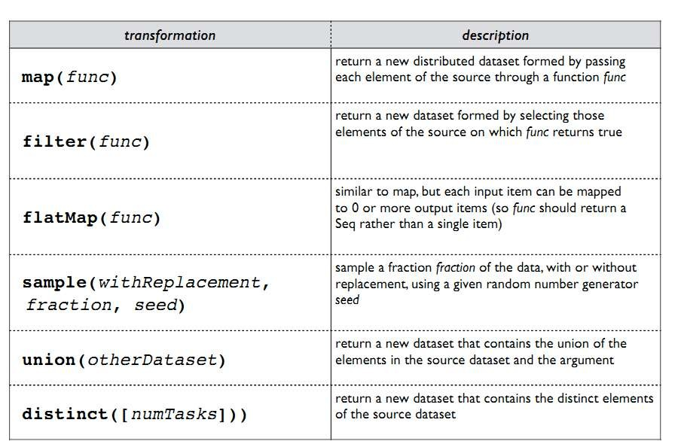
Spark transformations

Slide 34
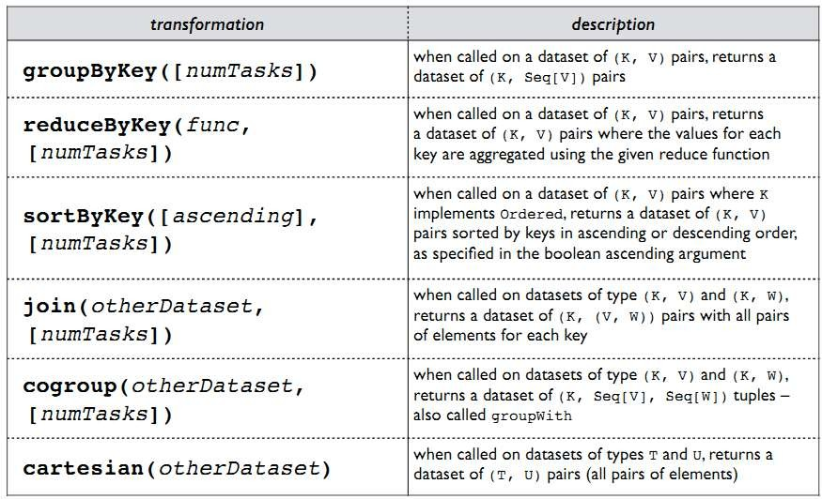
Spark transformations

Slide 35
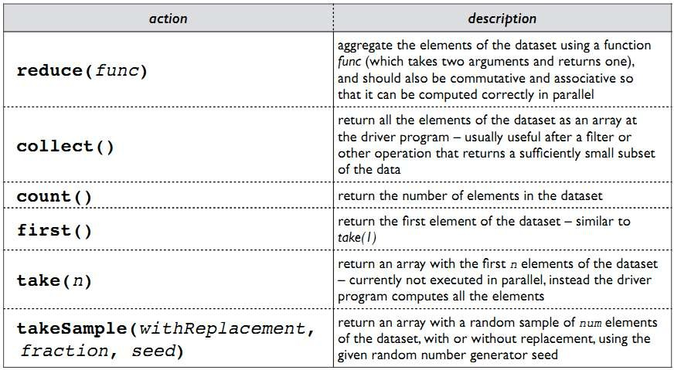
Spark actions

Slide 36
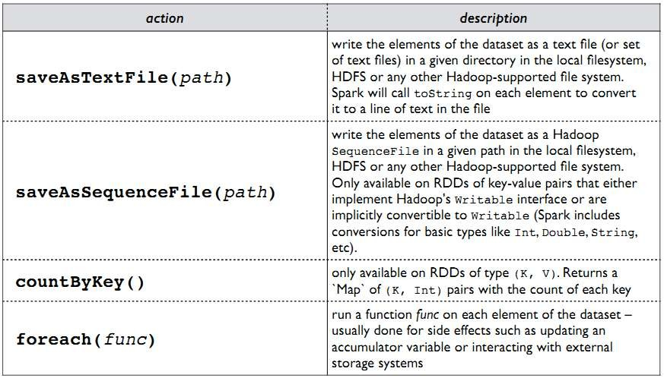
Spark actions

Slide 37
RDD and cache
Spark can persist (or cache) a dataset in memory across operations
Each node stores in memory any slices of it that it computes and reuses them in other actions on that dataset – often making future actions more than 10x faster
The cache is fault-tolerant: if any partition of an RDD is lost, it will automatically be recomputed using the transformations that originally created it
You can mark an RDD to be persisted using the persist() or cache() methods on it

Slide 38
Creating RDDs
#Turn a Scala collection into an RDD
sc.Parallelize( List( 1, 2, 3, 4 ) ) #Load Text File from FS or HDFS
sc.textFile( “file.txt”)
sc.textFile( “directory/*.txt”)
sc.textFile( “hdfs/namenode:9000/path/file.txt”) #Use Existing Hadoop InputFormat
Sc.hadoopFile( keyClass, valueClass , inputFmt , conf)

Slide 39
Install Spark

Slide 40
Installing Spark
Step 1: Installing Java
We need Java8
Step 2: Install Scala
We will use Spark Scala Shell
Step 3: Install Spark
Step 4: within the “spark” directory, run:
./bin/spark-shell
Follow instructions here to install Spark on Ubuntu

Slide 41
For Cluster installations
Each machine will need Spark in the same folder, and key-based passwordless SSH
access from the master for the user running Spark
Slave machines will need to be listed in the slaves file
See spark/conf/

Slide 42
Scala

Slide 43
Scala
Stands for SCAlable Language
Released in 2004
JVM-based language that can call, and be called, by Java
Strongly statically typed, yet feels dynamically typed
Type inference saves us from having to write explicit types most of the time
Blends the object-oriented and functional paradigms
Functions can be passed as arguments and returned from other functions
Functions as filters
They can be stored in variables
This allows flexible program flow control structures
Functions can be applied for all members of a collection, this leads to very compact coding
Notice above: the return value of the function is always the value of the last statement

Slide 44
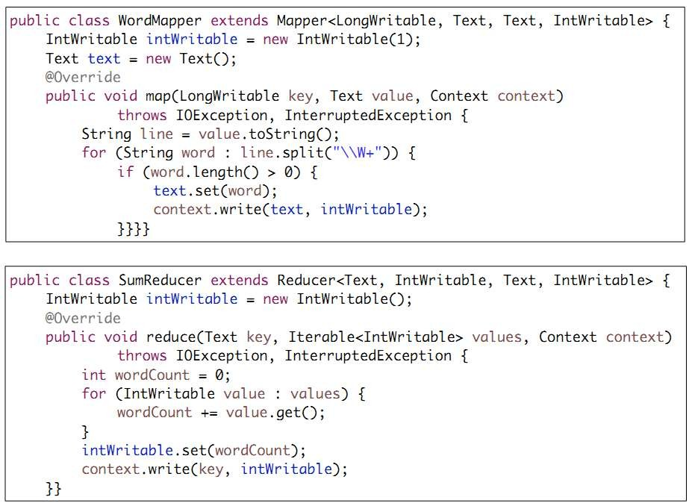
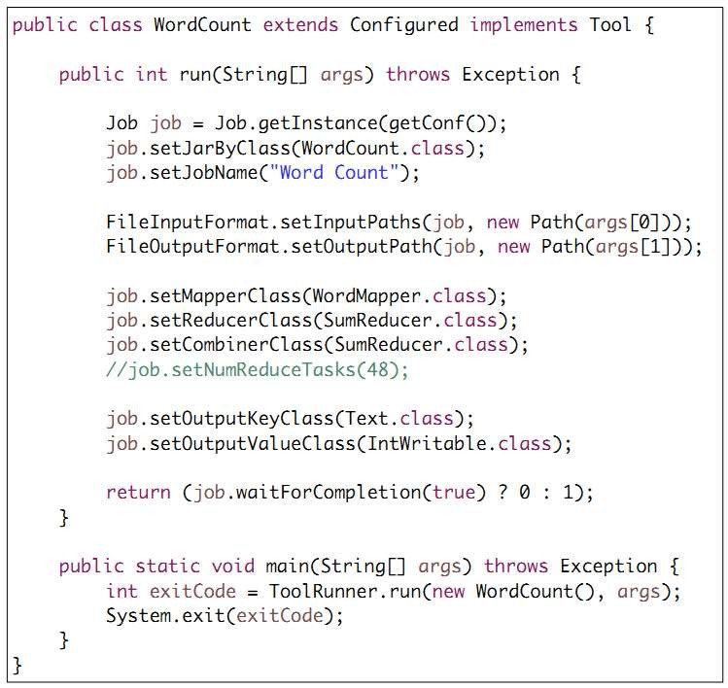
Wordcount in Java

Slide 45
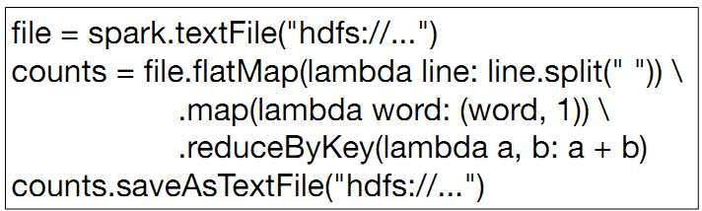
WordCount In Scala

Slide 46
Scala Sampler Syntax and Features
No semicolons
unless multiple statements per line
No need to specify types in all cases
types follow variable and parameter names after a colon
Almost everything is an expression that returns a value of a type
No checked exceptions
A pure OO language
all values are objects, all operations are methods

Slide 47
Scala Notation
‘_’ is the default value or wild card
‘=>’ Is used to separate match expression from block to be evaluated
The anonymous function ‘(x,y) => x+y’ can be
replaced by ‘_+_’
The ‘v=>v.Method’ can be replaced by ‘_.Method’
lsts.filter(v=>v.length>2) is the same as lsts.filter(_.length>2)
Iteration with for:
for (i <- 0 until 10) { // with 0 to 10, 10 is included
println(s"Item: $i")
}
"->" is the tuple delimiter
(2, 3) is equal to 2 -> 3
2 -> (3 -> 4) == (2,(3,4))
2 -> 3 -> 4 == ((2,3),4)
Notice above: single-statement functions do not need curly braces { }
Arrays are indexed with ( ), not [ ]. [ ] is used for type bounds (like Java's < >)

Slide 48
First Example

Slide 49
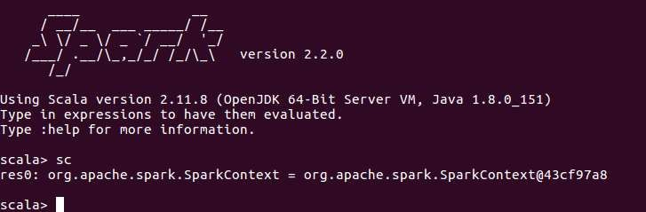
Spark Context

Slide 50
Spark context
First thing that a Spark program does is create a SparkContext object, which tells Spark how to access a cluster
In the shell for either Scala or Python, this is the sc variable, which is created automatically
Other programs must use a constructor to instantiate a new SparkContext
Then in turn SparkContext gets used to create other variables

Slide 51
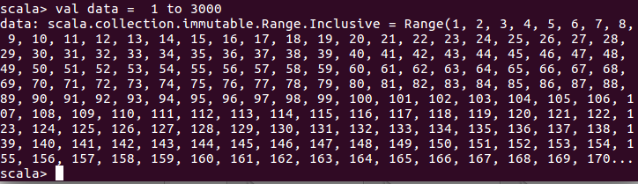
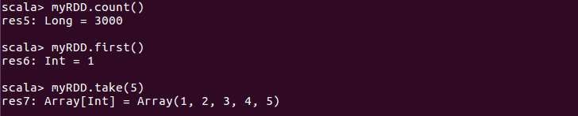
Create RDD + Some basic Actions

Slide 52
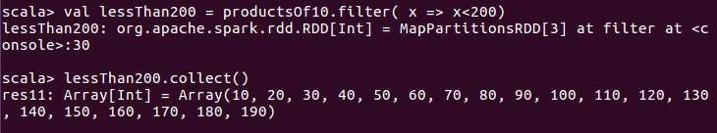
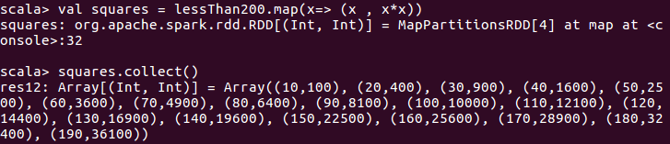
Some Basic Transformations and Actions

Slide 53
Second Example

Slide 54
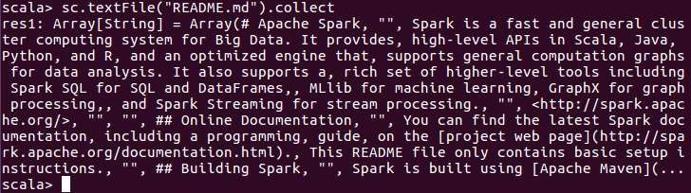
Read A text File into an RDD

Slide 55
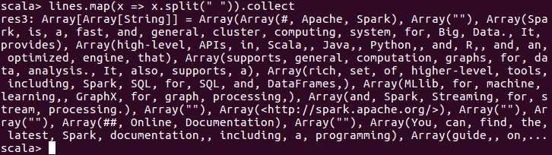
Read A text File into an RDD
each line
An item in the RDD
split out the words
use map function to transform each item into words
we end up with an array of arrays of words
one array for each line
Solution?
flatMap

Slide 56
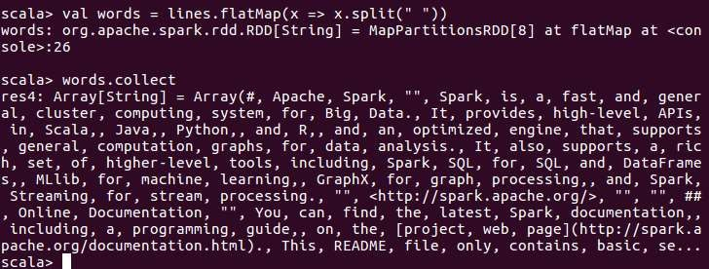
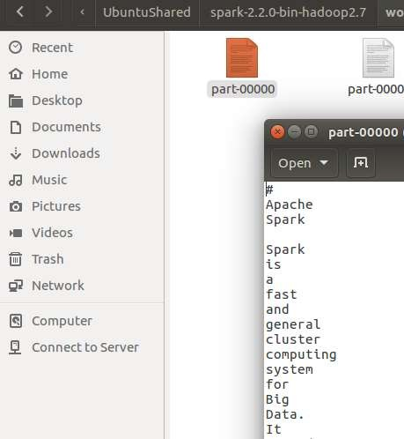
Read A text File into an RDD

Slide 57
Filter lines

Slide 58
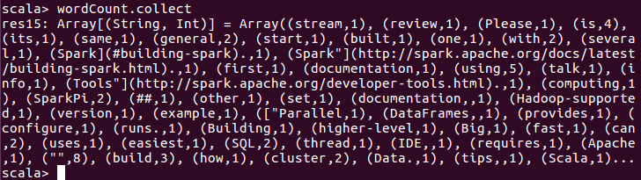
wordCount

Slide 59
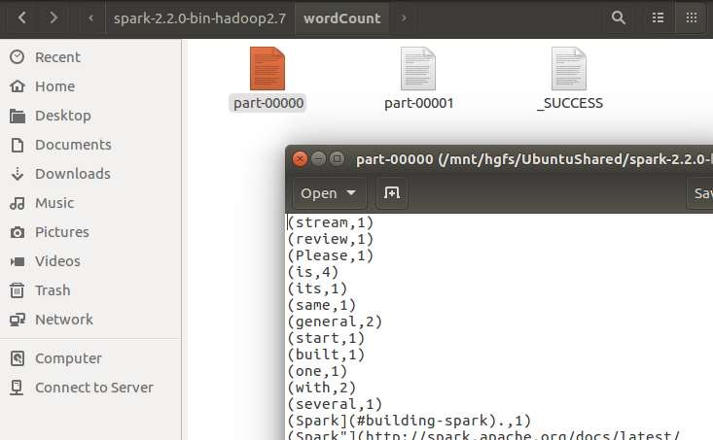
wordCount

Slide 60
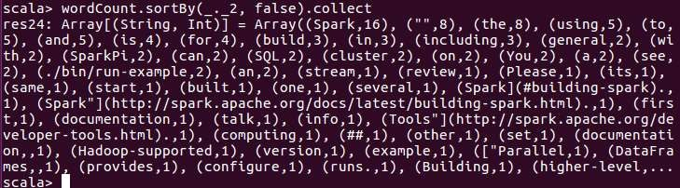
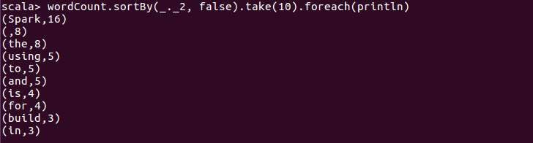
wordCount

Slide 61
Running Spark Examples

Slide 62
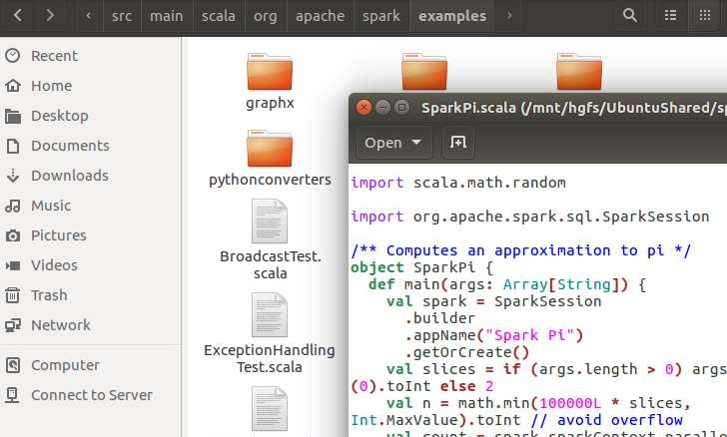
Running Spark Examples
Lets execute a Spark examples!
./bin/run-example SparkPi 30 local

Slide 63
Your Turn!
Find number of different Charactes in Words with
Finds how many times each character appears in all the words that appear more than 3 times in a text file

Slide 64
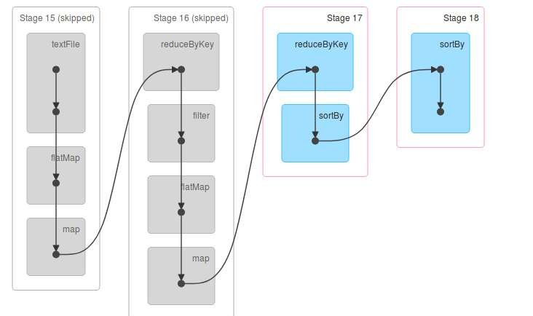
Your Turn Solution

