Slide 1
HIVE
Hariharan

Slide 2





















Background
Started at Facebook
Data was collected
by nightly cron jobs into Oracle DB
“ETL” via hand- coded python
Grew from 10s of GBs (2006) to 1 TB/ day new data (2007), now 10x that.

Slide 3
Hadoop as Enterprise Data Warehouse
The Hadoop ecosystem contains different sub- projects (tools) such as Sqoop, Pig, and Hive that are used to help Hadoop modules.
Sqoop: It is used to import and export data to and from between HDFS and RDBMS.
Pig: It is a procedural language platform used to develop a script for MapReduce operations.
Hive: It is a platform used to develop SQL type scripts to do MapReduce operations.
Hive is a data warehouse infrastructure tool to process structured data in Hadoop. It resides on top of Hadoop to summarize Big Data, and makes querying and analyzing easy.

Slide 4
Hive Applications
Log processing
Text mining
Document indexing
Customer-facing business intelligence (e.g., Google Analytics)
Predictive modeling, hypothesis testing

Slide 5
Features of Hive
It stores schema in a database and processed data into HDFS.
It is designed for OLAP.
It provides SQL type language for querying called HiveQL or HQL.
It is familiar, fast, scalable, and extensible.
Hive is designed for easy and effective data aggregation, ad-hoc querying and analysis of huge volumes of data.

Slide 6
Hive is not
A relational database
A design for OnLine Transaction Processing (OLTP)
A language for real-time queries and row-level updates

Slide 7
Architecture of Hive
3 major components:
hive clients
hive services
Meta Store Under Hive Client:
Thrift client
ODBC driver
JDBC driver

Slide 8
Architecture of Hive
Thrift Client- it provides an easy environment to execute the hive commands from a vast range of programming languages. Thrift client bindings for Hive are available for C++, Java, PHP scripts, python scripts and Ruby.
JDBC and ODBC- JDBC and ODBC drivers can be used for communication between hive client and hive servers for compatible options.

Slide 9
Architecture of Hive
Hive services:
Cli- the command line interface to Hive is the default service
Hive server-runs hive as a server exposing a thrift service , enabling access from a range of clients written in different languages
Hwi-Hive web interface

Slide 10
Architecture of Hive
Metastore- it is the central repository of Hive metadata. By default the metastore service runs in the same JVM as the HIVE service.
The metastore contains information about the partitions and tables in the warehouse, data necessary to perform read and write functions, and HDFS file and data locations.

Slide 11
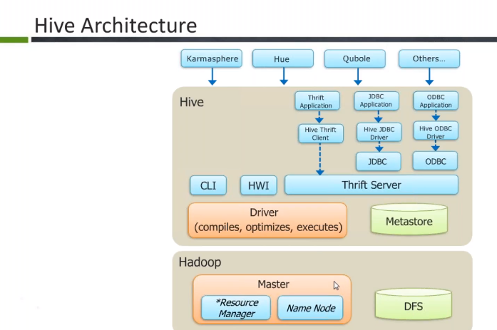

Slide 12
Hive Vs Relational Databases
Hive is not a full Database it can be called a data warehouse mainly.
Relational databases are of “Schema on READ" and "Schema on Write”. First creating a table and then inserting the data into the particular table. Insertions, Updates, Modifications can be performed on this relational database table.
Hive is “Schema on READ only”. Update, modifications won't work on this because the hive query in typical cluster is set to run on multiple Data Nodes. So it is not possible to update and modify data across multiple nodes.

Slide 13
Hive Vs Relational Databases
Hive is based on the notation of Write once Read many times, while the RDBMS is designed for Read once, Write many times.
In RDBMS, record level updates, inserts and deletes, are possible whereas these are not allowed in Hive
RDBMS is best suited for dynamic data analysis and where fast responses are expected but Hive is suited for data warehouse applications, where relatively static data is analyzed, fast responses are not required and when data is not changing rapidly.

Slide 14
Hive Vs Relational Databases
In RDBMS the maximum data size allowed will be in 10s of Terabytes whereas Hive has 100s of Petabytes
Hive is very easily scalable at low cost but RDBMS is not

Slide 15
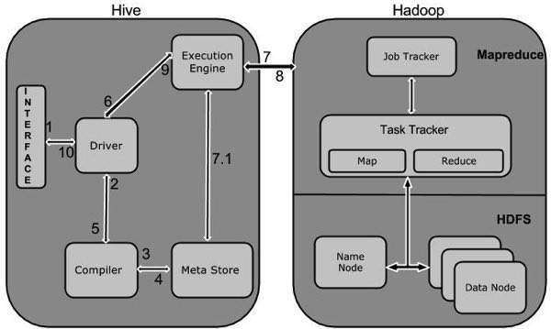
Job Execution Inside Hive

Slide 16
Job Execution Inside Hive
Steps:
Execute Query-The Hive interface such as Command Line or Web UI sends query to Driver (any database driver such as JDBC, ODBC, etc.) to execute.
Get Plan-The driver takes the help of query compiler that parses the query to check the syntax and query plan or the requirement of query.
Get Metadata-The compiler sends metadata request to Metastore (any database).

Slide 17
Job Execution Inside Hive
Send Metadata-Metastore sends metadata as a response to the compiler.
Send Plan-The compiler checks the requirement and resends the plan to the driver. Up to here, the parsing and compiling of a query is complete.
Execute Plan-The driver sends the execute plan to the execution engine.

Slide 18
Job Execution Inside Hive
Execute Job-Internally, the process of execution job is a MapReduce job. The execution engine sends the job to JobTracker, which is in Name node and it assigns this job to TaskTracker, which is in Data node. Here, the query executes MapReduce job.
Metadata Ops-Meanwhile in execution, the execution engine can execute metadata operations with Metastore
Fetch Result-The execution engine receives the results from Data nodes.

Slide 19
Job Execution Inside Hive
Send Results-The execution engine sends those resultant values to the driver.
Send Results-The driver sends the results to Hive Interfaces.

Slide 20
Hive Query Life cycle
1
Driver
10
Execution Engine
11
Hadoop Map Reduce
Hive Interface
13
14
12
9
Physical plan generator
Metastore
Optimizer
2
4
5
8
Compiler
Parser
3
Semantic Analyzer
6
Logical plan generator
7
Optimizer
6 7

Slide 21
Hive Data Models
Database
Table
Partition
Buckets or Clusters

Slide 22


Hive Data Models
Database: Holds namespace for tables Table: Container of actual data
sample
Id | Name | Age | Sex | State
In Hive warehouse stored as a folder
/user/$USER/warehouse/sample

Slide 23
Hive Data Models
Partition: Horizontal slice of table by a partition key Let say sample table is partitioned by state column
sample
Partition 1
Id | Name | Age | Sex | State
 |  |  |  | TX
 |  |  |  | IL
Partition 2
Stored as many subfolders under sample directory
/user/$USER/warehouse/State=AL/
/user/$USER/warehouse/State=GA/
/user/$USER/warehouse/State=NC/
/user/$USER/warehouse/State=ND/

Slide 24
Hive Data Models
Bucket: Divides into further chunks by an other column for sampling
Let say sample table is partitioned by ‘State’ column and clustered by ‘Age’ column of 2 buckets
In warehouse, the data is stored as
/user/$USER/warehouse/State=AL/part-00000
/user/$USER/warehouse/State=AL/part-00001
/user/$USER/warehouse/State=GA/part-00000
/user/$USER/warehouse/State=GA/part-00001
.
.
/user/$USER/warehouse/State=ND/part-00000
/user/$USER/warehouse/State=ND/part-00001

Slide 25




Data Loading Techniques
Managed Table: Tables managed by Hive Ware House
– Copy file from local file system to Hive Ware House
1)
Local FS
copy
HDFS
File
Hive
Warehouse
– Copy file from HDFS to Hive Ware House
2)
HDFS
copy
Hive
Warehouse
File

Slide 26



Data Loading Techniques contd.,
External Table: Tables are just referenced by Hive Ware House
– Directly managing file in HDFS with out copying it into Hive Ware House
3)
HDFS
Rreefefererenncceedd
Hive Warehouse
File

Slide 27
Data Loading Techniques contd.,
Explain when to go for external table and managed table?

Slide 28

Question - 01
In which scenario you use Hive?
Completely unstructured nasty data
Structured data
Any kind of data
None of the above

Slide 29

Question – 01 answer
2. Hive is mainly used to analyze structured data. Typically, Hive runs on the data that is generated by MapReduce job (or) pig

Slide 30
Question - 02
Which option is not correct about Metastore?
It stores the table location
It has information about number of partitions and number of buckets
It can give you time at which the table is created
It stores the actual data

Slide 31

Question – 02 answer
4. Metastore stores only the metadata. Actual data is stored in HDFS.

Slide 32
Question – 03 (last question)
What is incorrect about Hive?
Hive internally generates MapReduce jobs to serve your query
Hive runs on top of HDFS
Hive is a proprietary software
Hive supports multiple interfaces to interact with

Slide 33

Question – 03 answer
3. Hive is an open source. Not a proprietary software. Hive community is growing very rapidly.

Slide 34
Type System
Boolean :- true/false
Integers :- TinyInt - 1 byte integer
SmallInt - 2 byte integer
INT
BigInt
4 byte integer
8 byte integer
Floating point :- Float / Double
String

Slide 35
Complex Types
Struts
Maps
Array

Slide 36
Types of Table
Internal Table
External Table

Slide 37
THANKS

