Slide 1
File Format Benchmark - Avro, JSON, ORC, & Parquet

Slide 2
Goal
Seeking to discover unknowns
–How do the different formats perform?
–What could they do better?
–Best part of open source is looking inside!
Use real & diverse data sets
–Over-reliance on similar datasets leads to weakness
Open & reviewed benchmarks
2

Slide 3
The File Formats

Slide 4
Avro
Cross-language file format for Hadoop
Schema evolution was primary goal
Schema segregated from data
–Unlike Protobuf and Thrift
Row major format
4

Slide 5
JSON
Serialization format for HTTP & Javascript
Text-format with MANY parsers
Schema completely integrated with data
Row major format
Compression applied on top
5

Slide 6
ORC
Originally part of Hive to replace RCFile
–Now top-level project
Schema segregated into footer
Column major format with stripes
Rich type model, stored top-down
Integrated compression, indexes, & stats
6

Slide 7
Parquet
Design based on Google’s Dremel paper
Schema segregated into footer
Column major format with stripes
Simpler type-model with logical types
All data pushed to leaves of the tree
Integrated compression and indexes

Slide 8
Data Sets

Slide 9
NYC Taxi Data
Every taxi cab ride in NYC from 2009
–Publically available
–http://tinyurl.com/nyc-taxi-analysis
18 columns with no null values
–Doubles, integers, decimals, & strings
2 months of data – 22.7 million rows

Slide 10



Slide 11
Github Logs
All actions on Github public repositories
–Publically available
–https://www.githubarchive.org/
704 columns with a lot of structure & nulls
–Pretty much the kitchen sink
 1/2 month of data – 10.5 million rows

Slide 12
Finding the Github Schema
The data is all in JSON.
No schema for the data is published.
We wrote a JSON schema discoverer.
–Scans the document and figures out the type
Available at https://github.com/hortonworks/hive-json
Schema is huge (12k)

Slide 13
Sales
Generated data
–Real schema from a production Hive deployment
–Random data based on the data statistics
55 columns with lots of nulls
–A little structure
–Timestamps, strings, longs, booleans, list, & struct
25 million rows

Slide 14
Storage costs

Slide 15
Compression
Data size matters!
–Hadoop stores all your data, but requires hardware
–Is one factor in read speed
ORC and Parquet use RLE & Dictionaries
All the formats have general compression
–ZLIB (GZip) – tight compression, slower
–Snappy – some compression, faster

Slide 16
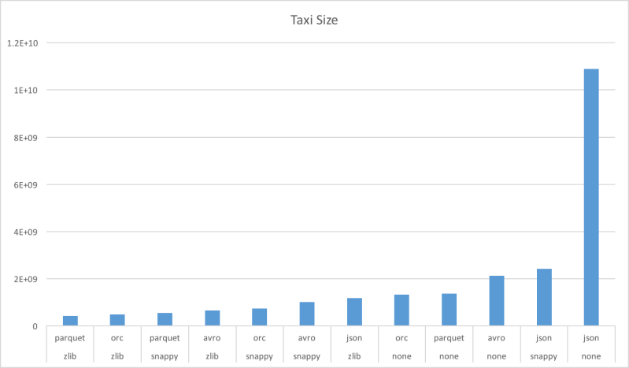

Slide 17
Taxi Size Analysis
Don’t use JSON
Use either Snappy or Zlib compression
Avro’s small compression window hurts
Parquet Zlib is smaller than ORC
–Group the column sizes by type

Slide 18
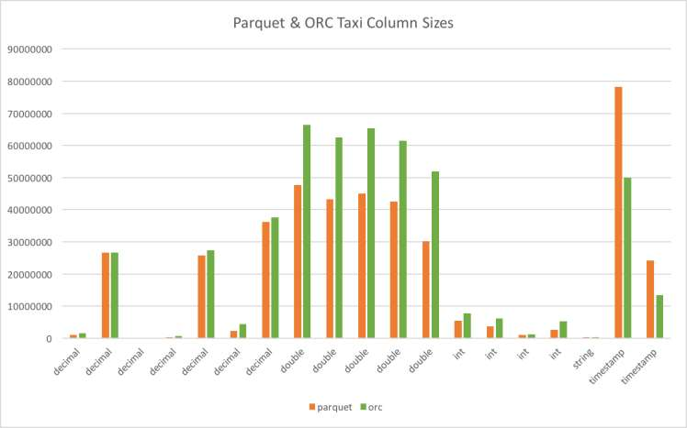

Slide 19
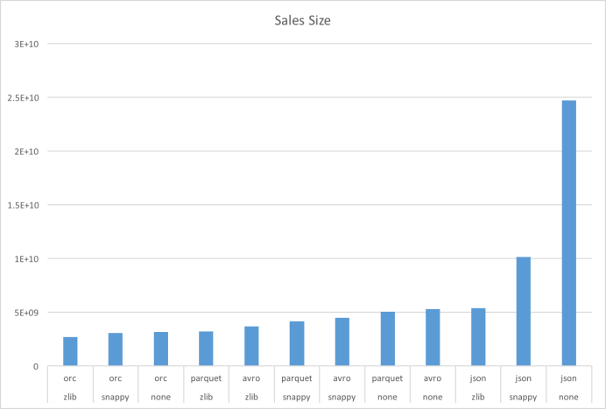

Slide 20
Taxi Size Analysis
ORC did better than expected
–String columns have small cardinality
–Lots of timestamp columns
–No doubles ☺
Need to revalidate results with original
–Improve random data generator
–Add non-smooth distributions

Slide 21
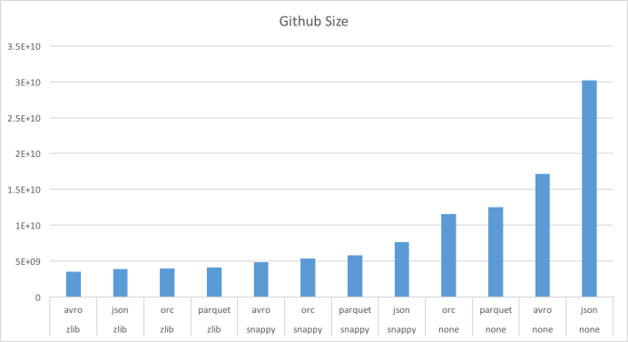

Slide 22
Github Size Analysis
Surprising win for JSON and Avro
–Worst when uncompressed
–Best with zlib
Many partially shared strings
–ORC and Parquet don’t compress across columns
Need to investigate shared dictionaries.

Slide 23
Use Cases

Slide 24
Full Table Scans
Read all columns & rows
All formats except JSON are splitable
–Different workers do different parts of file

Slide 25
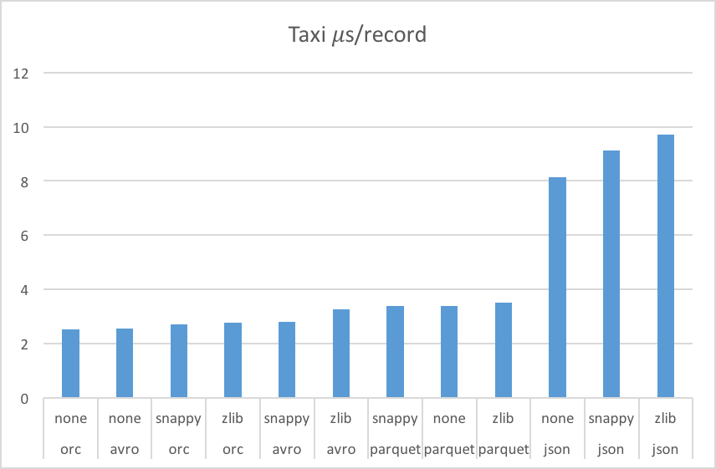

Slide 26
Taxi Read Performance Analysis
JSON is very slow to read
–Large storage size for this data set
–Needs to do a LOT of string parsing
Tradeoff between space & time
–Less compression is sometimes faster

Slide 27
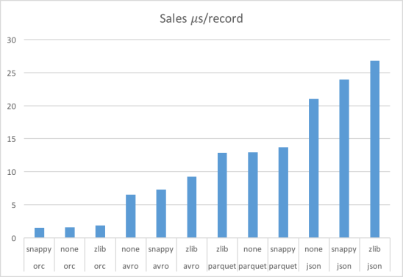

Slide 28
Sales Read Performance Analysis
Read performance is dominated by format
–Compression matters less for this data set
–Straight ordering: ORC, Avro, Parquet, & JSON
Garbage collection is important
–ORC 0.3 to 1.4% of time
–Avro < 0.1% of time
–Parquet 4 to 8% of time

Slide 29
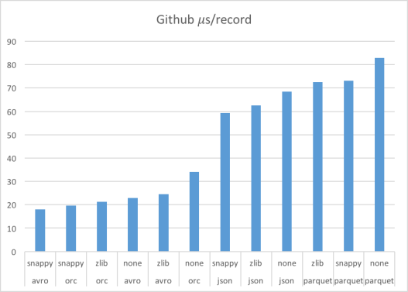

Slide 30
Github Read Performance Analysis
Garbage collection is critical
–ORC 2.1 to 3.4% of time
–Avro 0.1% of time
–Parquet 11.4 to 12.8% of time
A lot of columns needs more space
–Suspect that we need bigger stripes
–Rows/stripe - ORC: 18.6k, Parquet: 88.1k

Slide 31
Column Projection
Often just need a few columns
–Only ORC & Parquet are columnar
–Only read, decompress, & deserialize some columns
Dataset | format | compression | us/row | projection | Percent time
github | orc | zlib | 21.319 | 0.185 | 0.87%
github | parquet | zlib | 72.494 | 0.585 | 0.81%
sales | orc | zlib | 1.866 | 0.056 | 3.00%
sales | parquet | zlib | 12.893 | 0.329 | 2.55%
taxi | orc | zlib | 2.766 | 0.063 | 2.28%
taxi | parquet | zlib | 3.496 | 0.718 | 20.54%

Slide 32
Projection & Predicate Pushdown
Sometimes have a filter predicate on table
–Select a superset of rows that match
–Selective filters have a huge impact
Improves data layout options
–Better than partition pruning with sorting
ORC has added optional bloom filters

Slide 33
Metadata Access
ORC & Parquet store metadata
–Stored in file footer
–File schema
–Number of records
–Min, max, count of each column
Provides O(1) Access

Slide 34
Conclusions
35

Slide 35
Recomendations
Disclaimer – Everything changes!
–Both these benchmarks and the formats will change.
For complex tables with common strings
–Avro with Snappy is a good fit (w/o projection)
For other tables
–ORC with Zlib is a good fit
Experiment with the benchmarks

Slide 36
Fun Stuff
Built open benchmark suite for files
Built pieces of a tool to convert files
–Avro, CSV, JSON, ORC, & Parquet
Built a random parameterized generator
–Easy to model arbitrary tables
–Can write to Avro, ORC, or Parquet

