Slide 1
Strings

Slide 2
Introduction
Package - Java.lang
Not primitive type
Complex Objects or Reference
public final class String extends Object implements Serializable, Comparable<String>, CharSequence

Slide 3
Immutability of Strings
You can share duplicates by pointing them to a single instance.
Reduce space complexity.

Slide 4
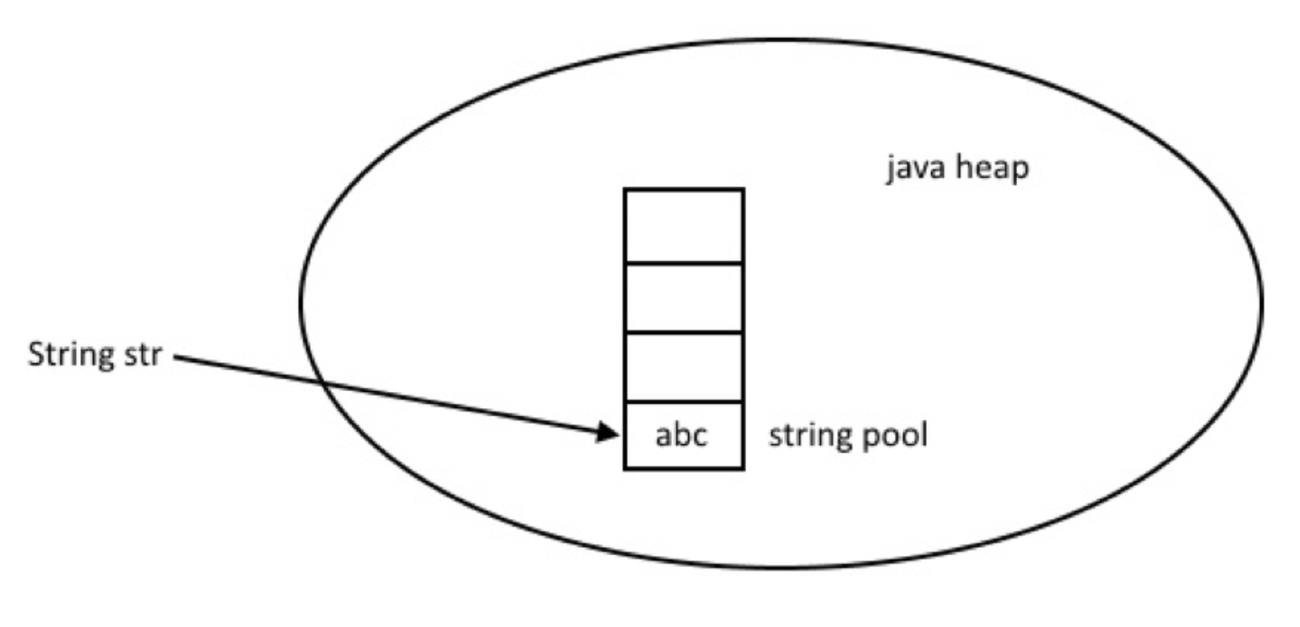
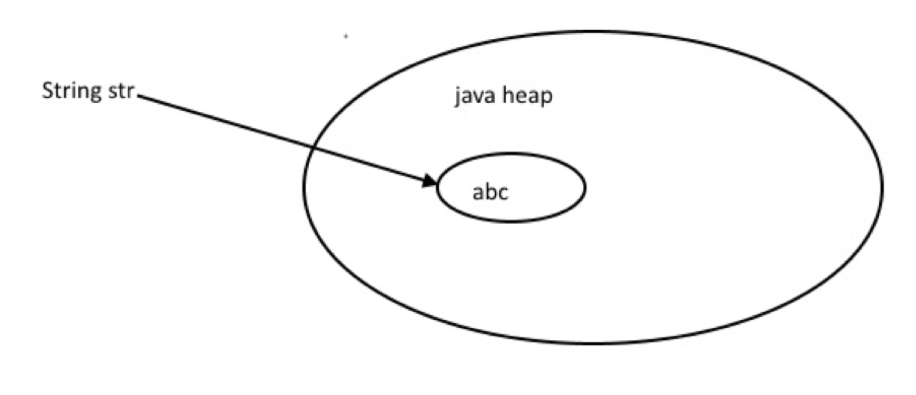
Ways to create String
String literal
String str = “abc”;
Flyweight pattern
new Keyword
String str = new String(“Hello”);

Slide 5
Fields
public static final Comparator<String> CASE_INSENSITIVE_ORDER

Slide 6
Constructors

Slide 7
Methods

Slide 8
+ and concat()
java.lang.NullPointerException
Number of arguments
Type of Argument

Slide 9
== and equlas() and compareTo()
We can use == operators for reference comparison (address comparison) and .equals() method for content comparison. In simple words, == checks if both objects point to the same memory location whereas .equals() evaluates to the comparison of values in the objects.
compareTo--firstString.charAt(i)-secondString.charAt(i).
out < 0 // s1 comes before s2
out = 0 // s1 and s2 are equal.
out >0 // s1 comes after s2.

Slide 10
StringBuffer
public final class StringBuffer extends Object implements Serializable, CharSequence
A thread-safe, mutable sequence of characters
Constructors
StringBuffer( )
StringBuffer(int size)
StringBuffer(String str)
StringBuffer(CharSequence chars)

Slide 11
Methods

Slide 12
StringBuilder
public final class StringBuilder extends Object implements Serializable, CharSequence
no guarantee of synchronization

Slide 13
Internationalization and Localization
I18N.
Adapt to different languages and regions.
display messages, currencies, date, time etc. according to the specific region or language.
Localization - I10N
specific language and region by adding locale-specific text and component.

Slide 14
Culturally dependent data
Messages
Dates
Times
Numbers
Currencies
Measurements
Phone Numbers
Postal Addresses
Labels on GUI components etc.

Slide 15
Locale Class
Constructors
Locale(String language)
Locale(String language, String country)
Locale(String language, String country, String variant)

Slide 16
Methods
public String getDisplayCountry() it returns the country name of this locale object.
public String getDisplayLanguage() it returns the language name of this locale object.
public String getDisplayVariant() it returns the variant code for this locale object.
public String getISO3Country() it returns the three letter abbreviation for the current locale's country.
public String getISO3Language() it returns the three letter abbreviation for the current locale's language.

Slide 17
Regex
Define string patterns for searching, manipulating and editing a text
public final class Pattern extends Object implements Serializable
Pattern.CASE_INSENSITIVE

