Slide 1
Shift-Left Meets Zero Trust: Building Secure-by-Design APIs from Day Zero
Hariharan Ragothaman Software Engineer, Advanced Micro Devices, Inc (AMD) SEI Secure Software by Design 2025

Slide 2
About Me
Hariharan Ragothaman, Software Engineer at AMD
Previously Lead Software Engineer at athenahealth
Also worked at Bain Capital, Bose Corporation, Northeastern University
Areas of Interest: DevSecOps, Distributed Systems, Applied Artificial Intelligence, Embedded Systems
LinkedIn: https://www.linkedin.com/in/hariharanragothaman/
GitHub: https://github.com/hariharanragothaman
Notes:
A quick introduction about myself—I am currently a Software Engineer at AMD and have previously worked at athenahealth, Bain Capital, and Bose Corporation. My interests span DevSecOps, Distributed Systems, Applied AI, and Embedded Systems. Feel free to connect with me on LinkedIn or check out my GitHub repository for more insights into my work."

Slide 3
AGENDA
Setting the context - What is Zero Trust?
Why API’s and services need Zero Trust?
Key Pillars of Zero Trust for APIs
Introducing SPIFFE / SPIRE
Mutual TLS Everywhere with SPIRE + Istio
Service Mesh in Action
API Gateway and Fine-Grained Control
Anti-Patterns and Pitfalls
Key Takeaways

Slide 4
What is Zero Trust?
Traditional perimeter-based models fail in cloud-native environments
Zero Trust = “Never Trust, Always Verify”
Expansion from users and endpoints → APIs and services

Slide 5

API Security and Zero Trust
APIs as primary interfaces for business logic
Vulnerabilities like over-permissioned services, lack of authentication, etc.
Stats: e.g., 83% of traffic in microservices is east-west (internal)

Slide 6
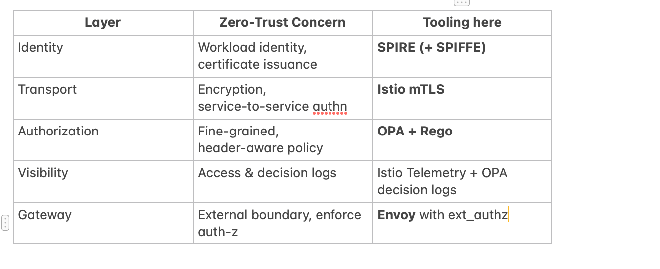
Key Pillars for Zero Trust for API’s
Strong identity
Least-privilege access
Continuous validation (behavioral baseline)
Visibility and logging

Slide 7
Introducing SPIFFE and SPIRE
What is SPIFFE? → Secure Production Identity Framework for Everyone
SPIRE → Runtime for issuing identities

Slide 8
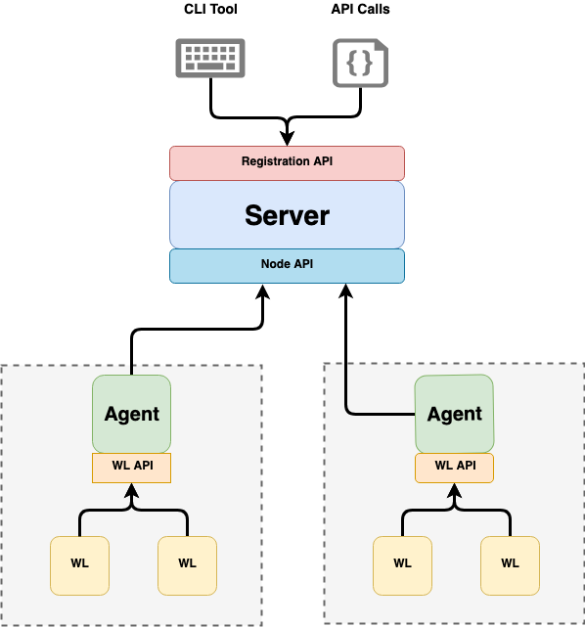
Introducing SPIFFE and SPIRE

Slide 9
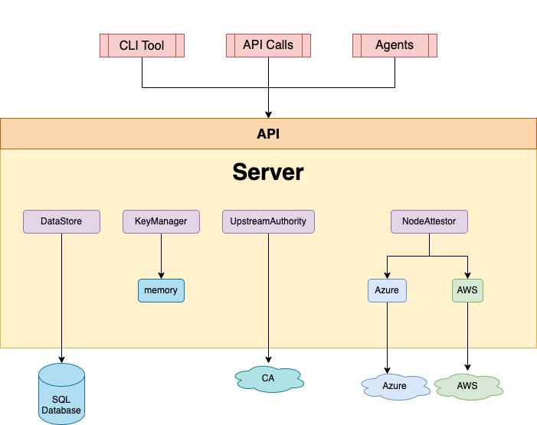
Introducing SPIFFE and SPIRE

Slide 10
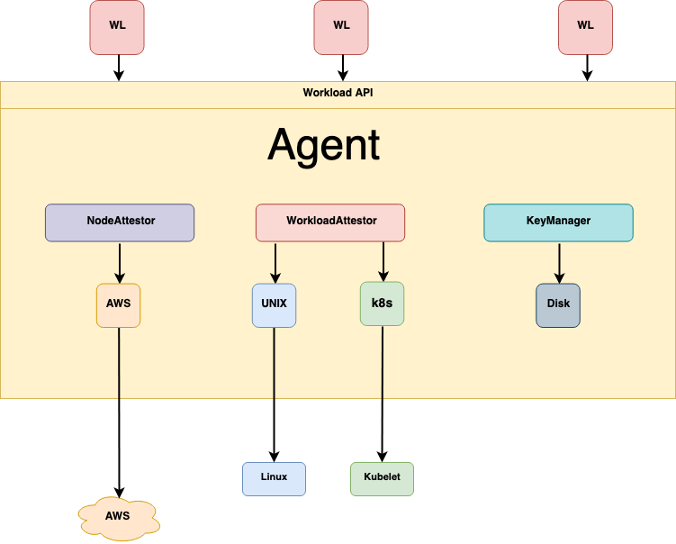
Introducing SPIFFE and SPIRE

Slide 11
Mutual TLS Everywhere with SPIRE and ISTIO
Authenticity of services
Encrypted transport
Istio + SPIRE integration architecture

Slide 12

GitHub Repository - Live Demo
https://github.com/hariharanragothaman/zero-trust-bootup/tree/main

Slide 13
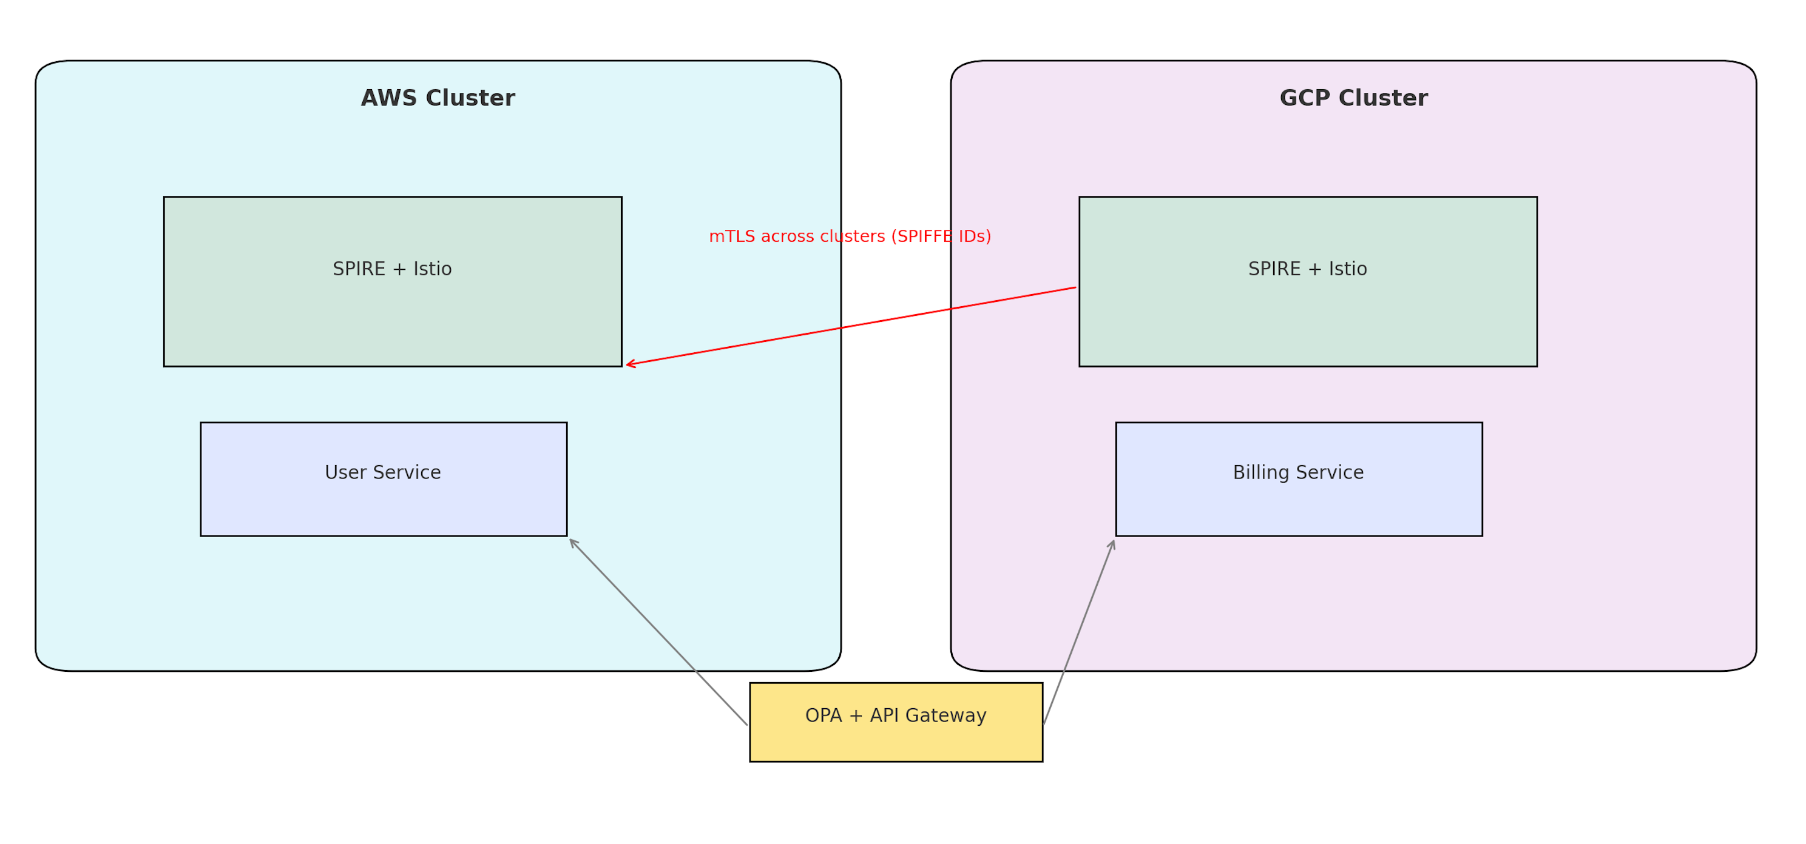
Reference Architecture for Multi Cloud

Slide 14
Key-Takeaways
APIs are the new trust boundaries
Zero Trust = Identity + Policy + Visibility SPIFFE/SPIRE + Service Mesh = Robust foundation
Design with east-west and multi-cloud in mind

Slide 15
Improvisations
Swap OPA policy to ABAC / JWT claims.
Add rate‑limit filter in Envoy. ( Layer-7 Controls)
Use GitHub Actions to kube‑lint manifests.
Use of eBPF (e.g., Cilium), Prometheus, and Jaeger for visibility
Train on normal behavior → alert on anomalies
ML/AI optional, heuristic approaches also work

