Slide 1
IMAGE RECONSTRUCTION USING NEURAL NETWORK
AUTHORS:
VISHAL AROCKIASAMY (A20446328)
HARIHARAN SHANKAR (A20442562)

Slide 2
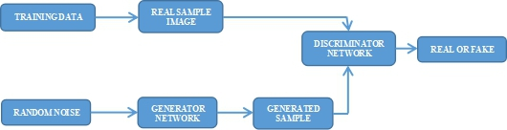
CONTENTS
PROBLEM STATEMENT
BACKGROUND MATERIAL
PROPOSED SOLUTION
IMPLEMENTATION
RESULTS
REFERENCES

Slide 3
PROBLEM STATEMENT
Natural hindrance such as raindrops, snow, dust etc. attached to glass surface, camera lens or while capturing pictures seriously effect the background exposure of images and drastically effect the quality of an image.
We address the problem by visually removing such noisy contents from the images such as raindrops, and thus transforming a raindrop degraded image into a clean one.
Such kind of problem associated with image processing is known as image restoration.

Slide 4
BACKGROUND MATERIAL
There are papers that deal with visibility enhancement and mostly focus on natural hindrances such as haze or fog.
There have been various methods [3] proposed to detect raindrops like use of PCA to learn the shape of the raindrops.
Roser and Geiger’s [2] proposes a method that compares the synthetically generated raindrop and these are assumes to be sphere in shape and later assumed to be inclined sphere sections.
Eigen at al.’s [1] solves the single image raindrop removal problem. The basic idea of the method is to build a convolutional neural network and train the same on set of raindrop free images and raindrop degraded images.

Slide 5
PROPOSED SOLUTION
Given an image impaired by raindrops, our goal is to remove the raindrops and produce a clean background. We intend to build a model using generative adversarial network which deals with substantial presence of raindrops.
The generative network first attempts to produce attention maps which is a critical part of the network as this would help us identity the raindrop regions and its surroundings based on which we could train the model and make sure to reconstruct those distorted regions.
After the attention maps are formed, the flow moves on to autoencoder. The output from the decoder layer which are the features is used as an input to the convolution layers which produces the image same as the original image.
The discriminative network (discriminator) which is a set of convolution layers uses the original image and the generated image and checks if the image is a real or a fake image.

Slide 6
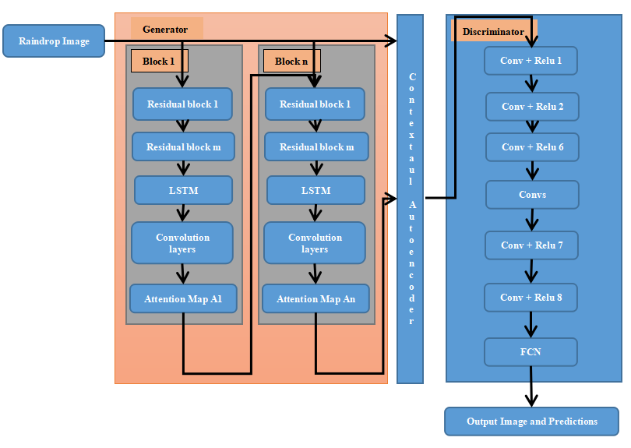
IMPLEMENTATION

Slide 7
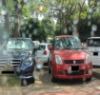









RESULTS
Attention maps:
Degraded image
Epochs = 1
Epochs = 3
Epochs = 5
Epochs = 10
Degraded image
Epochs = 1
Epochs = 3
Epochs = 5
Epochs = 10

Slide 8
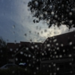
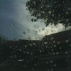
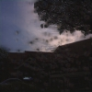


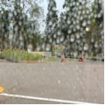
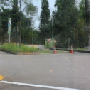
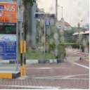
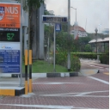
RESULTS
Validation data
Test data
Degraded image
Epochs = 1
Epochs = 3
Epochs = 5
Epochs = 10
Degraded image
Reconstructed image
Degraded image
Reconstructed image

Slide 9
REFERENCES
[1] D. Eigen, D. Krishnan, and R. Fergus. Restoring an image taken through a window covered with dirt or rain. In Proceedings of the IEEE International Conference on Computer Vision, pages 633–640, 2013.
[2] M. Roser and A. Geiger. Video-based raindrop detection for improved image registration. In Computer Vision Workshops (ICCV Workshops), 2009 IEEE 12th International Conference on, pages 570–577. IEEE, 2009.
[3] H. Kurihata, T. Takahashi, I. Ide, Y. Mekada, H. Murase, Y. Tamatsu, and T. Miyahara. Rainy weather recognition from in-vehicle camera images for driver assistance. In Intelligent Vehicles Symposium, 2005. Proceedings. IEEE, pages 205–210. IEEE, 2005.
[4] https://towardsdatascience.com/illustrated-guide-to-lstms-and-gru-s-a-step-by-step-explanation-44e9eb85bf21
[5] https://towardsdatascience.com/understanding-generative-adversarial-networks-gans-cd6e4651a29

