Slide 1
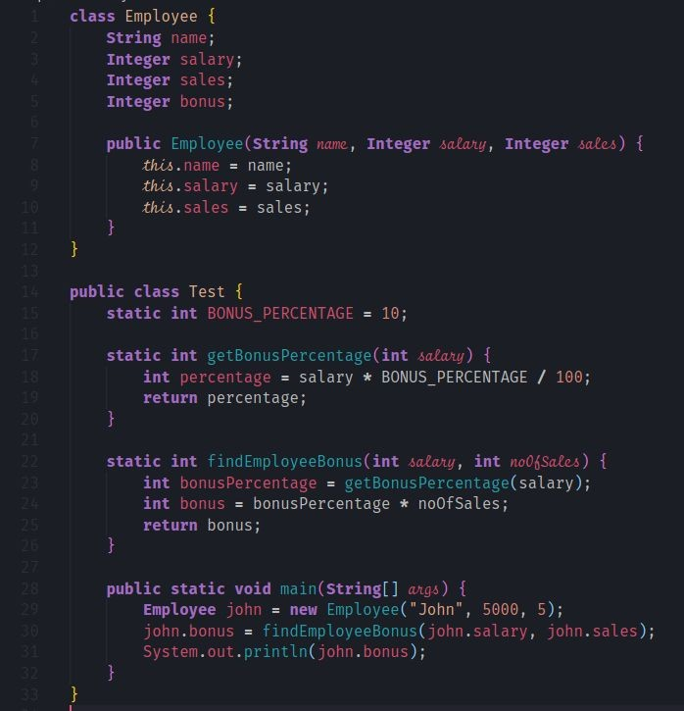
JVM Memory usage
Thread Stack
Heap memory
main

Slide 2
JVM Memory usage
Thread Stack
Heap memory
Employee instance
 | name | null
 | salary | null
 | sales | null
 | bonus | null
String instance
“John”
Employee:new
Integer instance
5000
this
name
salary
sales
Integer instance
5
main

Slide 3
JVM Memory usage
Thread Stack
Heap memory
Employee instance
 | name | null
 | salary | null
 | sales | null
 | bonus | null
String instance
“John”
Employee:new
Integer instance
5000
this
name
salary
sales
Integer instance
5
main

Slide 4
JVM Memory usage
Thread Stack
Heap memory
Employee instance
name
salary | null
sales | null
bonus | null
String instance
“John”
Employee:new
Integer instance
5000
this
name
salary
sales
Integer instance
5
main

Slide 5
JVM Memory usage
Thread Stack
Heap memory
Employee instance
name
salary
sales
null
bonus
null
String instance
“John”
Employee:new
Integer instance
this
name
5000
salary
sales
Integer instance
5
main

Slide 6
JVM Memory usage
Thread Stack
Heap memory
Employee instance
name
salary
sales
bonus
null
String instance
Employee:new
“John”
this
Integer instance
name
salary
5000
sales
Integer instance
main
5

Slide 7
JVM Memory usage
Thread Stack
Heap memory
Employee instance
name
salary
sales
bonus
null
String instance
Employee:new
“John”
this
Integer instance
name
salary
5000
sales
return
void
Integer instance
main
5

Slide 8
JVM Memory usage
Thread Stack
Heap memory
Employee instance
name
salary
sales
bonus
null
String instance
“John”
Integer instance
5000
main
john
Integer instance
5

Slide 9
JVM Memory usage
Thread Stack
Heap memory
Employee instance
name
salary
sales
bonus
null
String instance
findEmployeeBonus
“John”
salary | 5000
noOfSales | 5
Integer instance
5000
main
john
Integer instance
5

Slide 10
JVM Memory usage
Thread Stack
Heap memory
Employee instance
name
salary
getBonusPercentage
salary 5000
sales
bonus
null
String instance
findEmployeeBonus
“John”
salary | 5000
noOfSales | 5
Integer instance
5000
main
john
Integer instance
5

Slide 11
JVM Memory usage
Thread Stack
Heap memory
Employee instance
name
salary
getBonusPercentage
sales
bonus
null
salary | 5000
percentage | 500
String instance
findEmployeeBonus
“John”
salary | 5000
noOfSales | 5
Integer instance
5000
main
john
Integer instance
5

Slide 12
JVM Memory usage
Thread Stack
Heap memory
Employee instance
name
salary
getBonusPercentage
sales
salary | 5000
percentage | 500
return | 500
bonus
null
String instance
findEmployeeBonus
“John”
salary | 5000
noOfSales | 5
Integer instance
5000
main
john
Integer instance
5

Slide 13
JVM Memory usage
Thread Stack
Heap memory
Employee instance
name
salary
sales
bonus
null
findEmployeeBonus
String instance
“John”
Integer instance
5000
salary | 5000
noOfSales | 5
bonusPercentage | 500
bonus | 2500
main
john
Integer instance
5

Slide 14
JVM Memory usage
Thread Stack
Heap memory
Employee instance
name
salary
sales
bonus
null
findEmployeeBonus
String instance
“John”
Integer instance
5000
salary | 5000
noOfSales | 5
bonusPercentage | 500
bonus | 2500
return | 2500
main
john
Integer instance
5

Slide 15
JVM Memory usage
Thread Stack
Heap memory
Employee instance
name
salary
sales
bonus
String instance
“John”
Integer instance
5000
main
Integer instance
john
5
Integer instance
2500

Slide 16
JVM Memory usage
Thread Stack
Heap memory
Employee instance
name
salary
sales
bonus
String instance
“John”
Integer instance
5000
main
Integer instance
john
return | void
5
Integer instance
2500

Slide 17
JVM Memory usage
Thread Stack
Heap memory
Employee instance
name salary sales bonus
String instance
“John”
Integer instance
5000
Integer instance
5
Integer instance
2500

