Slide 1
Hariharan T
Final Project

Slide 2

PROJECT TITLE
Sentiment analysis of Customer Reviews

Slide 3


AGENDA
1.Problem Statement
2.Project Overview
3.End users
4.Our Solution and Proposition
5.Key Features
6.Modelling Approach
7.Results
3/21/2024 Annual Review

Slide 4

PROBLEM STATEMENT
Develop a robust Deep Learning model for Natural Language Processing (NLP) to create a dashboard for analyzing customer reviews and ratings on social media platforms. The primary focus is on Sentiment Analysis, with additional goals including product feedback understanding, brand perception assessment, competitive analysis, and market trend tracking.
Dataset Link: kaggle.com/datasets/crowdflower/twitter-airline-sentiment

Slide 5

PROJECT OVERVIEW
Objective: Develop a sentiment analysis system using RoBERTa for NLP to classify Twitter airlines reviews as positive, negative, or neutral.
Data Processing: Clean and preprocess the Twitter dataset for sentiment analysis.
Model Training: Train the RoBERTa model on the preprocessed data.
Evaluation: Assess the model's performance using metrics like accuracy, precision, recall, F1-score, and confusion matrix.
Dashboard Creation: Develop an interactive dashboard using Streamlit to visualize sentiment analysis results for user-friendly exploration.

Slide 6

WHO ARE THE END USERS?
Marketers: To understand customer sentiment towards their products or services and tailor marketing strategies accordingly.
Customer Support Teams: To monitor and address customer feedback and concerns in real-time.
Product Managers: To gain insights into product performance and identify areas for improvement.
Business Analysts: To track market trends and competitor performance based on customer feedback.
Decision Makers: To make informed business decisions based on sentiment analysis results.

Slide 7

YOUR SOLUTION AND ITS VALUE PROPOSITION
Solution
1. Implement a robust data collection framework for customer feedback.
2. Utilize advanced NLP techniques for sentiment analysis and insight extraction.
3. Conduct a comprehensive competitive analysis to identify strategic opportunities.
4. Develop intuitive data visualization tools for presenting actionable insights.
Value Propositions
1. Empower businesses to make informed decisions and drive improvements.
2. Enable proactive response to market dynamics and competitive pressures.
3. Facilitate sustainable growth and profitability through feedback analysis.
4. Stay ahead of industry trends and customer preferences.

Slide 8

THE WOW IN YOUR SOLUTION
Context-Based Stop Words Identification: Identifies and eliminates the top 25 frequently used words in all sentiment categories to enhance analysis relevance.
Emojis and Emoticons Understanding: Analyzes emojis and emoticons to capture nuanced sentiment expressions and improve analysis accuracy.
Negation Handling: Identifies and reverses negation statements in the text to ensure accurate sentiment classification.
Robust Model: Utilize the RoBERTa Deep-Learning Model for higher prediction accuracy.
Interactive Dashboard: Enable targeting of specific companies in the dashboard for focused analysis.
3/21/2024 Annual Review

Slide 9
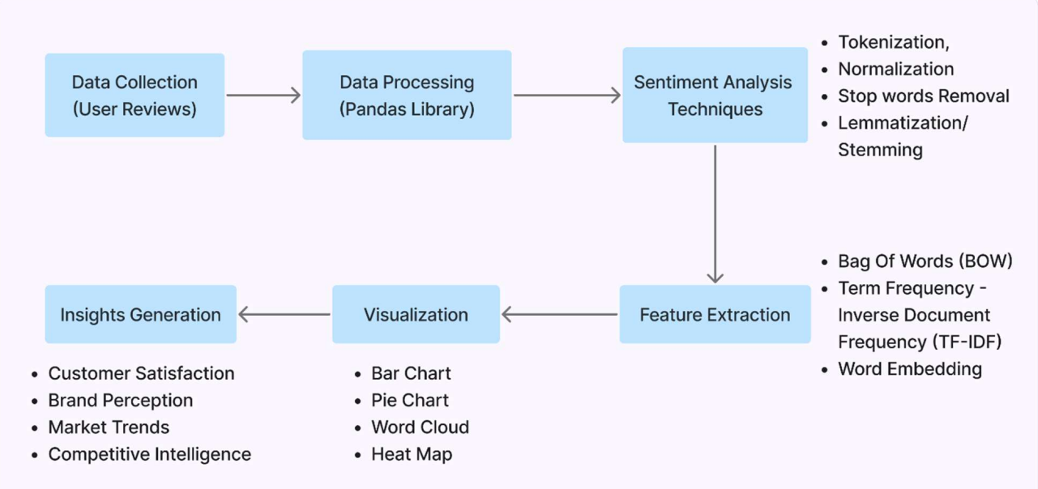
MODELLING

Slide 10
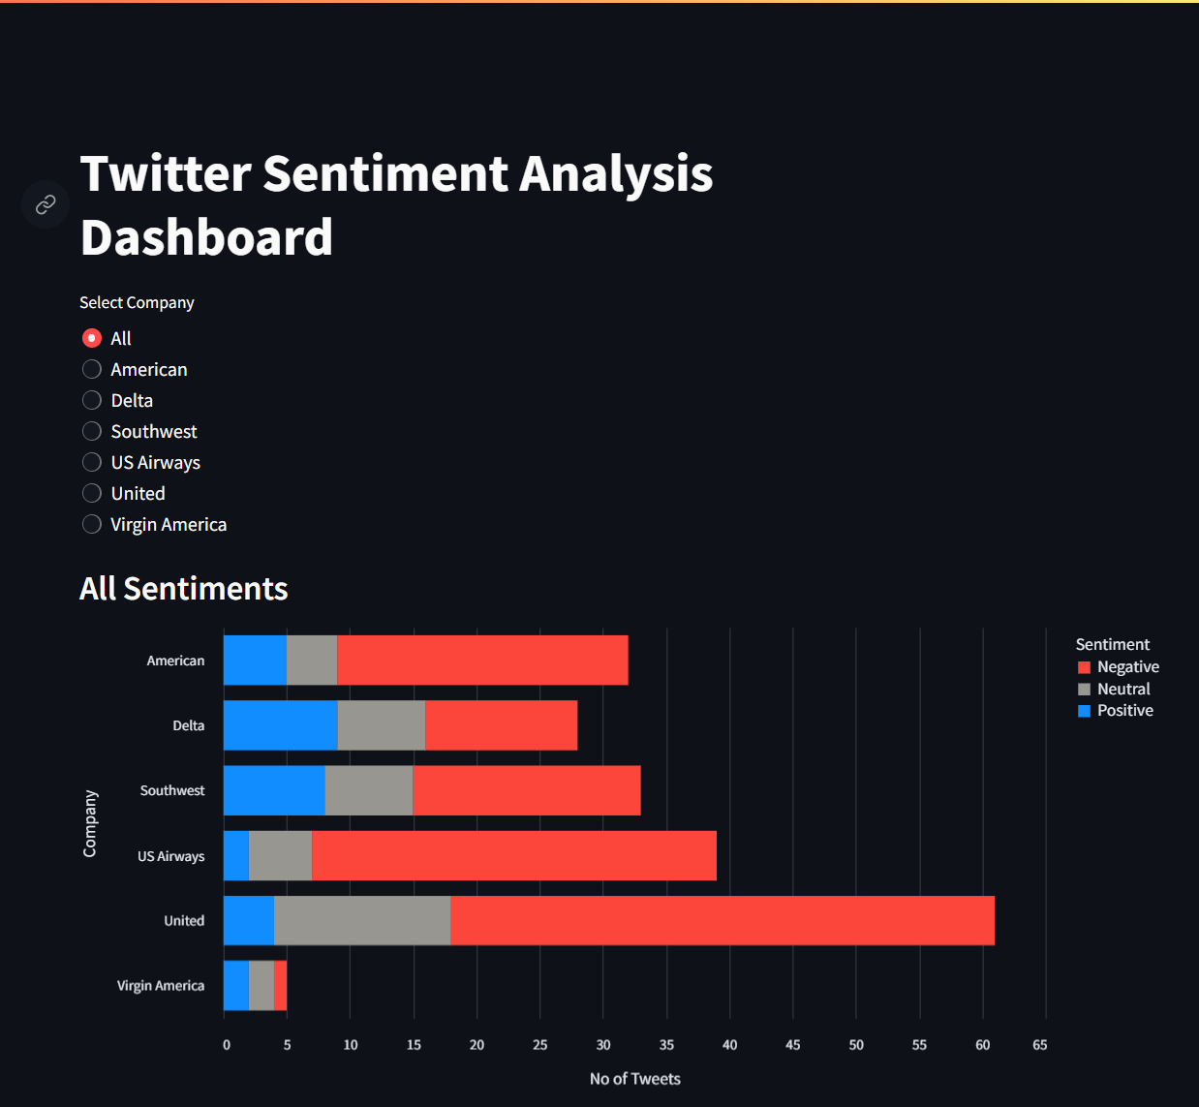
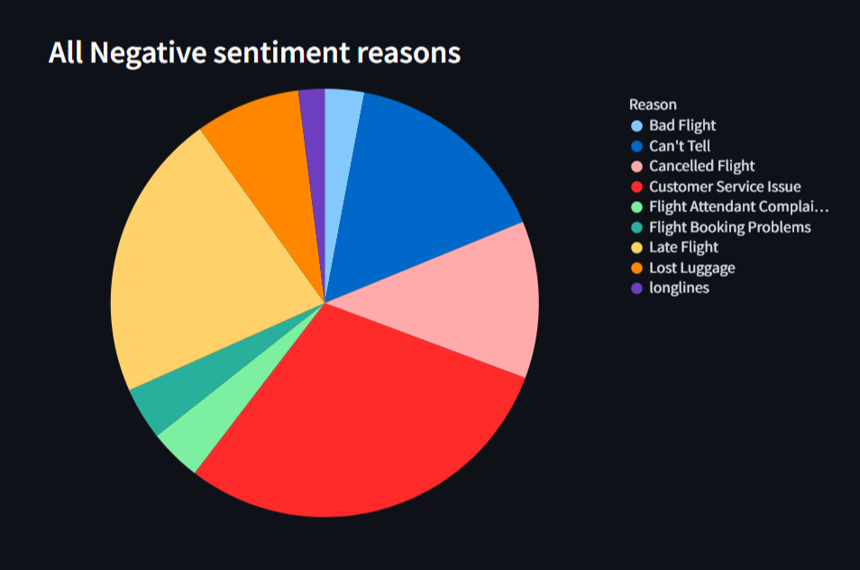
RESULTS

Slide 11
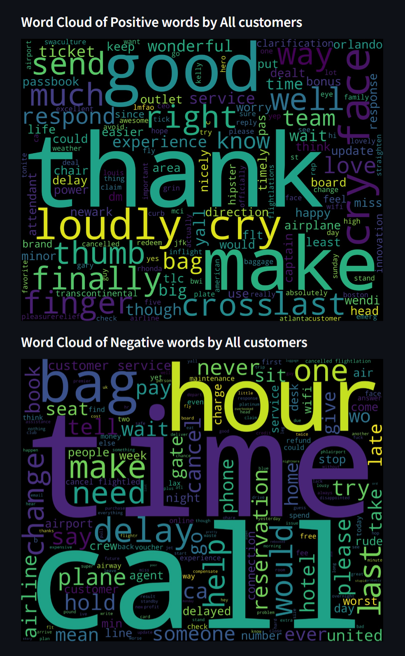
RESULTS
GitHub:
https://github.com/hariharanthangaraj/nan-mudhalvan
Google Colab:
https://colab.research.google.com/drive/1vIUKmRqcNrkrG1ftWgilaW6lsZUrEwTd?usp=sharing Deployment:
airlines-sentiment-analysis.streamlit.app/

