Slide 1
PixaBuild
GUIDED BY,
Mrs.Nagajothi
AssistantProfessor(Sr.Grade),ME
A. Hariharasudhan (24BCS040)
V. Hariprasad (24BCS041)

Slide 2
Introduction
PixaBuild is an offline AI app. A user uploads a photo of their room and picks a furniture item. The app shows how that item would look inside the room, and the photo never leaves the user's computer.
Three AI models work together: one finds the right spot in the room (SAM), one understands depth and size (Depth-Anything-V2), and one blends the furniture into the photo (Stable Diffusion with IP-Adapter).
A simple local backend (FastAPI or Gradio) runs the app in the browser. A small furniture catalog, a SQLite database, and local folders store all the data.
Once the AI models are downloaded during setup, the app works fully offline. No internet is needed to use it after that.

Slide 3
Problem Statement
It is hard to picture furniture before buying it. People mostly guess or take rough trial photos to check if a piece will fit their room, and this often leads to wrong purchases.
Cloud-based apps raise privacy worries. Most AI room-preview tools ask users to upload personal room photos to outside servers, so users lose control over their own photos.
AR apps do not give a real, photo-like preview. Apps like IKEA Place only show furniture through a live camera. They do not create a realistic edited photo, and none of them work fully offline.

Slide 4
Objectives
To build a fully offline AI tool that shows furniture inside a room photo, running only on the user's own computer.
To connect three AI models – room detection (SAM), depth sensing (Depth-Anything-V2), and image blending (Stable Diffusion + IP-Adapter) – into one smooth pipeline.
To let users browse a furniture catalog, choose or mark a spot in the room, and get a realistic preview image.
To check the quality of results using simple scores (CLIP similarity and LPIPS/SSIM), along with a small human review.

Slide 5
Expected Outcomes
Users will see the chosen furniture placed inside their own room photo, and their photo will stay only on their device.
Users will get a preview that looks correctly sized, since the app resizes the furniture image based on the room's depth.
A working demo will show that the furniture item still looks correct (CLIP similarity) and the room stays unchanged outside the edited area (LPIPS/SSIM).
A flexible pipeline will be ready, so any single part (like the diffusion model) can be replaced or improved later without rebuilding the whole app.

Slide 6
Dataset Details
Models Used (No Custom Training):
Stable Diffusion 1.5 / SDXL – ready-made model that blends the furniture into the photo.
SAM (Segment Anything Model) – Meta's ready-made model that finds objects and spaces in a photo.
Depth-Anything-V2 – ready-made model that measures depth in a single photo.
IP-Adapter – ready-made model that helps the furniture keep its real look after blending.
Local / User Data:
A small furniture catalog (about 20–50 items), with images and details stored in JSON/SQLite.
Room photos that the user uploads, saved only on their own computer.
Finished preview images and past designs, saved locally through SQLite and local folders.
Quality scores (CLIP, LPIPS, SSIM) calculated on the same computer for the project report.

Slide 7
Working Environment
IDE:
• VS Code / Jupyter Notebook – for writing and testing code.
Language & ML Tools:
• Python 3.10+, run inside a virtual environment.
• PyTorch, with Hugging Face's diffusers and transformers libraries.
Backend:
• A local FastAPI service (or a Gradio app) that handles the catalog, mask suggestions, and image generation.
Data Storage:
• SQLite for catalog data, saved designs, and history.
• Local folders for room photos, furniture images, and generated results.
Network Use:
• The app runs only on localhost. The only internet use is the one-time download of AI models during setup.

Slide 8
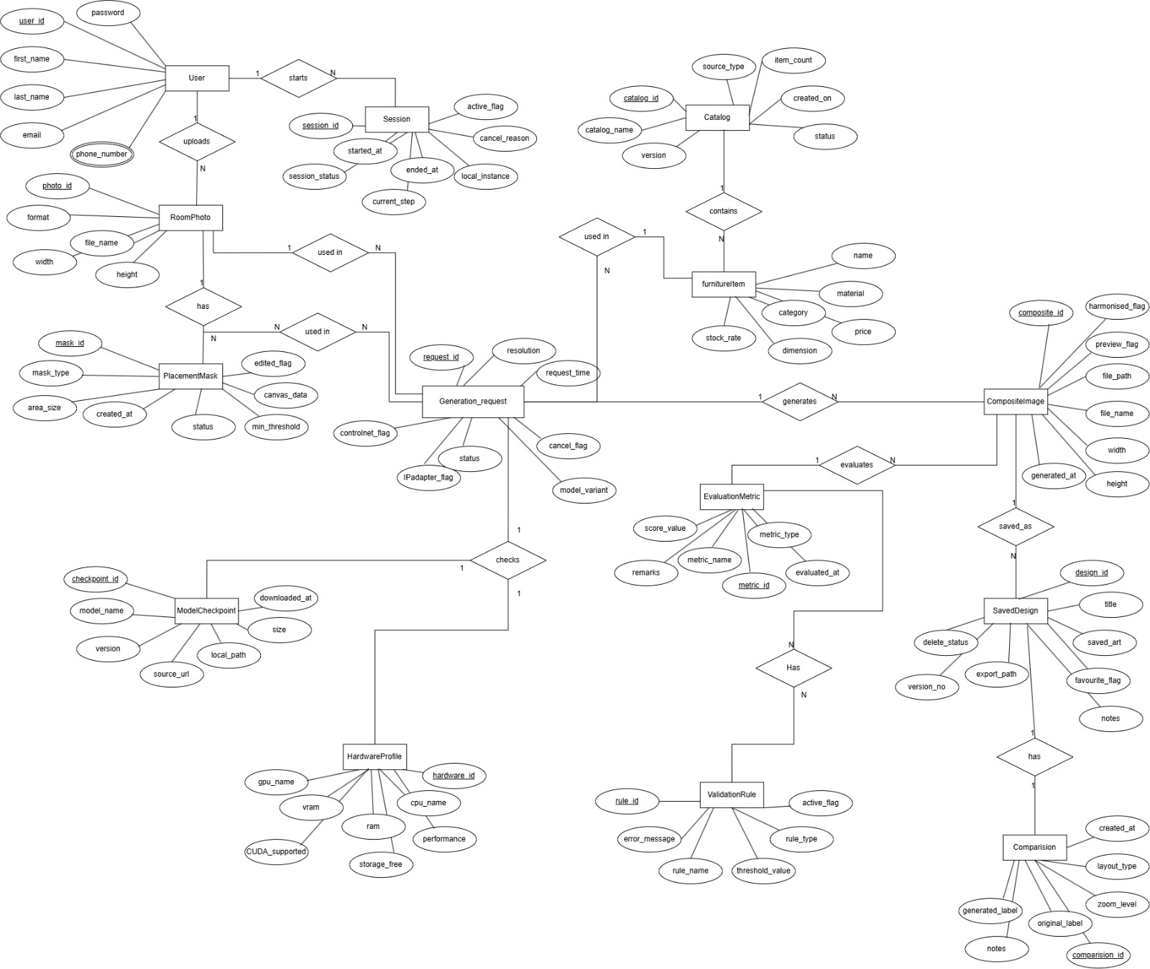
ER Diagram

Slide 9
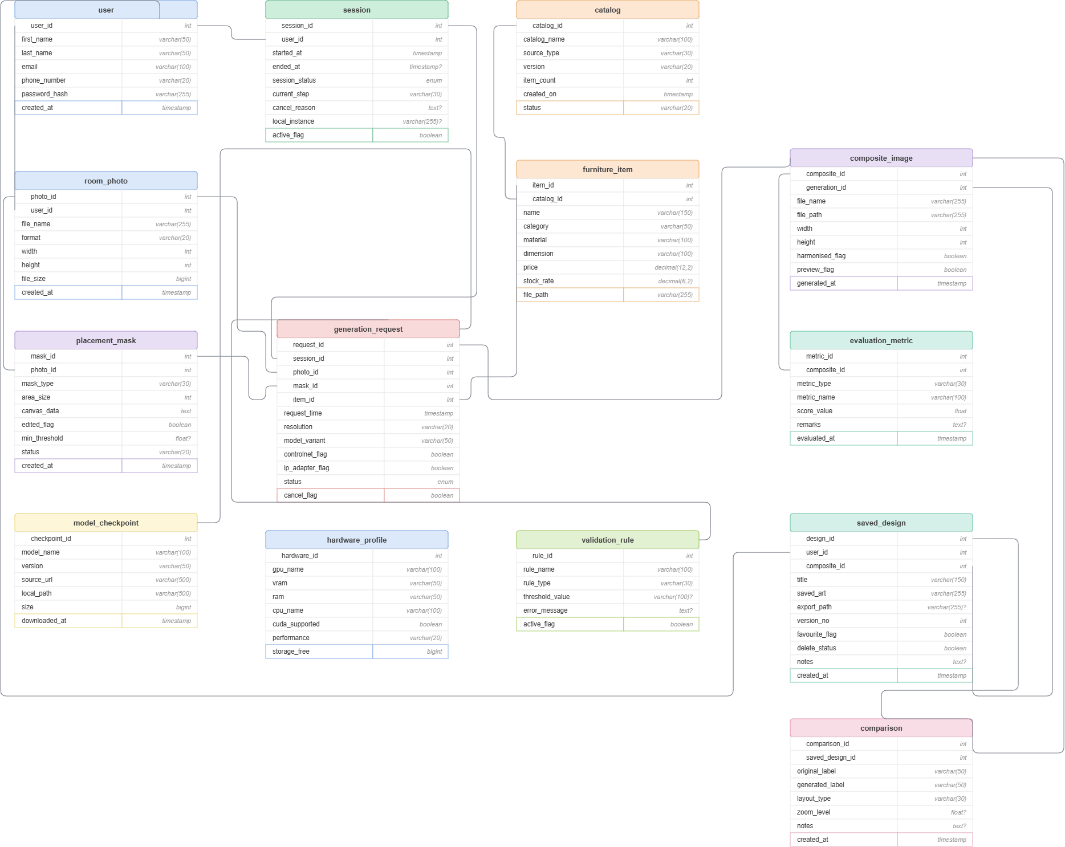
Database Schema Diagram

Slide 10
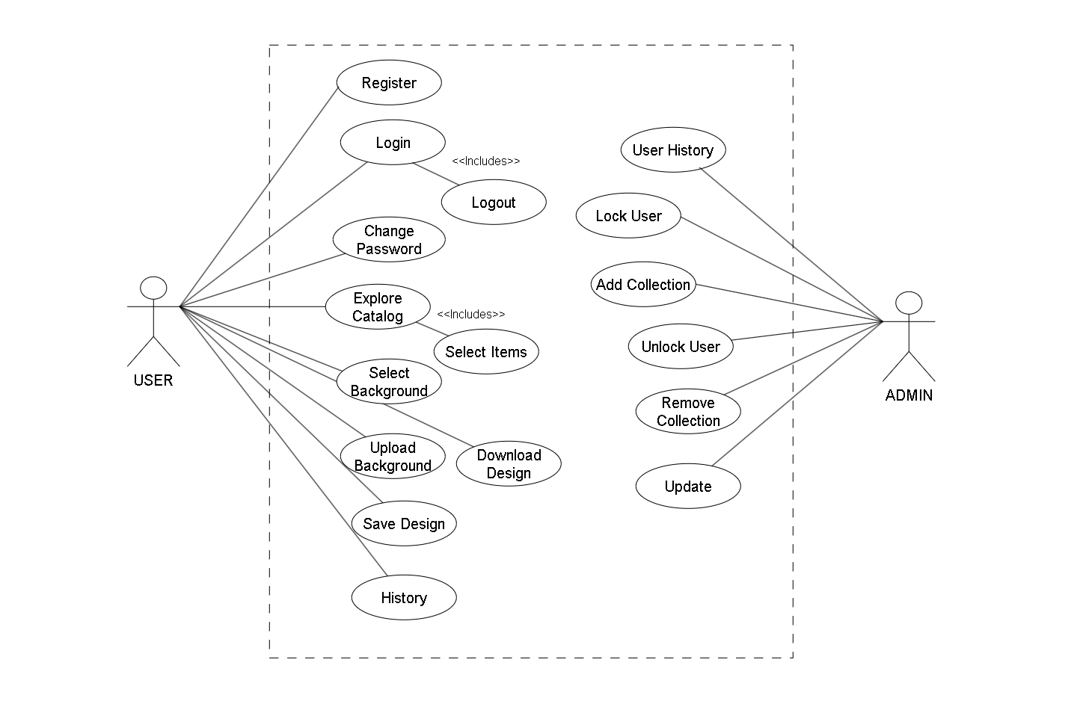
Use Case Diagram

Slide 11
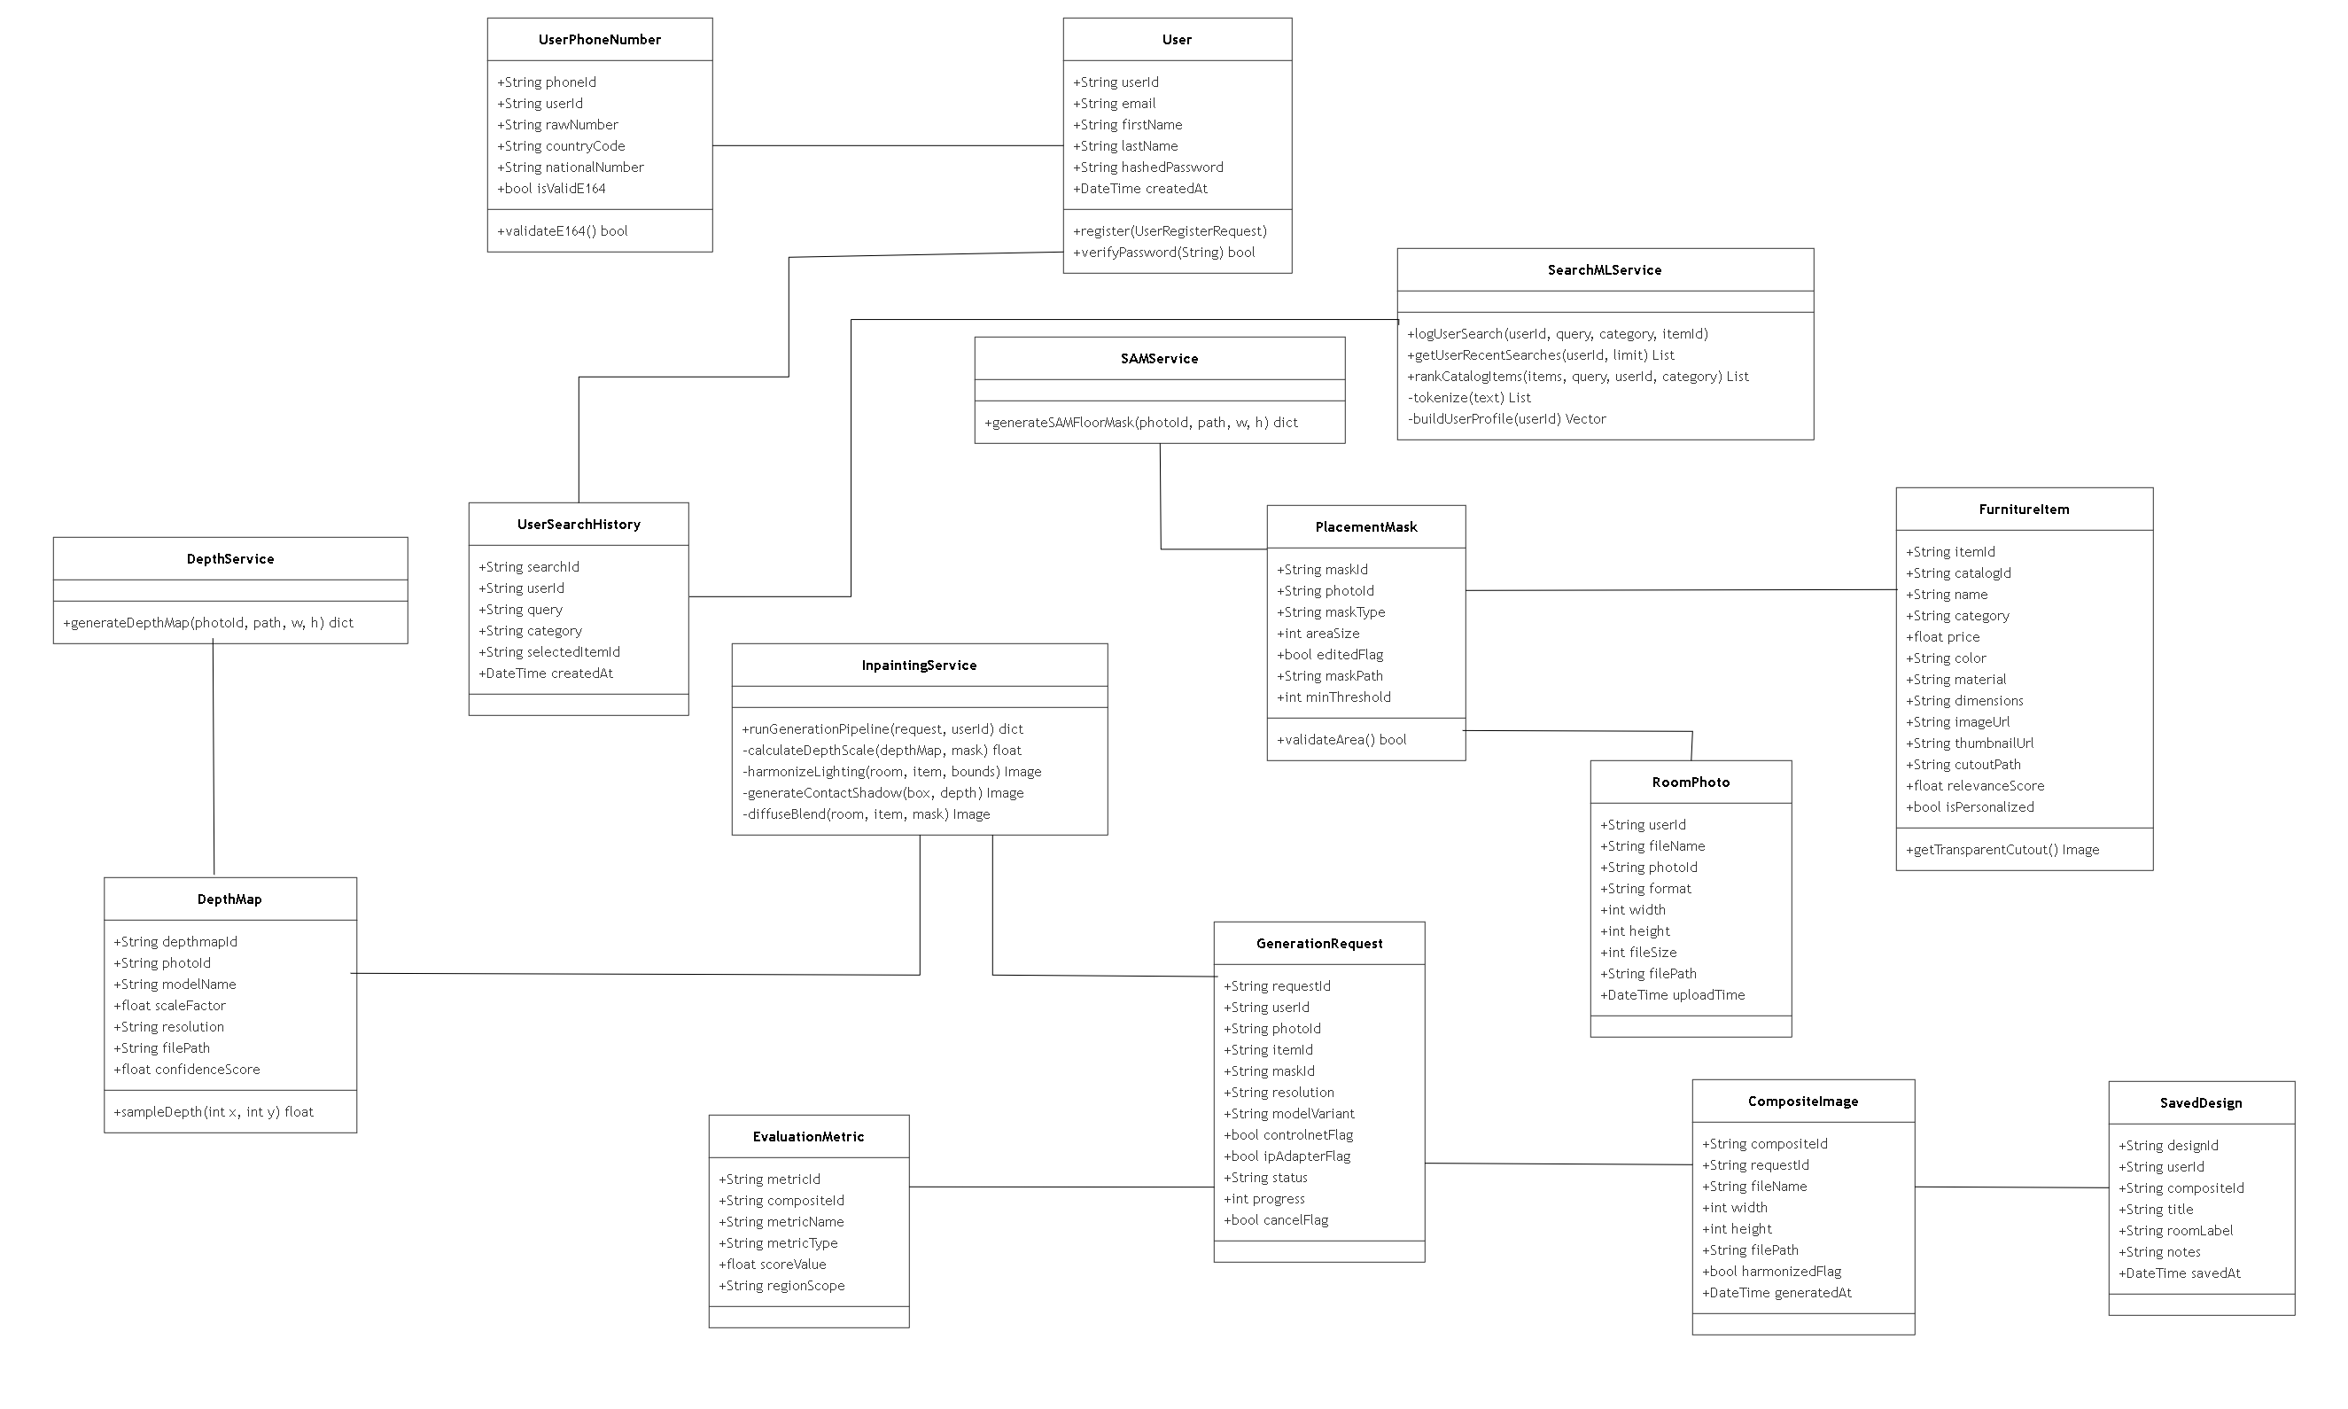
Class Diagram

Slide 12
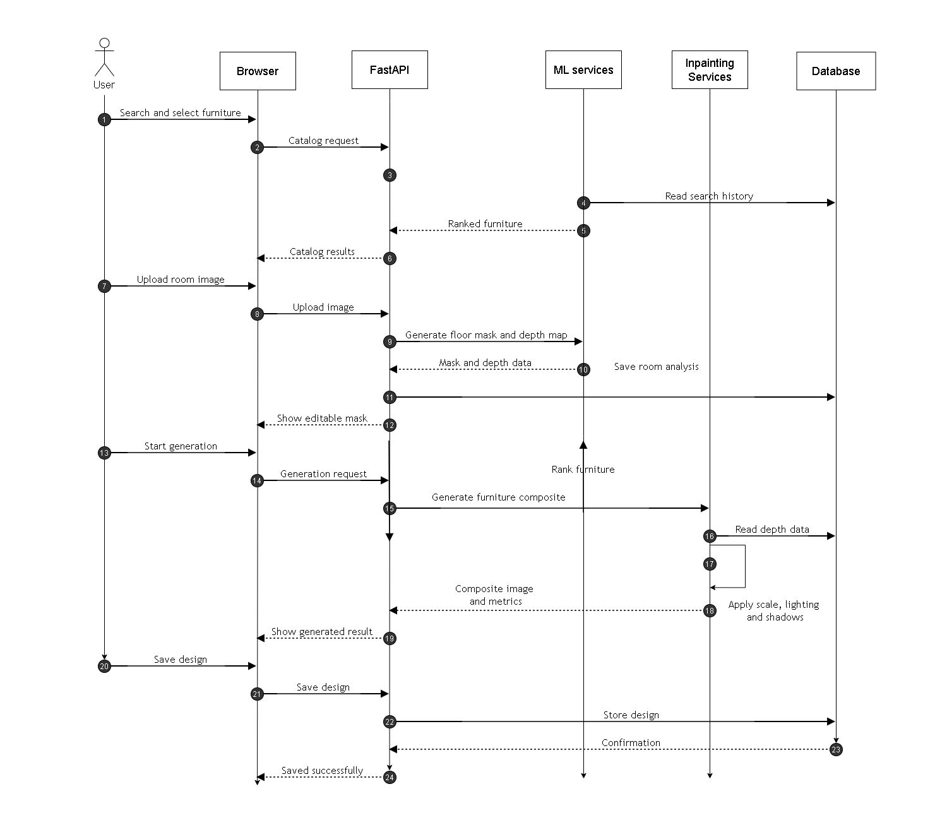
Sequence Diagram

Slide 13
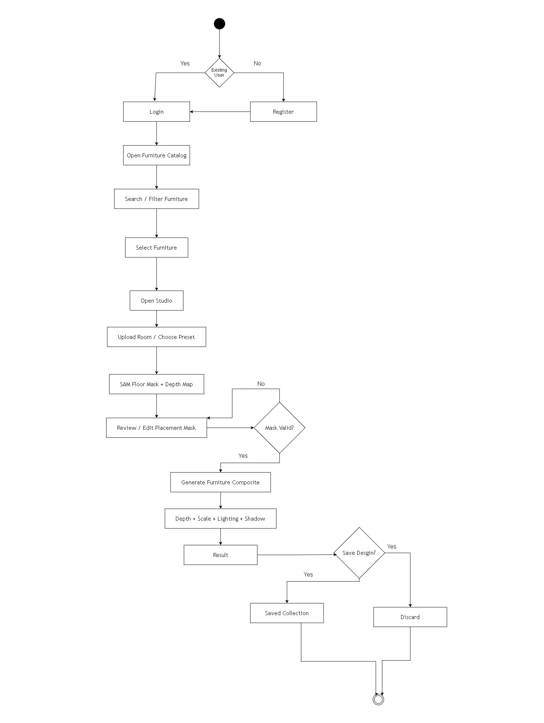
Activity Diagram

Slide 14
Module Descriptions
Catalog Module – lets users browse and filter the furniture catalog by category, with pictures and details.
Upload & Masking Module – handles room photo uploads and marks the placement spot, using SAM with a manual redraw option.
Depth & Scale Module – uses Depth-Anything-V2 to judge room depth and resize the furniture to the right scale.
Generation Module – uses Stable Diffusion and IP-Adapter to blend the furniture into the photo, then adjusts lighting and shadows.
History Module – saves and shows past designs, using SQLite and local folders.
Evaluation Module – scores each result using CLIP, LPIPS, and SSIM, to check the image quality for the report.

Slide 15
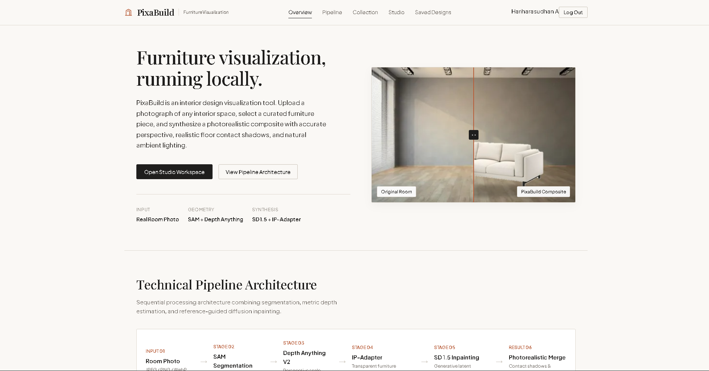
UI Screenshots – PixaBuild Web App

Slide 16
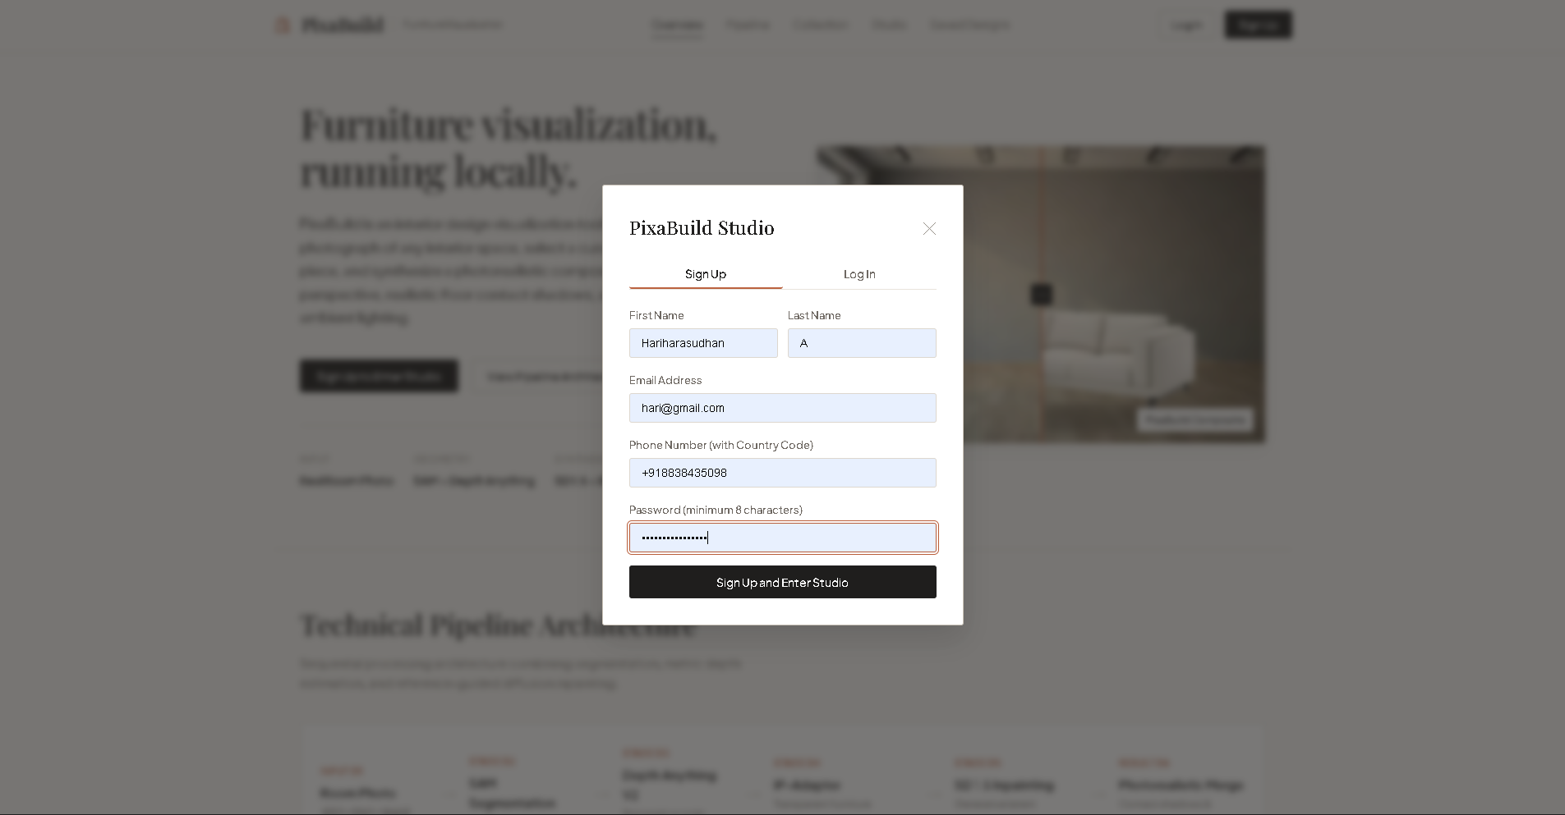
UI Screenshots – PixaBuild Web App

Slide 17
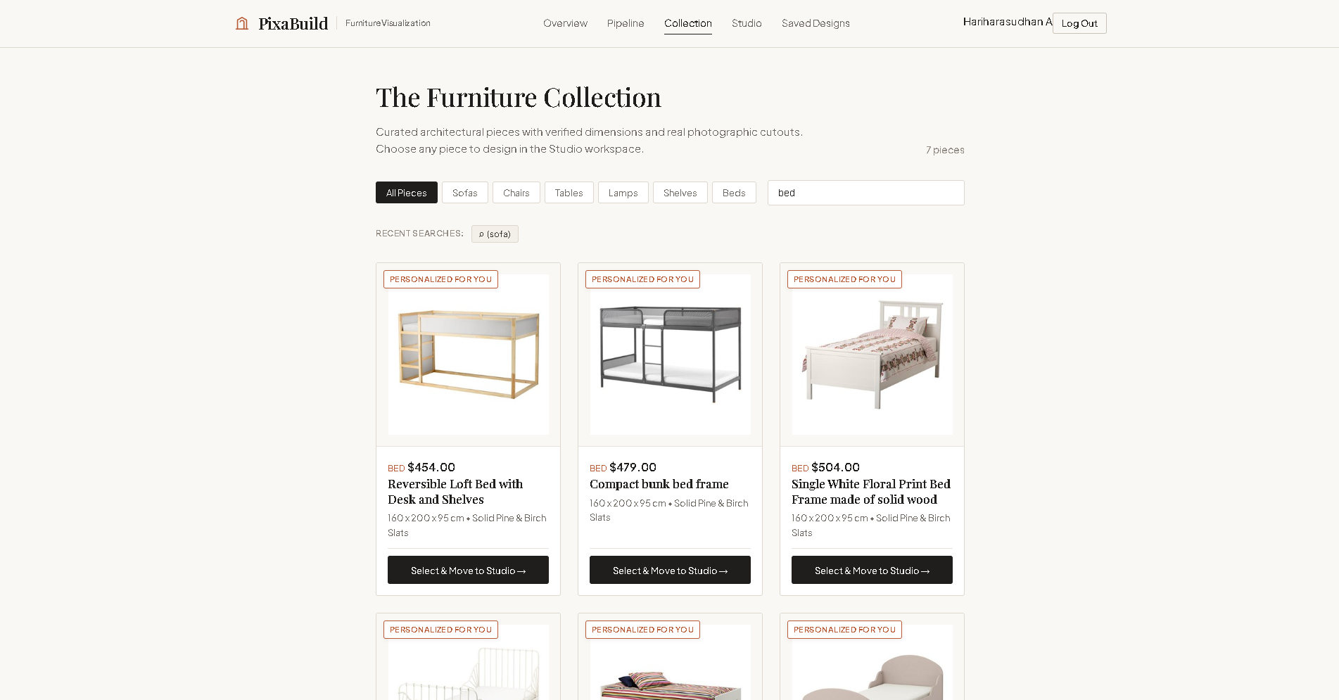
UI Screenshots – PixaBuild Web App

Slide 18
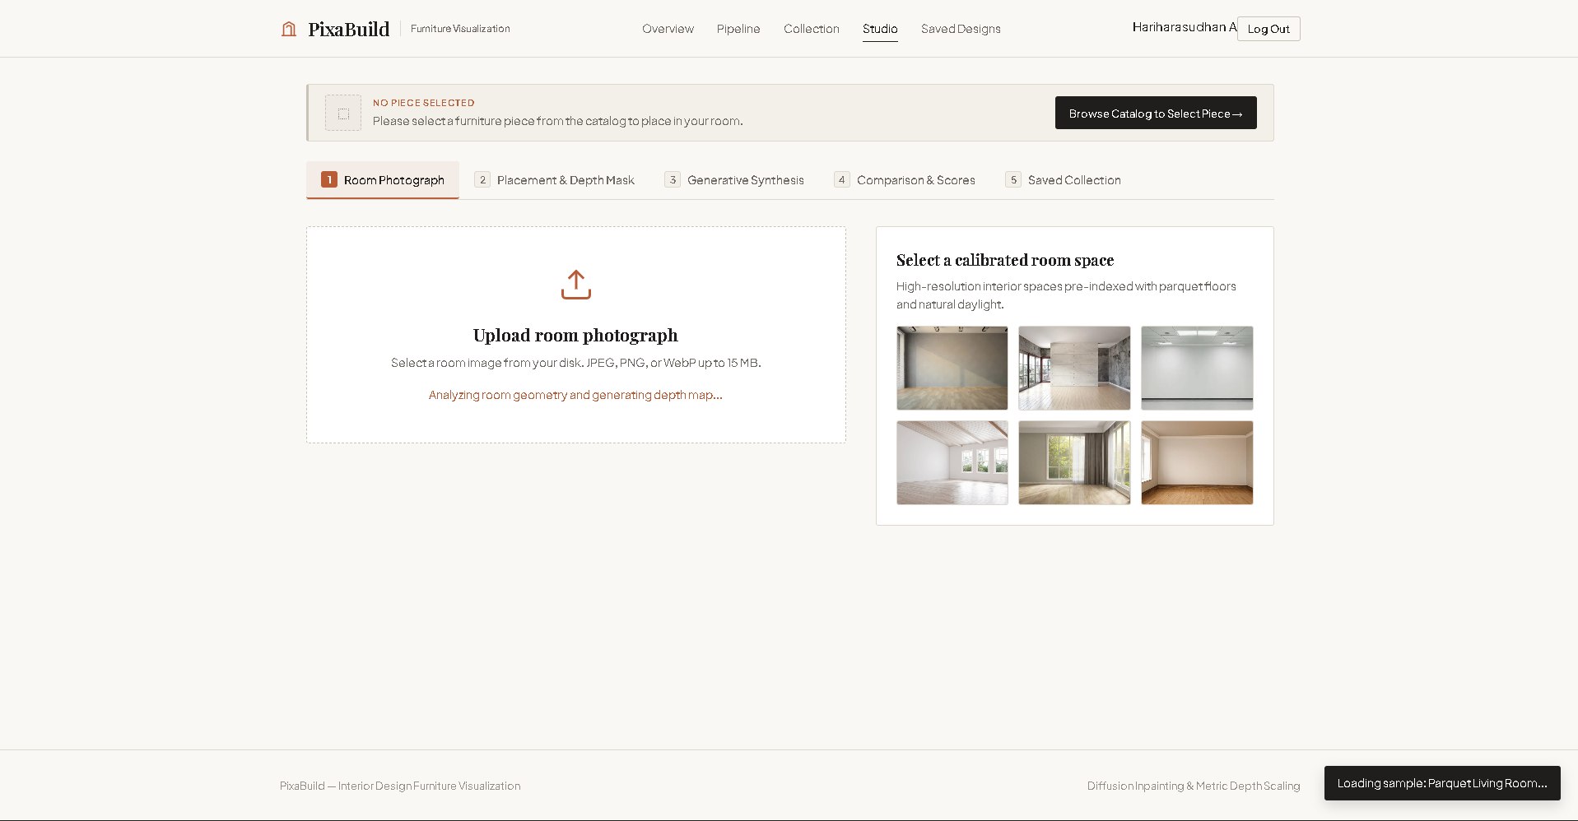
UI Screenshots – PixaBuild Web App

Slide 19
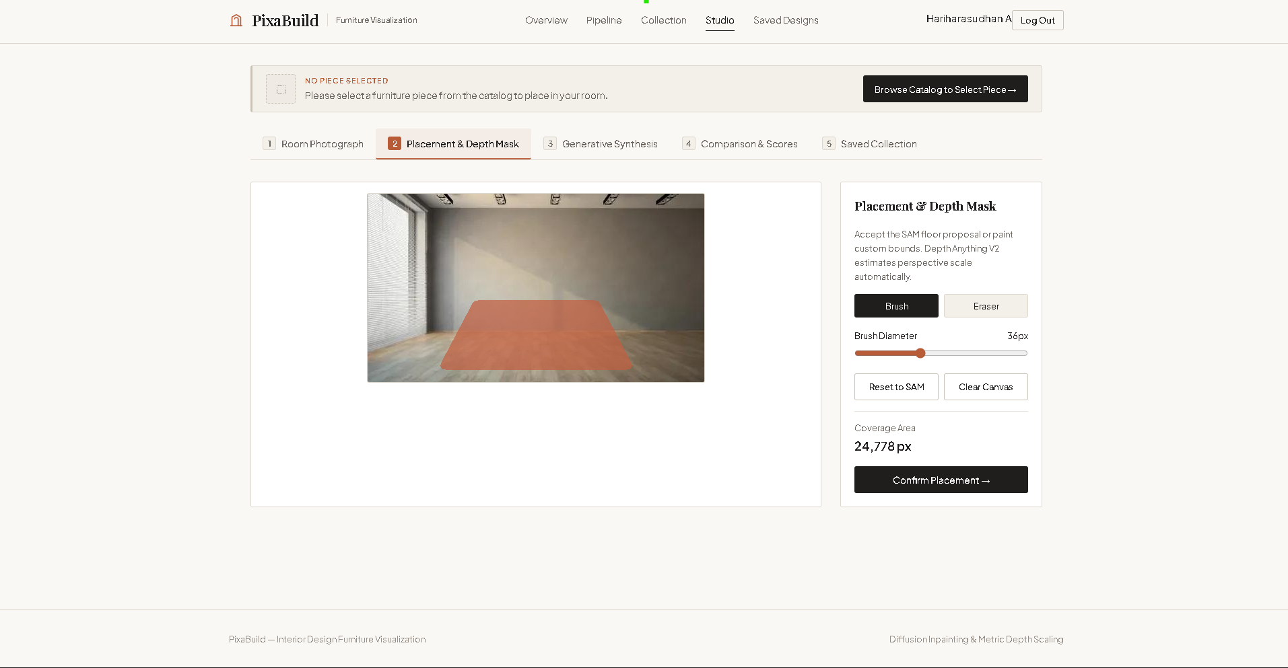
UI Screenshots – PixaBuild Web App

Slide 20
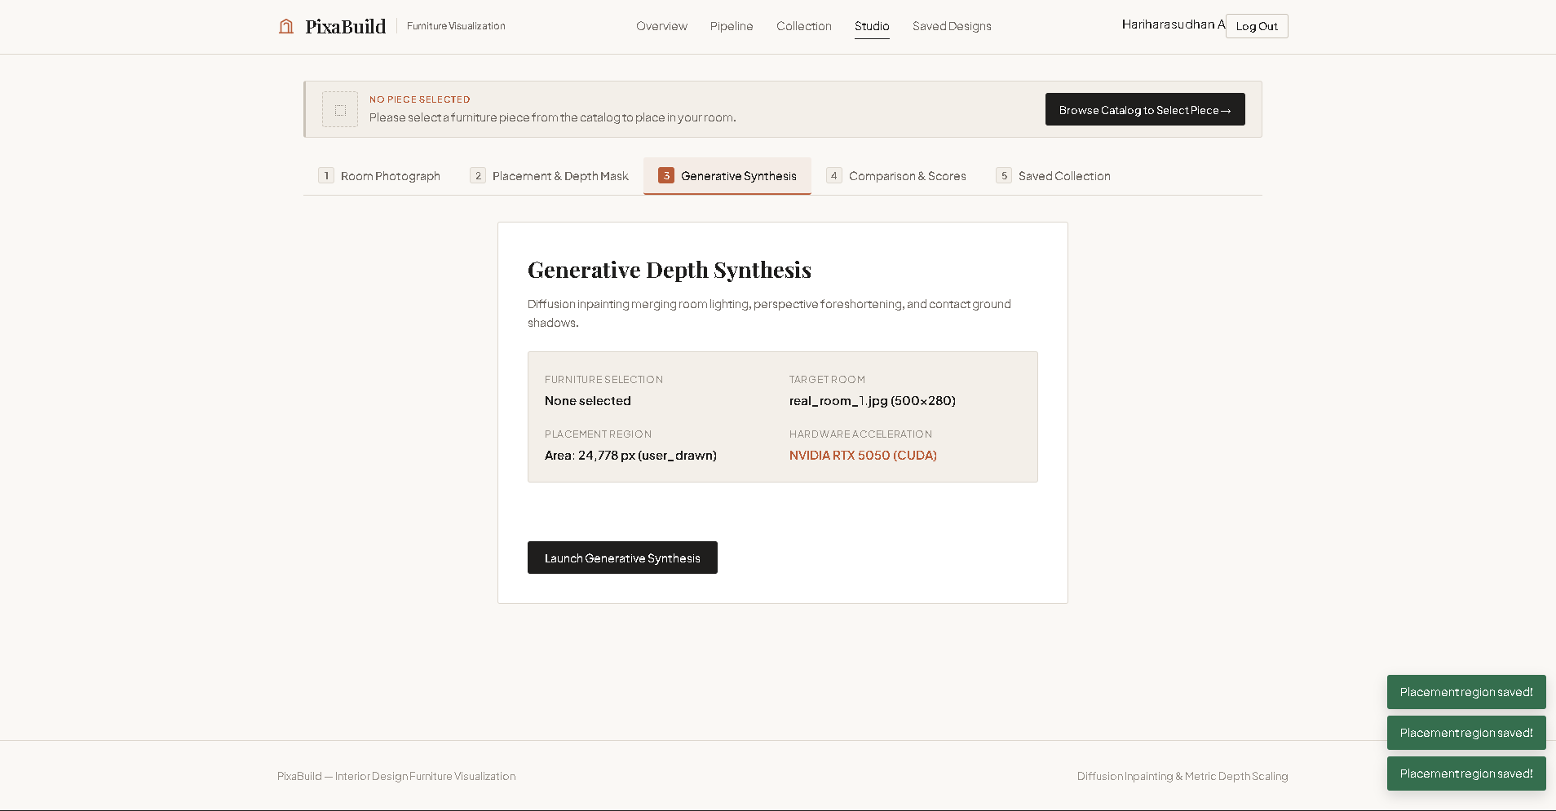
UI Screenshots – PixaBuild Web App

Slide 21
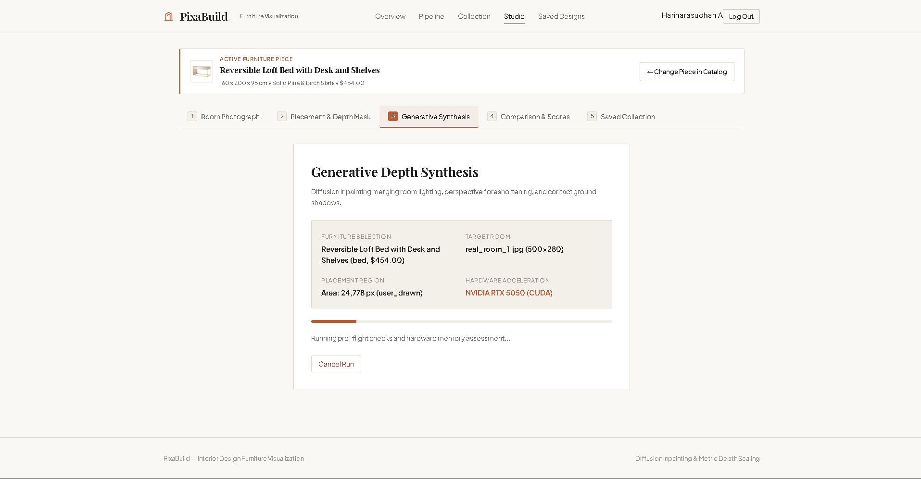
UI Screenshots – PixaBuild Web App

Slide 22
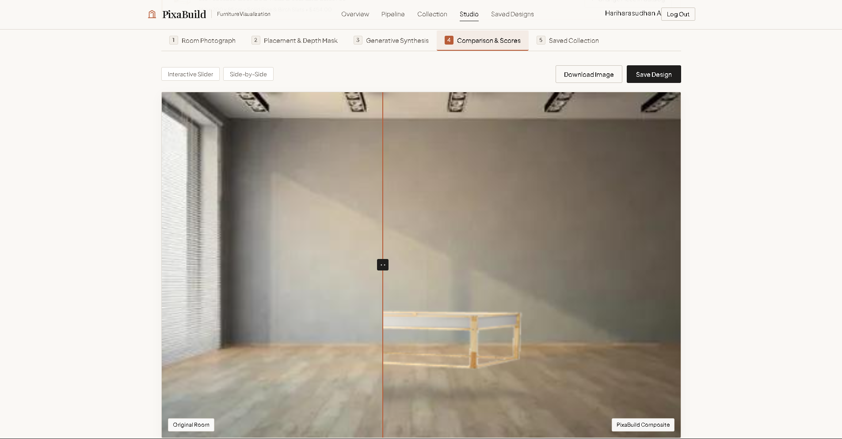
UI Screenshots – PixaBuild Web App

Slide 23
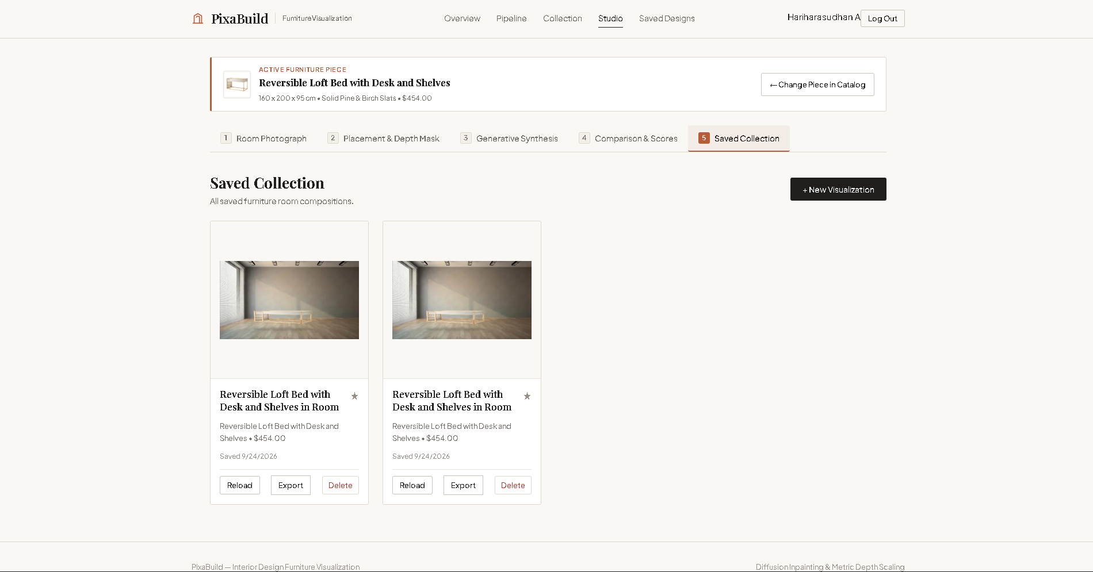
UI Screenshots – PixaBuild Web App

Slide 24
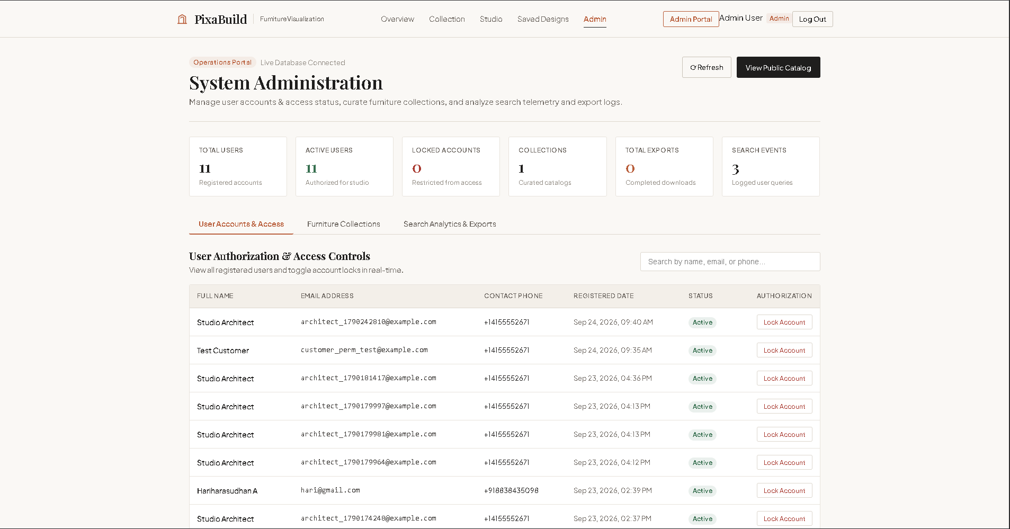
UI Screenshots – PixaBuild Web App

Slide 25
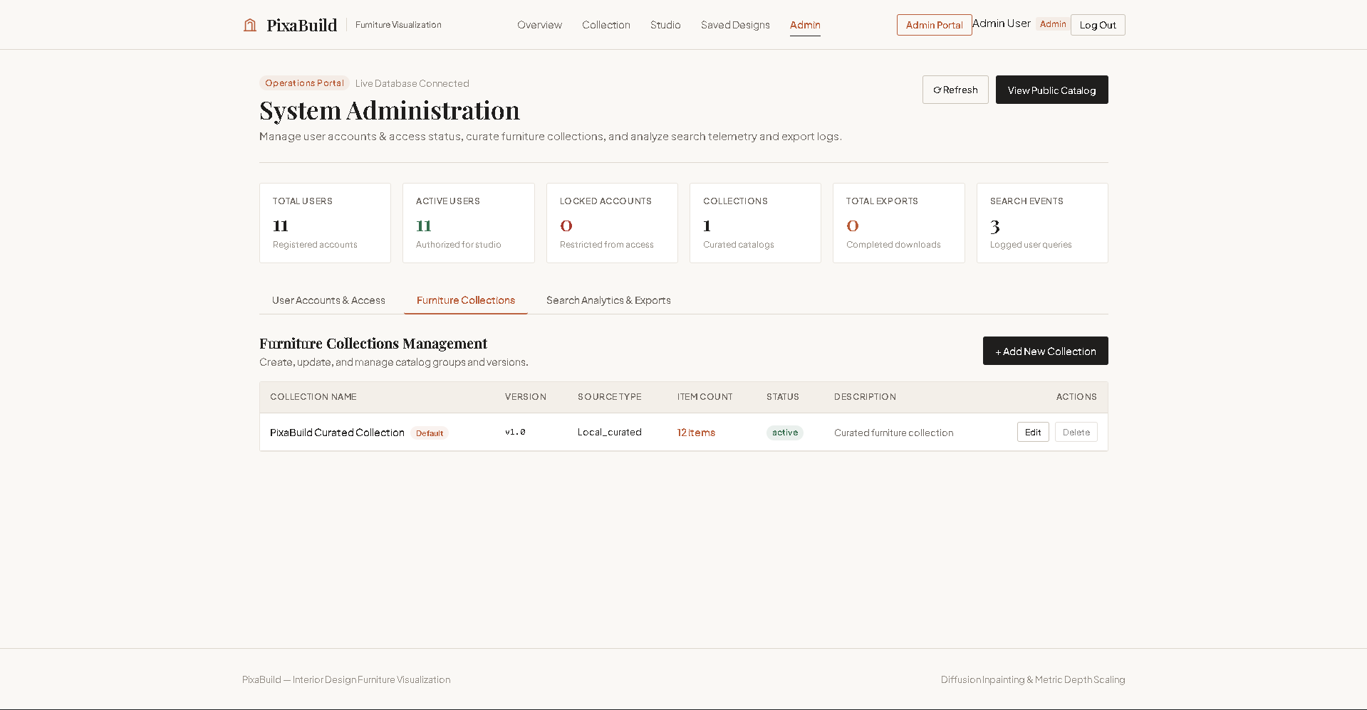
UI Screenshots – PixaBuild Web App

Slide 26
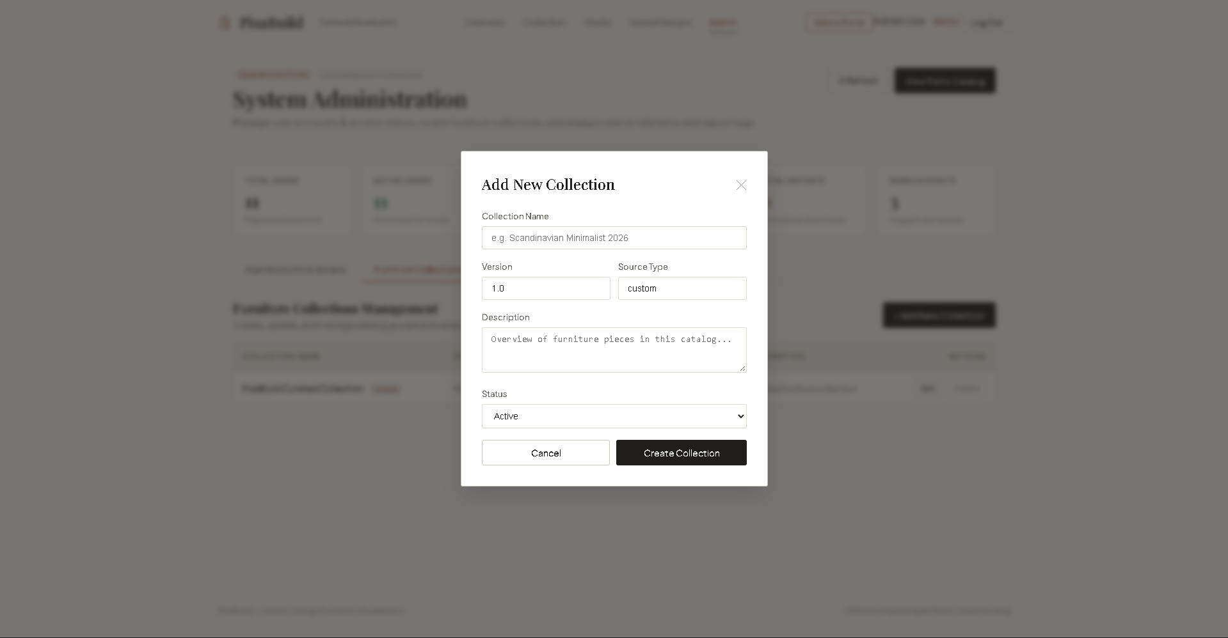
UI Screenshots – PixaBuild Web App

Slide 27
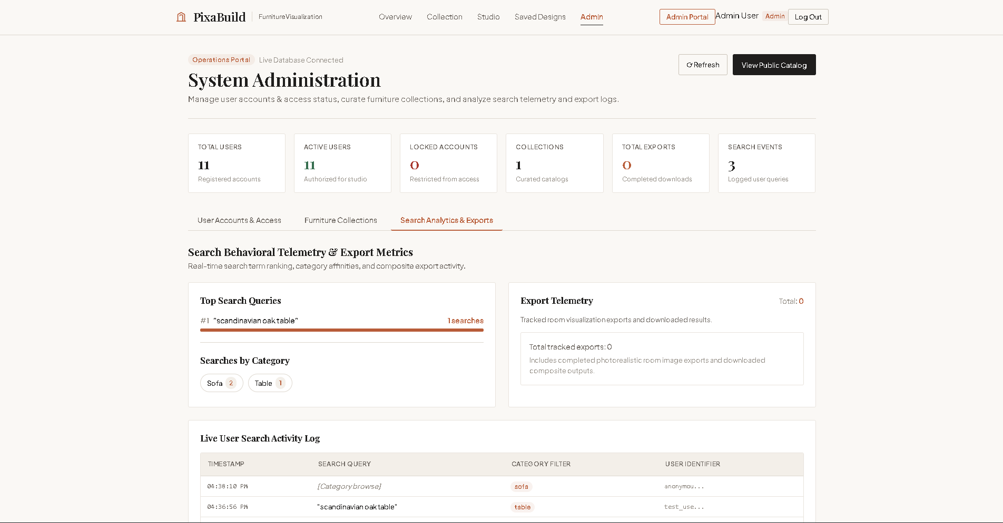
UI Screenshots – PixaBuild Web App

Slide 28
REFERENCES
IEEE Std 830-1998: Software Requirements Specifications
https://standards.ieee.org/ieee/830/1222/
Rombach et al., “High-Resolution Image Synthesis with Latent Diffusion Models” (Stable Diffusion paper)
https://arxiv.org/abs/2112.10752
Kirillov et al., “Segment Anything”, Meta AI Research
https://arxiv.org/abs/2304.02643
Ye et al., “IP-Adapter: Text Compatible Image Prompt Adapter for Text-to-Image Diffusion Models”
https://arxiv.org/abs/2308.06721
Zhang et al., “Adding Conditional Control to Text-to-Image Diffusion Models” (ControlNet paper)
https://arxiv.org/abs/2302.05543
Hugging Face Diffusers library documentation
https://huggingface.co/docs/diffusers
Gradio documentation
https://www.gradio.app/docs

Slide 29
Thank You

