Slide 1
Fair Use Building and Research Labs Presents
Introduction to Electronics and Breadboarding Circuits
Notes:
1. Add photos of the circuits
2. Show more clearly how energy flows through breadboard
3. Explain connectivity and wires
4. Show the wiring of the breadboards
5. Parts, and wires need to share the same row
6. Explain the LED before wiring, do an LED to battery. Maybe, burn it out to show the problem of no resistor.
7. Explanation of polarity in regards to troubleshooting and debugging.
8. Show in diagrams the part in holes more clearly.

Slide 2
What we're going to learn today:
What is an electronic circuit?
What kind of power is needed for these projects?
What are the fundamental principles of electronics?
What are the basic electronic components used in DC analog circuits?
How do these principles combine to make interesting things?
We're going to make some of those things, and you can take the kit, and the projects home with you.

Slide 4
Class Parts List
Breadboard 1
Wire kit 1
Red LEDs 3
Green LEDs 3
Yellow LEDs 1
Photoresistor 1
xPiezo sensor 1
Button 3
Slide button, switch 1
Reed switch 1
Potentiometer
Hall effect sensor 1
Rare Earth Magnet 1
Tilt ball switch 1
Transistor pn2222 1
TIP120 1
Relay 1
RGB led 1
Dc toy motor 1
Diode 1n4001 1
Lm7805 1
Power connector 1
9v snap power connector 1
10uf capacitor 1
47uf 1
100uf 1
1000uf Cap 1
1500uf cap 6.3v 1
10k Resistors 1
1k Resistors 1
330 ohm Resistors 1
Notes:
SHould really have 3 1k resistors, 3 330ohm etc.

Slide 5
About parts
Symmetric vs Asymmetric
Polarized
Physics and chemistry in a tiny package
Explain Data Sheets

Slide 6
What is electricity?
What kinds are there?
What can it do?
What are the dangers?

Slide 7
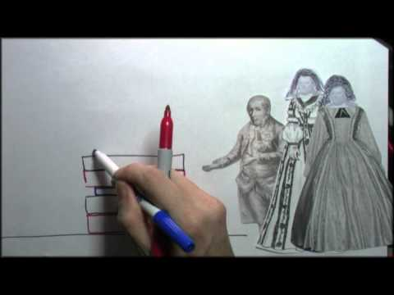
Batteries as a power source
What kinds of batteries are there?

Slide 8
What is a circuit?
Combination of electronic parts, wires connected between power sources. It's like a physical program. It's also like setting up dominoes in sequence.
Notes:
Show example of LED circuit with only wires.

Slide 9
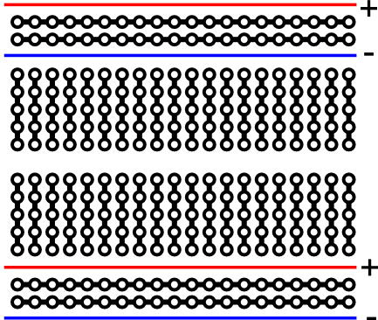
What is a breadboard?
What are they good for?
Creatings, organizing, and prototyping a circuit.
Literally started out as a bread board with nails.
Notes:
Find a interactive example. Also, show an old fashioned breadboard example.

Slide 10

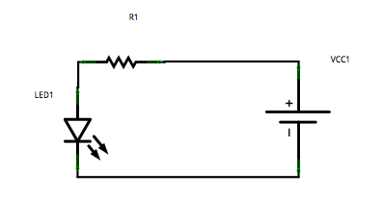
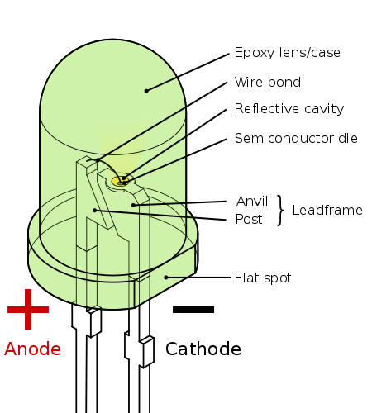
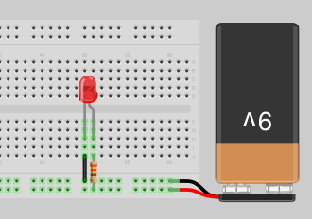
What are LEDs?
Light Emitting Diodes
Diode Symbol + Arrows for light
Points to ground
Notes:
Explain Anode, and Cathode.

Slide 11
Hello World for a Circuit
Light and LED
Parts:
Battery
Resistor
LED
Why:
Power Source
An LED will light up when enough voltage is supplied but can also burn out if too much is allowed to pass through. The resistor will limit the voltage to prevent damage.
Do:
Connect Battery, Resistor, LED

Slide 12
LED Circuit
1 LED Plus resistor
Why have a resistor?
Current, limiting.

Slide 13
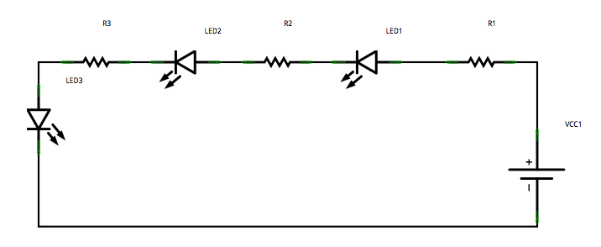
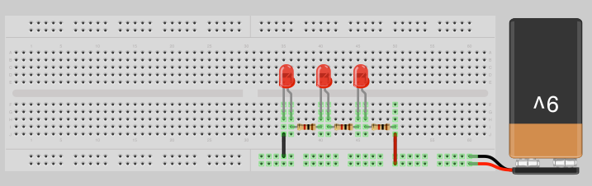
Series circuit example

Slide 14
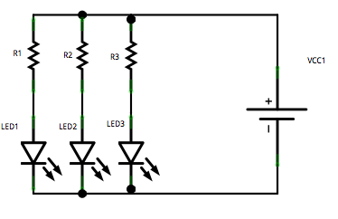
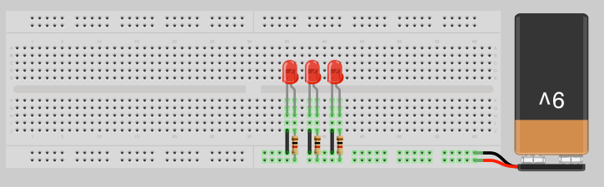
Parallel Circuit example

Slide 15
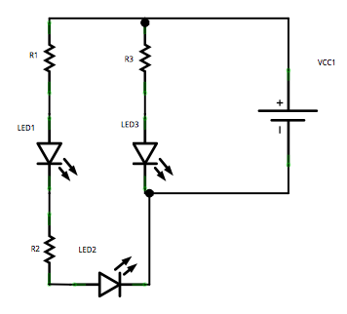
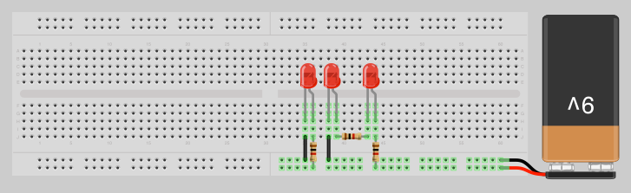
Parallel and Series Circuit Example
Notes:
Find a good explanation or modify the circuit to be more visual.

Slide 16
Fundamental Parts
Resistor
Capacitor
Wire
Diodes
Light Emitting Diodes (LED)
Battery
Transistors
Motors
They each have a physical property that interacts with electricity. When put in combination various actions occur.

Slide 17

What are resistors?
Resistors provide a specific amount of resistance to a path in a circuit or wire. Ohm's law is used to calculate the properties related to resistance.
Ohm's Law: I = V/R
I = Current measured in Amps
V = Voltage measured in Volts
R = Resistance measured in Ohms
Resistors are color coded.

Slide 18
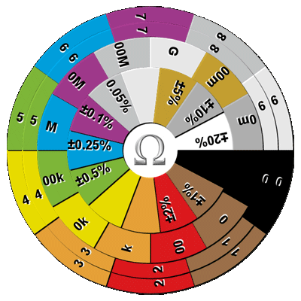
Resistor Color Code
Resistor Color Code Wheel Calculator

Slide 19
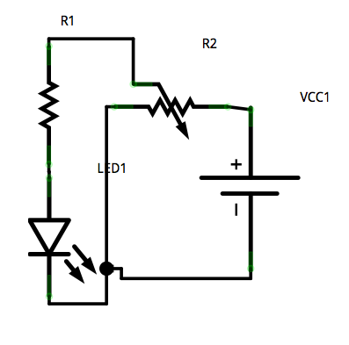
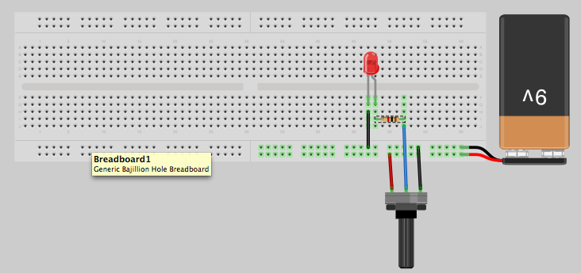
Variable resistor: The potentiometer
Voltage dividers
Try out the different pots.

Slide 20
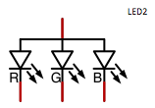
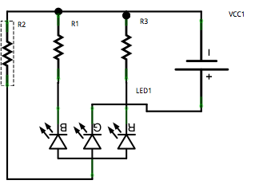
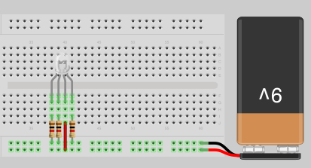
RGB LED
Try resistors out in various combination to make different colors. Experiment by adding potentiometers to the leads.

Slide 21

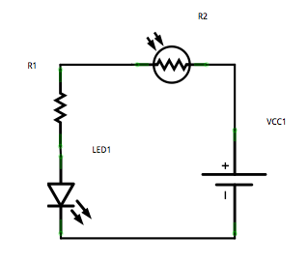
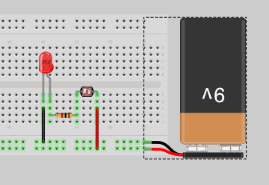
LED and Photoresistor
Photoresistors change their resistance by the amount of light detected.

Slide 22
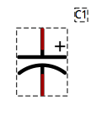

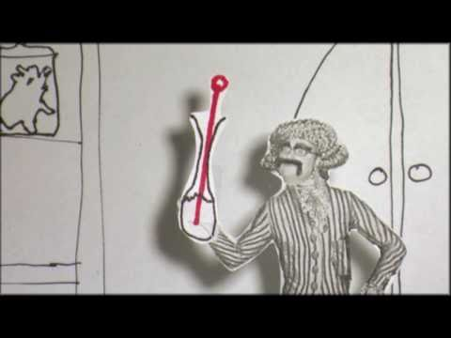
What are capacitors?
Capacitor is two separated charges.
Known charge up time.
Know discharge time.
Two major kinds
  Electrolytic, asymmetric, bipolar
  Ceramic, symmetric

Slide 23
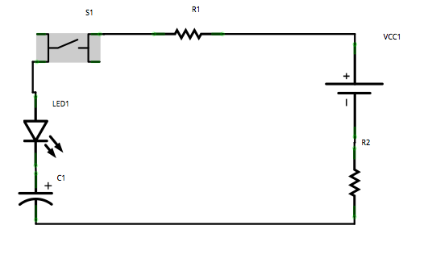
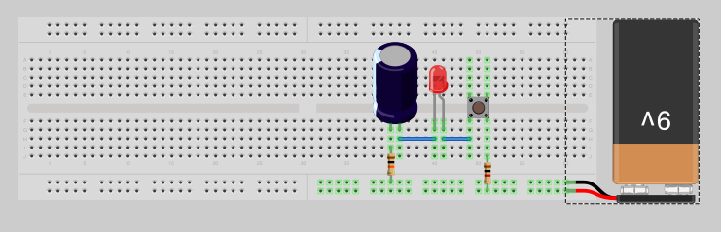
Capacitors in series

Slide 24
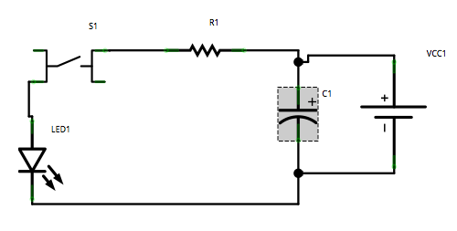
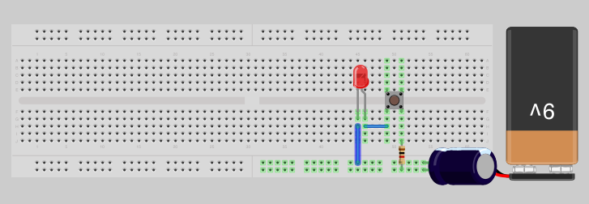
Capacitors in Parallel
They can provide energy, however briefly.
They can smooth out a signal.
Attach the battery briefly to fill the capacitor.

Slide 25
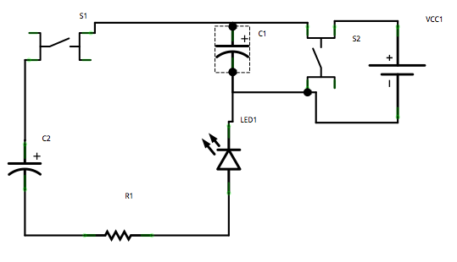
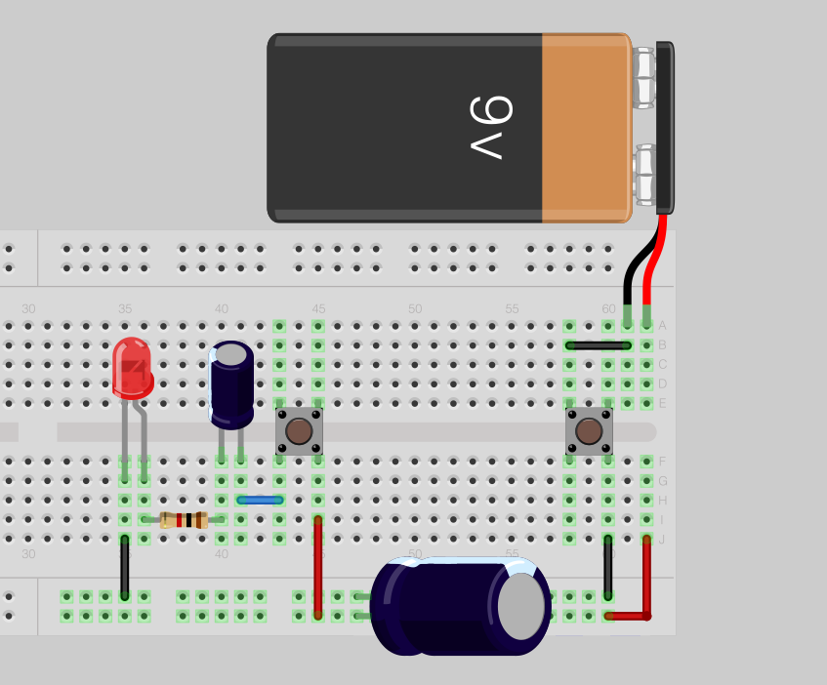
Capacitors in series and parallel

Slide 26
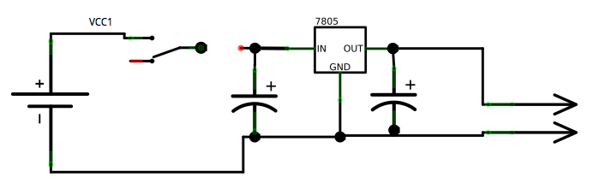
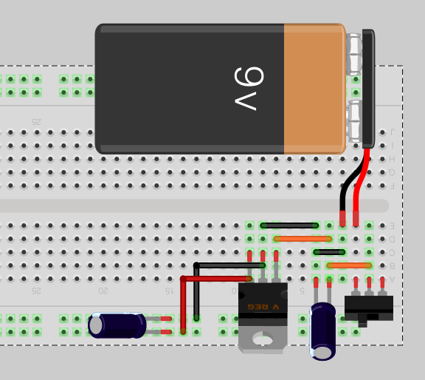
Make a voltage regulator

Slide 27
Turn things on and off with a:
Wire
Button
Photoresistor
Hall Effect Sensor
Relay
Transistor
Button
Switch

Slide 28

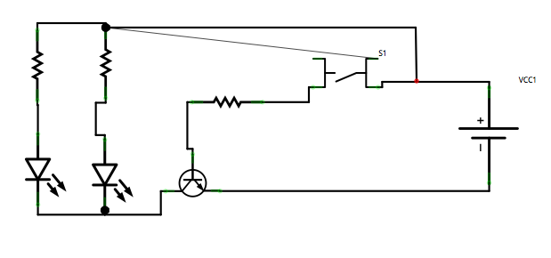
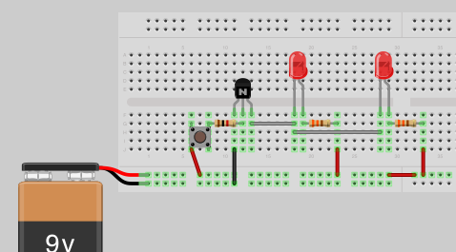
Transistors
NPN Transistor

Slide 29
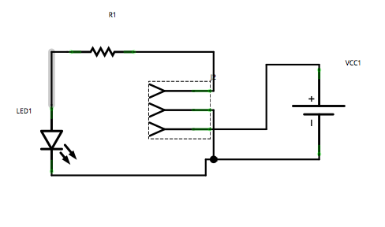
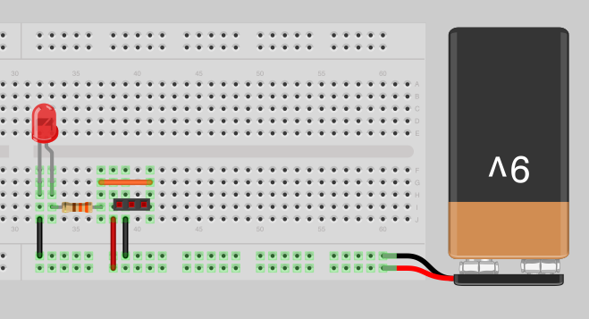
Hall Effect Sensor

Slide 30
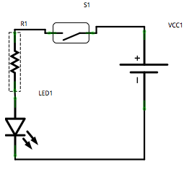
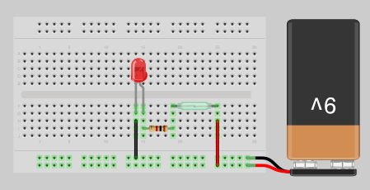
Reed Switch Example
A reed switch is closed when a magnet is in close proximity.
It is symmetric so it can placed either direction.

Slide 31
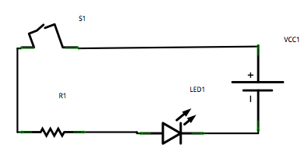
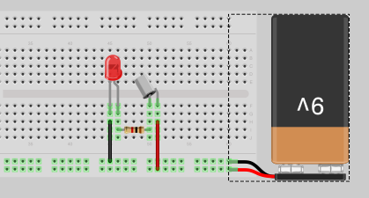
Tilt ball switch
Emergency on/off if project tips over.

Slide 32

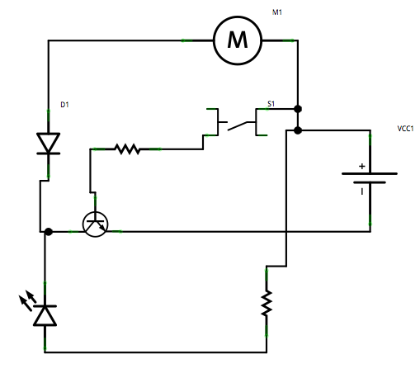
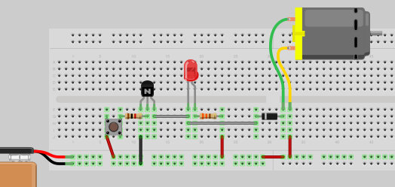
Motors
Try changing the direction
of the diode.
What happens?

Slide 33
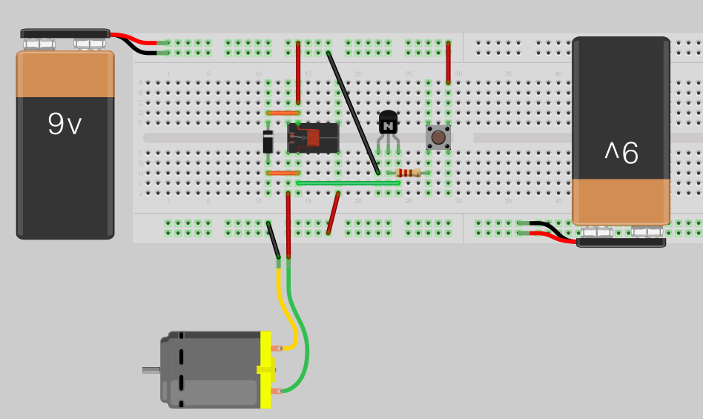
Relay
Notes:
Need to sue voltage regulator to make 9v -> 5v

