Slide 1

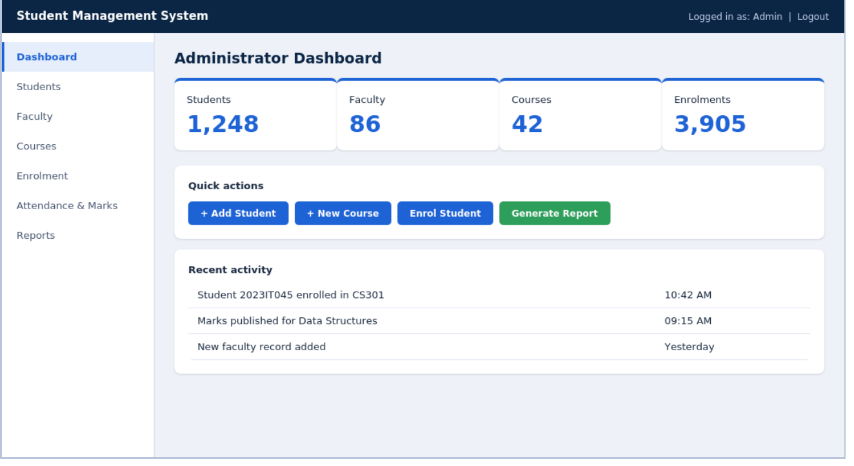
Student Management System
UNIVERSITY COLLEGE OF ENGINEERING, BIT CAMPUS | ANNA UNIVERSITY
SUMMER INTERNSHIP REVIEW | IT3711
A Python and Django web application built during a one-month internship at Fantasy Solution, Tiruchirappalli
Harihara Suthan M | 810023205302
Administrator dashboard of the application built during the internship
B.Tech Information Technology, Seventh Semester
Internship period: 01 June to 30 June 2026
Notes:
Introduce yourself, the internship (Fantasy Solution, 01-30 June 2026) and the project: a Student Management System built with Python, Django and MySQL. Plan about 20-25 minutes including questions.

Slide 2
Internship at a glance
30
10
8
3
days of training and project work
functional requirements delivered
entities in the database design
user roles: admin, faculty, student
Organisation | Fantasy Solution, Melapudur, Tiruchirappalli
Industry guide | Mr. Bragatheesh, Software Developer (MCA)
Project | Student Management System
Duration | 01 June 2026 to 30 June 2026
Student | Harihara Suthan M (810023205302)
Programme | B.Tech Information Technology, IT3711 Summer Internship
Notes:
Key facts from the official internship annexure. The project covers the full life cycle: analysis, design, implementation, testing and deployment.

Slide 3






About Fantasy Solution
Services across the software life cycle
An IT solution and service provider delivering technology-enabled solutions to businesses, institutions and individuals.
Application development and maintenance
E-business, CMS and payment gateways
Brand commitment: “Beyond Technology”
Website design, development and hosting
Android mobile applications
VISION
To be a leading IT company for consulting services and the deployment of best-of-breed business solutions to top-tier domestic and international customers.
ERP, testing and performance engineering
IT education and student project guidance
Technology areas: .NET · PHP · Java · Android · R · Python · MATLAB
Notes:
Fantasy Solution works across the full software life cycle. Internship environment was collaborative: approachable senior developers, open feedback and quick resolution of doubts.

Slide 4
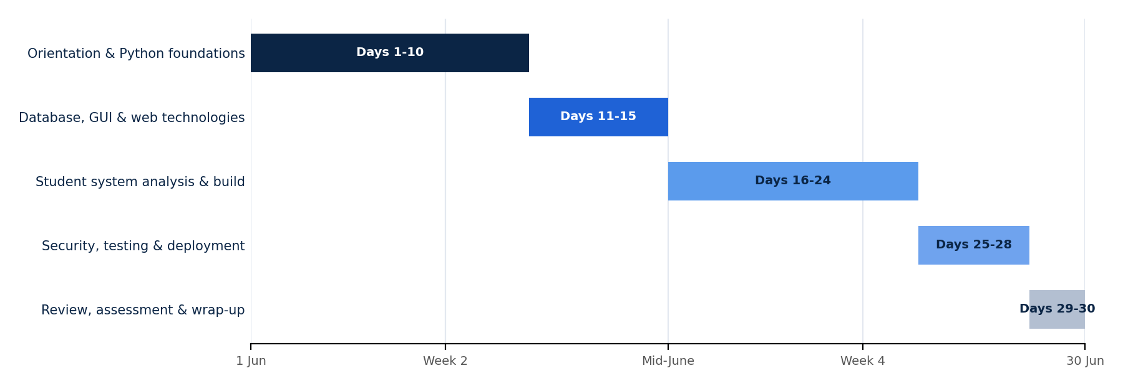






Training programme
Core Python and OOP
Classes, ABCs, exceptions, debugging
Advanced Python
Generators, decorators, threading, asyncio
Data and web basics
DB-API, MySQL, Tkinter, Flask
Short explanation
Coding exercises
Applied in project
Django stack
ORM, REST framework, authentication
Understanding was always tested by practice. The programme closed with documentation, presentations before mentors and peers, and a review.
Quality and delivery
pytest, Git, Gunicorn with Nginx
Notes:
Thirty days, organised into progressive phases: foundations first, then data and web technologies, then the project with Django, security, testing and deployment. Every concept was followed by exercises.

Slide 5




From training to project
Core Python and OOP
Data structures, type hints
DB-API and SQL
Domain model: Student, Course, Enrollment, Marks
In-memory search results and reports
Foundation for the database layer
Flask and Jinja2
Django and REST framework
Django ORM and migrations
Prototype screens and form handling
Views, services and configuration
Models mapped to MySQL tables
Django auth and permissions
unittest and pytest
Git, Gunicorn, Nginx
Role-based access for three user roles
Verifies grading and attendance rules
Source management and hosting
Notes:
Each technology studied during training has a direct role in the project. This slide is the bridge between the learning stream and the project stream.

Slide 6



Problem and proposed system
Manual records today
Student Management System
Slow to search, easy to lose
Central relational MySQL database
Attendance, marks and profiles kept apart
Role-based web interface
Totals and grades calculated by hand
Instant enrolment, attendance and marks
Students learn of shortage or results late
Automatic percentages and grades
Class-wise reports take hours
Reports generated on demand
Weak access control on registers
Each role sees only its own functions
Notes:
Problem: institutions relying on registers and spreadsheets face slow search, duplicate or missing entries, inconsistent attendance and error-prone result computation. The proposed system replaces this with one integrated digital workflow. Feasibility: technical, economic, operational and schedule were all assessed as favourable (open-source stack, modest hardware, familiar interface, module-by-module plan).

Slide 7



What the system must do
Admin
Faculty
Student
System
FR-02 to FR-05, FR-10
FR-06, FR-07, FR-10
FR-09
FR-01, FR-08
Manage students, courses and faculty
Enrol students with seat checks
Generate reports
Mark session-wise attendance
Enter assessment marks
View attendance and result reports
View own profile
Track attendance percentage
See results in a read-only view
Secure login and logout
Compute totals and grades
Derive attendance % and result
75%
40%
7
Config
minimum attendance of conducted sessions
pass mark of the maximum score
grade bands, from O down to RA
rules stored as settings, no code change
Non-functional: security · usability · reliability · performance · maintainability · portability
Notes:
Ten functional requirements (FR-01 to FR-10) grouped by who uses them. Academic rules are held as configuration values so the institution can change them without touching code: 75% minimum attendance, 40% pass mark, seven grade bands.

Slide 8
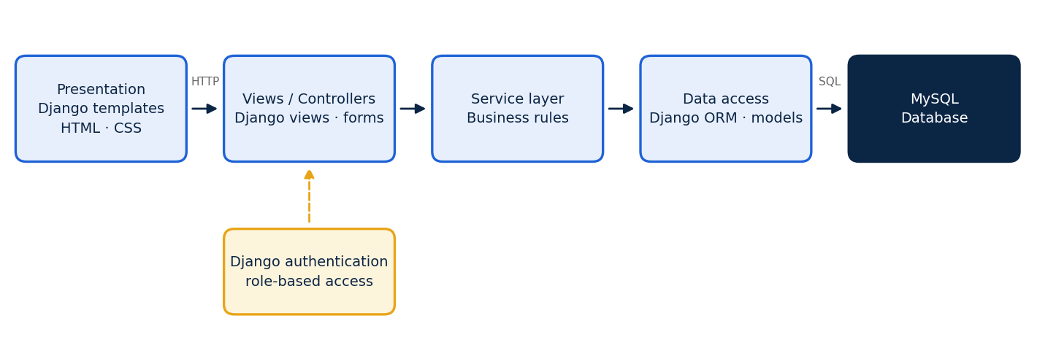

Layered architecture
One responsibility per layer
Security checks every request
Rules live in services
Easier to understand, test and extend
Identity and role verified before business logic
Grading and attendance unit-tested on their own
Notes:
Three-tier layered design: templates present data, views receive and validate requests, the service layer enforces business rules, the data access layer (Django ORM) talks to MySQL. Django's authentication and role checks sit beside the views.

Slide 9
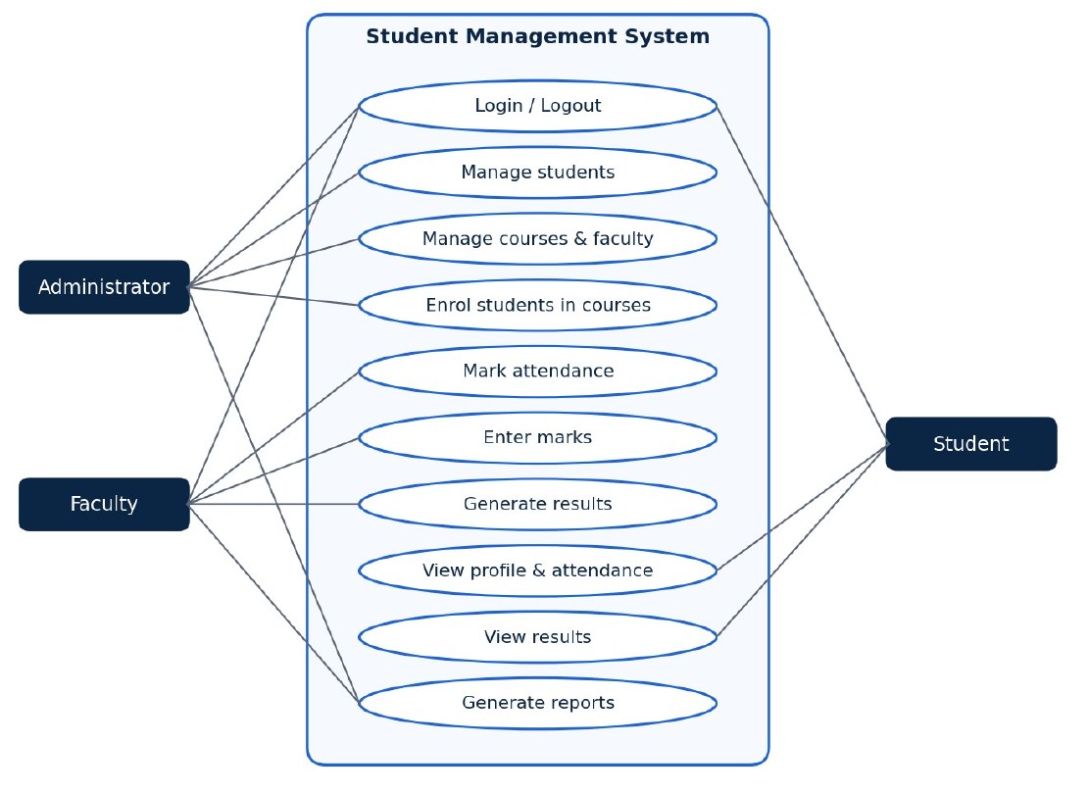
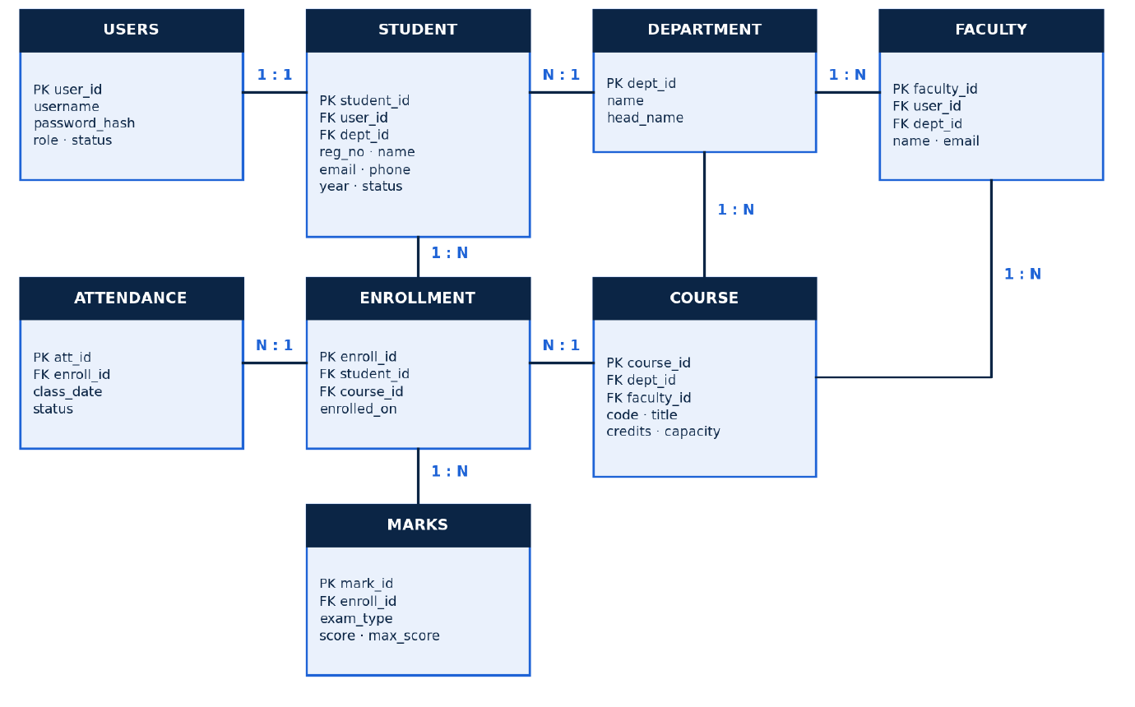
Use cases and data model
Three roles. Everyone logs in first; each role then has its own permitted functions.
Eight entities. Attendance and marks hang off enrolment; foreign keys keep every record valid.
Notes:
Use case diagram: administrator, faculty and student actors. ER diagram: users, student, department, faculty, course, enrollment, attendance and marks. Foreign keys ensure an enrolment can never refer to a missing student or course. In the application these tables are Django models created by migrations.

Slide 10
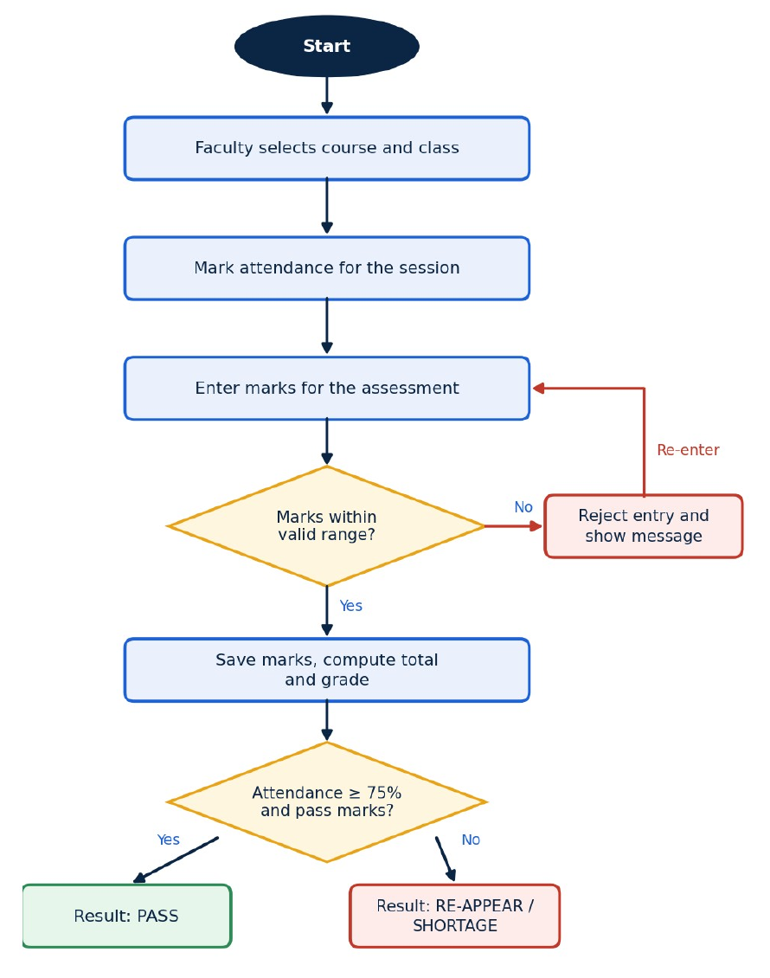
From attendance to result
1
2
3
Validate marks between 0 and the maximum
Compute total, grade and attendance %
Decide result on attendance and pass mark
Grade bands (percentage)
O
A+
A
B+
B
C
RA
90+
80–89
70–79
60–69
50–59
40–49
below 40
PASS
NOT ELIGIBLE
Attendance at least 75% and score at least 40%
Attendance shortage or score below the pass mark
Notes:
This is the heart of the system. Marks are validated first, then total and grade are computed, and finally the result is decided by checking both attendance percentage and pass mark. Boundary errors in grade bands were a typical defect, which is why this logic is covered by unit tests.

Slide 11


Implementation highlights
Transactional enrolment
Security by design
@transaction.atomic
def enroll_student(student_id, course_id):
student = Student.objects.get(pk=student_id)
course = (Course.objects.select_for_update()
.get(pk=course_id))
if Enrollment.objects.filter(
student=student, course=course).exists():
raise AlreadyEnrolledError()
if course.enrolled >= course.capacity:
raise CourseFullError()
course.enrolled += 1
course.save(update_fields=["enrolled"])
return Enrollment.objects.create(...)
Authentication
Salted password hashes
Authorisation
Role checks on every view
Validation
Server-side Django forms
SQL injection
ORM parameterised queries
Record and seat count change together, or not at all.
CSRF
Token on every form
Django apps
accounts
students
courses
attendance
Sessions
End on logout, expire when idle
marks
reports
services
Notes:
Business rules live in a service layer so they can be unit tested independently of the web layer. Enrolment runs inside one database transaction with a row lock on the course, so concurrent requests cannot oversell seats. The snippet is a simplified illustration of the approach. Deployment: Gunicorn behind Nginx, Git for version control.

Slide 12
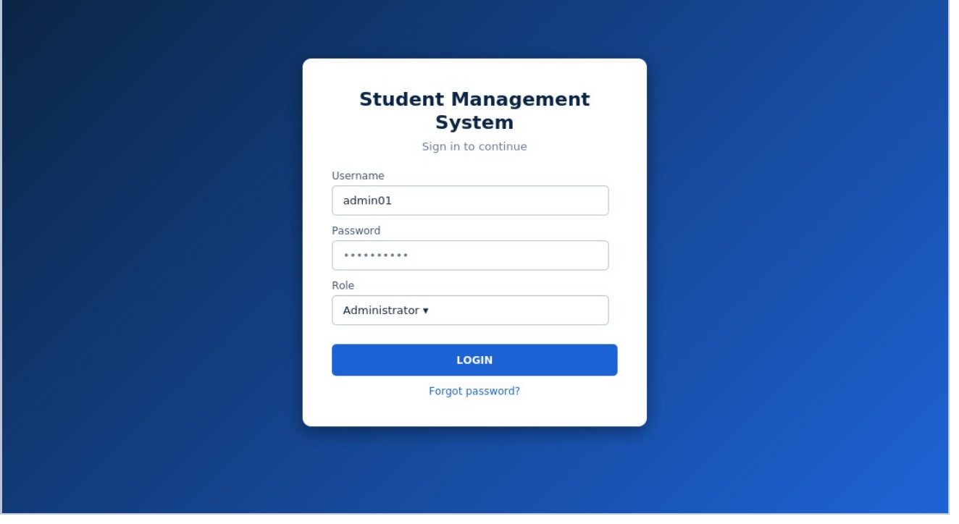
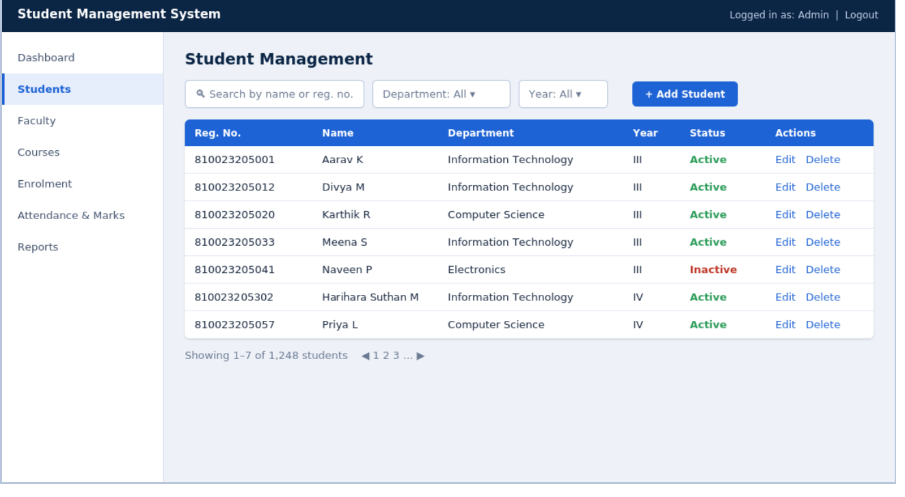
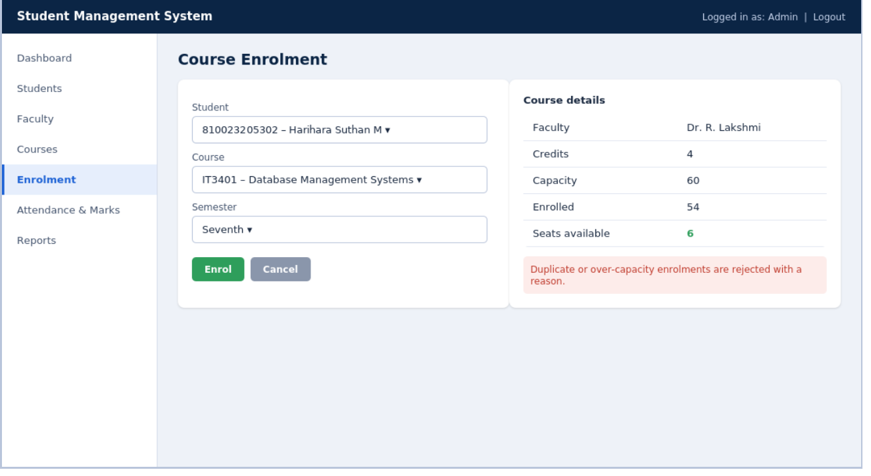
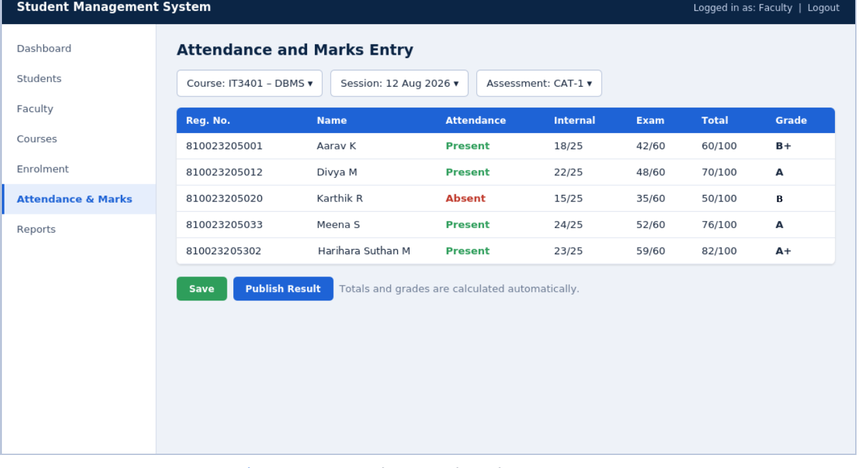
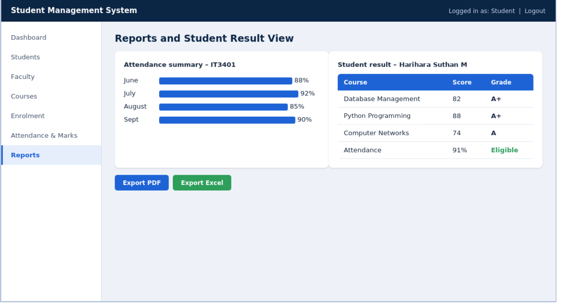
Application walkthrough
Login: role-based entry
Dashboard: tiles and quick actions
Students: search, filters, status
Enrolment: seats and clear rejections
Attendance and marks: auto grades
Reports and student result view
Notes:
Walk through the six main screens. Navigation shows only the options permitted for the logged-in role. Status badges use green, amber and red so attendance shortage and results are visible at a glance. Validation messages appear before saving.

Slide 13
Testing and results
Unit
Grade calculation and attendance % (unittest, pytest)
10/10
6/6
Integration
View, service and database layers (pytest-django)
functional requirements realised in screens
project objectives achieved
System
Full workflows from enrolment to result
Searchable student, faculty and course records
Security
Role limits, session expiry, invalid input
Duplicate and over-capacity enrolments blocked
Attendance % with automatic shortage detection
Acceptance
Mentor demonstration and feedback
Grades and pass or fail from configured rules
Role-based access on every function
Ten representative test cases (TC-01 to TC-10) trace back to the requirements.
Attendance, result and enrolment reports
Notes:
Testing was designed from the functional requirements so every requirement has at least one scenario. Examples: valid and invalid login, duplicate registration number, duplicate enrolment, full course, invalid marks, grade computation (82/100 gives A+), and a student opening an admin URL being denied. Defects were recorded, fixed in the relevant layer and re-tested.

Slide 14

Learning and challenges
Challenges and solutions
Technical skills
Many technologies in one month
Structured plan, instant practice, official documentation
OOP, data structures and type hints
Django, ORM and REST framework
SQL and MySQL connectivity
Authentication and permissions
Testing, Git and deployment
Python classes to relational tables
Django models and migrations, checked in the shell
Enrolment and seat counts out of sync
Wrapped the operation in transaction.atomic
Professional growth
Accurate grades and attendance
Service functions with boundary unit tests
Communication and teamwork
Time management and planning
Documentation and code review
Features restricted by role
Login and permission checks on every view
Notes:
Beyond technology, regular discussions with the industry guide, code reviews and module-wise planning built communication, teamwork and time management. Challenges and the solutions adopted are taken directly from the report.

Slide 15








Conclusion and future scope
CONCLUSION
FUTURE ENHANCEMENTS
Thirty days from Python fundamentals to a database-backed Django application
Manual registers replaced by a secure, role-based system
Professional habits: planning, feedback and documentation
Email and SMS notifications
Fee management and payments
Timetable generation
Parent portal
Analytics dashboard
Online assessments
Thank you
Multi-campus support
Android companion app
Questions and feedback welcome
Notes:
Close with the key takeaway: the internship covered the journey from Python basics to a complete deployed web application, and built professional habits. Future scope: notifications, fees, timetable, parent portal, analytics, online assessments, multi-campus and a mobile app. Invite questions.

