Slide 1



ID HALEON August 2026 Review

Slide 2



Agenda
Sell In & B2C Performance
B2C Marketing Activations
B2B Performance
Key Learnings and Initiatives for September
×
AnyMind Credential Deck
© AnyMind Group. All Rights Reserved.
CONFIDENTIAL
‹#›
© AnyMind Group. All Rights Reserved.
CONFIDENTIAL
‹#›

Slide 3

Sell In Performance
Sell In performance YTD August 2026
SLA still below 95% due to Multi Warehouse PO not fully fulfilled and Scott’s Original OOS Issue
Metrics | Q1 | Q2 | July | August | Total
Open PO | 26,509,161,700 | 21,683,641,700 | 12,988,402,800 | 10,916,313,700 | 72,097,519,900
Actual Inbound | 21,427,538,900 | 16,409,380,000 | 9,468,502,400 | 7,492,029,200 | 54,797,450,500
SLA | 81% | 76% | 73% | 69% | 76%
B2C JKT | 14,183,431,593 | 11,639,260,977 | 2,994,365,000 | 3,991,532,800 | 32,808,590,370
B2C SBY | 1,816,993,410 | 3,797,758,551 | 1,409,971,900 | 1,127,910,200 | 8,152,634,061
B2C MKS | 0 | 131,599,491 | 155,903,800 | 195,163,700 | 482,666,991
B2C MDN | 0 | 146,653,644 | 232,313,200 | 316,011,200 | 694,978,044
B2B | 7,012,741,600 | 2,251,476,700 | 4,675,948,500 | 1,729,904,400 | 15,670,071,200
Achievement | 102% | 73% | 121% | 93% | 93%
Nama Product | Brand Low SLA
Sens TB R&P Extra soft 2s | 56%
Scott's Jeruk 200ml | 69%
Scott's Jeruk 400ml | 60%
Scott's Original 400ml | 20%
Polident Fresh Mint 20g | 68%
Polident Fresh Mint 60g | 64%
Metrics | PO | GR | SLA
Waringin | 6,579,445,700 | 5,676,522,500 | 86%
Surabaya | 2,143,447,700 | 1,304,331,800 | 61%
Makassar | 1,122,936,200 | 195,163,700 | 17%
Medan | 1,070,484,100 | 316,011,200 | 30%
Total | 10,916,313,700 | 7,492,029,200 | 69%
Key Highlights
Scott's Original OOS contributed to the lower SLA in August, along with unfulfilled POs at multiple warehouses such as Medan and Makassar, which further lowered the SLA. Medan and Makassar are currently growing by 4% and 3% respectively in August.
Most SLA that are lower than 70% are coming from Scott’s and Polident which from unfulfilled PO’S from MWH with Sensodyne TB are the only SKU that are lower from SLA wise coming from B2B side

Slide 4
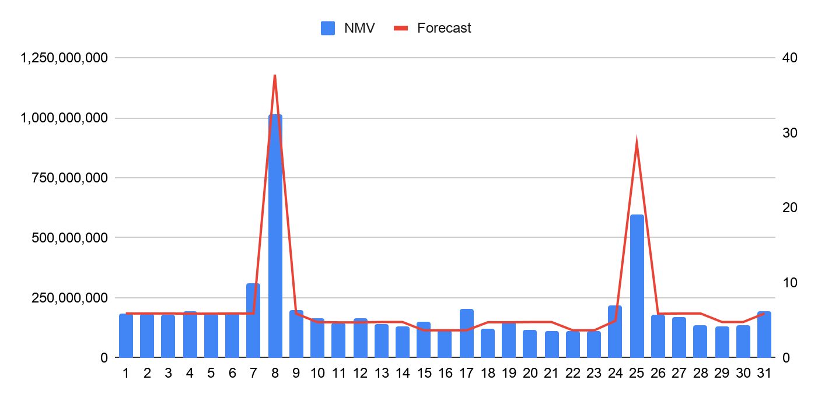
B2C Overall Performance
B2C Achievement and Daily Phasing to Target
Shopee achieving by 96% and sill growth by 2% even while the stock issue and cofund being withdrawn
Metrics | MTD | MTD M-1 | Growth | Forecast | Achievement
Shopee | 5,998,042,656 | 5,861,757,401 | 2% | 6,245,698,999 | 96%
Lazada | 269,270,474 | 272,605,993 | -1% | 319,206,080 | 84%
C2C | 66,593,952 | 57,059,074 | 17% | 65,724,486 | 101%
Total | 6,333,907,082 | 6,191,422,468 | 2% | 6,630,629,565 | 96%
Key Highlights
All channels achieved 96% of total target, leaving a 4% gap. Still, we managed to grow by 2%, even though some platforms considered August a slow month
Shopee achieved 96%, still growing by 2%. We managed to grow even as platform support started shifting to a different category. (Co-funding was withdrawn as a Shopee feature.
Lazada achieved 84% MTD overall due to decreased subsidy from the platform, but the overall NMV decline wasn't significant.
C2C managed to achieve 101% of target, driven by increases in PV and ABS

Slide 5
B2C Overall Performance
B2C Key Metrics MoM Performance
C2C showing the most growth on NMV by 14%, while shopee and and Lazada both gaving growth from the PV sides
Shopee | NMV | PV | Order CR | Order | Qty Sold | ABS | ASP | Subsidy
MTD | 5,991,933,117 | 1,498,736 | 4.84% | 72,532 | 84,590 | 82,611 | 70,835 | 1,064,046,516
MTD M-1 | 5,861,757,401 | 1,287,881 | 5.36% | 68,974 | 83,120 | 84,985 | 70,522 | 1,041,686,346
Growth | 2% | 16% | -0.5% | 5% | 2% | -3% | 1% | 2%
Lazada | NMV | PV | Order CR | Order | Qty Sold | ABS | ASP | Subsidy
MTD | 268,927,244 | 2,085,364 | 0.08% | 1,630 | 1,981 | 164,986 | 135,753 | 39,800,053
MTD M-1 | 272,605,993 | 870,047 | 0.23% | 1,981 | 2,498 | 137,610 | 109,130 | 63,763,832
Growth | -1% | 58% | -0.1% | -22% | -26% | 17% | 20% | -60%
C2C | NMV | PV | Order CR | Order | Qty Sold | ABS | ASP | Subsidy
MTD | 66,257,714 | 38,157 | 2.91% | 1,109 | 1,323 | 59,745 | 50,081 | 3,915,731
MTD M-1 | 57,059,074 | 33,343 | 3.19% | 1,063 | 1,215 | 53,677 | 46,962 | 4,232,595
Growth | 14% | 13% | -0.3% | 4% | 8% | 10% | 6% | -8%
Key Highlights
On the Shopee side, CR decreased by -0.5pp despite a 16% rise in PV which came from Ads metrics partly due to lower peak day subsidy support as the platform pushed non FMCG categories in August. Orders still grew 5%, and we'll push CR further through promotions wise.
Lazada's subsidy decreased by 60% MTD, but overall PV grew strongly by 58%. CR was impacted by -0.15pp, while ABS was higher due to bulk buyers on peak days."
C2C is growing strong across overall metrics, even though platform support is lower. We'll maintain this performance and continue planning for C2C growth

Slide 6
B2C Overall Performance
9.9 Post Mortem
Shopee hit another all time high for the highest NMV achieved in a day, due to huge support from platform and ads wise
Shopee | Nmv | Pv | Order | Qty Sold | CR | ABS | Subsidy
9.9 | 1,227,449,601 | 212,461 | 13,055 | 14,816 | 6.14% | 94,021 | 327,225,450
8.8 | 963,705,910 | 133,918 | 10,014 | 12,025 | 7.48% | 96,236 | 225,199,710
Growth | 27% | 59% | 30% | 23% | -7% | -2% | 45%
Lazada | Nmv | Pv | Order | Qty Sold | CR | ABS | Subsidy
9.9 | 65,755,422 | 42,614 | 415 | 473 | 0.97% | 158,447 | 17,573,154
8.8 | 50,949,382 | 57,144 | 311 | 356 | 0.54% | 163,824 | 12,168,235
Growth | 29% | -25% | 33% | 33% | 0.4% | -3% | 44%
Metrics | Impression | Clicks | GMV | Spend | Roi
9.9 | 2,743,716 | 91,858 | 1,240,000,000 | 128,220,000 | 9.7
8.8 | 1,656,480 | 51,023 | 893,182,016 | 99,959,684 | 8.9
Growth | 66% | 80% | 39% | 28% | 8%
Channel Contribution | MTD | MTD-1
Ads | 86% | 79%
Affiliate | 27% | 36%
Live Streaming | 17% | 13%
Key Highlights
Shopee hit another 1 Bio on Double date with MoM growth by 23%, a huge increased by Subsidy by platform by 45% also due to our participants on PE+ with a good performance from Ads which increased the PV by 58%, which also caused the CR quite drop by -7pp.
Lazada also giving a good push on D.D with subsidy increased also by 44% and NMV growth by 29% meanwhile CR increased by 4pp

Slide 7
B2C Shopee & Lazada Performance
B2C Brand Performance
Scott’s growing by 20% while Polident showing declined on shopee meanwhile on lazada Polident Contribution rise to 60%
Shopee
Brand | NMV | Contri % | Growth MTD-1
Sensodyne | 2,593,592,763 | 44.25% | -0.5%
Polident | 1,432,194,183 | 24.43% | -13%
Scott's | 1,943,032,598 | 33.15% | 21%
Centrum | 23,113,573 | 0.39% | 0%
Shopee
Brand | NMV | Contri % | Growth MTD-1
Sensodyne | 2,593,592,763 | 44.25% | -0.5%
Polident | 1,432,194,183 | 24.43% | -13%
Scott's | 1,943,032,598 | 33.15% | 21%
Centrum | 23,113,573 | 0.39% | 0%
Total | 5,968,819,544 | 101.83% | 1%
Lazada
Brand | NMV | Contri % | Growth MTD-1
Sensodyne | 68,777,872 | 25.18% | -30%
Polident | 164,371,589 | 60.17% | 24%
Scott's | 34,937,783 | 12.79% | -18%
Centrum | 840,000 | 0.01% | 0%
Total | 268,087,244 | 98.14% | -2%
Shopee | Ads | Growth % | Affiliate | Growth % | Live Streaming | Growth %
Sensodyne | 1,087,858,428 | -3% | 1,014,041,100 | 5% | 433,086,992 | 0.3%
Polident | 599,705,512 | -22% | 602,803,463 | -7% | 218,897,033 | -9%
Scott's | 909,837,160 | -1% | 933,860,445 | 32% | 315,471,688 | -3%
Centrum | 18,347,840 | 0% | 7,072,312 | 0% | 5,884,628 | 0%
Polident | July | August | Growth
Single | 108,829,966 | 97,255,190 | -11%
Twinpack | 86,904,274 | 57,376,567 | -34%
Triplepack | 91,994,241 | 94,947,000 | 3%
High Bundles | 207,331,390 | 63,899,649 | -69%
Key Highlights
Polident Decreased on overall month partly due Cofund support that been withdrawn by shopee sides on august, which also the reason the uplift on polident are lower on August, other than that on overall Channel partly decreased on Livestreaming and Affiliates by -9% & -7%, also on Product Ads by spending are lower compared to July since the overall budget on August is lower also compared to July.
Scott's increased by 20.65%, with its contribution now higher than Polident's, unlike in July. Even though the top SKU was OOS, it still grew overall, helped by channel activation from affiliates tapping into Mega KOLs. Polident on Lazada contribution growing higher compare to other month which hit 60% due to other channel dropped especially on Sensodyne since the Subsidy on Lazada are lower this month.

Slide 8
B2C Shopee & Lazada TOP SKU
B2C Top 10 SKU & Bundles Performance
Scott’s Original still having growth even though mid month OOS and Scott’s 200ml rise due to promotion by Mega Affiliate
Shopee
Sku Code | NMV | Growth
Scott's Jeruk 400Ml | 503,472,275 | 8%
Scott's Jeruk 200Ml | 370,538,914 | -3%
Scott's Ori 400Ml | 296,252,250 | 15%
Scott's Jeruk 200Ml (Twinpack) | 243,229,321 | 221%
Polident Freshmint 60g | 192,767,213 | -22%
Sensodyne SRP Extra Fresh | 170,311,905 | 67%
CGBS 80G (Triplepack) | 152,575,863 | -8%
Polident Cleanser 36s (Triplepack) | 149,758,042 | 34%
Sensodyne SRP Original (Triplepack) | 143,771,454 | -13%
Scott's Jeruk 400Ml (Twinpack) | 131,789,210 | 11%
Lazada
Sku Code | NMV | Growth
Polident Freshmint 60g (24) | 16,346,462 | 81%
Scott's Jeruk 400Ml | 13,006,223 | -14%
Polident Freshmint 60g | 12,023,132 | 28%
Polident Freshmint 60g (Twinpack) | 9,116,827 | -52%
Polident Freshmint 60g (6) | 7,675,843 | 46%
Scott's Ori 400Ml | 7,393,564 | -12%
Sensodyne SRP Original (Triplepack) | 6,438,975 | -44%
Polident Freshmint 20g (6) | 5,426,647 | -21%
Sensodyne Freshmint 100g (Triplepack) | 4,640,909 | -18%
Polident Freshmint 20g | 4,009,412 | -11%
Key Highlights
Scott's still dominates the Top 3, with Original growing 14.81% this month despite mid month OOS. Scott's Jeruk 200Ml Twinpack also grew significantly by 221%, driven by Mega Affiliate consistently promoting the 200Ml Twinpack (Tonicu)
Overall, Lazada's Top 10 SKUs show a declining trend, with most SKUs down. The strongest contributor and top growth are from polident which on overall brand growth by 60%
Shopee | July | August | Growth
Single | 2,678,123,826 | 2,897,526,804 | 8%
Twinpack | 970,449,044 | 1,116,984,291 | 15%
Triplepack | 1,466,674,314 | 1,439,781,546 | -2%
High Bundles | 746,468,326 | 537,640,476 | -28%
Lazada | July | August | Growth
Single | 65,851,434 | 66,085,015 | 0.4%
Twinpack | 53,081,382 | 32,138,362 | -39%
Triplepack | 85647727 | 47,732,735 | -44%
High Bundles | 58,713,377 | 120,947,132 | 106%

Slide 9
B2C Shopee & Lazada Performance
Centrum August Performance
Kick off from centrum showing a good growth on august by pushing lower funnel activation on Affiliates and Livestream
Metrics | Shopee |  | Lazada |  | Tiktok
Product Name | Qty | NMV | QTY | NMV | QTY | NMV
Centrum 30s | 127 | 15,095,442 | 7 | 840,000 | 1 | 112,000
Centrum 30s Twinpack | 15 | 3,551,814
Centrum 30s Triplepack | 13 | 4,583,640
Total | 155 | 23,230,896 | 7 | 840,000 | 1 | 112,000
Key Highlights
Centrum grew healthily in August, boosted by ads and channel’s activation, achieving 24 Mio in its first month. A strong start driven by Single’s, which will be pushed further with GWP & bundles going forward.
By contribution, Ads remains the top channel driving conversion, while Affiliate contributes around 50% to NMV, boosted by affiliates videos and livestreams with big KOLs.
Live Streaming still tagging at 32% contribution, though we're pushing promotions further with vouchers and GWP bundles featured on LS
We'll focus on overall channel activation to gather more GMV for Centrum,and more awareness push from Affiliates and more activation such as Review and Win to drive more GMV
Centrum Tracker | YTD | Order | Qty Sold | %
Overall GMV | 26,068,065 | 161 | 174
Overall NMV | 23,230,896 | 143 | 155
Ads | 24,774,506 | 195 | 205 | 95%
Live Streaming | 8,425,334 | 65 | 68 | 32%
Affiliate | 12,404,790 | 113 | 119 | 53%

Slide 10
B2C OTC Performance
OTC August Performance
Store Opened back at 14 August and starting Growing strong due as platform are on good trend and on Ads sides pushed strong
Metrics | Feb | Aug | Growth
Revenue | 32,927,669 | 40,346,984 | 23%
Order | 749 | 893 | 19%
CVR | 5.41% | 5.58% | 3%
PV | 13,832 | 16,008 | 16%
ABS/AOV | 43,962 | 45,181 | 3%
Target | 170,000,000 | 159,309,000
Nama Products | NMV | vs Feb
Panadol Extra [Kemasan Box] | 11,648,026 | 51%
Panadol Extra 10 Kaplet - isi 3 | 7,467,408 | 161%
Panadol Extra 10 Kaplet | 6,557,916 | -16%
Panadol Extra 10 Kaplet - isi 2 | 3,350,760 | -2%
Panadol Reguler 10 Kaplet | 2,041,364 | -10%
Panadol Anak Chewable Rasa Cherry 10 Kaplet | 1,713,060 | 17%
Voltaren 20g | 1,519,248 | 38%
Panadol Reguler 10 Kaplet - isi 3 | 1,324,128 | 0%
Panadol Anak Chewable Rasa Cherry 10 Kaplet - Isi 2 | 1,103,972 | -9%
Panadol Hijau 10 Kaplet | 847,880 | 30%
Key Highlights
Compared to February, which had the highest performance YTD with greater availability, August despite being live for only 2 weeks, NMV exceed February's performance by 23%. This indicates that once availability are resolved and ads pushed, we have even more potential to hit higher numbers to hit the forecast.
Other metrics also grew positively, CVR increased by 3pp, PV increased by 15%, and ABS is starting to hit 45K.
Our Main focus on September will be pushing more on PV by Ads sides to increase the PV while improving the ATP to be much better compared to H1.

Slide 11
Agenda
Sell In & B2C Performance
B2C Marketing Activations
B2B Performance
Key Learnings and Initiatives for August
×
AnyMind Credential Deck
© AnyMind Group. All Rights Reserved.
CONFIDENTIAL
‹#›
© AnyMind Group. All Rights Reserved.
CONFIDENTIAL
‹#›

Slide 12
B2C Marketing Activations
Activations Contributions
Ads contribution rise by 3% and having good growth by 5% meanwhile Affiliate contribution increased by 5pp
Shopee | MTD | Contribution | M-1 | Growth MoM
Ads | 4,610,517,815 | 66% | 4,357,105,118 | 6%
Affiliate | 2,563,892,017 | 43% | 2,329,935,570 | 10%
Livestream | 964,922,860 | 14% | 996,745,215 | -3%
Lazada | MTD | Contribution | M-1 | Growth MoM
Ads | 273,401,050 | 78% | 227,440,000 | 20%
Affiliate | 124,251,296 | 35% | 112,230,875 | 11%
Key Highlights
Ads Contribution remains quite healthy steady in 67% and by GMV growth by 5% which also increased our PV this month
Affiliate growing healthy by 10% MoM, by contribution also growing stronger to 43% from 38% on July meaning a more strong potential that we cloud shift more on affiliate
Live Streaming by growth slightly decreased by -3% but the Contribution increased slowly and still be our focus to grow the Livestreaming especially since centrum in this month will have more activation on Ls
Lazada most activation growing healthy by more than 10% growth each activation and on overall GMV also increased by 30% this month eve though by platform support lower this month

Slide 13
B2C Marketing Activations
Shopee Ads Performance August
Contribution to store increase with the huge growth by ROAS aswell by 16pp with increase of the GMV by 5%
Shopee | Ads Revenue | Ads Spend | ROAS | Cont % to Shop
MTD | 4,610,517,815 | 533,377,700 | 8.64 | 68%
MTD M-1 | 4,357,105,118 | 588,566,114 | 7.40 | 63%
Growth | 6% | -9% | 17% | 7%
Key Highlights
Ads Contribution increase to 66% with July at 63% still remains healthy with the Growth on GMV
ROAS end on august at 8.6 with a huge growth by 16% meaning the efficiency on the ads sides work well. But still hoping tos till optimize the peakdays period so we could uplift even more on those days/
Overall Month by period remains healthy on the ROAS sides, but hoping on the maximixe optimization on the peakdays since the roas exceed our threshold aswell to gain even more GMV on those period.
Period | GMV | Expense | ROI
Pre Heat (1-7) | 1,317,908,940 | 190,621,124 | 6.91
Peakdays (8.0) | 893,182,016 | 99,959,684 | 8.94
BAU (9-24) | 1,175,624,859 | 101,654,892 | 11.56
Payday (25) | 477,700,000 | 56,770,000 | 8.41
Post Payday (26-31) | 746,102,000 | 84,372,000 | 8.84
Total | 4,610,517,815 | 533,377,700 | 8.64

Slide 14

B2C Marketing Activations
Livestream Performance
Shopee
Month | Duration | GMV | GMV/h | Orders | UV | UV/h | ABS | CR% | LS Contribution | LS ADS Spent | LS ADS GMV
1-31 July 2026 | 468 | Rp998,701,271 | Rp2,133,977 | 9592 | 271,036 | 579 | Rp104,118 | 3.54% | 16.10% | 15,045,963 | 60,825,923
1-31 Aug 2026 | 472 | Rp973,534,995 | Rp2,062,574 | 9449 | 279,580 | 592 | Rp103,030 | 3.38% | 15.89% | 8,194,684 | 54,177,551
MoM Growth | 0.85% | -2.52% | -3.35% | -1.49% | 3.15% | 2.28% | -1.04% | -0.16pp% | -0.21pp% | -45.54% | -13.52%
Key Highlights
Live streaming performance declined slightly in August, with GMV (-2.52%) and Orders (-1.49%) dropping despite a minor increase in LS Duration (+0.85%), Unique Viewers (UV) (+3.15%), and UV/h (+2.28%).
UV (+3.15%) & UV/h (+2.28%): Unique Viewers increased to 279,580 (from 271,036 in July) and UV/h rose to 592, indicating healthy audience reach and active engagement during live sessions but with declining ads spent, the traffic sources was most likely low-intent buyer from Shopee algorithm.
ABS (-1.04%) & CR% (-0.16pp): Average Basket Size decreased slightly to Rp103,030 and Conversion Rate (CR%) dropped from 3.54% to 3.38% in August. Scott's remains the product with the highest GMV, suggesting to create cross brand bundling to push other SKU e.g (Bundle Scotts & Centrum) or (Bundle Polident & Sensodyne)
LS ADS Spent (-45.54%) & LS ADS GMV (-13.52%): Livestream ads spend was reduced by -45.54% (to Rp8.19M), causing a direct -13.52% drop in LS Ads GMV (to Rp54.17M). Overall GMV growth remains highly dependent on consistent LS Ads support to acquire high-intent buyers.
© AnyMind Group. All Rights Reserved.
CONFIDENTIAL

Slide 15
B2C Marketing Activations
9.9 Livestream Performance
Date | Duration | GMV | GMV/h | Orders | UV | UV/h | ABS | CVR | LS Ads Spent | LS Ads Revenue
08/08 | 18 | 148,078,020 | Rp8,226,557 | 1280 | 19,009 | 1056 | Rp115,686 | 6.73% | Rp1.120.000 | Rp7.809.112
09/09 | 24 | 241,163,939 | Rp10,048,497 | 2135 | 83,778 | 3491 | Rp112,957 | 2.55% | Rp2.482.108 | Rp19.628.329
WoW Growth | 33.33% | 62.86% | 22.15% | 66.80% | 340.73% | 230.55% | -2.36% | -4.19% | 121.62% | 151.35%
Key Highlights
9.9 Livestream performance showed significant(WoW) increment on 09/09 compared to 08/08, driven by increased stream duration (+33.33%) and aggressive ad spend scaling.
GMV (+62.86%) & Orders (+66.80%): Livestream GMV expanded from Rp148.1M to Rp241.2M with orders rising to 2,135 Combining increased ad spend (+121.62%) with the addition of Shopee Coins successfully drove a massive surge in top-of-funnel traffic, with increased volume of UV, GMV/h successfully driven up with increment (22.15%)
UV (+340.73%) & UV/h (+230.55%): Unique Viewers surged to 83,778 (up from 19,009 on 08/08) Shopee Coins successfully drove UV volume by est 42k UV, but the quality of the audience was not as good as live ads causing CVR diluted (-4.19pp)
LS Ads Spent (+121.62%) & LS Ads Revenue (+151.35%): Increasing livestream ad spend to Rp2.48M generated Rp19.63M in ad revenue, increased the ads budget during the 9.9 peak day is highly efficient with ads Revenue growth outperformed LS ads spent growth
ABS (-2.36%): Average Basket Size held relatively steady at Rp112,957. (-2.36%). Polident gains product with highest GMV in 9.9 without any Gimmick/GWP
© AnyMind Group. All Rights Reserved.
CONFIDENTIAL

Slide 16
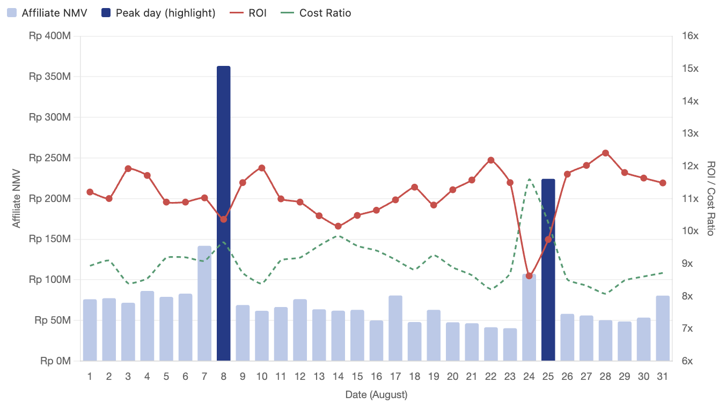
Monthly Review August 2026
Shopee Affiliates Performance (Upper Funnel)
Affiliate NMV grew +10.84% MoM to Rp2.54B, and Scott's is the real engine — growing nearly 3x the portfolio's overall rate.
Month | Affiliate NMV | Commission | ROI | Cost Ratio | Affiliates with Sales | Cont. to Store
July 2026 | 2,287,779,020 | 207,257,691 | 11.04 | 9.06% | 4,992 | 39.00%
August 2026 | 2,535,803,556 | 234,477,347 | 10.81 | 9.25% | 4,949 | 42.00%
Growth | 10.84% ▲ | 13.13% ▲ | -2.03% ▼ | 2.07% ▲ | -0.86% ▼ | 7.69% ▲
Month | DD NMV | DD Affiliate with Sales | Cont. to Store | PayDay NMV | PayDay Affiliate with Sales | Cont. to Store
July 2026 | 317,430,894 | 1,113 | 30.00% | 192,449,903 | 596 | 35.00%
August 2026 | 363,247,772 | 1,114 | 38.00% | 224,315,683 | 671 | 39.00%
Growth | 14.43% ▲ | 0.09% ▲ | 26.67% ▲ | 16.56% ▲ | 12.58% ▲ | 11.43% ▲
Key Highlights
Affiliate NMV +10.84% MoM — as established, roughly 80% of this increase traces to one creator, tonixzx, breaking out via Live/Scott's.
Scott's is driving disproportionate growth — its revenue jumped +31.93% MoM, nearly 3x the portfolio's overall growth rate, and its Order volume grew +33.63%.
Affiliates with Sales declined slightly overall (-0.86%), meaning growth is concentrated in existing affiliates transacting more, not a widening base — most visible in Scott's, where Revenue/Affiliate jumped +30.3% while affiliate count grew just +1.3%.
DD's growth is concentration-driven (same ~1,114 affiliates, way more revenue each), while Payday's growth is participation-driven (+75 more affiliates with sales) — genuinely different patterns worth tracking separately.
Notes:
What Needs Improvement (Key Actions)
Build a retention mechanism for creators active in month N to reduce the ~70% monthly churn rate — this is currently the single biggest drag on sustainable growth.
Diagnose why PayDay-specific affiliate participation dropped so sharply and refresh incentive mechanics ahead of August.
Treat tanggal kembar as a proven lever: lock in August/September double-date campaigns and creator commitments earlier to replicate the July 7 spike.

Slide 17
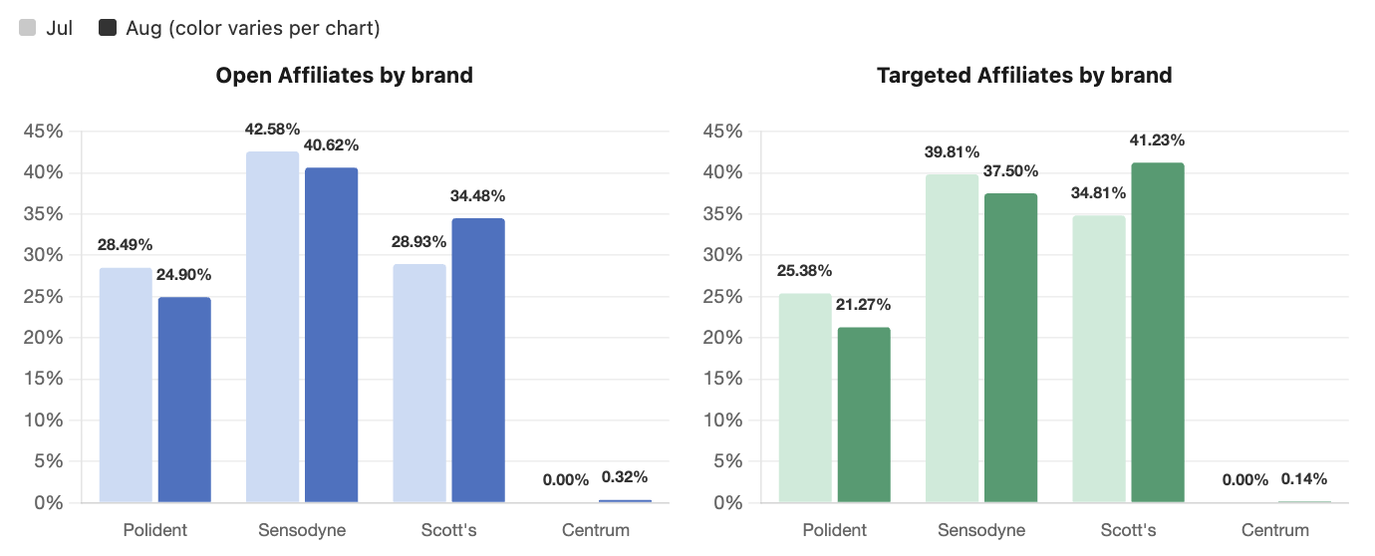
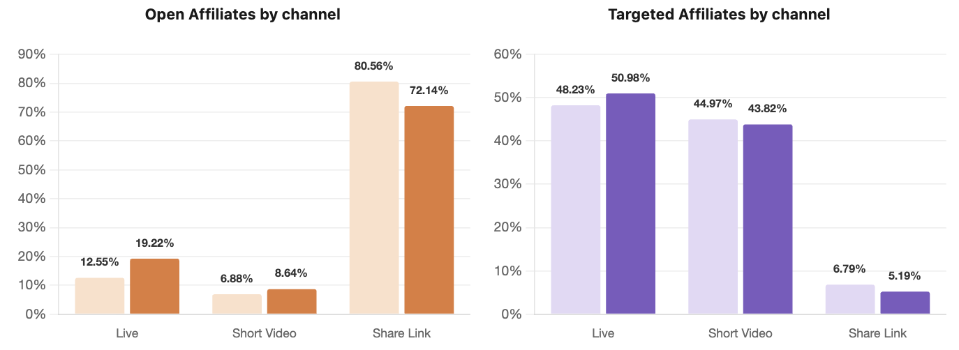
Monthly Review August 2026
Shopee Affiliates Performance (Lower Funnel)
Live is the standout funnel (+39.55% MoM), driven specifically by Scott's — which now holds 11 of 29 Top-tier affiliates, confirming its Live-content push is the story behind this month's lower-funnel gains.
Month | Open NMV | Open Affiliates with Sales | Open Cont. | Targeted NMV | Targeted Affiliates with Sales | Targeted Cont.
July 2026 | 1,592,664,159 | 4,908 | 69.62% | 695,114,861 | 120 | 30.38%
August 2026 | 1,718,712,584 | 4,859 | 67.78% | 816,989,175 | 117 | 32.22%
Growth | 7.91% ▲ | -1.00% ▼ | -2.64% ▼ | 17.53% ▲ | -2.50% ▼ | 6.04% ▲
Month | Live NMV | Live Affiliates with Sales | Video NMV | Video Affiliates with Sales | Share Link NMV | Share Link Affiliates with Sales
July 2026 | 535,194,121 | 144 | 422,225,690 | 502 | 1,330,359,209 | 4,354
August 2026 | 746,863,866 | 131 | 506,606,690 | 519 | 1,282,333,000 | 4,312
Growth | 39.55% ▲ | -9.03% ▼ | 19.98% ▲ | 3.39% ▲ | -3.61% ▼ | -0.96% ▼
Key Highlights
Targeted Affiliates revenue +17.53% with fewer affiliates (-2.5%) — same tonixzx effect, likely sitting in the Targeted tier.
Live Revenue +39.55%, but Affiliates with Sales fell -9.03%. Two things happened simultaneously: kazemyattharaa (Rp63.8M in July, the #4 creator that month) churn entirely from August's top creator list, while tonixzx more than made up for that loss and then some. Net effect: fewer Live affiliates overall, but dramatically higher output from the ones still there.
Live Sessions grew +18.56% (749→888) — genuine increased activity, not just one creator's efficiency; some of this is likely tonixzx going live more often, but the session count growing faster than the affiliate count staying flat/declining suggests existing Live creators broadly did more sessions this month.
Notes:
What Needs Improvement (Key Actions)
Sustain and formalize the Live/Video focus with channel-specific Targeted KPIs, since the strategy is already validated by this month's results.
Treat Share Link as a complementary, promo-driven channel rather than a growth lever — separate its budget/incentive logic from Live/Video.
Build a more structured promo/voucher calendar (tanggal kembar, payday) for Share Link to keep it stable without competing for Targeted-focused resources.

Slide 18
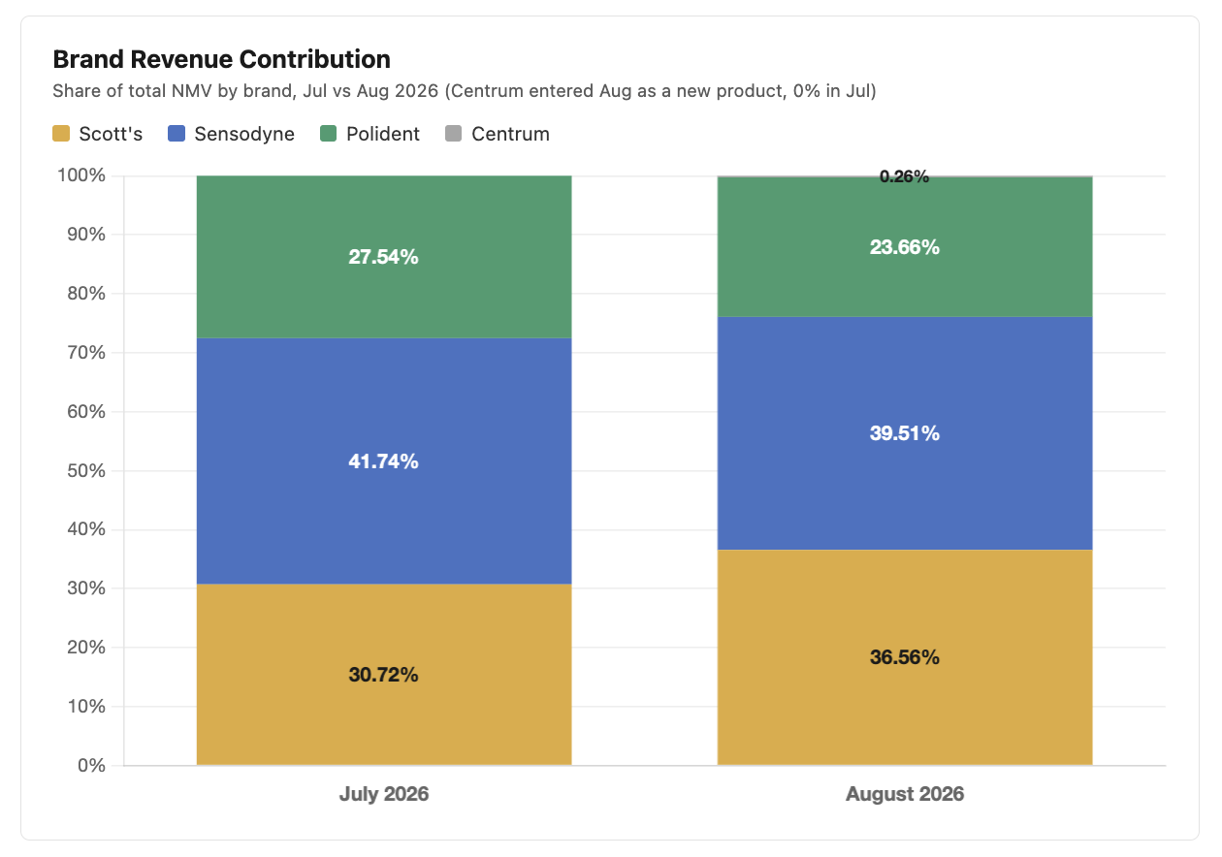
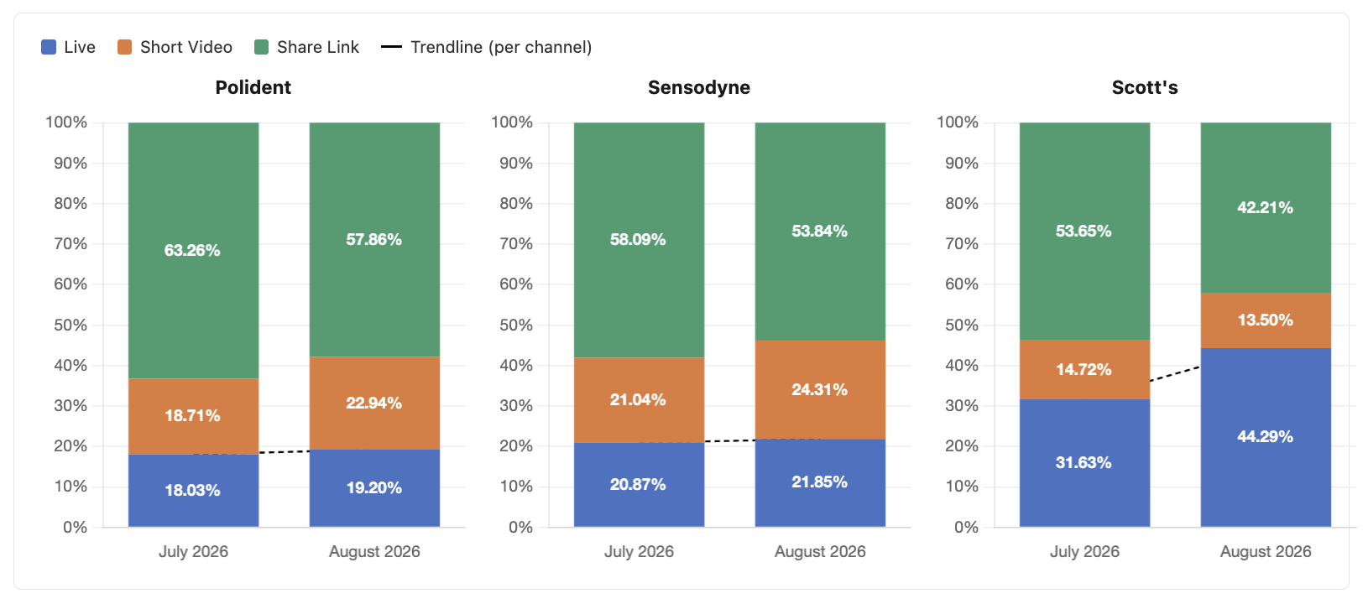
Monthly Review August 2026
Shopee Affiliates Performance (Lower Funnel)
Scott's grew on pure volume, Sensodyne grew despite selling fewer items (a pricing effect), and Polident's decline is actually a basket-size problem, not a demand problem.
Month | Polident NMV | Polident Affiliates with Sales | Sensodyne NMV | Sensodyne Affiliates with Sales | Scott's NMV | Scott's Affiliates with Sales
July 2026 | 630,165,466 | 1,341 | 954,892,054 | 3,112 | 702,721,500 | 1,793
August 2026 | 600,060,277 | 1,301 | 1,001,928,146 | 3,101 | 927,080,069 | 1,816
Growth | -4.78% ▼ | -2.98% ▼ | 4.93% ▲ | -0.35% ▼ | 31.93% ▲ | 1.28% ▲
Centrum Performance
NMV | 6,633,267
Commission | 393,572
ROI | 16.9
Cost Ratio | 5.93%
Affiliate with Sales | 39
Key Highlights
Scott's (+31.93%) is a pure volume story — Item Sold and Order both grew ~32%, ASP stayed flat — consistent with tonixzx driving more transactions, not a pricing shift
Sensodyne (+4.93%) grew despite Item Sold falling -4.49% — ASP rose +9.85%, a mix/pricing effect, not a demand increase
Polident (-4.78%) is a basket-size problem, not a traffic problem — Order actually grew +3.39%, but ASP (-4.87%) and ABS (-7.90%) both fell, meaning each transaction is worth less
Centrum's launch was efficient — Rp6.7M NMV, 16.9x ROI from just 39 affiliates.
Notes:
What Needs Improvement (Key Actions)
Prioritize Scott's inbound/SLA fixes as the direct lever for brand recovery — this is a supply chain fix, not a marketing or creator-activation fix.
Given the narrow SKU base, consider building safety stock buffers specifically for Scott's variants (especially Original) to reduce the blast radius of future OOS events.
Keep leaning on Mega Affiliate matchmaking (Slide 16) as a short-term offset while inbound is stabilized — but flag it clearly as a bridge, not a fix, since it can't compensate for a fundamentally unavailable SKU.

Slide 19
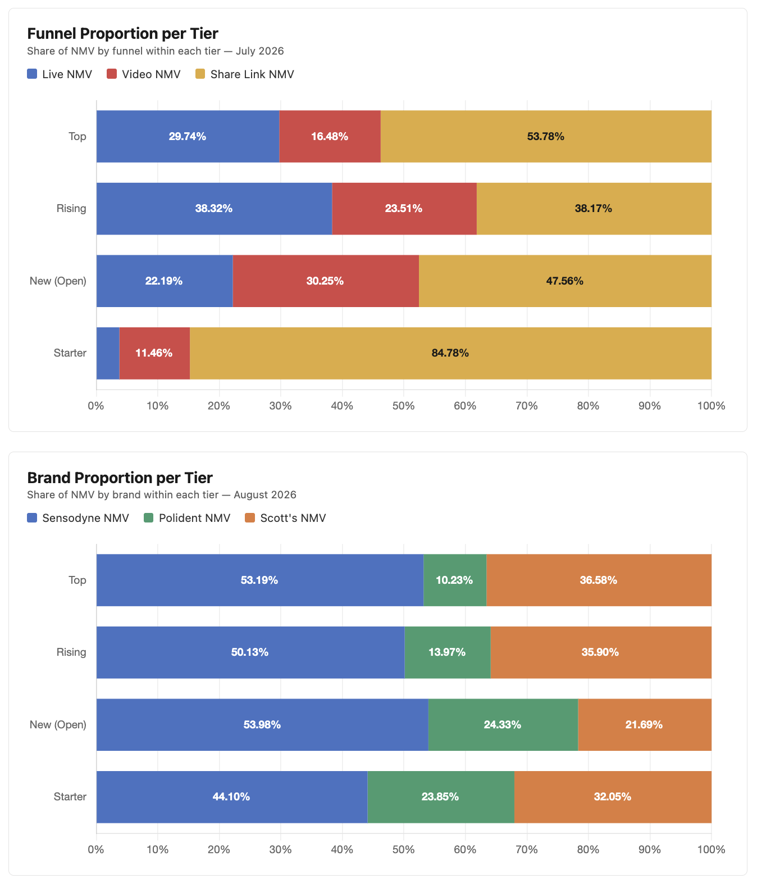
Monthly Review August 2026
Shopee Affiliates Performance (Rank Up Program)
Top & Rising tiers both grew solidly, with Scott's now holding 38% of Top-tier affiliates — but the New (Open) tier, the pipeline feeding tomorrow's Top/Rising, actually shrank.
Rank | Target Baseline (Start) | Target Baseline (End) | Affiliate with Sales |  |  | NMV
 |  |  | Jul | Aug | Growth | Jul | Aug | Growth
Top | 15,000,000 |  | 25 | 29 | 16.00% ▲ | 1,081,082,493 | 1,266,378,817 | 17.14% ▲
Rising | 5,000,000 | 14,999,999 | 34 | 39 | 14.71% ▲ | 303,764,608 | 354,601,447 | 16.74% ▲
New (Open) | 1,000,000 | 4,999,999 | 171 | 156 | -8.77% ▼ | 345,789,339 | 333,605,947 | -3.52% ▼
Starter | 1 | 999,999 | 4,762 | 4,725 | -0.78% ▼ | 557,142,580 | 581,217,345 | 4.32% ▲
Overall |  |  | 4,992 | 4,949 | -0.86% ▼ | 2,287,779,020 | 2,535,803,556 | 10.84% ▲
Key Highlights
Top tier grew +16% in count, +17% in NMV — Scott's now holds 38% of Top-tier affiliates (11 of 29), reflecting tonixzx's rise into the highest bracket.
Rising tier nearly matched Top's pace (+15% count, +17% NMV) — but it's unclear if this came from New-tier graduations or Top-tier affiliates sliding down.
New (Open) tier declined on both fronts (-8.8% count, -3.5% NMV) — the direct feeder into Rising, worth watching closely.
Polident holds just 3 of 29 Top-tier affiliates (10%) — the brand most at risk of losing relevance at the highest tier.
Notes:
What Needs Improvement (Key Actions)
Double down on Live as the primary growth channel across all tiers — it's the only channel with consistently strong growth from Starter through Top.
Investigate what's driving Video's concentration at Top tier specifically, and test whether that playbook (creator type, content format) can be replicated to lift Video at Rising/New/Starter.
For Starter-tier retention (see churn analysis above), pair retention incentives with Live-specific onboarding, since Starter creators already show strong Live growth momentum — the gap is keeping them active, not activating them on the right channel.
Let Share Link's growth at New (Open) run its course as a natural on-ramp, but design nudges to accelerate the transition to Live once creators move past New into Rising.

Slide 20
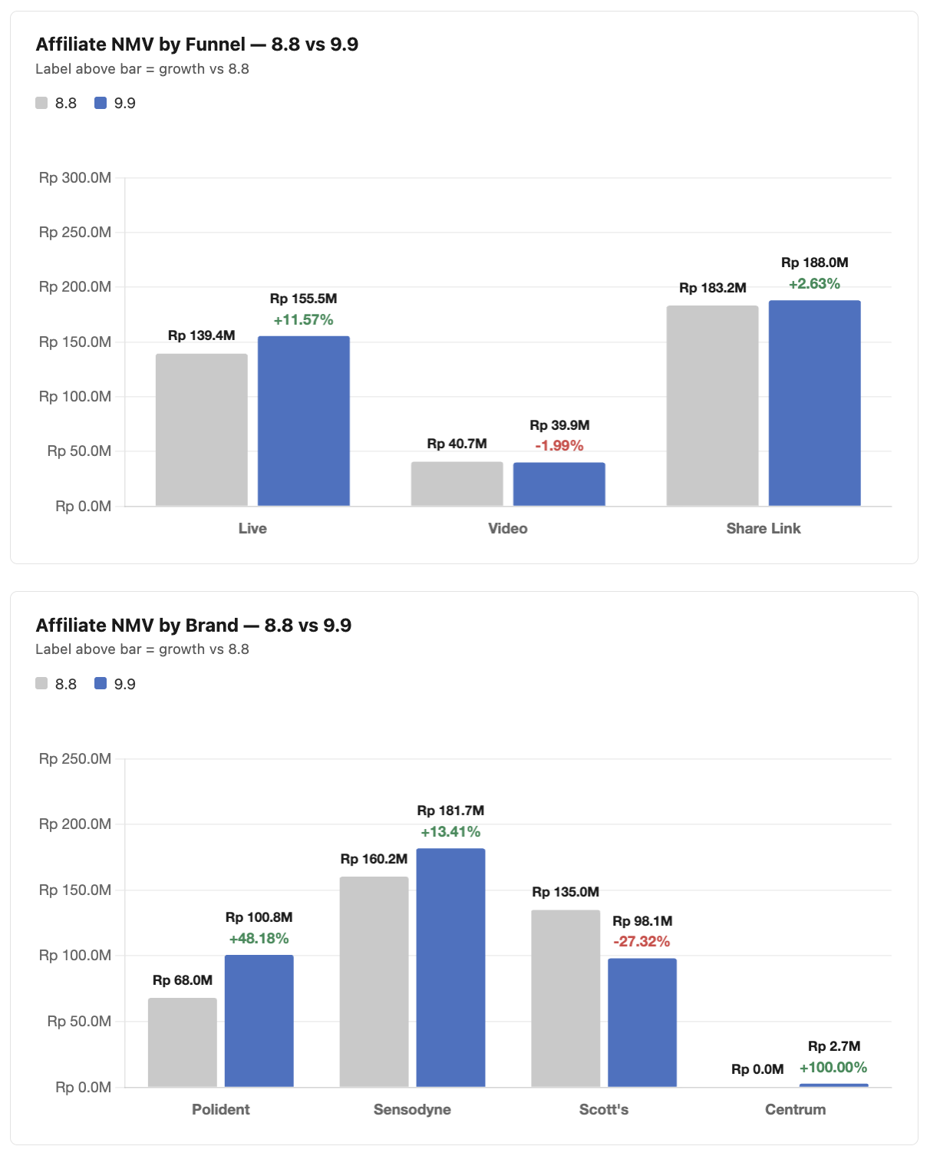
Monthly Review August 2026
Shopee Affiliates Performance (9.9 Performance)
9.9 outperformed 8.8 overall, but Polident had a breakout day (+48%) while Scott's fell sharply (-27%).
Date | Affiliate NMV | Commission | ROI | Cost Ratio | Affiliates with Sales
8.8 | 363,247,772 | 35,062,700 | 10.36 | 9.65% | 1,114
9.9 | 383,383,861 | 38,769,267 | 9.89 | 10.11% | 1,286
Growth | 5.54% ▲ | 10.57% ▲ | -4.55% ▼ | 4.76% ▲ | 15.44% ▲
Key Highlights
Overall NMV +5.54%, with Affiliates with Sales up a stronger +15.44% — more participants.
Polident had a breakout day (+48.18%) — a sharp reversal from its ongoing monthly decline, worth digging into for a repeatable fix.
Scott's fell -27.32%, likely because OOS on Scott’s original variant.
Live was the strongest funnel (+11.57%), Video was flat (-1.99%), Share Link grew modestly (+2.63%)
Notes:
What Needs Improvement (Key Actions)
Expand matchmaking slots for Sensodyne and Polident, which currently get minimal matchmaking support despite being the brands with stronger organic fundamentals to build on.
Set a visibility flag on Scott's performance excluding matchmaking-driven NMV, so the team can track whether the underlying brand issue (Slide 14) is actually improving or just being masked.

Slide 21
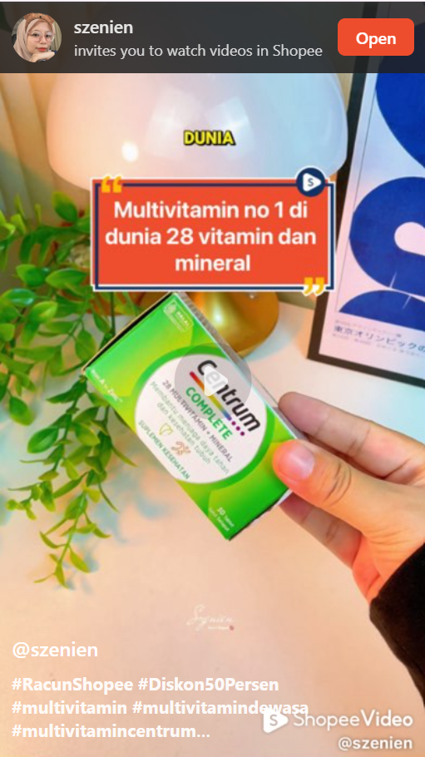
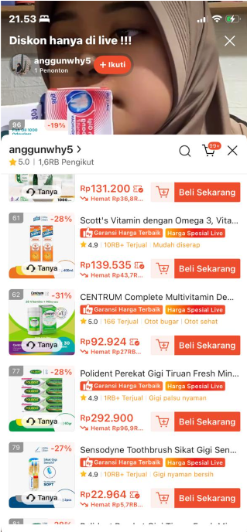
Monthly Review August 2026
Shopee Affiliates Performance (Centrum Recap)
Key Highlights
Top-Selling Video: Centrum’s highest-performing sales video was driven by a Product Knowledge-focused content approach, highlighting product benefits and information to support purchase consideration.
Shopee Video Performance: The video generated Rp171K in sales with 2,000+ views, showing potential for product education content to drive conversion.
Live Streaming: Centrum was also included in HSL (Haleon Super Live) sessions to increase product exposure and leverage live commerce opportunities.
Video with Sales
Rp 171,000
Views
> 2000
Live Streaming session
Notes:
What Needs Improvement (Key Actions)
Expand matchmaking slots for Sensodyne and Polident, which currently get minimal matchmaking support despite being the brands with stronger organic fundamentals to build on.
Set a visibility flag on Scott's performance excluding matchmaking-driven NMV, so the team can track whether the underlying brand issue (Slide 14) is actually improving or just being masked.

Slide 22
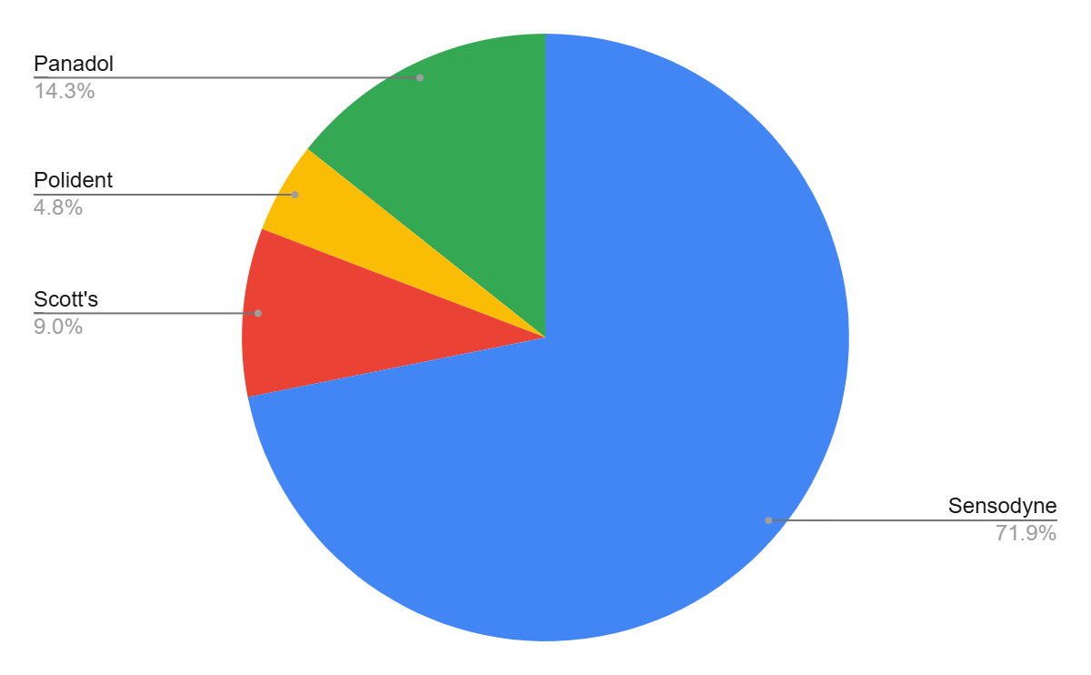


B2B Overview
Overall Performance
Overall achievement at 70%, month-on-month growth -46% (-Rp1.85 bio)
Platform Performance
Platform | Target | Actual PO | Ach (%)
ALLO FRESH | 4,000,000 | 8,578,080 | 214%
LAZADA | 45,000,000 | 66,970,296 | 149%
BLIBLI | 50,000,000 | 60,969,630 | 122%
GRAB MART | 24,000,000 | 27,834,320 | 116%
SEGARI | 40,000,000 | 38,652,885 | 97%
VITAMIN DISKON | 30,000,000 | 26,159,653 | 87%
FARMAKU | 1,062,815,679 | 878,665,668 | 83%
SAYURBOX | 5,000,000 | 3,702,960 | 74%
KAP | 50,000,000 | 36,607,516 | 73%
PYRIDAM | 3,000,000 | 2,111,220 | 70%
ASTRO | 700,000,000 | 424,770,134 | 61%
SHOPEE | 694,184,321 | 220,054,392 | 32%
Non OTC | 2,708,000,000 | 1,795,076,755 | 66%
ASTRO | 270,000,000 | 289,221,269 | 107%
SEGARI | 20,000,000 | 11,188,217 | 56%
OTC | 290,000,000 | 300,409,486 | 104%
HALEON TOTAL | 2,998,000,000 | 2,095,486,241 | 70%
Sales Contribution on Brand Level
Key Insights
-46%
Month-on-month decreased. Compared July at Rp3.6 Bio
Sensodyne remains the main sales contributor at 71%.
Vitamin Discount sell in continue to increase month over month.

Slide 23



B2B Overview
Top 10 SKU August (Revenue Driver)
Rank | Product Name | Revenue | Contr (%)
1 | Sensodyne Sensitif Repair&Protect Advanced Care Whitening 100gr | 585,289,612 | 27.93%
2 | Sensodyne Pasta Gigi Sensitif Essensial Care Whitening 100gr | 203,434,434 | 9.71%
3 | Sensodyne Pasta Gigi Sensitif Repair and Protect Original 100g | 139,171,474 | 6.64%
4 | Sensodyne Sensitif Repair&Protect Advanced Care Extra Fresh 100gr | 126,903,654 | 6.06%
5 | SCOTTS EMUL ORIG X400ML_HIGHLANDER ID | 125,350,524 | 5.98%
6 | PANADOL EXTRA TABLET 65/500MG 10X10 | 98,628,109 | 4.71%
7 | PANADOL TABLET 500MG 1X100 | 88,334,879 | 4.22%
8 | Sensodyne Pasta Gigi Sensitif Essensial Care Fresh Mint 100gr | 77,438,959 | 3.70%
9 | PANADOL COLD&FLU CAPLET 1X100 | 70,617,645 | 3.37%
10 | Sensodyne Pasta Gigi Sensitif Essensial Care Multi Action 100gr | 51,860,580 | 2.47%
TOTAL REVENUE TOP 10 SKU |  | 1,567,029,870
GMV August |  | 2,095,486,266
CONTRIBUTION TOP 10 SKU |  | 74.79%
Key Insights
Sensodyne SRP & Essensial become top 5 due to the huge demand coming from Farmaku.
Sensodyne, Scott’s, and Panadol became the top brand revenue drivers from 10 main revenue driver skus.
Out of 46 SKUs, these 10 SKUs covered 74% of the Revenue.

Slide 24

B2B Overview
B2B Fulfillment August
A month-on-month improvement in SLA from AnyMind to Platforms.
SLA from PPG to AnyMind
List of Unfulfilled SKUs (PPG to AnyMind)
Nama Barang | QTY PO CRT | Qty GR | SLA | Contribution
SCOTTS EMUL ORIG X400ML_HIGHLANDER ID | 371 | 141 | 38.01% | 13.81%
SENSODYNE TP CAVITY SENS 40G | 7 | 3 | 42.86% | 0.29%
SENS TB ULTRA SENSITIVE EX SOFT X2 | 23 | 10 | 43.48% | 0.98%
POLIDENT FLAVOUR FREE CREAM 1X60G_ID | 9 | 4 | 44.44% | 0.39%
SENSODYNE MULTI ACTION TB SOFT 1X1 | 30 | 18 | 60.00% | 1.76%
SENS TB SENSI SOFT 1X2 | 20 | 13 | 65.00% | 1.27%
SCOTTS EMUL VITA X200ML_ID | 30 | 25 | 83.33% | 2.45%
SENSODYNE R+P WHITENING TP 1X100G | 352 | 340 | 96.59% | 33.30%
July | August | Growth
74% | 77% | +3pp
SLA from AnyMind to Platforms
July | August | Growth
99% | 99% | +0pp
Key Insights
AnyMind achieved its highest customer SLA fulfillment rate in July - Aug 2026 at 99%, driven by strategic stock buffering and customer demand forecasting.
Stable in fulfillment rate from AnyMind to platforms (99% SLA)
Increasing in FR PPG to AnyMind, but still need improvement regarding the forecast to Supply Chain

Slide 25
B2B Overview
Slow Moving SKU List
Nama Barang | Segmentation | SOH | DOI | SOH Value
SENSODYNE ORIGINAL FLUORIDE TP 1X100G | Super Low | 148 | 701 | 325,274,400
SENSODYNE MULTI ACTION TB SOFT 1X2 | Super Low | 15 | 450 | 43,756,200
Multi-Action Soft 3s | Super Low | 9 | 90 | 33,326,640
SENSODYNE HERBAL TP 1X100G | Super Low | 13 | 130 | 28,467,504
SENS TB ULTRA SENSITIVE EX SOFT X1 | Super Low | 11 |  | 17,582,400
Total Value |  | 448,407,144
Key Insights
Need more promotional activities on the highlighted yellow SKUs to accelerate stock flush-out

Slide 26
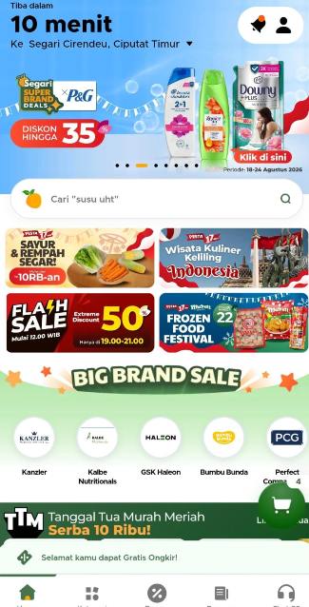
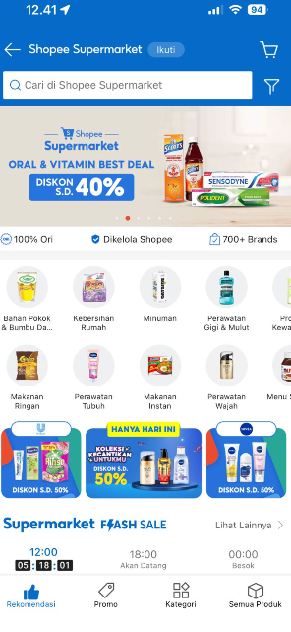
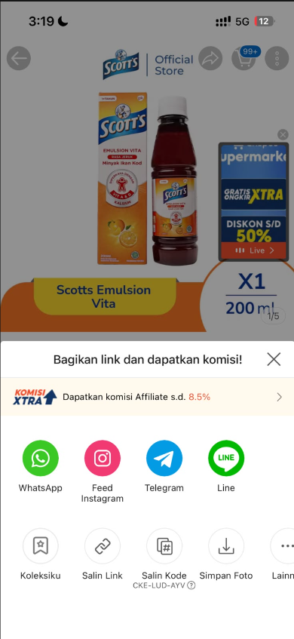
B2B Overview
Activations
Big Brand Sale Segari & Homepage Banner & Affiliate Shopee SPM
Big Brand Sale Segari
Homepage Banner Shopee SPM
Affiliate Shopee SPM

Slide 27

B2B Overview
Activations
Ads Performance Shopee Supermarket
Polident, Scotts, Sensodyne |  | Impressions | Clicks | Conversions | Item Sold | Ads Expense (IDR) | Ads GMV (IDR)
July Total |  | 347,737 | 10,061 | 1,734 | 938 | 7,738,138 | 65,552,100
August Total |  | 687,773 | 15,818 | 2,906 | 1,385 | 20,746,315 | 89,767,687
Growth |  | 97.79% | 57.22% | 67.59% | 47.65% | 168.10% | 36.94%
Polident, Scotts, Sensodyne |  | %CTR | %CR | ROAS | CPC
July Total |  | 2.79% | 20.38% | 5.12 | 1,237
August Total |  | 2.30% | 18.37% | 4.33 | 1,312
Growth |  | -17.56% | -9.86% | -15.43% | 6.06%

Slide 28
Agenda
Sell In & B2C Performance
B2C Marketing Activations
B2B Performance
Key Learnings and Initiatives for August
×
AnyMind Credential Deck
© AnyMind Group. All Rights Reserved.
CONFIDENTIAL
‹#›
© AnyMind Group. All Rights Reserved.
CONFIDENTIAL
‹#›

Slide 29



Key Learnings and Initiatives for September
Overall Initiatives
MWH SLA Improvements
Centrum Focus for Activation
OTC Improvement
Key Highlights
Improving Multi Warehouse forecast especially on Medan and Makasar, which from medan our SC Team revise the current forecast to December hoping to be improving the SLA on Multi Warehouse
Centrum still remains to be our top product focus, and pushed even more on lower Funnel by optimizing the GWP bundles on Live Streaming with Review and Win Promotion and Affiliate by increasing the Videos and Promoting using Mega Affiliate
For September, we're aiming to improve on a feature we haven't used before such as Search Ads, and will try to optimize it to capture even more traffic and GMV. Also to Improve the ATP to be better ever since we’re opening again

Slide 30
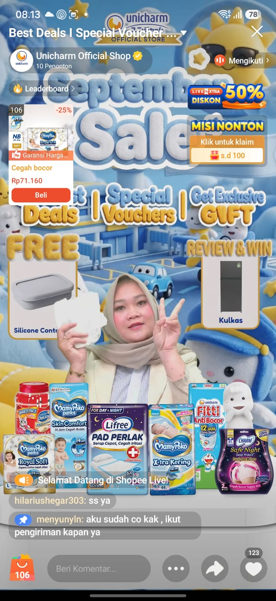
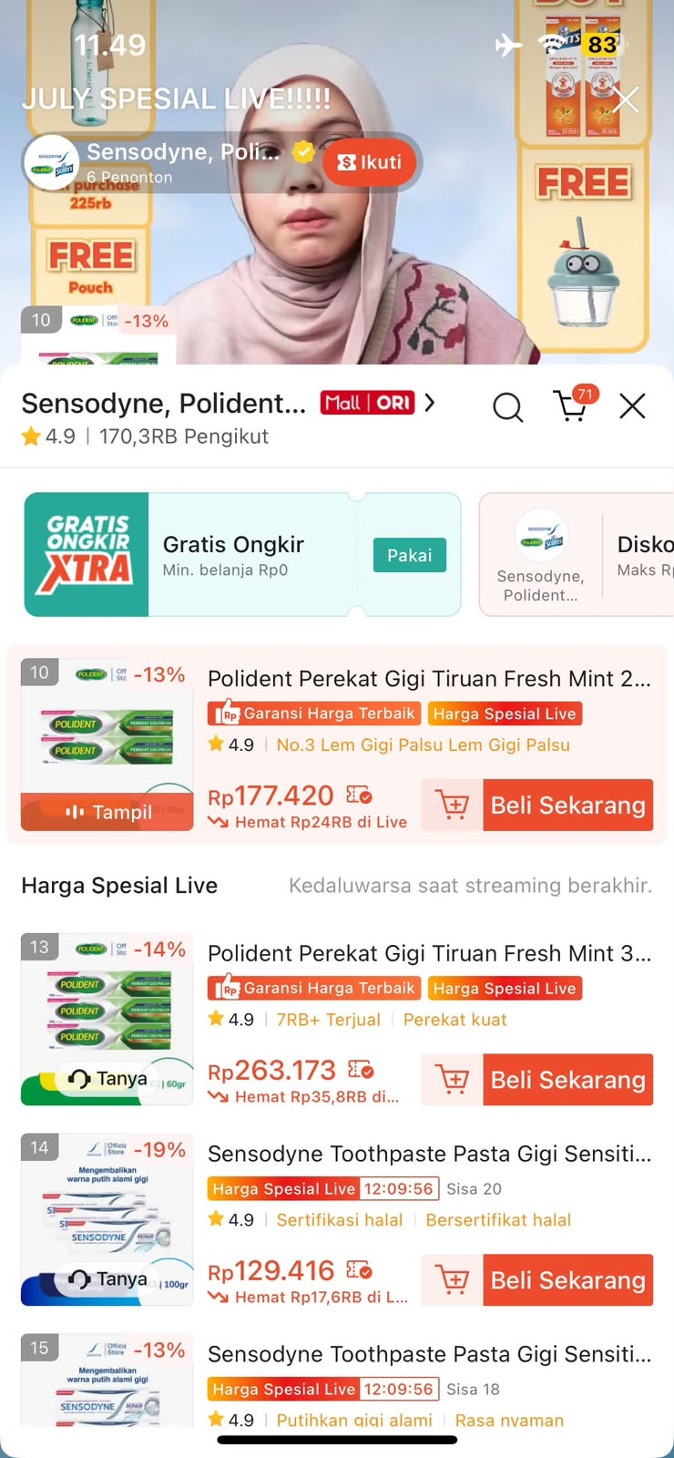
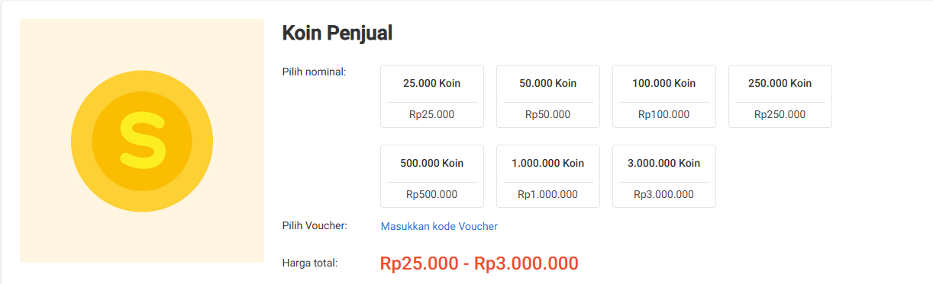
Key Learnings and Initiatives for Next Month
Livestream Initiatives
Utilize SHP Coins to Recover Traffic from lower LS Ads
Increase Viewers Engagement with Giveaways & TOP Spender
Highlight promoted SKU, GWP & Voucher
Key Highlights
Allocate Shopee Coins incentives during low-traffic livestream sessions and peakdays to re-engage audience, boost viewer retention, and recover performance from reduced LS ad spend, while SHP Coins incentives planned to activated following the Activations activity such as Giveaways to maximize CVR.
Drive viewer interaction and boost basket size by leveraging exclusive giveaway mechanics and TOP Spender rewards.
Maximize stream conversion rate by prominently displaying hero SKUs alongside Gift With Purchase (GWP) teasers and livestream-exclusive vouchers.

Slide 31
Key Learnings and Initiatives
Shopee Affiliates (Q4 Plan)
Affiliate Plan - Haleon Q4
Affiliate | Oct 2026 | Nov 2026 | Dec 2026 | Total
Overall Forecast
Total Creator | 42 | 83 | 42 | 167
# Total Video | 104 | 256 | 104 | 464
# Total Live Session | 200 | 300 | 200 | 700
Activation Budget | 93,000,000 | 161,000,000 | 93,000,000 | 347,000,000
Activation Plan Breakdown:
1. Mega Affiliate
# Total Creator | 2 | 3 | 2 | 7
# Total Live Session | 4 | 6 | 4 | 14
# Total Budget | 60,000,000 | 90,000,000 | 60,000,000 | 210,000,000
2. Short Video MCN
# Total Creator | 20 | 50 | 20 | 90
# Total Video | 100 | 250 | 100 | 450
# Total Budget | 20,000,000 | 50,000,000 | 20,000,000 | 90,000,000
3. Polident - Creator Incentive Live Full Month
# Total Creator | 10 | 15 | 10 | 35
# Total Live Session | 200 | 300 | 200 | 700
# Total Budget | 10,000,000 | 15,000,000 | 10,000,000 | 35,000,000
4. Personalized Target (Replicate)
# Total Creator | 10 | 10 | 10 | 30
# Total Live Session/Video | 0
# Total Budget | 10,000,000 | 10,000,000 | 10,000,000 | 30,000,000
5. Mass Program (Exclude Top Creator)
# Total Creator | 5 | 5 | 5 | 15
# Total Live Session/Video | 0
# Total Budget | 4,000,000 | 4,000,000 | 4,000,000 | 12,000,000
Key Highlights
Mega Affiliate: Collaborate with Shopee-managed top creators to unlock greater exposure, traffic, and potential buyers.
Short Video MCN: Scale MCN collaborations to drive more creator videos, unlock proven GMV drivers, and increase video GMV contribution.
Polident Incentive: Lock live creators to promote Polident consistently, targeting at least 20 live days per month.
Personalized Target: Continue the retention program with personalized targets to maintain top creator performance.
GMV Mass Program: Target non-top creators with a structured push to increase GMV and accelerate their progression toward higher tiers.
Notes:
What Needs Improvement (Key Actions)
Expand matchmaking slots for Sensodyne and Polident, which currently get minimal matchmaking support despite being the brands with stronger organic fundamentals to build on.
Set a visibility flag on Scott's performance excluding matchmaking-driven NMV, so the team can track whether the underlying brand issue (Slide 14) is actually improving or just being masked.

Slide 32
Thank You

Slide 33
APPENDIX

Slide 34
B2C Overall Performance
Brand Level Sell In B2C
Metrics | Sensodyne |  |  | Polident |  |  | Scott's
 | PO | GR | SLA | PO | GR | SLA | PO | GR | SLA
January | 2,372,811,000 | 2,321,319,500 | 98% | 1,091,659,300 | 992,945,500 | 91% | 693,376,300 | 311,500,900 | 45%
February | 4,371,048,300 | 4,032,911,600 | 92% | 2,203,846,200 | 1,728,164,400 | 78% | 1,442,524,800 | 1,392,455,400 | 97%
March | 2,600,800,800 | 1,935,764,500 | 74% | 1,698,862,200 | 1,566,001,800 | 92% | 689,514,800 | 631,180,900 | 92%
April | 2,118,785,000 | 1,967,489,500 | 93% | 2,221,843,300 | 1,593,215,800 | 72% | 848,295,200 | 805,924,700 | 95%
May | 2,798,267,600 | 2,795,033,700 | 100% | 2,101,076,300 | 1,886,554,400 | 90% | 2,472,388,000 | 1,786,591,100 | 72%
Total | 14,261,712,700 | 13,052,518,800 | 92% | 9,317,287,300 | 7,766,881,900 | 83% | 6,146,099,100 | 4,927,653,000 | 80%

Slide 35










Key Learnings and Initiatives
B2B Q2 Key Initiatives
Current channel has room for optimization
SEPTEMBER
Key Activities
1. Optimizing Current Channel & Expanding Accounts
2. New Product Listing
Target vs Actual PO
Target vs Actual PO
SPM Ads Budget Optimization
Nurturing Potential Smaller Accounts
Constants Search of New Revenue Streams

Slide 36
Sell In Performance
Sell In performance YTD Aug 2026
SLA still below 95% due to Multi Warehouse PO not fully fulfilled and Scott’s Original OOS Issue
Metrics | January | February | March | April | May | June | July | Aug | Total
Open PO | 7,110,378,200 | 11,322,996,900 | 8,075,786,600 | 6,297,000,800 | 8,336,606,500 | 7,050,034,400 | 12,988,402,800 | 10,784,806,800 | 71,966,013,000
Actual Inbound | 6,310,186,300 | 8,838,994,600 | 6,278,358,000 | 5,174,618,300 | 6,039,975,700 | 5,194,786,000 | 9,468,502,400 | 7,360,522,300 | 54,665,943,600
SLA | 89% | 78% | 78% | 82% | 72% | 74% | 73% | 68% | 76%
B2C JKT | 3,918,742,890 | 6,722,419,407 | 3,542,269,296 | 3,443,565,099 | 5,187,459,903 | 3,008,235,975 | 2,994,365,000 | 3,991,532,800 | 32,808,590,370
B2C SBY | 105,857,259 | 665,834,055 | 1,045,302,096 | 1,224,112,107 | 993,546,348 | 1,580,100,096 | 1,409,971,900 | 1,127,910,200 | 8,152,634,061
B2C MKS |  |  |  |  |  | 131,599,491 | 155,903,800 | 195,163,700 | 482,666,991
B2C MDN |  |  |  |  |  | 146,653,644 | 232,313,200 | 316,011,200 | 694,978,044
B2B | 2,684,420,400 | 2,182,910,400 | 2,145,410,800 | 969,503,700 | 471,501,600 | 810,471,400 | 4,675,948,500 | 1,729,904,400 | 15,670,071,200
Achievement | 111% | 109% | 88% | 70% | 82% | 68% | 121% | 91% | 92%
Key Highlights
Scott's Original OOS contributed to the lower SLA in August, along with unfulfilled POs at multiple warehouses such as Medan and Makassar, which further lowered the SLA. Medan and Makassar are currently growing by 4% and 3% respectively in August.
To improve SLA in September, we will coordinate with PPG on Scott's Original availability and will not place orders if the PPG is OOS. We've also shared the revised Medan forecast through December, hoping this will improve Medan's SLA.

