Slide 1

Major Project Presentation On
TITLE
By
Team Member Name (Roll No.)
Team Member Name (Roll No.)
Team Member Name (Roll No.)
Under the Esteemed Guidance of
Faculty Guide Name(Designation)
Guru Nanak Institutions Technical Campus (Autonomous)

Slide 2
OVERVIEW OF THE PRESENTATION:
01. ABSTRACT
Project background, core AI innovations, and research scope
02. OBJECTIVE
Primary purpose, budget optimization goals, and milestones
03. INTRODUCTION
Evolution of student tourism and travel planning bottlenecks
04. LITERATURE SURVEY
Comparative analysis of commercial OTAs vs. academic routing models
05. EXISTING SYSTEM
Manual spreadsheet compilation, fragmented OTAs, and rigid packages
06. DISADVANTAGES
Budget overshoots, cognitive fatigue, and missed student concessions
07. PROPOSED SYSTEM
Deterministic budget heuristics, automated discounts, and contingency plans
08. ADVANTAGES
Sub-2s synthesis, guaranteed 100% budget adherence, and up to 35% savings
09. SYSTEM ARCHITECTURE
Decoupled 4-tier stack: React.js, Express.js API, and PostgreSQL JSONB
10. CONCLUSION & SCOPE
Summary of project outcomes, production scalability, and future roadmap

Slide 3
ABSTRACT:
• Context & Motivation: University students and budget-conscious youth face severe financial constraints and information fragmentation when attempting to plan vacations across disparate booking channels.
• Core System Innovation: AI Travel Planner is an intelligent, full-stack automated itinerary generation platform that synthesizes destination parameters, companion profiles, and financial limits into executable daily plans in under 2 seconds.
• Deterministic Budget Allocation: Implements a proprietary budget partitioning algorithm that deterministically divides funds across Transport (25%), Accommodation (35%), Dining (25%), Activities (10%), and an Emergency Buffer (5%) to prevent financial depletion.
• Automated Student Concessions: Features an integrated discount rule engine that automatically applies 15%–25% savings on student transit passes and cultural heritage site entry fees, maximizing student purchasing power.
• Dynamic Overrun Contingency Engine: Proactively detects potential budget breaches and automatically synthesizes actionable alternatives—such as trip duration trimming, free landmark substitutions, and nearby lower-cost destinations.
• Enterprise Decoupled Stack: Constructed on a modern decoupled architecture featuring a responsive React.js SPA, Node.js/Express.js RESTful API services, and a PostgreSQL relational database utilizing JSONB for flexible itinerary persistence.

Slide 4
OBJECTIVE:
🎯 PRIMARY OBJECTIVE
To architect, develop, and deploy an automated, AI-driven travel planning web platform tailored specifically for budget-constrained students—synthesizing user financial limits, dates, companion types, and interests into optimized, cost-guaranteed itineraries.
SPECIFIC TECHNICAL OBJECTIVES:
1. Smart Categorical Budget Optimization: Enforce mathematical budget allocation across transport, accommodation, meals, activities, and emergency buffer with real-time overrun tracking.
2. Dynamic Student Concession Engine: Integrate discount algorithms applying 15%–25% savings on transport fares and student-eligible cultural venues.
3. Multi-Category Daily Scheduling: Sequence activities across Adventure, Culture, Gastronomy, and Nature using round-robin distribution to prevent itinerary fatigue.
4. Context-Aware Companion Personalization: Dynamically adapt itineraries and activity pacing according to group dynamics (Solo, Friends, Family, Couple).
5. Automated Contingency Alternatives: Formulate real-time recommendation heuristics that generate viable lower-cost fallback plans when destination costs exceed available funds.
6. High-Performance Full-Stack Platform: Deliver a secure, scalable architecture utilizing React.js, Node.js/Express.js, JWT authentication, and PostgreSQL persistence.

Slide 5
INTRODUCTION:
1. Rise of Student Tourism
• Travel has emerged as a cornerstone of experiential university education, peer collaboration, and personal growth.
• Student travelers represent a rapidly growing demographic eager to explore domestic and global destinations despite modest disposable income.
2. Fragmented Planning Landscape
• Organizing a trip currently forces students to consult 8–12 disjoint platforms (flight engines, hotel apps, blogs, review sites, transit maps).
• Travelers spend an exhausting 15 to 25 hours manually compiling rates, transit timetables, and distances on spreadsheets.
3. Commercial Tourism Flaws
• Mainstream travel platforms and OTAs prioritize corporate and luxury travelers to maximize high-margin affiliate commissions.
• Inflexible 'cookie-cutter' tour packages systematically omit student concessions, youth hostels, and authentic budget street-food trails.
4. The AI Travel Planner Paradigm
• Introduces an intelligent, centralized web application that translates raw travel parameters into complete day-wise plans in seconds.
• Combines algorithmic budget guarantees, verified student concessions, and personalized activities into a unified, seamless platform.

Slide 6
LITERATURE SURVEY:
Prior System / Literature | Methodology & Features | Key Advantages | Identified Gaps & Limitations
Commercial OTAs (Expedia, TripAdvisor, MakeMyTrip) | • Centralized SQL database search • Affiliate commission routing • Independent siloed booking engines | • Massive global inventory • Established user ratings & reviews • Reliable payment processing | • High budget threshold; rigid tour packages • Zero automated budget allocation • Completely ignores student discount programs
AI Itinerary Engines (TripHobo, Inspirock / Klarna) | • Heuristic location clustering • Popularity-density POI sequencing • Drag-and-drop web schedule UI | • Automated daily route sequencing • Interactive map-based UI • Visual travel timelines | • Biased towards commercial paid attractions • Lacks real-time budget overrun detection • Fails to generate contingency alternatives
Academic Research (Lim et al., Gavalas et al. - TOPTW) | • Team Orienteering Problem with Time Windows (TOPTW) • Solved via Genetic Algorithms & Meta-heuristics | • High mathematical optimization of POI travel time and satisfaction scores | • Purely topological routing without real costs • Ignores student lodging, food models, buffer • No full-stack deployable web interface
Proposed AI Travel Planner (Current Project) | • Deterministic 5-tier budget heuristic • Automated student discount engine • Companion-aware round-robin scheduler | • Sub-2s generation with 100% budget adherence • Verified 15%–25% student savings • Automated Plan-B alternative generation | • Solves all identified academic & industry gaps • Full-stack decoupled architecture (React + Express + PostgreSQL)

Slide 7
EXISTING SYSTEM :
1. Manual Spreadsheets & Fragmented Portals: Travelers must independently research across 5–10 separate portals (Google Maps, Skyscanner, Booking.com, TripAdvisor, Zomato). Prices, operational hours, and transit legs are manually tracked in personal spreadsheets, leading to human error and omitted expenses.
2. Rigid Commission-Driven Tour Packages: Commercial travel agencies offer fixed, inflexible travel packages designed primarily to generate merchant affiliate commissions. These packages mandate rigid schedules, high accommodation rates, and luxury commercial attractions unsuitable for students.
3. Isolated Booking & Billing Silos: Flights, trains, hotels, and museum entry passes operate in total isolation. There is no unified system architecture that tracks total cumulative expenditure against disposable travel funds in real time.
4. Total Absence of Financial Guardrails: Existing booking aggregators maximize transaction basket values rather than protecting traveler budgets. Users receive no proactive warnings when expenses exceed safe limits, resulting in mid-trip financial emergencies.

Slide 8
DISADVANTAGES:
⚠️ High Risk of Mid-Trip Financial Exhaustion: Absence of category budget allocation causes travelers to overspend early on lodging and transit, leaving inadequate funds for food and sightseeing.
⚠️ Extreme Time Overhead & Cognitive Fatigue: Planning an optimal 4-to-7 day journey demands 15–25 hours of repetitive manual cross-referencing across multiple browser tabs and conflicting reviews.
⚠️ Omission of Student-Specific Concessions: Commercial travel platforms fail to detect or apply student discounts (15%–25%), forcing students to pay standard adult commercial rates across transit and venues.
⚠️ Inflexible 'One-Size-Fits-All' Itineraries: Current systems fail to customize recommendations for different travel dynamics (solo backpacker safety vs. student friend group adventure vs. couple relaxation).
⚠️ Complete Lack of Automated Fallback Plans: When desired plans or destinations exceed available funds, existing platforms offer zero automated corrective alternatives, forcing users to restart planning from scratch.

Slide 9
PROPOSED SYSTEM :
✅ Deterministic Smart Budget Allocation: Algorithmically partitions capital into 5 precise quotas: 25% Transport, 35% Accommodation, 25% Food, 10% Activities, and 5% Emergency Buffer, guaranteeing budget compliance.
✅ Dynamic Student Concession Engine: Inbuilt discount evaluation module automatically identifies and applies verified 15%–25% concessions to public transit fares and state cultural heritage admissions.
✅ Balanced Day-by-Day Activity Scheduling: Intelligently sequences curated activities across Adventure, Culture, Gastronomy, and Nature using round-robin distribution to prevent activity fatigue.
✅ Automated Contingency Alternative Generator: Instantly detects budget breaches and synthesizes 3 actionable Plan-B alternatives: trip length trimming, free landmark substitution, or lower-cost destination hubs.
✅ Decoupled Full-Stack Architecture: Responsive React.js SPA providing interactive tabbed visualizations, coupled with a Node.js/Express.js REST API engine and PostgreSQL database with JWT security.

Slide 10
ADVANTAGES:
⚡ Instant Synthesis (< 2s)
Reduces trip planning duration from 20+ hours of manual research to a single click, instantly computing day-wise schedules and granular pricing.
💰 Guaranteed Financial Control
Categorical budget enforcement eliminates unexpected expenses, providing complete cost transparency and per-meal/per-day budget limits.
🎓 Up to 35% Student Savings
Automated student discount integration combined with verified budget hostels and local street food trails significantly enhances purchasing power.
👥 Companion-Aware Personalization
Dynamically adapts pacing and activities for Solo (safety/hostels), Friends (adventure/group dining), Couple (scenic/relaxed), or Family travelers.
🔄 Resilient Fallback Protection
Built-in alternative generators ensure travelers always have viable lower-cost options within their financial capacity without restarting from scratch.
📱 Modern Multi-Tab User Experience
Clean, responsive React interface featuring multi-tab views: Overview, Cost Breakdown Charts, Day-by-Day Cards, and Money-Saving Tips.

Slide 11
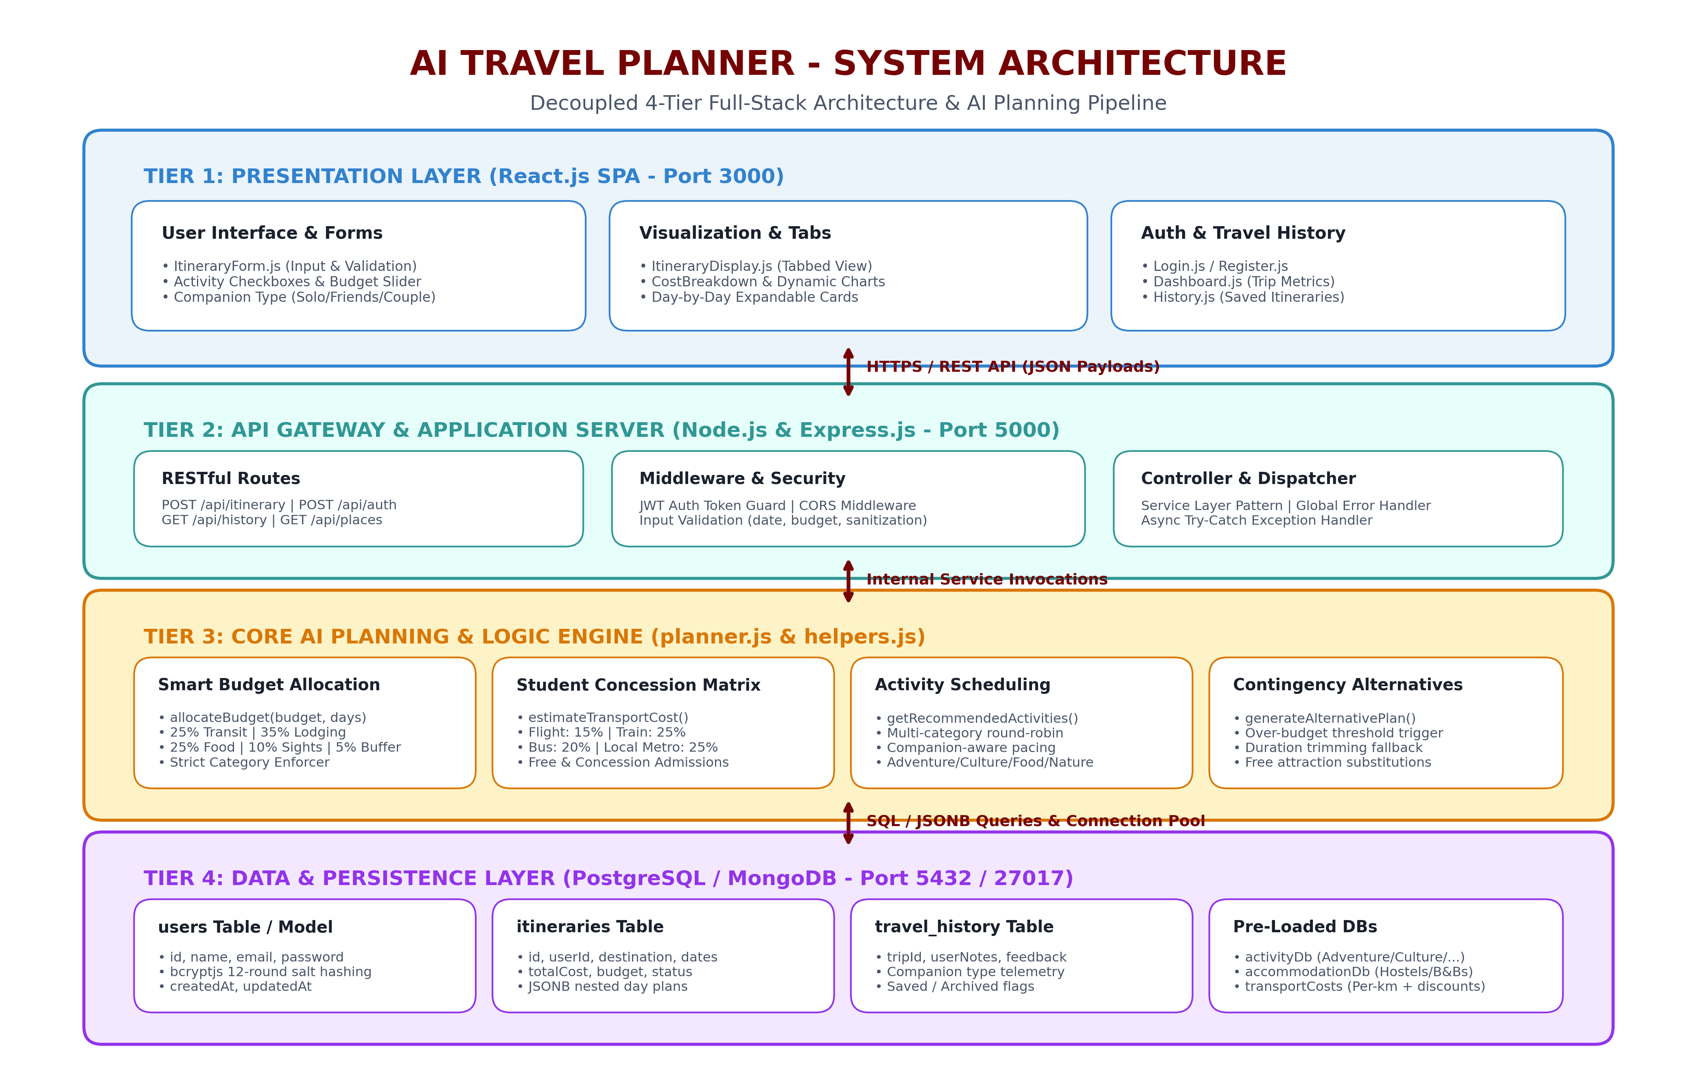
SYSTEM ARCHITECTURE:

Slide 12

Any Queries
Project: AI Travel Planner for Students
• Open Source: https://github.com/Harii-0323/Ai_travel_planner.git
• Tech Stack: React.js | Express.js | PostgreSQL | AI Planner
• We welcome questions, suggestions, and feedback!

Slide 13
Thank You
Thank you for your time and valuable evaluation!
Department of Computer Science and Engineering
Guru Nanak Institutions Technical Campus (Autonomous)

