Slide 1


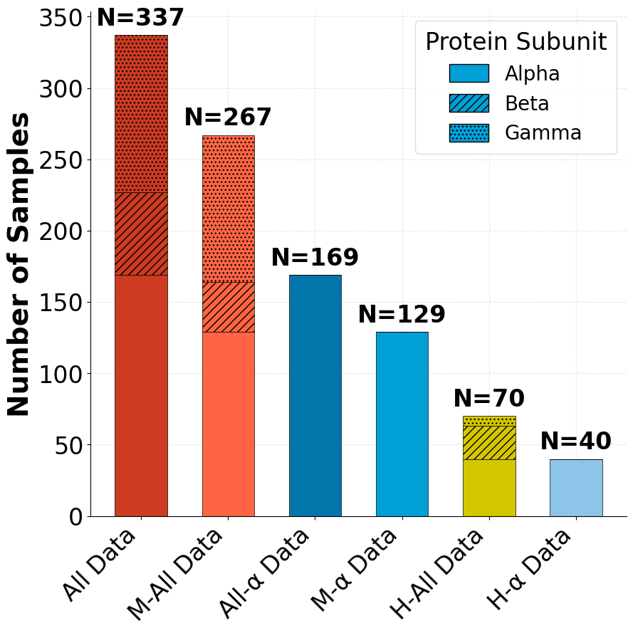
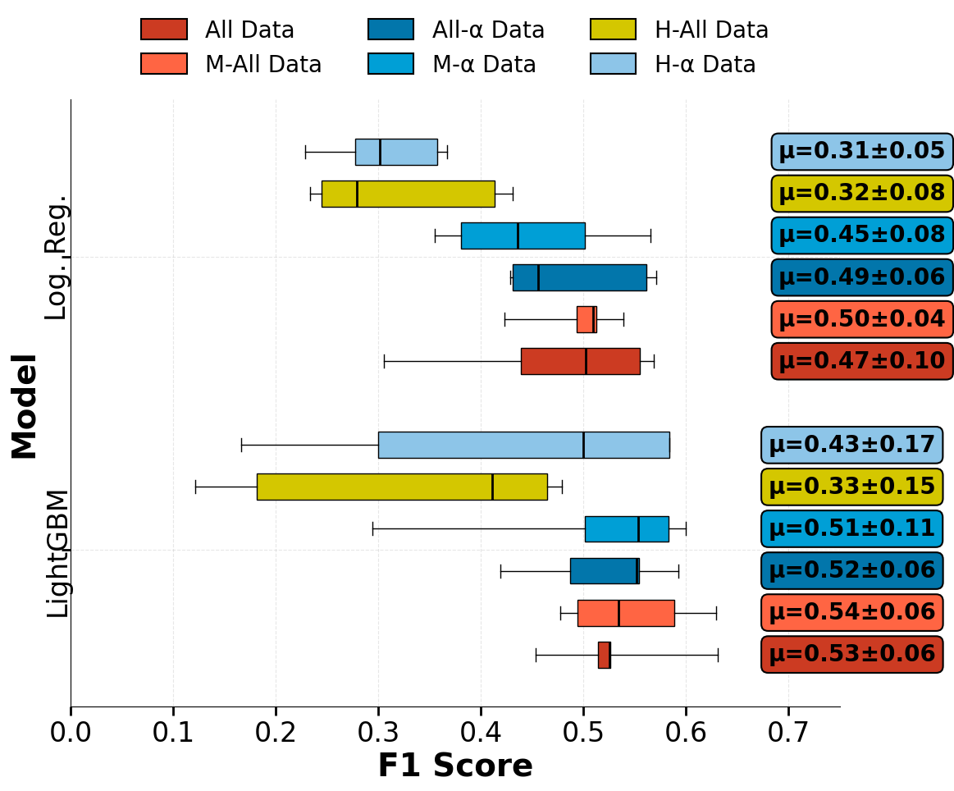
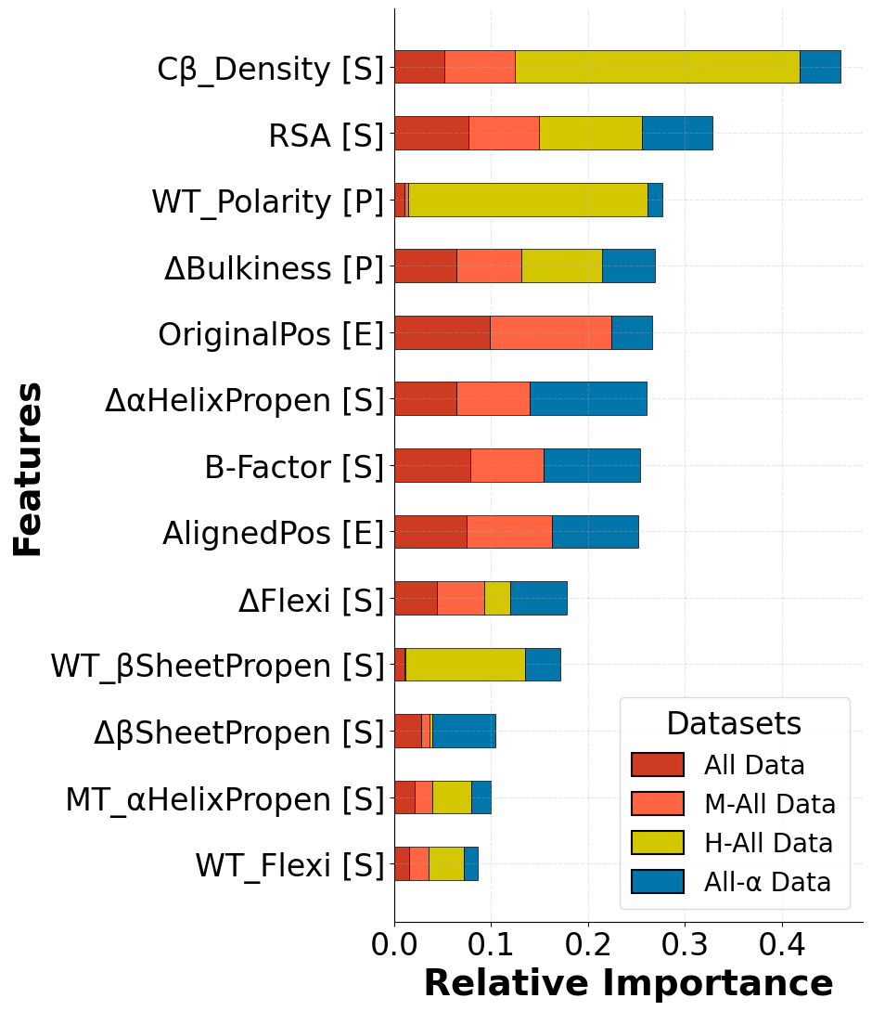
Department of Computer Science
Department of Natural Sciences
Impact of Data & Feature Scope on Variant Effect Predictors (VEPs) for epithelial sodium (ENaC) channels
Noah Plingen, Mike Althaus, Karl Kirschner, Karen Luján López
DFG GRANT: Project-ID 528562393 – FIP 26
1. Introduction
LightGBM is an open-source gradient boosting framework based on decision trees⁴. It is designed for efficiency and scalability in classification and regression tasks and provides built-in measures of feature importance.
Mutations in ENaC channels can substantially alter channel function and cause pathogenic phenotypes¹, but experimental characterization is resource- and time-intensive. Machine learning offers a fast, preliminary way to predict mutation-function relationships, yet choosing an appropriate data scope and feature set is challenging for sparse, heterogeneous datasets.
Because ENaC functional effects are directly measurable, they provide a useful testbed for variant effect prediction (VEP). This study examines how data scope and engineered feature scope affect multiclass functional prediction (Loss-of-Function, No-Net-Effect, Gain-of-Function) when training data are small and imbalanced. We focus on results from the best performing model architecture, LightGBM.
2. Methods
3. Dataset
Methods We trained Logistic Regression, Support Vector Machine, Random Forest and LightGBM models and chose the best performer for detailed investigation.
As input format we chose engineered features rather than raw amino-acid sequences. These features were computed from information such as mutation position, wildtype (WT) and mutant (MT) residues, yielding 38 input features with substantial intercorrelation.
Structural descriptors were derived from a human Cryo-EM structure file (PDB ID: 6BQN)². Performance estimates were obtained using stratified 5-fold cross-validation with hyperparameter tuning to address class imbalance and small sample size.
All models were trained on data compiled from 36 electrophysiology studies³, comprising 337 unique single amino-acid substitutions. From this set we defined six subsets differing in species and subunit scope. As presented in Table 1 and Table 2, all subsets exhibit pronounced class imbalance and limited size.
Code | Species | Subunit | LoF | NnE | GoF
All | Both | α/β/γ | 15% | 53% | 32%
M-All | Mouse | α/β/γ | 14% | 56% | 30%
H-All | Human | α/β/γ | 20% | 40% | 40%
All-α | Both | α | 14% | 34% | 51%
M-α | Mouse | α | 12% | 57% | 31%
H-α | Human | α | 22% | 32% | 45%
Tab. 1: Dataset composition incl. target distribution
Fig. 1: Comparison of dataset total and subunit count
4. Data Scope Impact
5. Feature Importance
The results shown in Figure 2 suggest that data size has the largest effect on performance stability (CV variance), but peak F1 score does not systematically scale with size.
Datasets with greater biological scope sometimes yield lower F1 despite larger N, likely because increased heterogeneity (species and subunit context) introduces complexity, raising modelling challenges. Thus, enriching VEP training datasets with related protein information can improve stability, but not significantly offset lack of data.
As shown in Figure 3, on the most stable dataset, LightGBM attributes the greatest importance to structural descriptors. Especially information about the structural burial of residues are valuable for effect prediction.
Structural descriptors derived from the human PDB (6BQN) contribute disproportionately to performance on human-only subsets, highlighting the value of high-quality, context-matched structural data.
Fig. 3: Feature Importance calculated by LightGBM’s gain function. Each bar represents importance across datasets while the bar segments indicate dataset contribution. Features are categorized as physiochemical [P], structural [S] or sequential/evolutionary [E].
Fig. 2: LightGBM and Logistic Regression F1 performance across all data subsets. Mean±Std are shown in boxes.
6. Conclusion
Under sparse-data conditions, pooling related proteins can reduce estimate variance and improve stability of model performance, but absolute predictive accuracy depends strongly on context-matched data and careful feature engineering. Structural descriptors (especially residue burial/solvent exposure) are particularly informative for human subsets.
Importantly, many engineered features are intercorrelated; multicollinearity can bias importance measures, so feature-importance results should be interpreted cautiously. These findings support prioritizing context-aware data and decorrelation/selection strategies (e.g., correlation filtering, forward selection) in future VEP efforts.
References
(1) R.A. Shimkets, R. Lifton, & C.M. Canessa (1998), In vivo phosphorylation of the epithelial sodium channel, Proc. Natl. Acad. Sci. U.S.A. 95 (6) 3301-3305
(2) S. Noreng, A. Bharadwaj, R. Posert, C. Yoshioka, I. Baconguis (2018) Structure of the human epithelial sodium channel by cryo-electron microscopy eLife 7:e39340
(3) Rotin D, Staub O. (2021), Function and Regulation of the Epithelial Na+ Channel ENaC. Compr Physiol;11(3):2017-2045. doi: 10.1002/cphy.c200012. PMID: 34061979.
(4) Ke, Guolin & Meng, Qi & Finley, Thomas & Wang, Taifeng & Chen, Wei & Ma, Weidong & Ye, Qiwei & Liu, Tie-Yan. (2017). LightGBM: A Highly Efficient Gradient Boosting Decision Tree.

