Slide 1
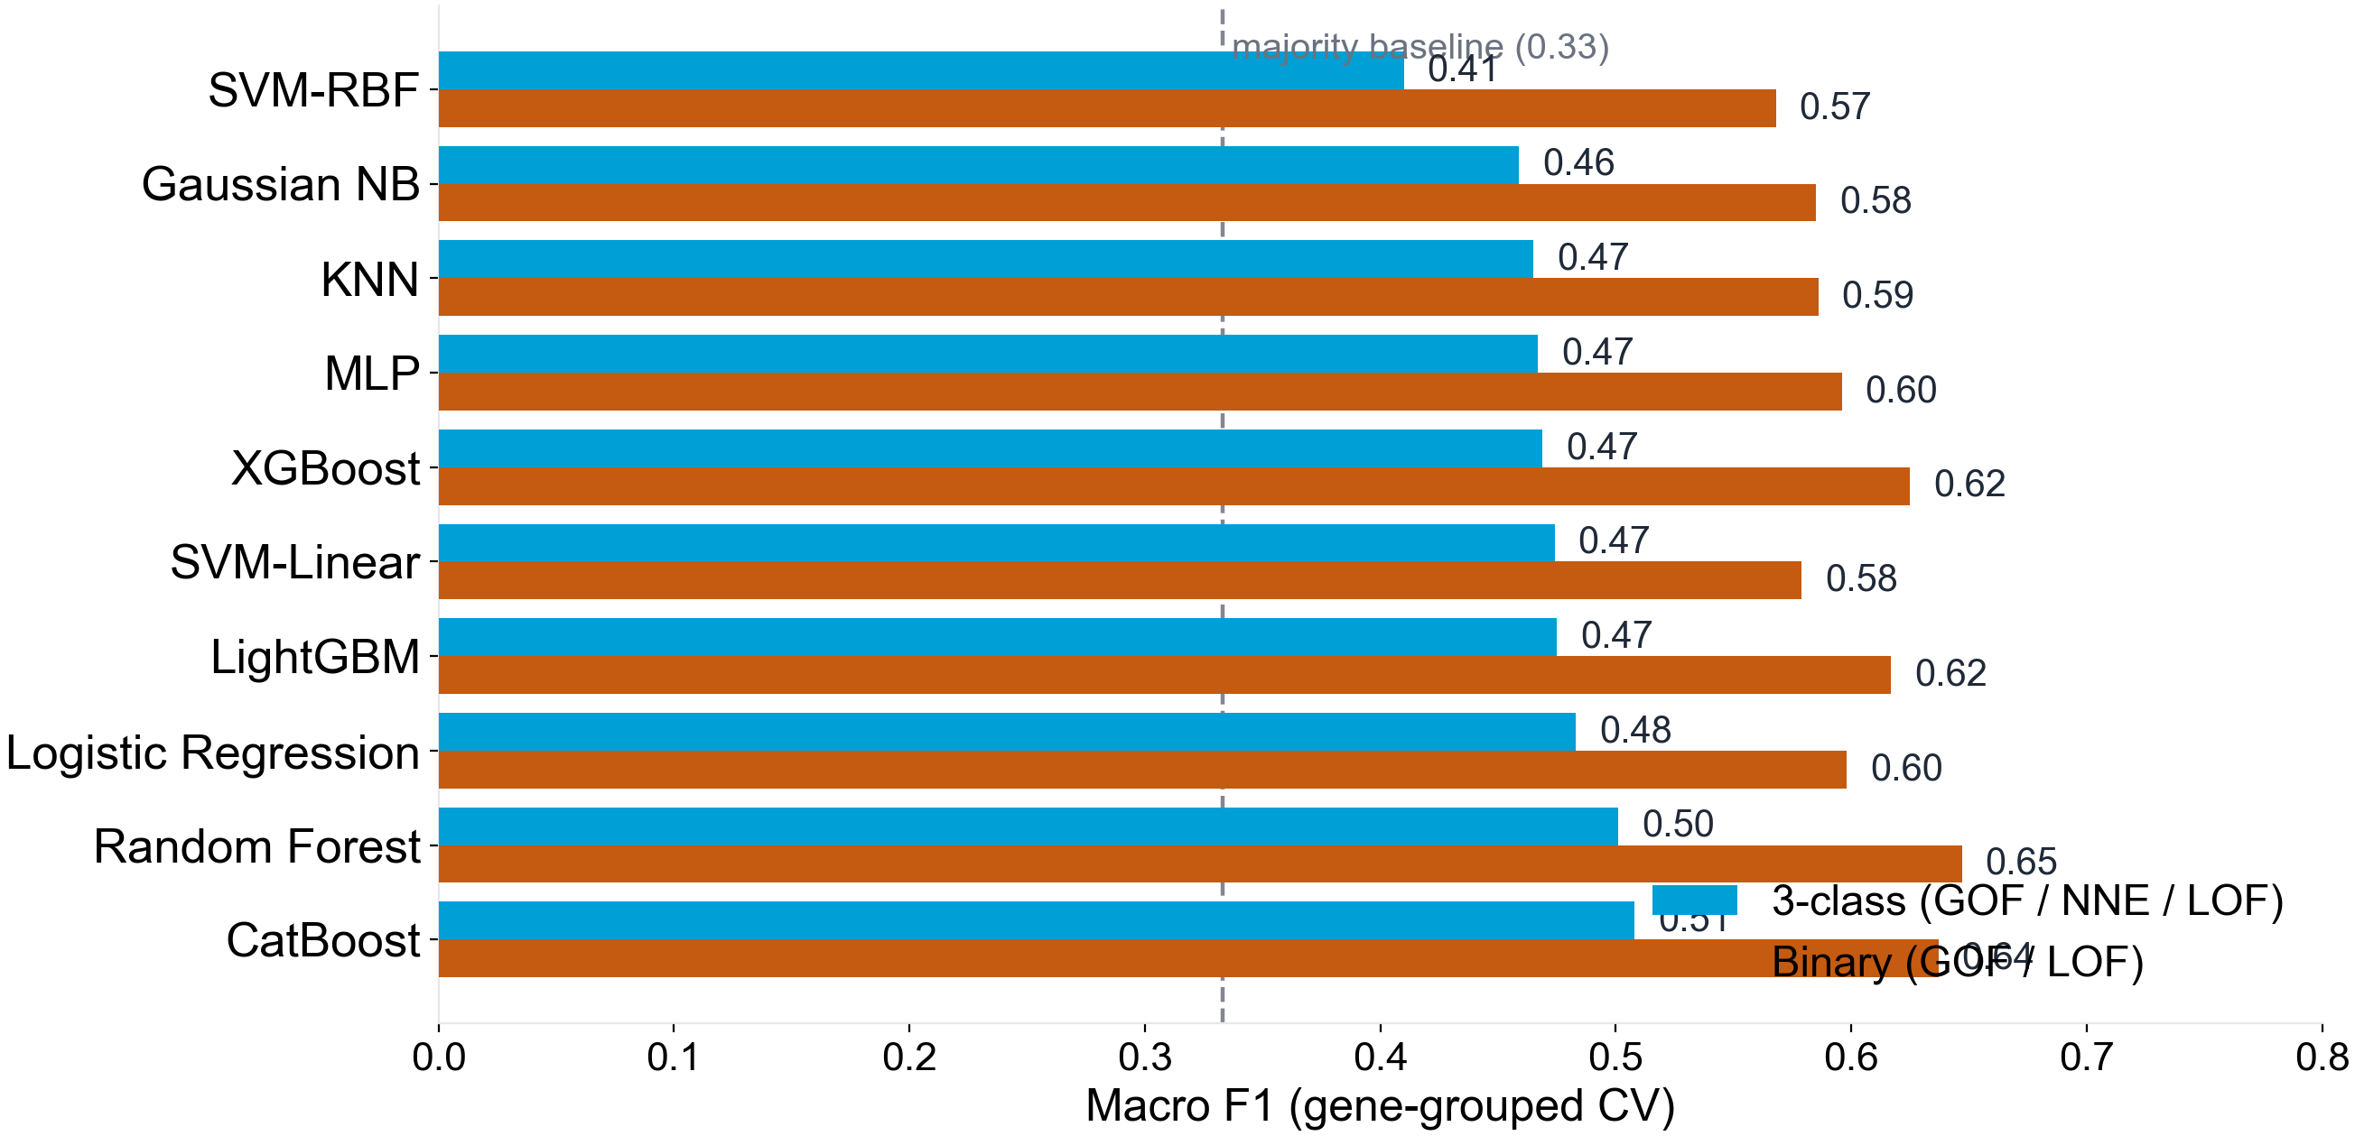
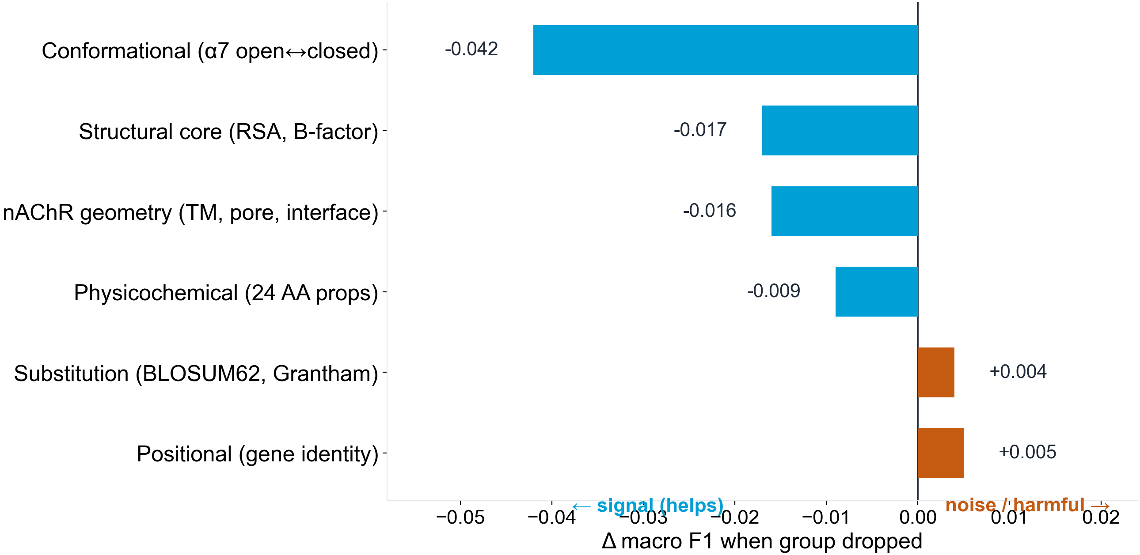
Hochschule Bonn-Rhein-Sieg (HBRS) · University of Applied Sciences · Sankt Augustin
A Variant Effect Predictor for Nicotinic Acetylcholine Receptors
Predicting the direction of effect — gain- vs. loss-of-function
Hari Krishna Mohan Raj · Supervisors: Dr. Karl N. Kirschner & Dr. Alexander Hagg
1. Introduction
Nicotinic acetylcholine receptors (nAChRs) are pentameric ligand-gated ion channels. Missense variants cause disease either by increasing channel activity (gain-of-function, GOF) or by decreasing it (loss-of-function, LOF) — opposite effects that map onto distinct disorders and demand opposite therapies.
Most variant-effect predictors (AlphaMissense, PolyPhen, CADD) score pathogenicity — damaging vs. benign — not direction. A pathogenic variant can be GOF or LOF, so these tools cannot separate the two. We present the first nAChR-specific GOF-vs-LOF predictor.
2. Pipeline
Curated variants → engineered features → tuned classifiers → gene-grouped cross-validation → direction prediction.
3. Methods
4. Dataset
We curated 717 missense variants across 16 nAChR genes and three species (human, rat, mouse), each labelled GOF, no-net-effect (NNE) or LOF from electrophysiology literature.
66 engineered features in seven groups: physicochemical, substitution (BLOSUM62, Grantham), positional, structural (RSA, B-factor), nAChR geometry, α7 conformational and ESM-2 zero-shot scores.
Ten classifiers — logistic regression, SVM, random forest, LightGBM, XGBoost, CatBoost, k-NN, MLP, Gaussian NB — tuned with Optuna.
Nested leave-one-subunit-out (gene-grouped) cross-validation prevents gene leakage, reporting macro F1, MCC and balanced accuracy.
16 nAChR genes (CHRNA1-7, A9, A10, CHRNB1-4, CHRND/E/G) across three species — 507 human, 138 rat, 72 mouse. Class distribution is skewed toward LOF (Tab. 1).
Class | Variants | Share
Loss-of-function (LOF) | 363 | 51%
No-net-effect (NNE) | 164 | 23%
Gain-of-function (GOF) | 190 | 26%
Total | 717 | 100%
Tab. 1 — Target distribution of the curated variant set.
5. Results
6. Feature Analysis
Under gene-grouped CV, CatBoost reaches macro F1 0.51 (3-class) and Random Forest 0.65 (binary) — above the 0.33 baseline but below clinical utility.
Conservation + ESM-2 scores lift 3-class F1 by +0.023 but leave binary unchanged (+0.004): they separate “effect” from “no effect”, not GOF from LOF.
Gene identity dominates: dropping the positional features costs ΔF1 −0.042, far more than any other group. Physicochemical and substitution features follow; structural and conformational geometry are near-neutral.
Fig. 2 — Model performance (macro F1, mean of 3 seeds).
Fig. 3 — Feature-group ablation (Δ macro F1 when dropped; negative = helps).
7. Conclusion
We built the first nAChR-specific GOF/LOF predictor (macro F1 0.51 three-class, 0.65 binary). Direction-of-effect is a distinct, harder problem than pathogenicity, and gene identity dominates current signal.
Take-home — Direction ≠ pathogenicity. The path forward is nAChR-specific mechanism and cross-species augmentation: from “is it damaging?” to “which way does it push the receptor?”
References
(1) Cheng J, et al. Accurate proteome-wide missense variant effect prediction with AlphaMissense. Science 381:eadg7492 (2023). (2) Meier J, et al. Language models enable zero-shot prediction of the effects of mutations on protein function. NeurIPS 34 (2021). (3) Boßelmann CM, et al. Predicting functional effects of ion channel variants using phenotypic machine learning. PLoS Comput Biol 19:e1010959 (2023). (4) Zhong G, et al. PreMode predicts mode-of-action of missense variants by deep graph representation learning. bioRxiv (2024). (5) Ke G, et al. LightGBM: a highly efficient gradient boosting decision tree. NeurIPS 30 (2017).

