Slide 1



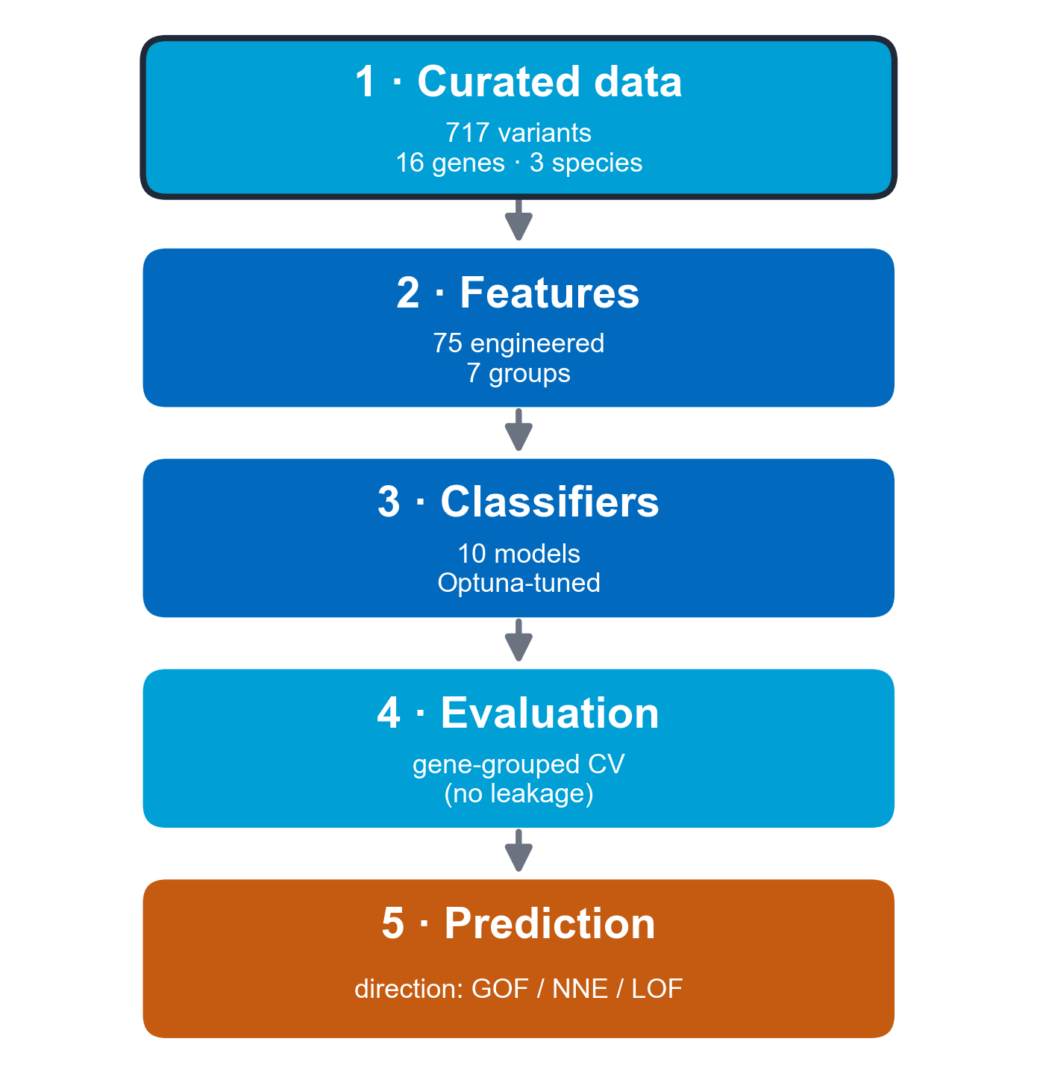
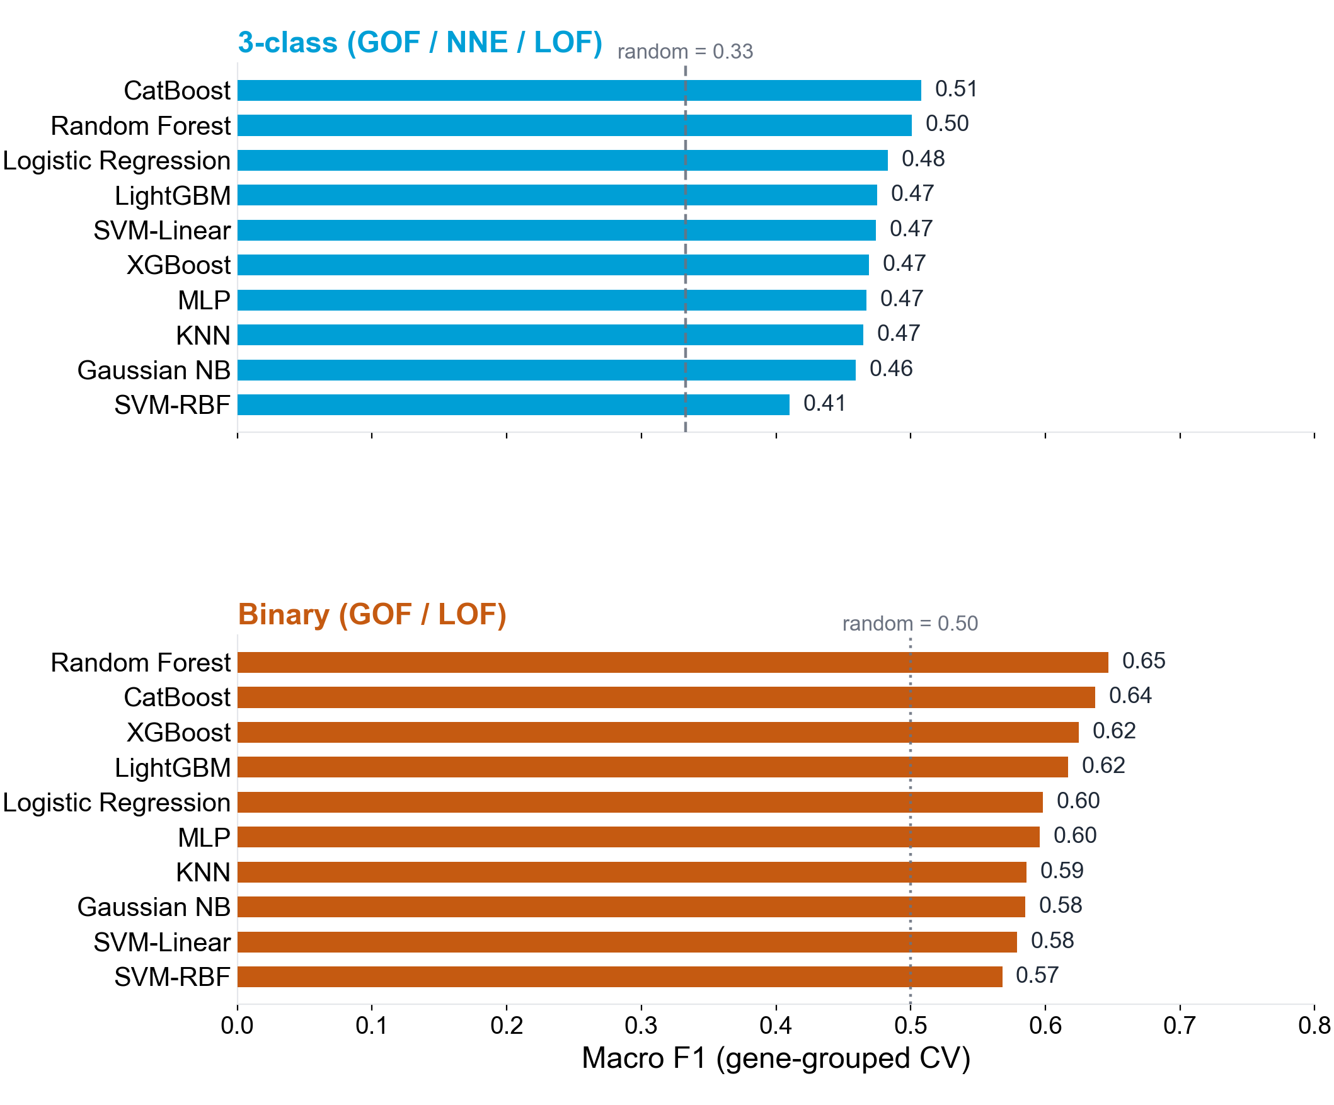
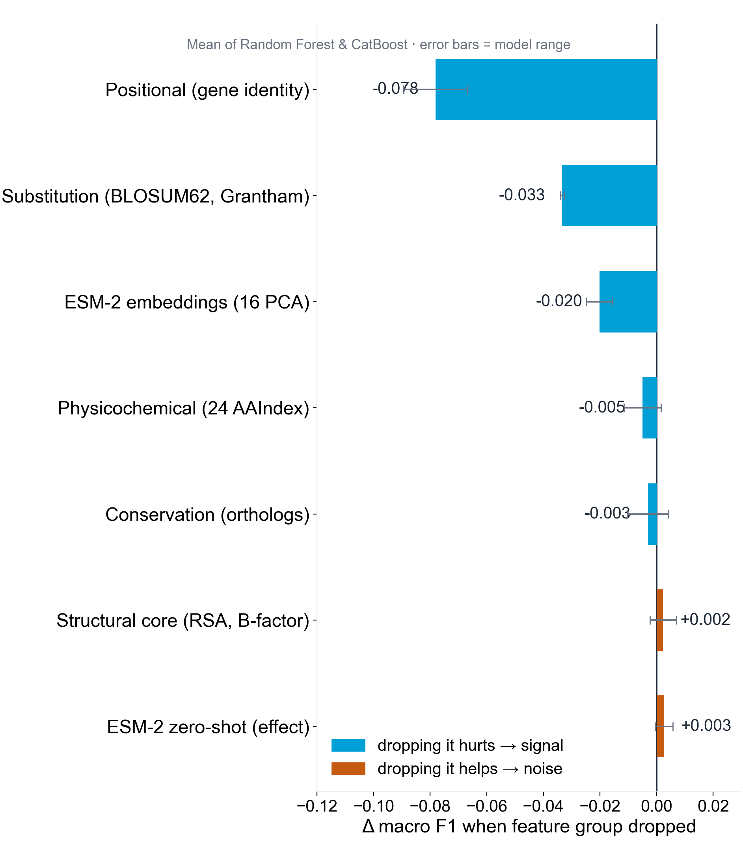
Department of Computer Science
A Variant Effect Predictor for Nicotinic Acetylcholine Receptors
Hari Krishna Mohan Raj, Karl N. Kirschner, Alexander Hagg
1. Introduction
Challenges
• Small data (717 variants) - transfer over from-scratch training
• Direction ≠ pathogenicity - GOF vs LOF (effect direction), not just damaging-or-benign
• Gene leakage - needs leave-one-subunit-out CV
• Cross-species alignment - mapping residue numbering & structural features
Nicotinic acetylcholine receptors (nAChRs) are pentameric ligand-gated ion channels. Missense variants cause disease by increasing channel activity (gain-of-function, GOF) or decreasing it (loss-of-function, LOF) - opposite effects mapping onto distinct disorders and therapies.
Most variant-effect predictors (AlphaMissense [1], PolyPhen, CADD) score pathogenicity, not direction. A pathogenic variant can be GOF or LOF, so these tools cannot separate the two; existing direction predictors [3,4,5] are not nAChR-specific. We present the first nAChR-specific GOF-vs-LOF predictor.
2. Methods
3. Pipeline & Data
Curated missense variants across 16 nAChR genes, each labelled GOF, no-net-effect or LOF from electrophysiology literature.
75 engineered features in seven groups: physicochemical (24), substitution (3), positional gene-identity (20), conservation (3), structural core (7), ESM-2 zero-shot (2) [2] and ESM-2 embeddings (16).
Ten classifiers (LR, SVM, random forest, LightGBM, XGBoost, CatBoost, k-NN, MLP, Gaussian NB), tuned with Optuna.
Nested leave-one-subunit-out (gene-grouped) cross-validation prevents gene leakage.
Data creation: 717 missense variants manually curated from electrophysiology literature.
16 nAChR genes · three species (507 human, 138 rat, 72 mouse) · 51% LOF / 23% NNE / 26% GOF.
α subunits dominate (68%) · β (17%) · muscle-type δ/ε/γ (15%).
Tab. 1: Dataset composition incl. target distribution
Class | Variants | Share
Loss-of-function (LOF) | 363 | 51%
No-net-effect (NNE) | 164 | 23%
Gain-of-function (GOF) | 190 | 26%
Total | 717 | 100%
Fig. 1: VEP-nAChR pipeline
4. Results
5. Feature Analysis
Under gene-grouped CV, CatBoost reaches macro F1 0.51 (3-class) and Random Forest 0.65 (binary). The baseline for 3 class(GOF/ NNE/LOF) is 0.33 and Binary(GOF/ LOF) is 0.5 which is basically a random guess.
And in the ablation study figure, we can see which features are working at its best and which are not, this helps us identify where we have to focus more on and improve.
Gene identity dominates: dropping the positional features costs ΔF1 −0.078, followed by substitution (−0.033) and ESM-2 embeddings (−0.020); the remaining groups are near-neutral (Fig. 3).
Fig. 2: Model performance (macro F1, mean of 3 seeds) under gene-grouped CV.
Fig. 3: Feature-group ablation (7 groups, mean of Random Forest & CatBoost) — Δ macro F1 when dropped.
6. Future Work
• Experiment with more species data and combine them with our model.
• Build a gene-conditioned predictor that uses subunit identity explicitly, to move past the ~0.50 gene-agnostic ceiling.
• Engineer nAChR-specific mechanism features - gating energetics, allosteric coupling, subunit interfaces - instead of more generic pathogenicity scores.
• Acquire more data to make the model perform better.
References
(1) Cheng J, et al. Accurate proteome-wide missense variant effect prediction with AlphaMissense. Science 381:eadg7492 (2023).
(2) Meier J, et al. Language models enable zero-shot prediction of the effects of mutations on protein function. NeurIPS 34 (2021).
(3) Boßelmann CM, et al. Predicting functional effects of ion channel variants using phenotypic machine learning. PLoS Comput Biol 19:e1010959 (2023).
(4) Zhong G, et al. PreMode predicts mode-of-action of missense variants by deep graph representation learning. bioRxiv (2024).
(5) Stein D, et al. Genome-wide prediction of pathogenic gain- and loss-of-function variants from ensemble learning of a diverse feature set. Genome Med 15:103 (2023).

