Slide 1


Presentation on Attendance Management System
Guided By: Presented By:
Prof. Monika Choudhary Diya Jain
Gagan Mandloi
Hariom Mandloi
Mustafa Fehmi

Slide 2
Contents
Introduction
1.1 Overview
1.2 Purpose
Requirement Engineering
2.1 Requirement Collection
2.2 Functional Requirements
2.3 Non Functional Requirements
2.4 Use Case Diagram
Technical Design
3.1 Technical Architecture
3.2 Sequence Diagram
3.3 Class Diagram
3.4 DFD
User Interface Design
Data Design
5.1 Schema Design
5.2 E-R Diagram
REFERENCES

Slide 3
1. Introduction
1.1 Overview
Streamlines the process by automating attendance marking, reducing manual effort and ensuring accuracy.
Provides instant access to attendance data for both students and faculty, enhancing transparency and efficiency.
Designed for ease of use, allowing students and faculty to quickly mark attendance, view records, and analyze trends.
1.2 Purpose
Replaces manual paper and Excel methods for accurate attendance management.
Provides insights into student attendance trends.
Generates detailed reports for better evaluation.

Slide 4
2. Requirement Engineering
2.1 Required collection
Students: Name, ID, attendance history.
Name, ID, assigned courses.
Attendance: Date, present/absent status.
Admin Records: System settings and role-based access details.

Slide 5
2.2 Function Requirements
Attendance Management:-Enable teachers to mark and update attendance for students.
Role-Based Access:-Provide separate dashboards for Admin, Teachers, and Students.
Notification System:-Send SMS or email alerts to students and parents for absentees.
Attendance Reports: Generate and export monthly or semester-wise attendance reports.
Login System:-Secure login for all users with unique credential.

Slide 6
2.2 Non Functional Requirements
Performance: System should handle up to 1000 simultaneous users without lag.
Scalability: Allow easy addition of new users, courses, and attendance categories.
Security: Ensure encrypted data storage and secure user authentication.
Usability: Provide an intuitive and user-friendly interface for all roles.
Availability: Maintain 99.9% uptime for consistent access to the system.

Slide 7
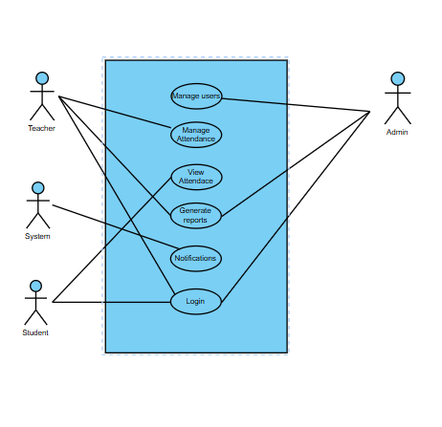
2.3 Use Case Diagram

Slide 8
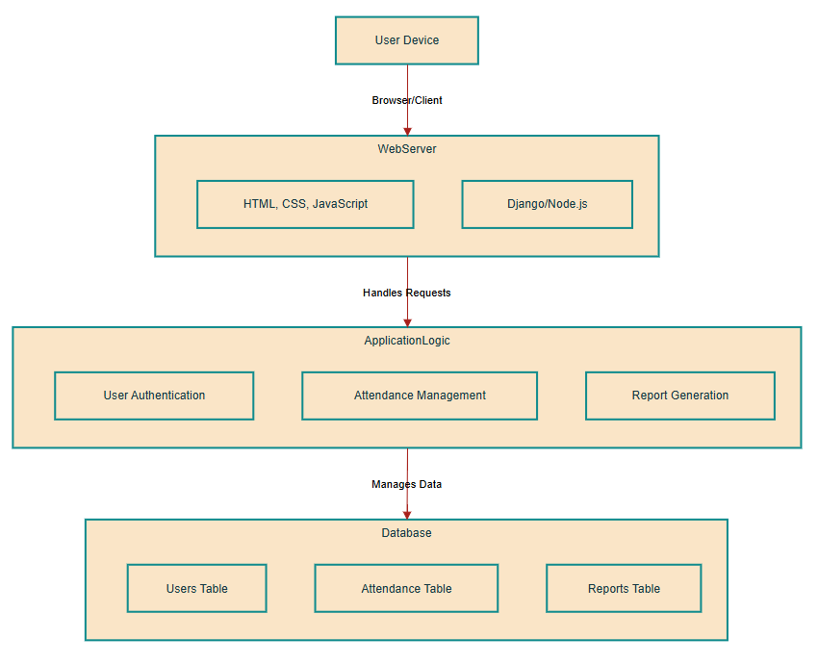
3. Technical Design 3.1 Technical Architecture

Slide 9
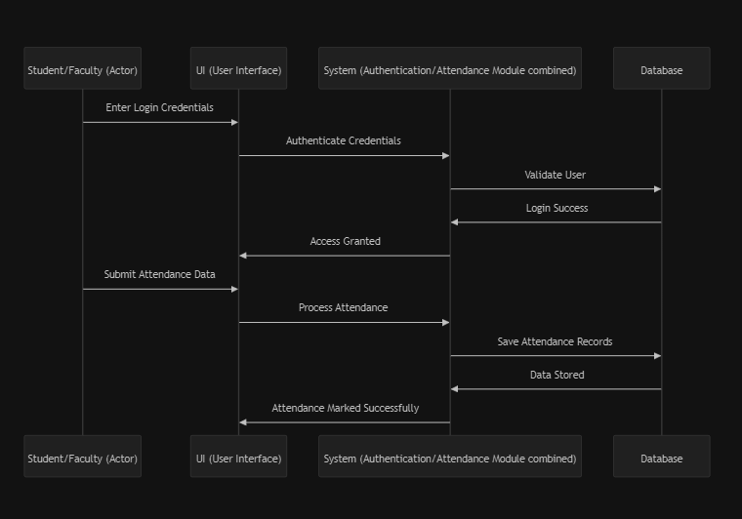
3.2 Sequence Diagram
System Sequence Diagram

Slide 10
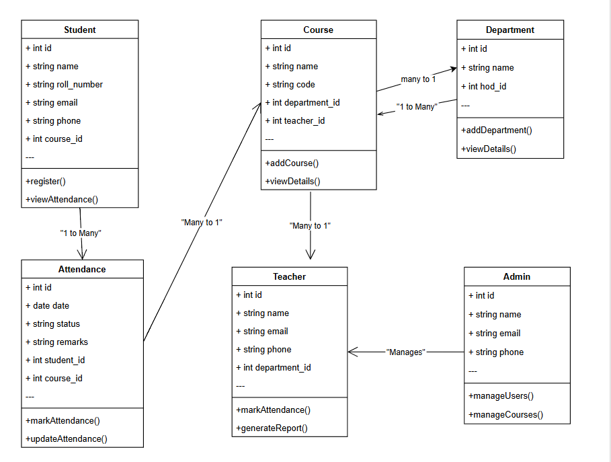
3.3 Class Diagram

Slide 11
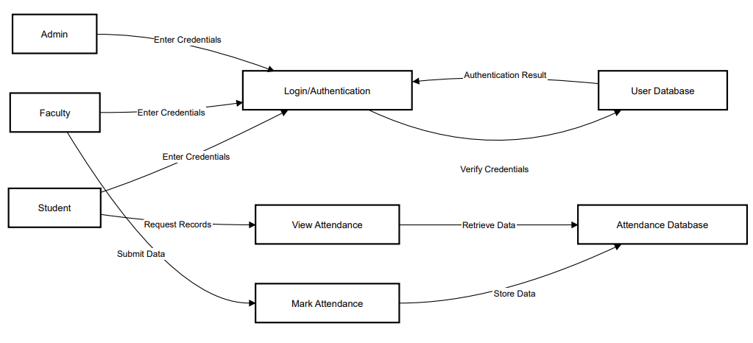
3.4 DFD
DFD Diagram

Slide 12
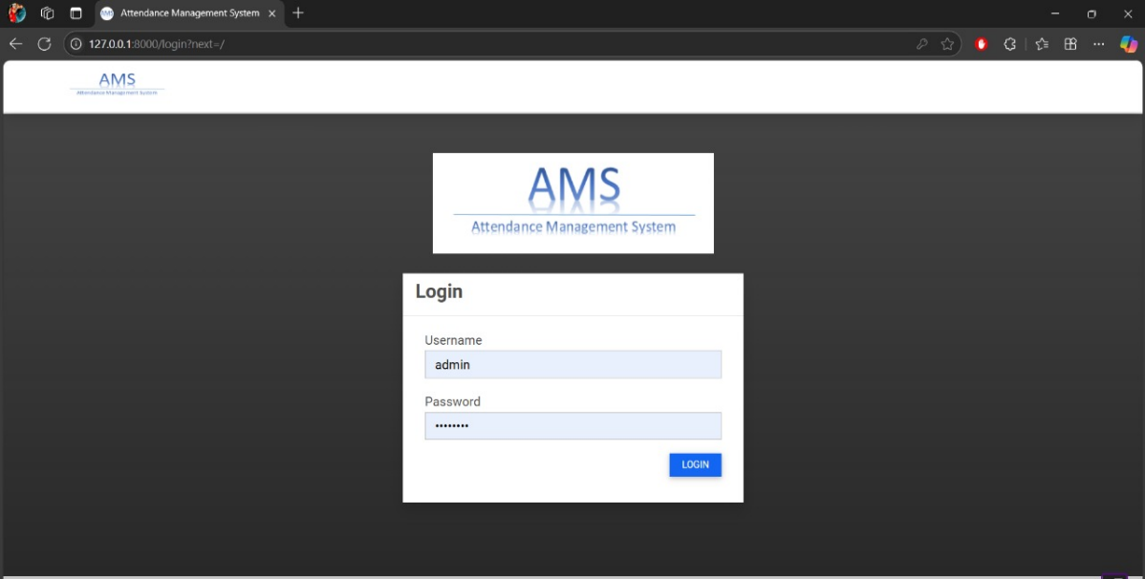
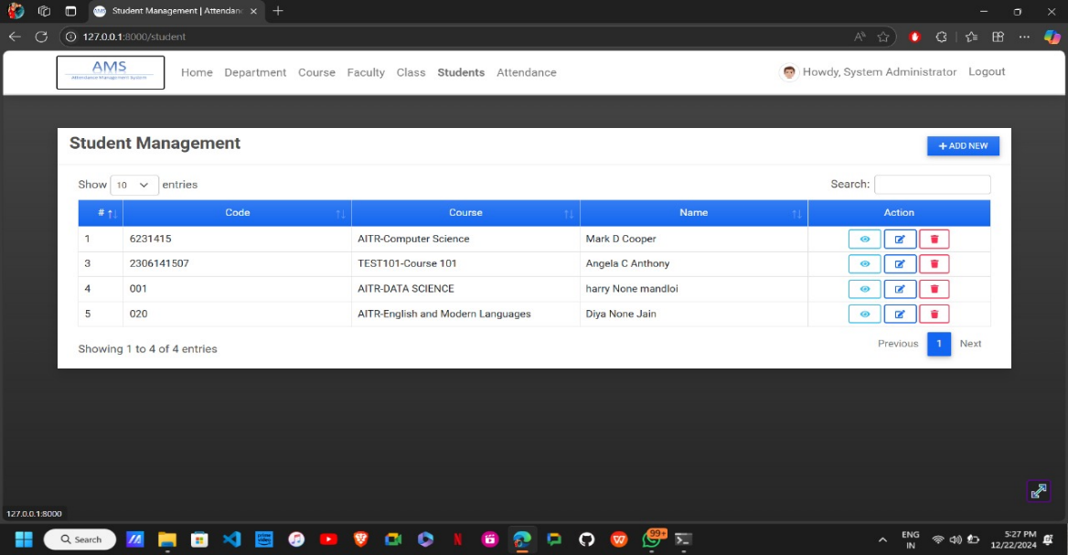
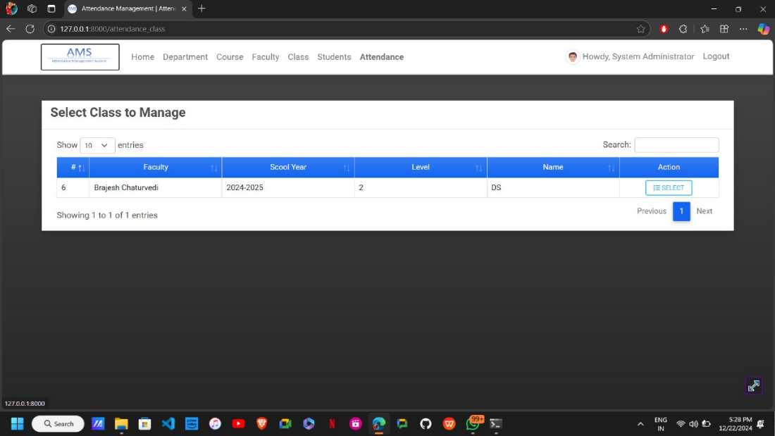
4. User Inface Design

Slide 13
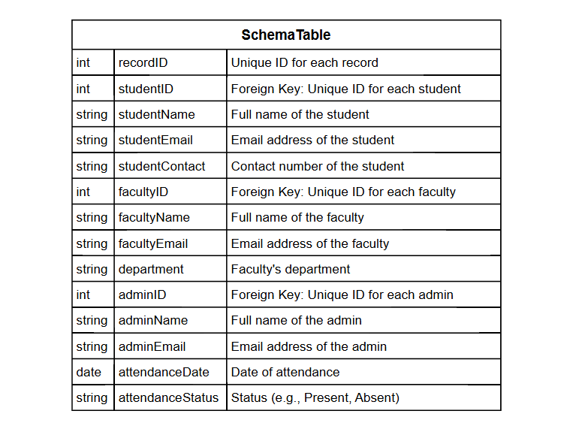
4. Data Design 4.1 Schema Definition

Slide 14
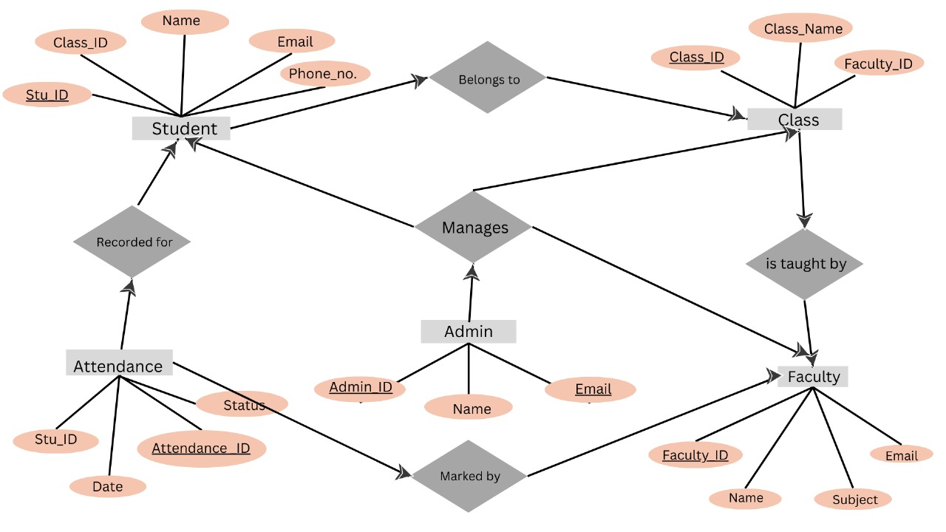
4.2 E-R Diagram
System E-R Diagram

Slide 15
GitHub Link
https://github.com/mustafa1850
https://github.com/hariiom08/Attendance-Management-System

Slide 16
REFERENCES
Journal
[1] Bharti, P. and Kumar, R. Automated Attendance Management System using Biometrics and Embedded Technology. Journal of computer science and Applications (2021)
[2] Wakode, S., Shingade, S., and Pawar, P. Web-based Attendance Management System. International Journal of Computer Applications, 182(26), pp. 25-30. (2019)
Research Paper
[1] Dey, T., & Mukherjee, R. - Integration of Analytics in Attendance Management System at IEEE Xplore (2020)

Slide 17
Thank You
Queries ?

