Slide 1


Presentation on
E-Commerce Sales Prediction
Guided By: Presented By:
Prof. Mahendra Verma Hariom Mandloi (0827CD221033)
Shubham Siloriya (0827CD221068)
Deepak Patel (0827CD221023)
Deepak Patel (0827CD221024)

Slide 2
Contents
Introduction
  1.1 Overview
  1.2 Purpose
Requirement Engineering
  2.1 Requirement Collection
  2.2 Functional Requirements
  2.3 Non Functional Requirements
  2.4 Use Case Diagram
Technical Design
  3.1 Technical Architecture
  3.2 Sequence Diagram
  3.3 Class Diagram
  3.4 DFD
User Interface Design
Data Design
  5.1 Schema Design
  5.2 E-R Diagram
REFERENCES

Slide 3
1. Introduction
1.1 Overview
The E-commerce Sales Analysis and Prediction System is a data-driven software solution designed to analyze online shopping data, visualize trends, and build machine learning models to predict future sales, revenue, customer behavior, and product demand.
This project helps in understanding customer buying patterns, popular product categories, seasonal sales trends, and predicting future demand using historical data.
1.2 Purpose
The purpose of this project is to analyze real-world e-commerce sales data to uncover meaningful insights and use machine learning techniques to predict future outcomes such as sales trends, revenue, customer behavior, and delivery performance. In today’s rapidly evolving digital marketplace, e-commerce platforms generate vast amounts of data from customer purchases, payments, product categories, and logistics. However, this raw data is rarely used to its full potential. Through this project, the aim is to transform raw data into valuable business intelligence by applying data preprocessing, exploratory data analysis (EDA), visualization, and predictive modeling.

Slide 4
2. Requirement Engineering
2.1 Requirement Collection
Stakeholder Inputs:
Requirements are gathered by discussing with business owners and analysts to understand needs like sales analysis, customer segmentation, forecasting, and performance insights.
Dataset Examination:
The e-commerce dataset is reviewed to check available features, data quality, and missing values, ensuring it is suitable for analytics and machine learning tasks
Goal & Use-case Definition:
Project objectives such as predicting sales, identifying top categories, or visualizing customer behavior are finalized to shape system functionality.

Slide 5
2.2 Function Requirements
The system should allow users to upload e-commerce datasets in CSV format for analysis.
The system should automatically clean, preprocess, and prepare the uploaded data for further processing.
The system should generate visual insights such as sales trends, category-wise revenue, and customer behavior charts.
The system should allow users to train machine learning models on the processed data.
The system should allow users to input new values or upload a file to generate predictions.
The system should display model outputs, predictions, and visual analytics instantly after processing.
All data files, processed outputs, trained models, and generated insights should be stored securely within the system
.

Slide 6
2.2 Non Functional Requirements
The system should provide a fast and responsive interface, ensuring smooth user interaction and minimal delays.
The system should handle large e-commerce datasets efficiently without performance degradation.
The system should ensure data security by protecting uploaded files and user-generated outputs.
The system should maintain high accuracy and reliability in machine learning predictions.
The system should offer a user-friendly interface that is easy to navigate even for non-technical users
. The system should ensure compatibility across different devices and screen sizes.

Slide 7
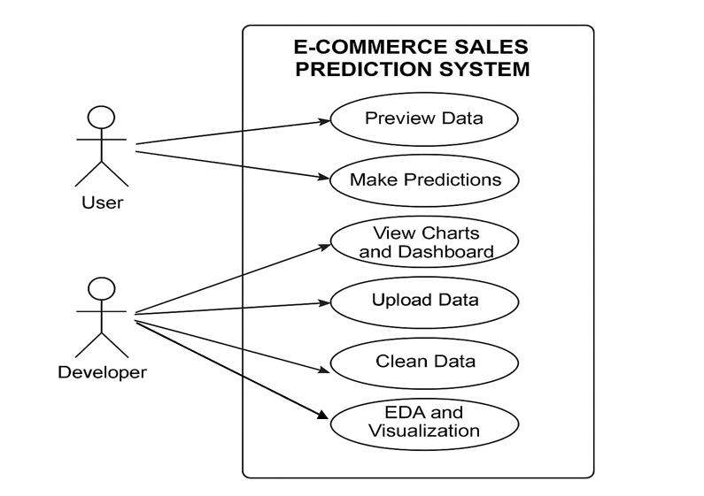
2.3 Use Case Diagram

Slide 8
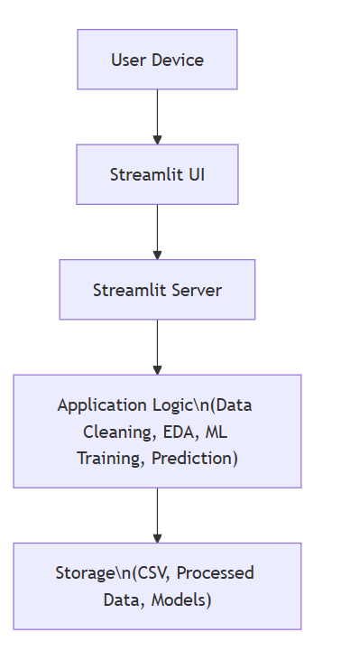
3. Technical Design
3.1 Technical Architecture

Slide 9
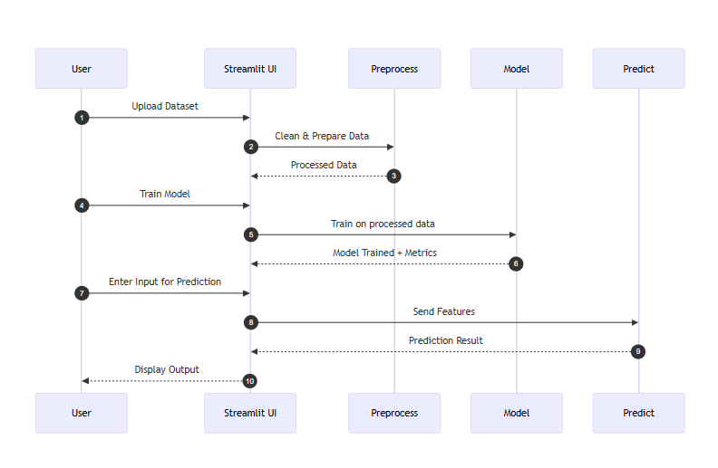
3.2 Sequence Diagram

Slide 10
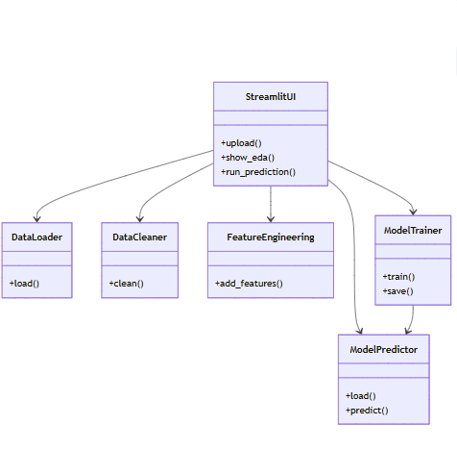
3.3 Class Diagram

Slide 11
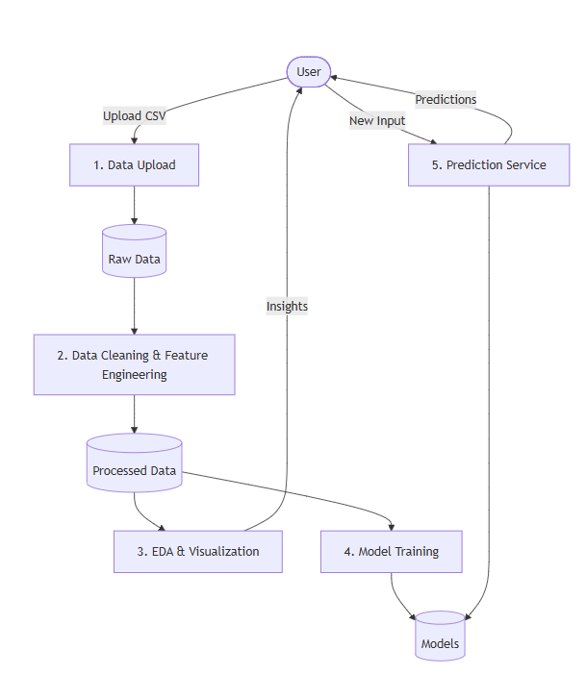
3.4 DFD

Slide 12
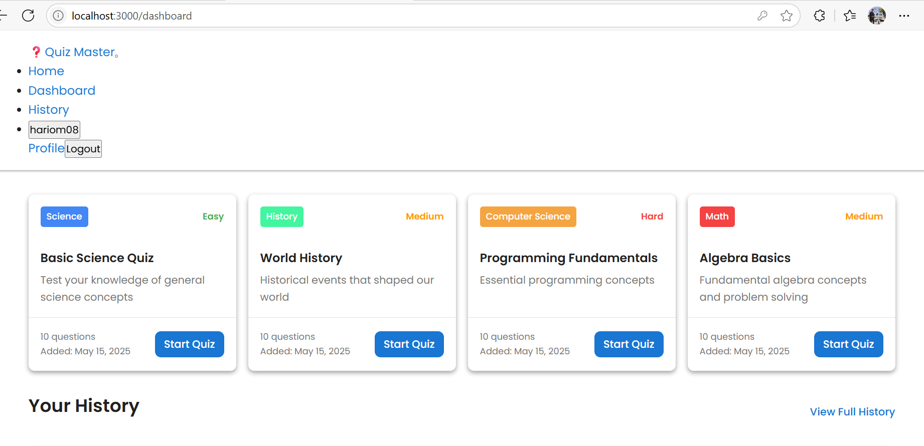
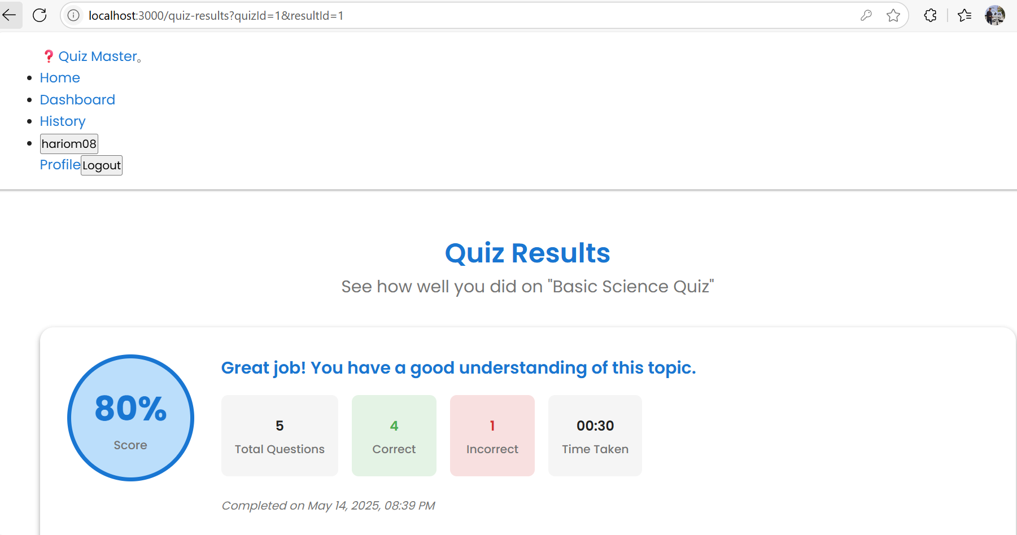
4. User Inface Design

Slide 13
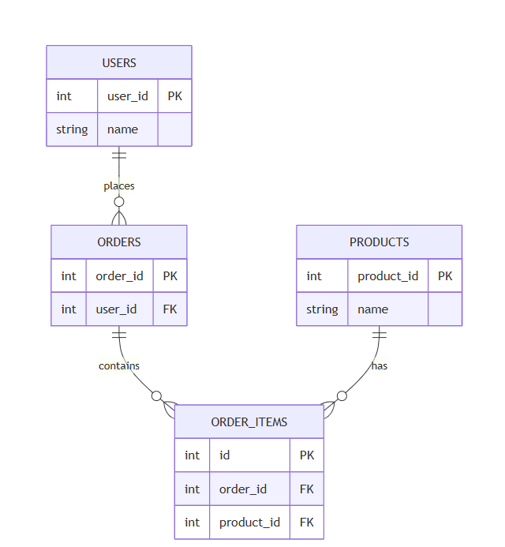
4. Data Design
4.1 Schema Definition

Slide 14
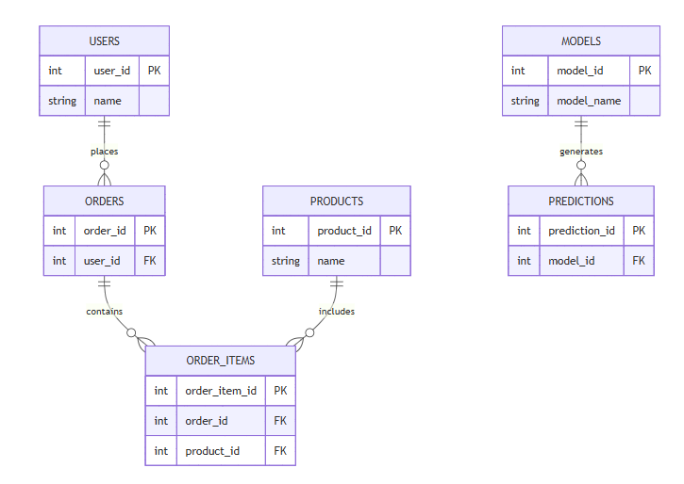
4.2 E-R Diagram

Slide 15
GitHub Link
https://github.com/hariiom08/Major-1.git

Slide 16
REFERENCES
[1] Kaggle – Brazilian E-commerce Public Dataset by Olist (used for real-world sales, customers, and delivery data).
[2] Aurélien Géron – Hands-On Machine Learning with Scikit-Learn, Keras & TensorFlow (for ML concepts and implementation)
[3] Choudhary, S., & Shukla, S. (2020). “Sales Forecasting for E-commerce Using Machine Learning Techniques” — International Journal of Scientific Research in Computer Science and Engineering (IJSRCSE).

Slide 17
[4] Tsai, C. F., & Hung, C. S. (2019). “Customer Purchase Behavior Prediction in E-commerce using Data Mining Techniques”

Slide 18
Thank You
Queries ?

