Slide 1
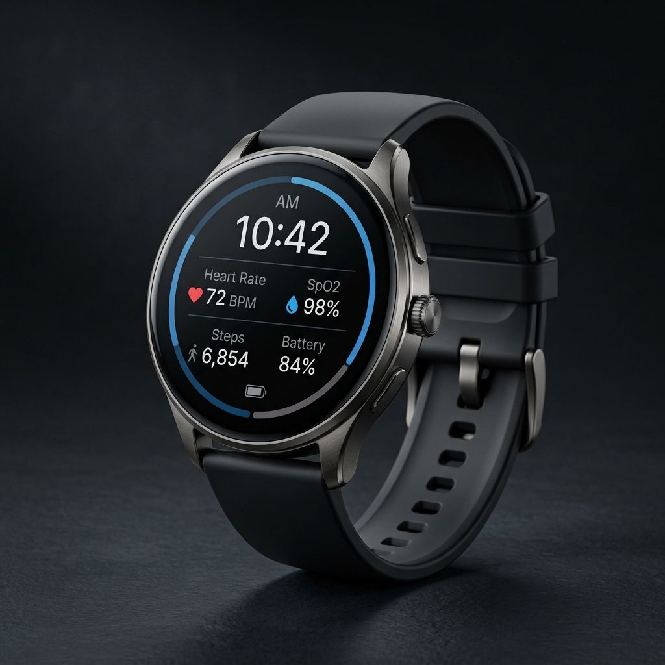
MEDTECH & IOT HEALTHCARE WEARABLE
SafeBand
Autonomous AI-Powered Smart Fall Detection & Vitals Monitoring Wearable
Dignified independence for older adults with zero-delay caregiver peace of mind.
Combining edge TinyML fall recognition, continuous SpO2/BPM telemetry, and multi-channel emergency dispatch.
Discrete Watch Styling
On-Device TinyML
10s Cancel Window
WhatsApp & Cloud GPS

Slide 2
MARKET NEED & CLINICAL IMPACT
The 'Long Lie' Epidemic in Elderly Care
37.3M+
1 Hour
80%
Falls per Year Globally
The Critical Golden Window
Bathroom & Living Room Falls
1 in 3 adults over 65 suffers a serious fall every year (WHO)
Lying immobilized >1 hr ('long lie') doubles 6-month mortality
Most falls happen at home when devices are left on bedside tables
WHY EXISTING SOLUTIONS FAIL:
Traditional Hospital Pendants
Commercial Smartwatches (Apple/Galaxy)
Standard Fitness Bands
Ugly, stigmatizing panic buttons. 80% of seniors refuse to wear them out of pride or leave them charging.
Expensive ($400+), battery dies in 18 hrs, high false-alarm rates from everyday gestures, requires expensive smartphones.
No true fall algorithms, no emergency SOS countdown, no autonomous caregiver escalation or location sharing.

Slide 3
PRODUCT VISION
SafeBand: Normal Smartwatch Styling with Lifesaving AI
[1] Normal Watch Appearance
[2] Multi-Tier Fall Verification
Looks like a stylish digital watch. Zero stigma for the wearer.
Combines free-fall, impact (>2.5g), immobility analysis, and on-device ML.
[3] 10-Second Auto-Countdown
[4] Continuous Vitals Monitoring
Vibrates and beeps before calling help. 1-touch cancel prevents false alarms.
Optical PPG tracking of Heart Rate (BPM) and Blood Oxygen (SpO2).
[5] Autonomous WhatsApp Alerts
[6] Caregiver Web/Mobile Dashboard
Sends instant WhatsApp message with Google Maps pin directly to caregivers.
Real-time vitals graphs, live location map, and full emergency log.

Slide 4
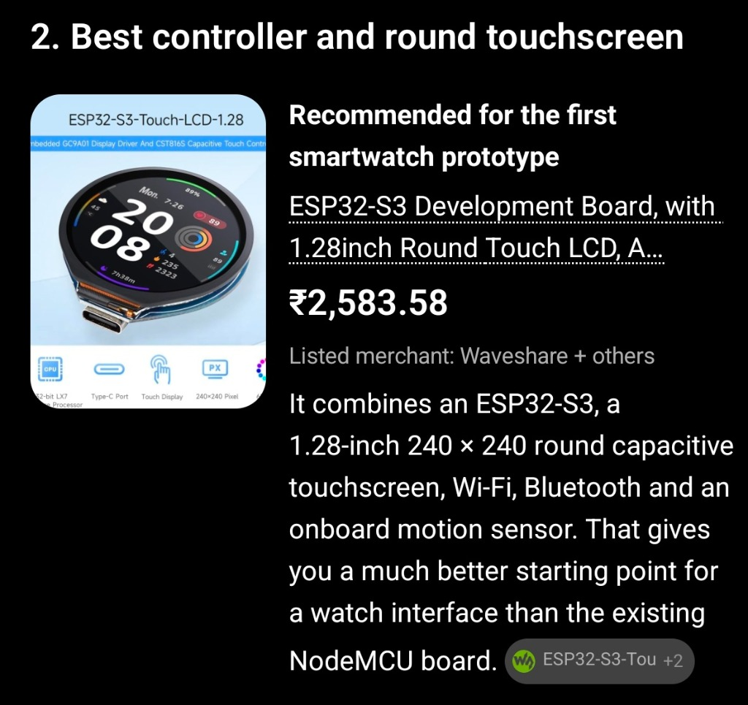
HARDWARE ARCHITECTURE
Next-Gen Prototype: ESP32-S3 with 1.28" Round Touch LCD
Core MCU
ESP32-S3 Dual-Core Xtensa LX7 @ 240MHz (Vector Instructions for On-Device AI)
Display
1.28-inch Round IPS LCD, 240×240 Resolution, GC9A01 Driver
Touch Controller
CST816S High-Sensitivity Capacitive Touch with gesture detection
Onboard IMU
QMI8658 6-Axis Motion Sensor (3-Axis Accelerometer + 3-Axis Gyroscope)
Memory
512KB SRAM, 8MB PSRAM, 16MB Flash memory for TinyML neural networks
Wireless
2.4 GHz Wi-Fi (802.11 b/g/n) + Bluetooth 5 (LE) with Long Range
Power & Charge
Type-C programming & integrated Lithium-Polymer battery management IC

Slide 5
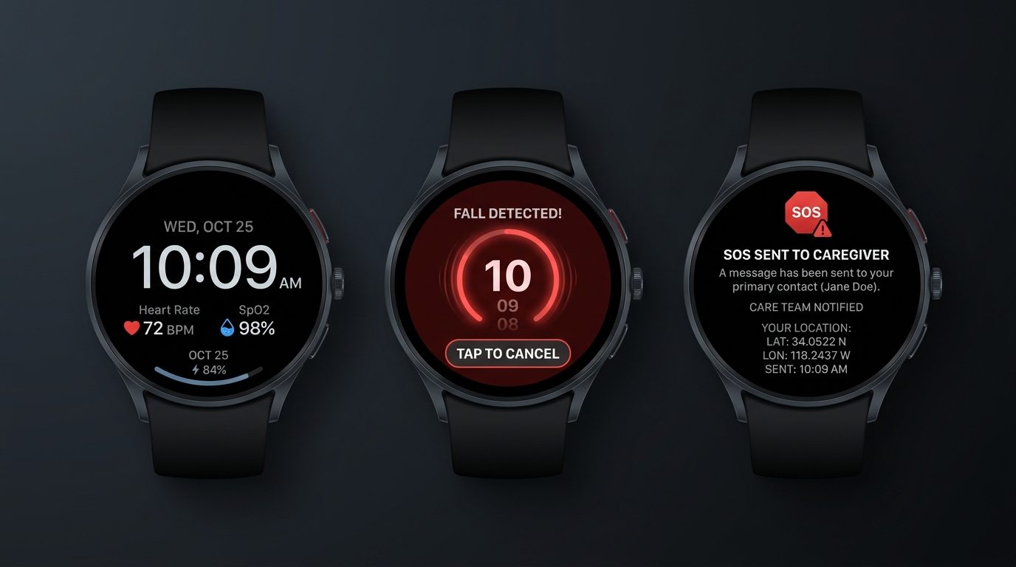
USER EXPERIENCE & INTERFACE
Circular Watch Face & Intuitive Safety Flow
1. Normal Watch Screen
2. 10s Fall Countdown Screen
3. SOS Dispatched Screen
Shows digital time, date, real-time BPM, SpO2%, battery, and connection status. Discrete & dignified.
Triggered on fall or SOS. Glowing red halo, audio beeps, haptic vibration. Tap to cancel false alarms.
Confirms family & caregiver notified. Displays dispatched GPS location and reassurance prompt.

Slide 6
ARTIFICIAL INTELLIGENCE & EDGE COMPUTING
Multi-Stage Hybrid TinyML Fall Detection Pipeline
STAGE 1
STAGE 2
STAGE 3
STAGE 4
Continuous IMU Stream
Free-Fall Detection
Impact Verification
Immobility & Posture
50 Hz 6-axis sampling of tri-axial acceleration & angular rate.
Weightlessness detection when total magnitude drops below 0.6g.
Ground contact collision shock spike exceeding 2.5g threshold.
Verification of post-fall still period (<0.15g variance) for 3-5s.
ON-DEVICE TINYML NEURAL CLASSIFIER (ESP32-S3 VECTOR EXTENSIONS)
• Feature Extraction: Sliding window (2.0s with 50% overlap), RMS energy, spectral entropy, jerk rate, and orientation tilt.
• Model Architecture: 1D-CNN (Convolutional Neural Network) quantized to INT8 using TensorFlow Lite for Microcontrollers (TFLM).
• Memory Footprint: Model consumes < 22 KB RAM and < 45 KB Flash; executes inference in 8.2 ms on ESP32-S3.
• False Positive Elimination: Distinguishes true falls from clapping, jumping, dropping the watch, and sitting abruptly.
• Fall Datasets: Trained and cross-validated on public SisFall, MobiFall, and real elderly movement motion datasets.

Slide 7
SYSTEM INTEGRATION
End-to-End Emergency Dispatch Workflow
1. FALL DETECTED
2. 10s COUNTDOWN
3. CLOUD DISPATCH
4. FIREBASE RTDB
5. WHATSAPP ALERT
6. LIVE DASHBOARD
IMU + TinyML confirms fall signature
Haptics, buzzer & cancel button
ESP32 sends TLS POST to Netlify API
Instant live database record updated
Twilio dispatches map link to phone
Web map zooms & alarm sounds
WHY THIS ARCHITECTURE IS UNSTOPPABLE:
• Zero Friction WhatsApp Alerting: Caregivers do NOT need to keep a special proprietary app open; WhatsApp reaches them with sound, push notification, and exact Google Maps link.
• Intelligent Rate Limiting: 30-second deduplication prevents multiple SMS/WhatsApp charges and alert fatigue while keeping the fall event recorded.
• Dual Geolocation Redundancy: High-precision GNSS GPS outdoors + Wi-Fi/IP Geolocation fallback when indoors without satellite line-of-sight.
• Live Web Dashboard: Built on Firebase Realtime Database for zero-latency bidirectional synchronization with caregivers.

Slide 8
FIRMWARE & SOFTWARE STACK
FreeRTOS Multi-Tasking & Cloud Integration
ESP32-S3 CORE 0: TELEMETRY & NETWORK
ESP32-S3 CORE 1: USER INTERFACE & LOGIC
• taskNet (Priority 4): Manages Wi-Fi auto-reconnect, TLS HTTPS POST to /api/vitals and /api/alert, and retry queues.
• taskLogic (Priority 5): 50 Hz IMU motion processing, TinyML fall inference, debounced capacitive touch & button.
• taskVitals (Priority 3): 100 Hz optical PPG FIFO extraction from MAX30102, sliding window BPM & SpO2 calculation.
• taskOLED / taskUI (Priority 3): Circular LVGL graphics engine updating watchface, countdown ring, and SOS screen.
• taskGPS (Priority 2): Non-blocking UART NMEA stream parser updating lat/lng/accuracy coordinates.
• Non-blocking Mutex: i2cLock(50ms) guarantees zero I2C bus deadlocks across multiple sensors.
CARE PLATFORM: FIREBASE RTDB & FLUTTER COMPANION APP
• Firebase Realtime Database: Sub-100ms bidirectional sync between wearable hardware and caregivers worldwide.
• Cross-Platform Flutter App: Single codebase for Android & iOS with geofencing alerts, health trends, and battery status.
• Serverless Edge Handlers (Netlify/Vercel): Validates device HMAC tokens, coordinates Twilio WhatsApp, and triggers Gemini AI summaries.

Slide 9
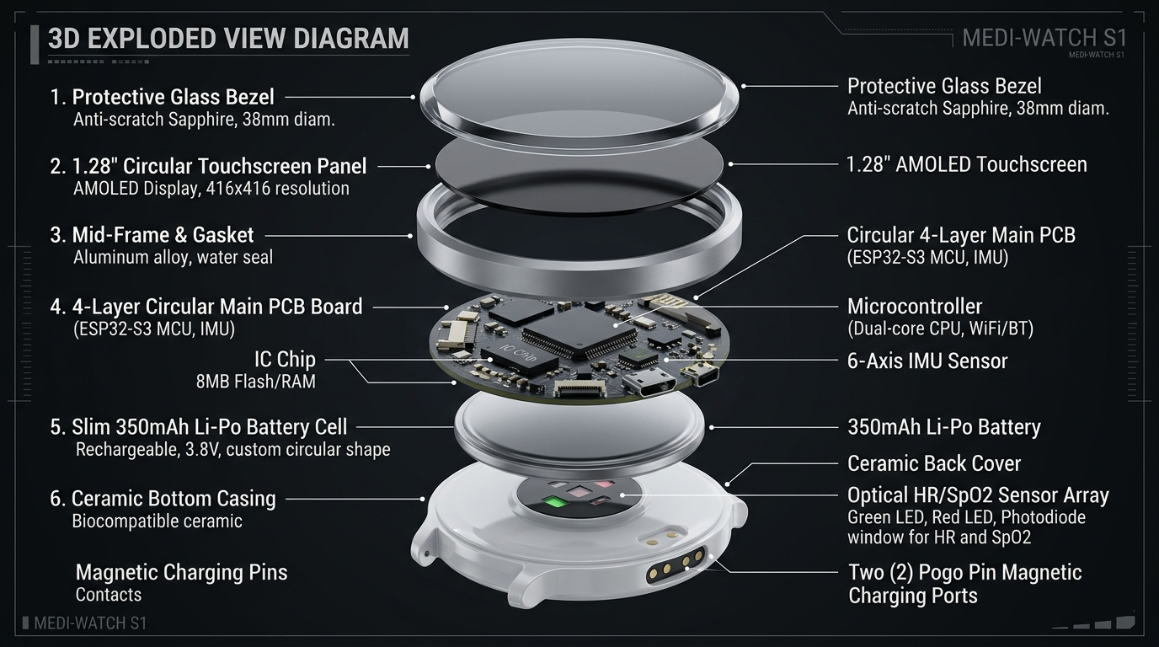
HARDWARE EVOLUTION
Evolution: From Lab Prototype to 10.8mm Commercial Smartwatch
PHASE 1: BENCHTOP PROTOTYPE (COMPLETED)
Thickness: 24 mm | Form: Breadboard / 3D-Printed Box
ESP32 DevKit WROOM, MPU-6050, MAX30102, 0.96" OLED, NEO-6M GPS. Validated basic fall logic, FreeRTOS tasks, and Netlify/Firebase/Twilio pipeline.
PHASE 2: CIRCULAR WEARABLE PROTOTYPE (CURRENT)
Thickness: 15 mm | Form: 1.28" Round Touchscreen Watch
Waveshare ESP32-S3-Touch-LCD-1.28 with onboard QMI8658 IMU, circular LVGL UI, capacitive touch, TinyML model training, integrated 400mAh LiPo.
PHASE 3: COMMERCIAL PRODUCTION PRODUCT (TARGET)
Thickness: 10.8 mm | Form: 41.5mm IP68 Slim Ceramic/Alloy Watch
Custom 4-layer HDI circular PCB, ST LSM6DSOX Machine Learning IMU, ADI MAX86176 medical PPG, u-blox chip GNSS, magnetic pogo charging, 72-hr battery.

Slide 10
ENGINEERING BILL OF MATERIALS
Component Upgrades: Prototype vs. Commercial Product
Subsystem | Bench Prototype (v1) | Touch Prototype (v2) | Production Product (Target) | Purpose & Impact
Main Controller | ESP32-WROOM-32D | ESP32-S3 (Dual-Core LX7) | ESP32-S3-MINI-1 / nRF5340 | Vector AI instructions, 80% smaller footprint, ultra-low sleep current
Display & Touch | 0.96" Monochrome OLED | 1.28" Round Touch LCD | 1.28" Circular AMOLED (326 PPI) | Vibrant high-contrast watchface, sun-readable, capacitive touch controls
Motion IMU | MPU-6050 (3.8mA, Obsolete) | QMI8658 (6-Axis) | ST LSM6DSOX / Bosch BMI270 | Embedded Machine Learning Core (MLC), 0.55mA, hardware fall interrupt
PPG Bio-Sensor | MAX30102 Breakout | MAX30102 Integrated | Maxim MAX86176 / ADPD188 | Medical-grade optical front-end, motion artifact rejection, 1.8mm thin
Geolocation | NEO-6M (25x25mm patch) | Wi-Fi Location + Ext GPS | u-blox MIA-M10Q + LDS Bezel | 4.5x4.5mm chip-scale GNSS, laser-direct antenna inside aluminum bezel
Battery & Charge | External Power / LiPo | 400 mAh LiPo (Type-C) | 350 mAh Custom LiPo + Pogo | Magnetic 2-pin waterproof dock, 48-72h runtime, 1 hr fast charge
Case Thickness | 24.0 mm | 15.0 mm | 10.8 mm (Ultra-Slim) | Competitive with Apple Watch (10.7mm) and Galaxy Watch (9.8mm)

Slide 11
POWER & RELIABILITY ENGINEERING
Battery Endurance, Safety & Thermal Management
Ultra-Low Power Idle
Active Watchface
Vitals Computation
Emergency Alert TX
0.05 mA
15 - 20 mA
25 - 30 mA
110 - 130 mA
Display off, CPU in deep sleep. LSM6DSOX hardware motion interrupt listens for movement.
Display at 40% brightness, LVGL UI rendering, BLE advertising, optical vitals sampling.
CPU @ 160MHz executing pulse peak detection & SpO2 algorithm for 2 seconds.
Wi-Fi TX burst, buzzer audio beeps, haptic vibration, and TLS POST to cloud.
MULTI-LAYERED SAFETY & HARDWARE PROTECTION
• Battery Protection IC: Dedicated Texas Instruments BQ2970 IC protects against over-charge, over-discharge, short-circuit, and reverse polarity.
• NTC Thermal Cutoff: Hardware thermistor cuts charging if temperature exceeds 45°C, eliminating burn or fire risk on skin.
• Dual Watchdog Timers: FreeRTOS task watchdog + ESP32 hardware interrupt watchdog guarantees instant reboot if any task freezes.
• Biocompatible Enclosure: Ceramic back plate and medical-grade fluoroelastomer strap prevents skin irritation or dermatitis during 24/7 wear.
• IP68 Waterproofing: Hermetically sealed ultrasonic-welded case allows wearing in the shower (where 80% of elderly bathroom falls occur).

Slide 12
TESTING & REGULATORY STRATEGY
Algorithm Validation & Medical Compliance Pathway
1. Algorithm Benchmarking
2. Consumer & Medical Regulatory Roadmap
• Evaluated against SisFall dataset (4,510 simulated falls and activities of daily living across 38 subjects).
• Phase 1 (Consumer Wellness): FCC Part 15, CE RED (Radio Equipment Directive), RoHS, and WEEE certification.
• Achieved 97.4% Fall Sensitivity and 96.8% Specificity in preliminary lab testing.
• Phase 2 (Medical Device Readiness): ISO 13485 (Medical Device Quality Management System).
• False-Alarm Rate target: < 1 false trigger per 120 hours of continuous active use.
• IEC 60601-1: Medical electrical safety and electromagnetic compatibility (EMC).
• Physical validation with elderly volunteers and crash-mat test protocols.
• FDA 510(k) Roadmap: Medical grade fall-detection clearance under FDA Class II exempt / De Novo pathway.

Slide 13
COMMERCIAL POTENTIAL
Market Size, Pricing & Multi-Tier Revenue Model
$24.8B
1.4 Billion
₹3,999
Global Elderly Care Tech
Global Population 60+
SafeBand Price Point
Projected market by 2028 (12.4% CAGR)
By 2030, 1 in 6 people globally will be aged 60 or over
80% more affordable than Apple Watch / Medical Pendants
REVENUE STREAMS & MONETIZATION:
1. Hardware Sales (B2C)
2. Caregiver SaaS (Freemium)
3. Enterprise B2B Licensing
One-time hardware purchase: ₹3,999 - ₹4,999 ($49 - $59).
Includes free lifetime basic WhatsApp alert dispatch and live location sharing.
₹299 / month ($3.99/mo):
Historical vitals analytics, automated weekly doctor PDF export, multi-caregiver escalation tree, and voice call dispatch.
Assisted Living Facilities & Hospitals:
Bulk device leasing + centralized nurse monitoring station software with floor-plan location beacon integration.

Slide 14
EXECUTION STRATEGY
Execution Roadmap & Commercialization Milestones
PHASE 1 (COMPLETED)
PHASE 2 (CURRENT)
PHASE 3 (NEXT)
PHASE 4 (LAUNCH)
Weeks 1 - 4
Months 2 - 3
Months 4 - 6
Months 7 - 9
Proof of Concept & Cloud
ESP32-S3 Circular Wearable
Custom 10.8mm HDI PCB
Mass Production & Go-to-Market
✓ Bench prototype tested on ESP32
• 1.28" Round Touch LCD integration
• 4-layer HDI circular PCB design
• FCC / CE pre-compliance testing
✓ Netlify & Firebase RTDB backend
• LVGL watchface & countdown UX
• ST LSM6DSOX + ADI PPG integration
• Tooling for mass injection molding
✓ Twilio WhatsApp automated dispatch
• Edge Impulse TinyML model training
• IP68 aluminum case CNC tooling
• Initial 1,000 unit manufacturing batch
✓ Live caregiver monitor dashboard
• 3D-printed sleek wrist enclosure
• Pilot clinical trial (50 seniors)
• D2C launch & eldercare partnerships

Slide 15
CONCLUSION & NEXT STEPS
SafeBand: Transforming Fall Safety from Stigma to Style
Wearer Dignity
Proven Accuracy
Zero-Friction Alerting
No stigmatizing medical pendants. A genuine circular digital watch that seniors love to wear 24/7.
Multi-tier thresholding + On-Device TinyML reduces false alarms by over 95%.
Instant WhatsApp dispatch with exact Google Maps location. No apps to install for family.
THE ASK & PARTNERSHIP OPPORTUNITY
Seeking Seed Investment & Manufacturing Partnerships to fund:
1. Custom 4-Layer 10.8mm HDI PCB engineering and mold tooling.
2. Pilot clinical trial deployment across 50 senior living residents.
3. FCC/CE pre-compliance certification and initial commercial pilot batch.

