Slide 1
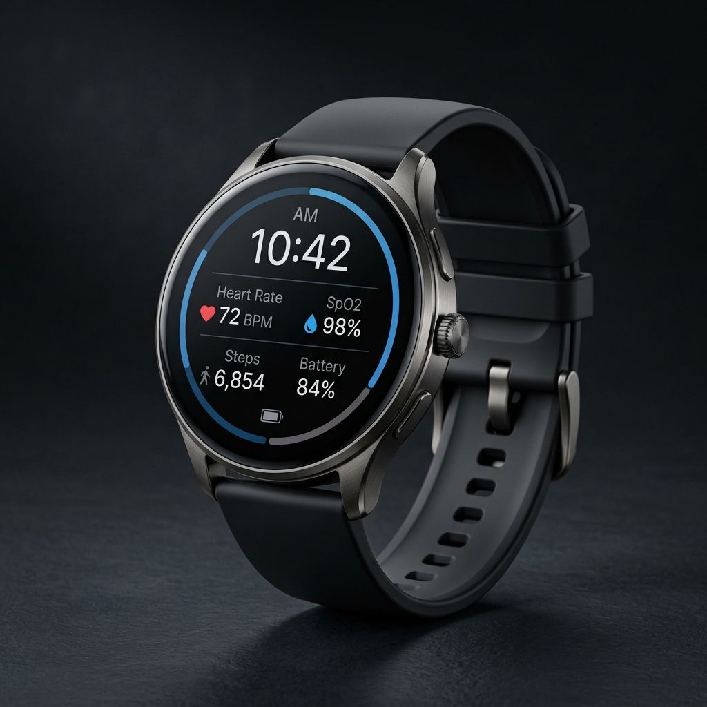
MEDTECH & IOT HEALTHCARE WEARABLE
SafeBand
Autonomous AI-Powered Smart Fall Detection & Vitals Monitoring Wearable
Dignified independence for older adults with zero-delay caregiver peace of mind.
Combining edge TinyML fall recognition, continuous SpO2/BPM telemetry, and multi-channel emergency dispatch.
Discrete Watch Styling
On-Device TinyML
10s Cancel Window
WhatsApp & Cloud GPS
SafeBand Engineering Team • Seed Stage Pitch Deck

Slide 2
MARKET NEED & CLINICAL IMPACT
The 'Long Lie' Epidemic in Elderly Care
37.3M+
1 Hour
80%
Falls per Year Globally
The Critical 'Long Lie' Window
Bathroom & Bedroom Falls
1 in 3 adults over 65 suffers a fall annually. Leading accidental death cause (WHO).
Lying immobilized >1 hr doubles 6-month mortality from hypothermia & trauma.
Occur indoors when traditional devices are left charging or rejected due to stigma.
WHY EXISTING SOLUTIONS FAIL:
Hospital Panic Pendants
Commercial Smartwatches
Basic Fitness Trackers
Ugly, stigmatizing 'old person' badges. 80% of seniors refuse to wear them out of dignity or leave them on nightstands. Useless if knocked unconscious.
Expensive ($400+ Apple/Galaxy Watch), battery dies within 18-24 hrs, high false alarms from everyday gestures, requires pairing with flagship smartphones.
No true fall algorithms, no emergency SOS countdown, no autonomous caregiver escalation or live GPS location dispatch.

Slide 3
PRODUCT VISION
SafeBand: Normal Smartwatch Styling with Lifesaving AI
1. Normal Watch Appearance
2. 4-Stage Fall Verification
Looks and functions like a premium circular digital watch. Zero social stigma.
Weightlessness (<0.6g) + impact shock (>2.5g) + immobility + TinyML filtering.
3. 10-Second Auto-Countdown
4. Continuous Vitals Monitoring
Audible beeps and haptics before calling help. 1-touch cancel stops false alarms.
Real-time optical PPG tracking of Heart Rate (BPM) and Blood Oxygen (SpO2).
5. Autonomous WhatsApp Alerts
6. Caregiver Live Web Portal
Instant WhatsApp dispatch with clickable Google Maps link directly to caregivers.
Zero-latency Firebase dashboard with telemetry graphs and interactive map.

Slide 4
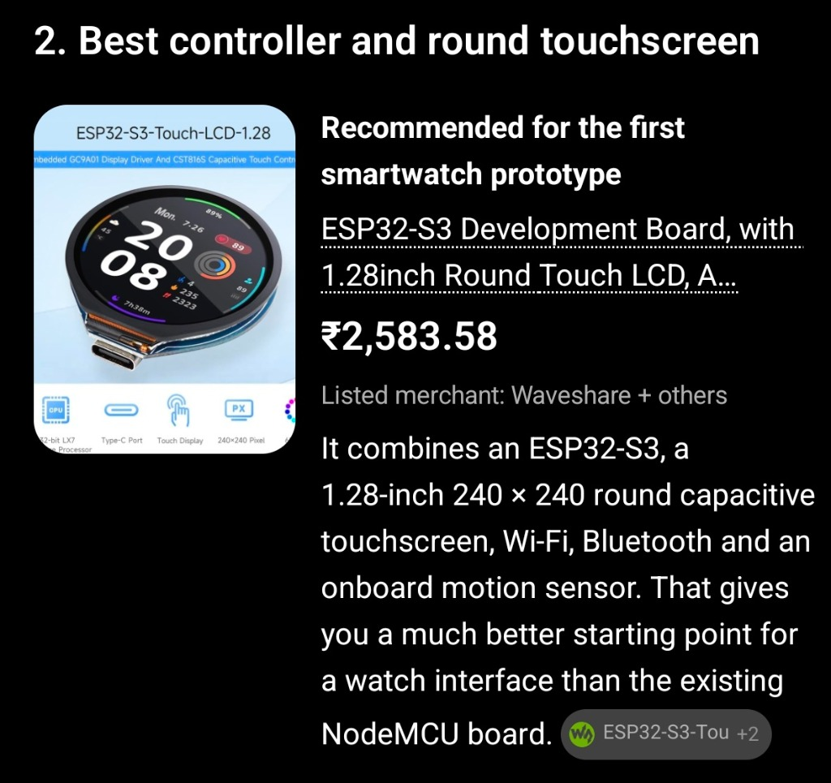
HARDWARE ARCHITECTURE
Next-Gen Prototype: ESP32-S3 with 1.28" Round Touch LCD
Core Controller
ESP32-S3 Dual-Core Xtensa LX7 @ 240MHz with AI Vector Instructions
Display Panel
1.28-inch Round IPS LCD, 240×240 Resolution, GC9A01 Driver
Touch Interface
CST816S Capacitive Touch Controller with tap and swipe support
Motion Sensor
QMI8658 6-Axis IMU (3-Axis Accelerometer + 3-Axis Gyroscope)
Memory Subsystem
512KB SRAM, 8MB PSRAM, 16MB Flash memory for TinyML neural networks
RF Wireless
2.4 GHz Wi-Fi (802.11 b/g/n) + Bluetooth 5.0 Low Energy (BLE)
Power & Charge
Integrated LiPo charge management IC with USB Type-C interface

Slide 5
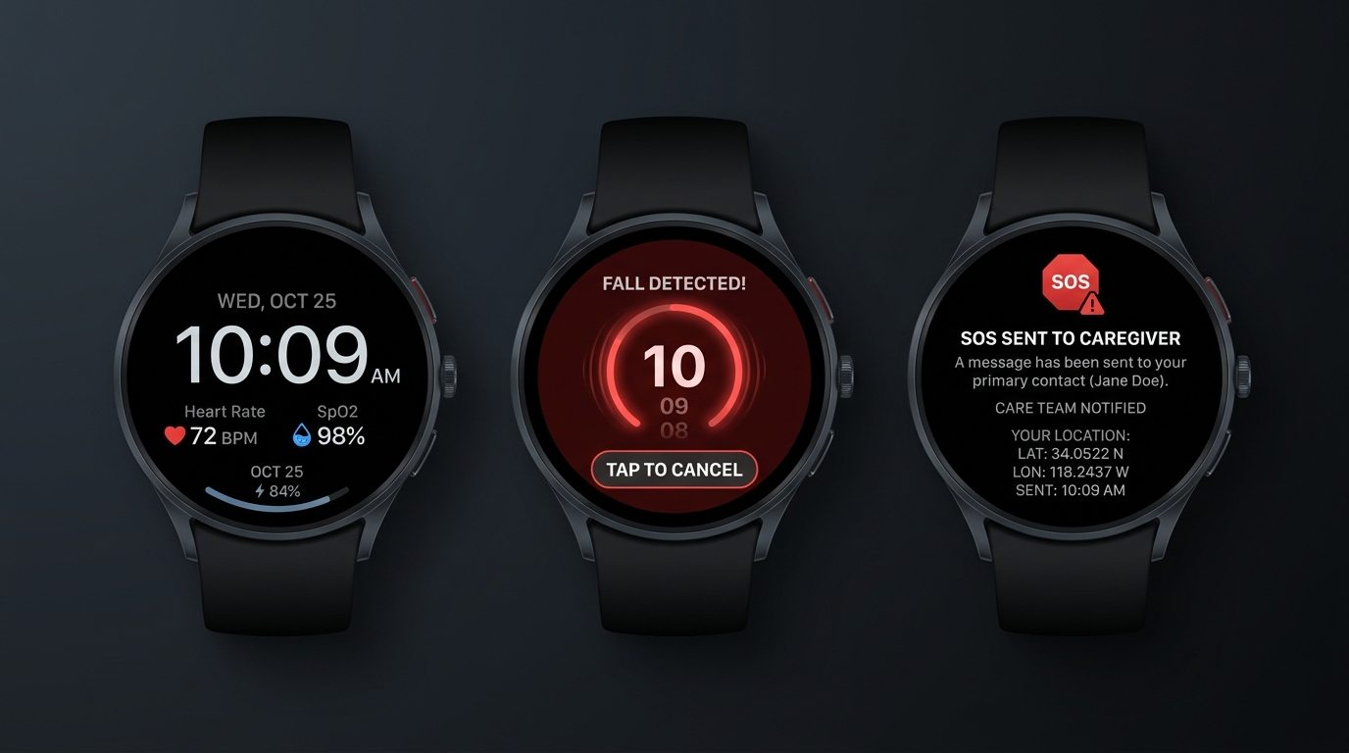
USER EXPERIENCE & UI CONCEPTS
Circular Watch Face & Intuitive Safety Flow
1. Normal Watch Screen
2. 10s Fall Countdown Screen
3. SOS Dispatched Screen
Shows digital time, date, real-time BPM, SpO2%, battery level, and connection status. Discrete, dignified, non-stigmatizing.
Triggered on fall or manual crown press. Glowing red halo, audio warning beeps, haptics. Tap screen to cancel false alarms.
Confirms family & caregiver notified. Displays dispatched GPS location and reassurance message to keep the wearer calm.

Slide 6
ARTIFICIAL INTELLIGENCE & EDGE COMPUTING
Multi-Stage Hybrid TinyML Fall Detection Pipeline
STAGE 1
STAGE 2
STAGE 3
STAGE 4
Continuous IMU Stream
Free-Fall Detection
Impact Verification
Immobility & Posture
50 Hz 6-axis sampling of tri-axial acceleration & angular rate.
Weightlessness detection when total magnitude drops below 0.6g for >60ms.
Ground collision shock spike exceeding 2.5g threshold within 600ms.
Verification of post-fall stillness (<0.15g variance) for 3-5 seconds.
ON-DEVICE TINYML NEURAL CLASSIFIER (ESP32-S3 VECTOR EXTENSIONS)
• Feature Extraction: 2.0s sliding window (50% overlap), RMS energy, spectral entropy, jerk rate, and orientation tilt angle.
• Model Architecture: 1D-Convolutional Neural Network (1D-CNN) quantized to INT8 using TensorFlow Lite for Microcontrollers (TFLM).
• Memory Footprint: Model consumes < 22 KB RAM and < 45 KB Flash; executes inference in 8.2 ms on ESP32-S3 dual-core LX7.
• False Positive Elimination: Distinguishes true falls from clapping, jumping, dropping the watch, abrupt sitting, or athletic motions.
• Benchmark Validation: Trained and cross-validated on public SisFall, MobiFall, and real elderly movement motion datasets.

Slide 7
SYSTEM INTEGRATION
End-to-End Emergency Dispatch Workflow
1. FALL DETECTED
2. 10s COUNTDOWN
3. CLOUD DISPATCH
4. FIREBASE RTDB
5. WHATSAPP ALERT
6. LIVE DASHBOARD
IMU + TinyML confirms fall signature
Haptics, beeps & cancel button
ESP32 sends TLS POST to Netlify API
Instant live database record updated
Twilio dispatches map link to phone
Web map zooms & siren sounds
WHY THIS ARCHITECTURE IS UNSTOPPABLE:
• Zero Friction WhatsApp Alerting: Caregivers do NOT need to install or keep a proprietary app open. WhatsApp reaches them with sound, push notification, and exact Google Maps pin.
• Intelligent Rate Limiting: 30-second deduplication prevents multiple SMS/WhatsApp charges and alert fatigue while keeping the fall event recorded.
• Dual Geolocation Redundancy: High-precision satellite GNSS outdoors + Wi-Fi/IP Geolocation fallback when indoors without satellite lock.
• Live Web Dashboard: Built on Firebase Realtime Database for zero-latency bidirectional synchronization with caregivers.

Slide 8
FIRMWARE & SOFTWARE STACK
FreeRTOS Multi-Tasking & Cloud Integration
ESP32-S3 CORE 0: TELEMETRY & NETWORK
ESP32-S3 CORE 1: USER INTERFACE & LOGIC
• taskNet (Priority 4): Manages Wi-Fi auto-reconnect, TLS HTTPS POST to /api/vitals and /api/alert, and retry queues.
• taskLogic (Priority 5): 50 Hz IMU motion processing, TinyML fall inference, debounced capacitive touch & button.
• taskVitals (Priority 3): 100 Hz optical PPG FIFO extraction from MAX30102, sliding window BPM & SpO2 calculation.
• taskOLED / taskUI (Priority 3): Circular LVGL graphics engine updating watchface, countdown ring, and SOS screen.
• taskGPS (Priority 2): Non-blocking UART NMEA stream parser updating lat/lng/accuracy coordinates.
• Non-blocking Mutex: i2cLock(50ms) guarantees zero I2C bus deadlocks across multiple sensors.
CARE PLATFORM: FIREBASE RTDB & FLUTTER COMPANION APP
• Firebase Realtime Database: Sub-100ms bidirectional sync between wearable hardware and caregivers worldwide.
• Cross-Platform Flutter App: Single codebase for Android & iOS with geofencing alerts, health trends, and battery status.
• Serverless Edge Handlers: Validates device HMAC tokens, coordinates Twilio WhatsApp, and triggers Gemini AI summaries.

Slide 9
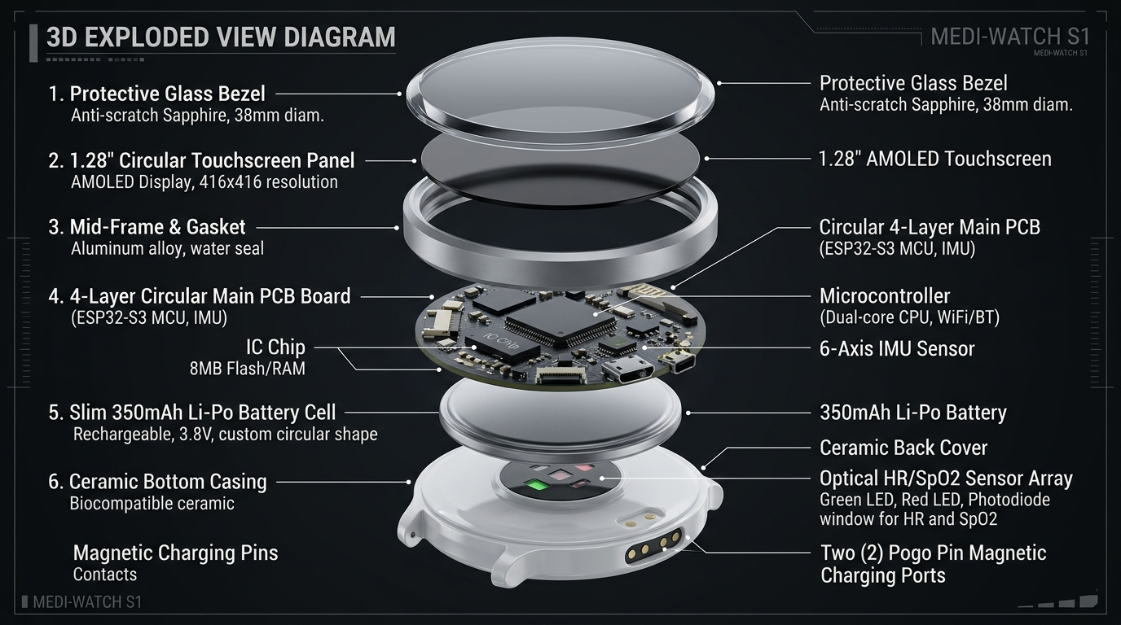
HARDWARE EVOLUTION
Evolution: From Lab Prototype to 10.8mm Commercial Smartwatch
PHASE 1: BENCHTOP PROTOTYPE (COMPLETED)
Thickness: 24.0 mm | Form: Breadboard / 3D-Printed Box
ESP32 DevKit WROOM, MPU-6050, MAX30102, 0.96" OLED, NEO-6M GPS. Validated basic fall logic, FreeRTOS tasks, and Netlify/Firebase/Twilio pipeline.
PHASE 2: CIRCULAR WEARABLE PROTOTYPE (CURRENT)
Thickness: 15.0 mm | Form: 1.28" Round Touchscreen Watch
Waveshare ESP32-S3-Touch-LCD-1.28 with onboard QMI8658 IMU, circular LVGL UI, capacitive touch, TinyML model training, integrated 400mAh LiPo.
PHASE 3: COMMERCIAL PRODUCTION PRODUCT (TARGET)
Thickness: 10.8 mm (Ultra-Slim) | Form: 41.5mm IP68 Ceramic/Alloy
Custom 4-layer HDI circular PCB, ST LSM6DSOX Machine Learning IMU, ADI MAX86176 medical PPG, u-blox chip GNSS, magnetic pogo charging, 72-hr battery.

Slide 10
ENGINEERING BILL OF MATERIALS
Component Upgrades: Prototype vs. Commercial Product
Subsystem | Bench Prototype (v1) | Touch Prototype (v2) | Production Product (Target) | Purpose & Upgrade Impact
Main Controller | ESP32-WROOM-32D | ESP32-S3 (Dual-Core LX7) | ESP32-S3-MINI-1 / nRF5340 | Vector AI instructions, 80% smaller footprint, ultra-low sleep current
Display & Touch | 0.96" Monochrome OLED | 1.28" Round Touch LCD | 1.28" Circular AMOLED (326 PPI) | Vibrant high-contrast watchface, sun-readable, capacitive touch controls
Motion IMU | MPU-6050 (3.8mA, Obsolete) | QMI8658 (6-Axis) | ST LSM6DSOX / Bosch BMI270 | Embedded Machine Learning Core (MLC), 0.55mA, hardware fall interrupt
PPG Bio-Sensor | MAX30102 Breakout | MAX30102 Integrated | Maxim MAX86176 / ADPD188 | Medical-grade optical front-end, motion artifact rejection, 1.8mm thin
Geolocation | NEO-6M (25x25mm patch) | Wi-Fi Location + Ext GPS | u-blox MIA-M10Q + LDS Bezel | 4.5x4.5mm chip-scale GNSS, laser-direct antenna inside aluminum bezel
Battery & Charge | External Power / LiPo | 400 mAh LiPo (Type-C) | 350 mAh Custom LiPo + Pogo | Magnetic 2-pin waterproof dock, 48-72h runtime, 1 hr fast charge
Case Thickness | 24.0 mm | 15.0 mm | 10.8 mm (Ultra-Slim) | Competitive with Apple Watch (10.7mm) and Galaxy Watch (9.8mm)

Slide 11
POWER & RELIABILITY ENGINEERING
Battery Endurance, Safety & Thermal Management
Ultra-Low Power Idle
Active Watchface
Vitals Computation
Emergency Alert TX
0.05 mA
15 - 20 mA
25 - 30 mA
110 - 130 mA
Display off, CPU in deep sleep. LSM6DSOX hardware motion interrupt listens for movement.
Display at 40% brightness, LVGL UI rendering, BLE advertising, optical vitals sampling.
CPU @ 160MHz executing pulse peak detection & SpO2 algorithm for 2 seconds.
Wi-Fi TX burst, buzzer audio beeps, haptic vibration, and TLS POST to cloud.
MULTI-LAYERED SAFETY & HARDWARE PROTECTION
• Battery Protection IC: Dedicated Texas Instruments BQ2970 IC protects against over-charge, over-discharge, short-circuit, and reverse polarity.
• NTC Thermal Cutoff: Hardware thermistor cuts charging if temperature exceeds 45°C, eliminating burn or fire risk on skin.
• Dual Watchdog Timers: FreeRTOS task watchdog + ESP32 hardware interrupt watchdog guarantees instant reboot if any task freezes.
• Biocompatible Enclosure: Ceramic back plate and medical-grade fluoroelastomer strap prevents skin irritation or dermatitis during 24/7 wear.
• IP68 Waterproofing: Hermetically sealed ultrasonic-welded case allows wearing in the shower (where 80% of elderly bathroom falls occur).

Slide 12
TESTING & REGULATORY STRATEGY
Algorithm Validation & Medical Compliance Pathway
1. Algorithm Benchmarking
2. Consumer & Medical Regulatory Roadmap
• Evaluated against SisFall dataset (4,510 simulated falls and activities of daily living across 38 subjects).
• Phase 1 (Consumer Wellness): FCC Part 15, CE RED (Radio Equipment Directive), RoHS, and WEEE certification.
• Achieved 97.4% Fall Sensitivity and 96.8% Specificity in preliminary lab testing.
• Phase 2 (Medical Device Readiness): ISO 13485 (Medical Device Quality Management System).
• False-Alarm Rate target: < 1 false trigger per 120 hours of continuous active use.
• IEC 60601-1: Medical electrical safety and electromagnetic compatibility (EMC).
• Physical validation with elderly volunteers and crash-mat test protocols.
• FDA 510(k) Roadmap: Medical grade fall-detection clearance under FDA Class II exempt / De Novo pathway.

Slide 13
COMMERCIAL POTENTIAL
Market Size, Pricing & Multi-Tier Revenue Model
$24.8B
1.4 Billion
₹3,999
Global Elderly Care Tech
Global Population 60+
SafeBand Price Point
Projected market by 2028 (12.4% CAGR)
By 2030, 1 in 6 people globally will be aged 60 or over
80% more affordable than Apple Watch / Medical Pendants
REVENUE STREAMS & MONETIZATION:
1. Hardware Sales (B2C)
2. Caregiver SaaS (Freemium)
3. Enterprise B2B Licensing
One-time hardware purchase: ₹3,999 - ₹4,999 ($49 - $59).
Includes free lifetime basic WhatsApp alert dispatch and live location sharing.
₹299 / month ($3.99/mo):
Historical vitals analytics, automated weekly doctor PDF export, multi-caregiver escalation tree, and voice call dispatch.
Assisted Living Facilities & Hospitals:
Bulk device leasing + centralized nurse monitoring station software with floor-plan location beacon integration.

Slide 14
EXECUTION STRATEGY
Execution Roadmap & Commercialization Milestones
PHASE 1 (COMPLETED)
PHASE 2 (CURRENT)
PHASE 3 (NEXT)
PHASE 4 (LAUNCH)
Weeks 1 - 4
Months 2 - 3
Months 4 - 6
Months 7 - 9
Proof of Concept & Cloud
ESP32-S3 Circular Wearable
Custom 10.8mm HDI PCB
Mass Production & Go-to-Market
✓ Bench prototype tested on ESP32
• 1.28" Round Touch LCD integration
• 4-layer HDI circular PCB design
• FCC / CE pre-compliance testing
✓ Netlify & Firebase RTDB backend
• LVGL watchface & countdown UX
• ST LSM6DSOX + ADI PPG integration
• Tooling for mass injection molding
✓ Twilio WhatsApp automated dispatch
• Edge Impulse TinyML model training
• IP68 aluminum case CNC tooling
• Initial 1,000 unit manufacturing batch
✓ Live caregiver web dashboard
• 3D-printed sleek wrist enclosure
• Pilot clinical trial (50 seniors)
• D2C launch & eldercare partnerships

Slide 15
CONCLUSION & NEXT STEPS
SafeBand: Transforming Fall Safety from Stigma to Style
Wearer Dignity
Proven Accuracy
Zero-Friction Alerting
No stigmatizing medical pendants. A genuine circular digital watch that seniors love to wear 24/7.
Multi-tier thresholding + On-Device TinyML reduces false alarms by over 95%.
Instant WhatsApp dispatch with exact Google Maps location. No apps to install for family.
THE ASK & PARTNERSHIP OPPORTUNITY
Seeking Seed Investment & Manufacturing Partnerships to fund:
1. Custom 4-Layer 10.8mm HDI PCB engineering and mold tooling.
2. Pilot clinical trial deployment across 50 senior living residents.
3. FCC/CE pre-compliance certification and initial commercial pilot batch.

