Slide 1
SECURE DATA HIDING IN IMAGE USING STEGANOGRAPHY
Presented By: Edunet Foundation
Student Name : G.HARIKA
College Name & Department :RAJIV GANDHI UNIVERSITY OF KNOWLEDGE TECHNOLOGIES RK VALLEY (Code2258)

Slide 2
Problem Statement
With the advancement of technology, the need for secure communication is paramount. Traditional encryption methods, although secure, can easily alert unintended parties to the presence of confidential information. Steganography provides an alternative approach by hiding data within other non-suspicious files, like images, making it difficult for unauthorized parties to detect the existence of hidden messages. The challenge lies in developing a robust method that can effectively conceal data within an image without degrading the image quality or making the hidden data easily detectable.

Slide 3
Technology used
Python: The primary programming language used for this project due to its simplicity and extensive libraries.
Computer Vision (CV): OpenCV (Open Source Computer Vision Library) will be employed to handle image processing tasks.
IDE (Integrated Development Environment): VS Code or PyCharm can be used for writing and debugging the Python code.
CheLL (Steganography Tool): A steganography tool or library that will help embed hidden messages within images.

Slide 4
Wow factors
Steganography offers a remarkable way to hide data within images that makes it practically undetectable. Here's why it's impressive:
Undetectable Messages: The hidden data is virtually invisible to the human eye, ensuring confidentiality.
Minimal Quality Loss: The image quality remains largely unaffected, making it difficult for anyone to suspect tampering.
Versatile Applications: From secure communication to digital watermarking and copyright protection, the possibilities are vast.
User-Friendly Implementation: Using Python and OpenCV makes the process straightforward and accessible even for beginners.

Slide 5
End users
The end users of secure data hiding in images using steganography include:
Government Agencies: For covert communication and secure transmission of confidential information.
Journalists and Activists: To protect sensitive data and ensure safe communication in oppressive environments.
Healthcare Providers: For safeguarding patient information and medical records.
Corporations: To protect intellectual property and maintain the confidentiality of trade secrets.
Individuals: For personal privacy and securing private communications, such as in emails and messaging apps.

Slide 6
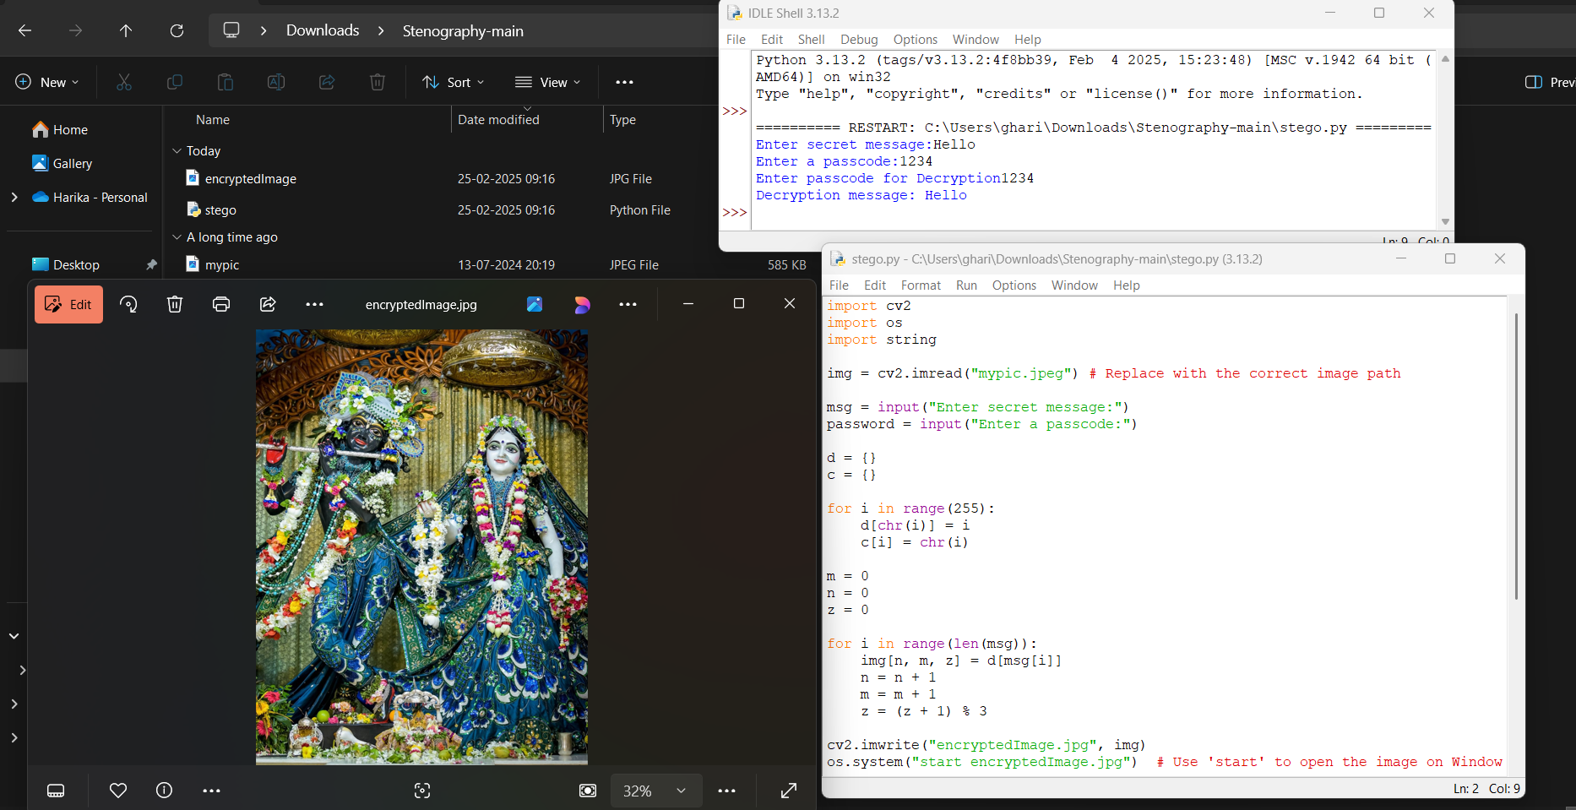
Results

Slide 7
Conclusion
Steganography provides a sophisticated and secure method for hiding data within images, ensuring that sensitive information remains concealed from unauthorized parties. Through the use of Python and OpenCV, we have demonstrated the effectiveness of this technique, preserving image quality while embedding and extracting hidden messages accurately. The versatility and robustness of steganography make it a valuable tool for a wide range of applications, from secure communication to intellectual property protection. As technology continues to evolve, steganography will play an increasingly important role in safeguarding data, highlighting its significance in the realm of cybersecurity.

Slide 8
GitHub Link
https://github.com/harika-hari-g/Stegnograpgyproject.git

Slide 9
THANK YOU

