Slide 1
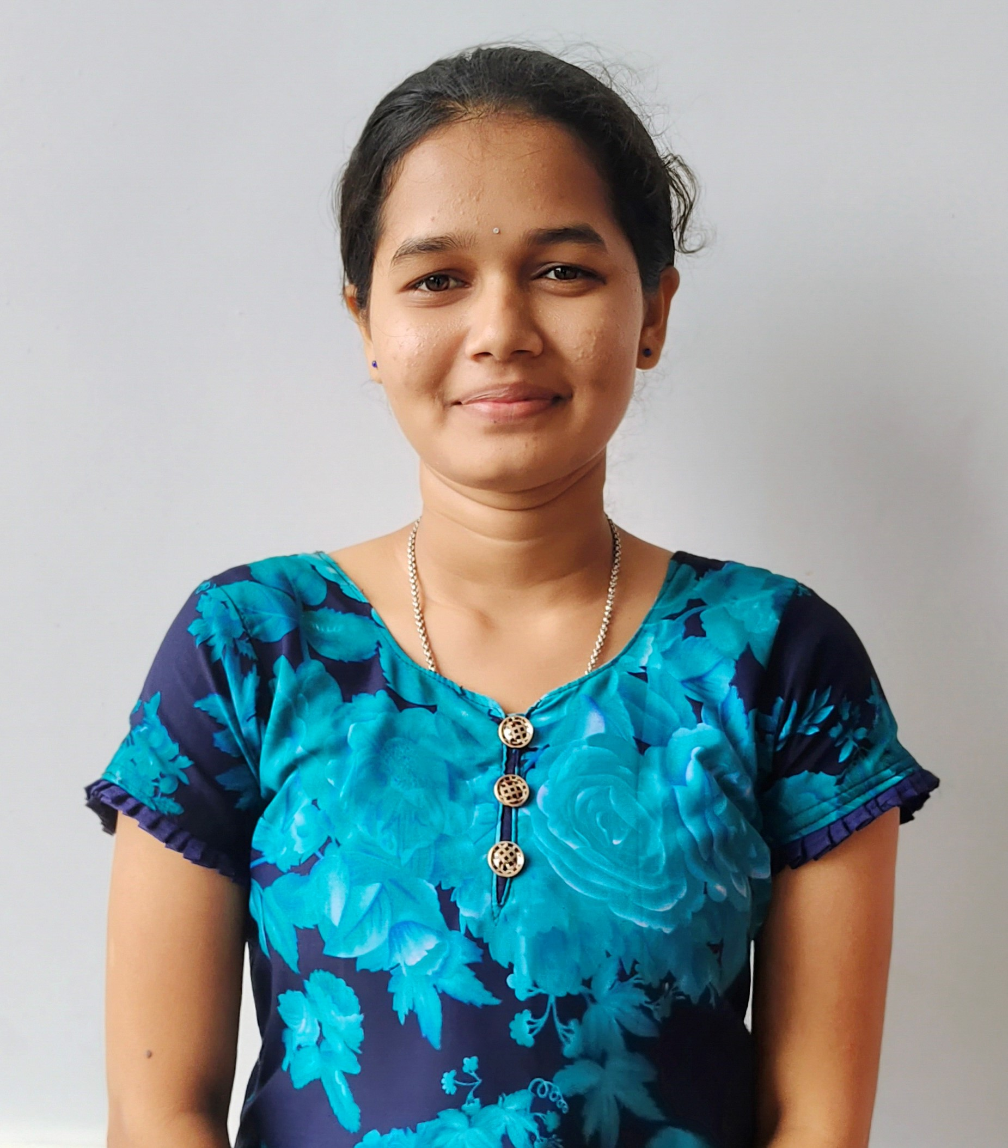
STUDENT DETAILS
Name: HARIKA RAJAPU SMARTINTERNZ Email Id: harikarajapu2002@gmail.com
College Name: Vignan’s Institute of Engineering for Women
College State: Andhra Pradesh Internship Domain: Front End Development
Internship Start Date: 14th June 2023
Internship End Date: 4th August 2023

Slide 2
PROBLEM STATEMENT
Domain: Frontend Development
Topic of the project : Portfolio Website

Slide 3
AGENDA
A portfolio website is a unique way to showcase your work and let others know about yourself.
It’s like an evergreen platform for your projects, case studies, and information about you.
In addition, it’s one of the best ways to express your personality, experience, and capabilities.
A website portfolio will help you stand out from the crowd, show your uniqueness, build trust, and make sure that others can actually find you.
The basic formula of a portfolio website would include a logo, tagline, your best work, and contact information.

Slide 4
PROJECT OVERVIEW
The purpose of a portfolio website is multifaceted. Firstly, it allows professionals to display their best work in an organized and visually appealing manner. It acts as a virtual gallery or showroom where they can exhibit their capabilities and demonstrate their unique style or approach..
The scope of a portfolio website extends beyond displaying previous work samples. It also allows professionals to provide background information about themselves, including their education, experience, skills, and contact details. This comprehensive overview enables visitors to gain a better understanding of the professional's background and qualifications.
The objective of having a portfolio website varies from person to person. For freelancers or independent contractors, it serves as an essential marketing tool that helps attract new clients and projects. It enables them to reach a wider audience beyond their immediate network and increases visibility in the industry.

Slide 5
END USERS
FREELANCERS: Freelancers are one of the primary end users of portfolio websites. These independent professionals from various fields such as graphic design, photography, writing, web development and more rely on portfolio websites to exhibit their talents and build credibility in the eyes of potential clients. By showcasing their best work samples and testimonials from satisfied clients, freelancers can effectively demonstrate their skills and attract new projects.
JOB-SEEKERS: Job seekers also greatly benefit from having a portfolio website. Creative professionals such as artists, designers or architects can use it as a platform to present their work in an organized manner. This allows recruiters or hiring managers to easily assess the candidate's abilities before even reaching out for an interview. A well-designed portfolio website can make a job seeker stand out among other applicants and increase their chances of landing the desired position.

Slide 6
SOLUTION AND IT’S VALUE PROPORTION
A portfolio serves as a visual representation of one's skills, experience, and achievements. It not only showcases the quality of work but also acts as a powerful marketing tool to attract potential clients or employers.
A portfolio solution provides an efficient and organized way for end users to manage their portfolios. With the help of user-friendly platforms and tools, individuals can easily create and update their portfolios with relevant content such as projects completed, certifications earned, and testimonials received.
For end users, the benefits of utilizing a portfolio solution are numerous. Firstly, it allows them to present their work in a visually appealing manner that captures attention and leaves a lasting impression on viewers. This is particularly important in creative fields where aesthetics play a crucial role.

Slide 7
CUSTOMIZATION OF PROJECT
VISION: Having a clear vision of your portfolio aids in developing a strategic approach to tailoring the website to your personality and goals.
INTERESTS & HOBBIES: Including your interests that might not be necessarily work-related, like music, art, literature, help convey your personality but also makes it unique and memorable.
AESTHITIC: Tailoring your website visual appearance to your personality might help you stand out in employers eyes. Use colors, fonts and element shapes that fit your brand and personality.
CREATIVITY: Creativity is another crucial element. Portfolio should showcase our ability to approach projects with originality, bringing a fresh perspective to every piece of work. Whether it's through imaginative design choices, compelling storytelling, or innovative problem-solving, your creativity should shine through in every project you present.

Slide 8
MODELLING
Define the goals and target: Determine the purpose of your portfolio website. Identify your target audience and consider their needs and preferences. This will help you tailor the design and content of your website accordingly.
Plan your website structure: Create a sitemap or outline of the pages you want to include in your portfolio website. Common pages may include Home, About, Portfolio, Services, Blog, Contact, etc.
Design and layout: Choose a clean and professional design that reflects your personal brand and aligns with your target audience's expectations. Use a consistent color scheme, typography, and visual elements throughout the website to maintain a cohesive look.
Implement interactive elements: Incorporate social media links to your profiles on platforms like LinkedIn, GitHub, or Behance, allowing visitors to connect with you on various channels.
Test and launch: Before launching your website, thoroughly test its functionality, responsiveness, and compatibility across different browsers and devices.

Slide 9
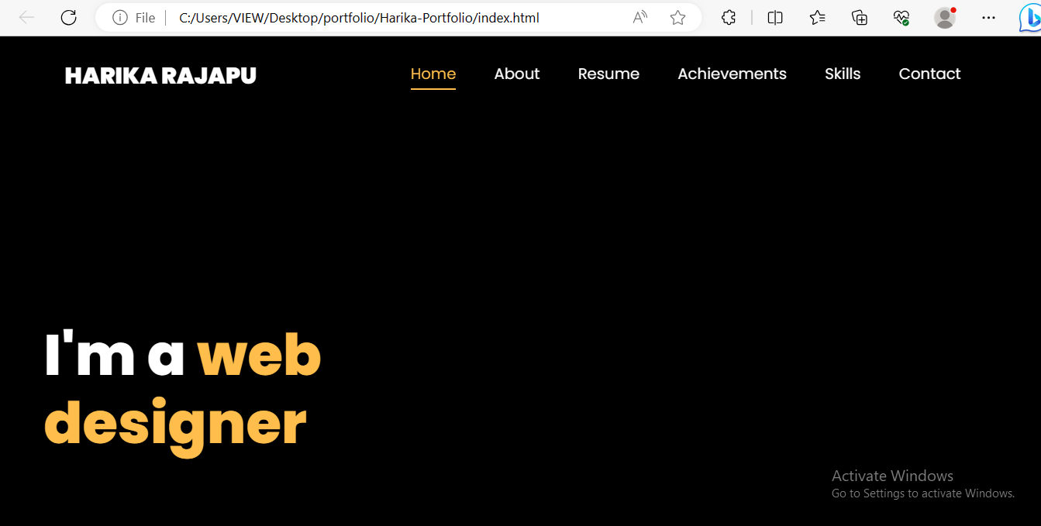
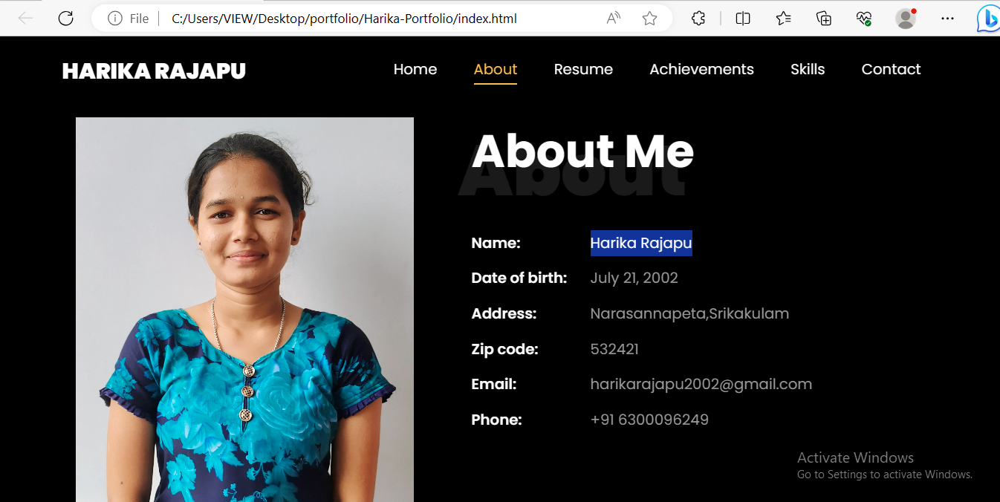
RESULTS
HOME PAGE ABOUT PAGE

Slide 10
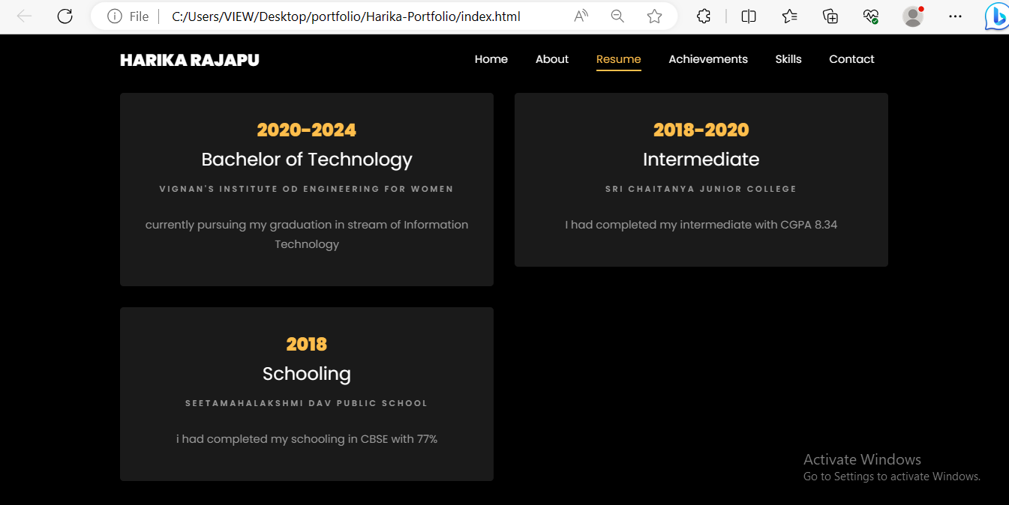
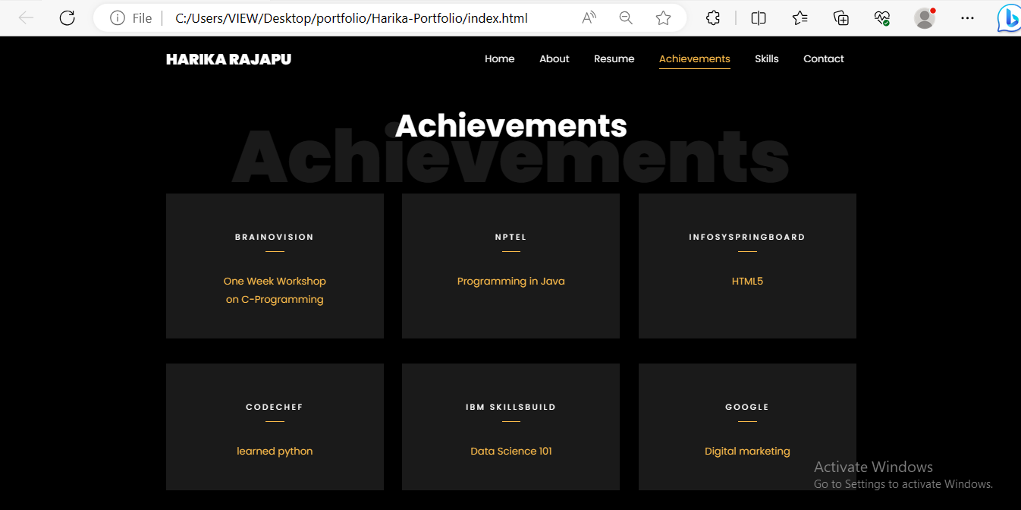
RESULTS
EDUCATION PAGE ACHIEVEMENTS PAGE

Slide 11
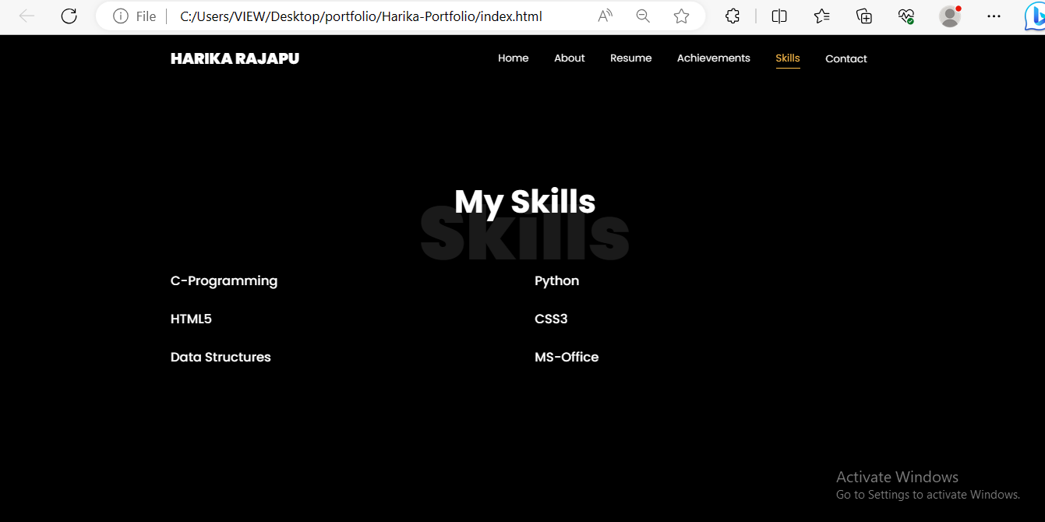
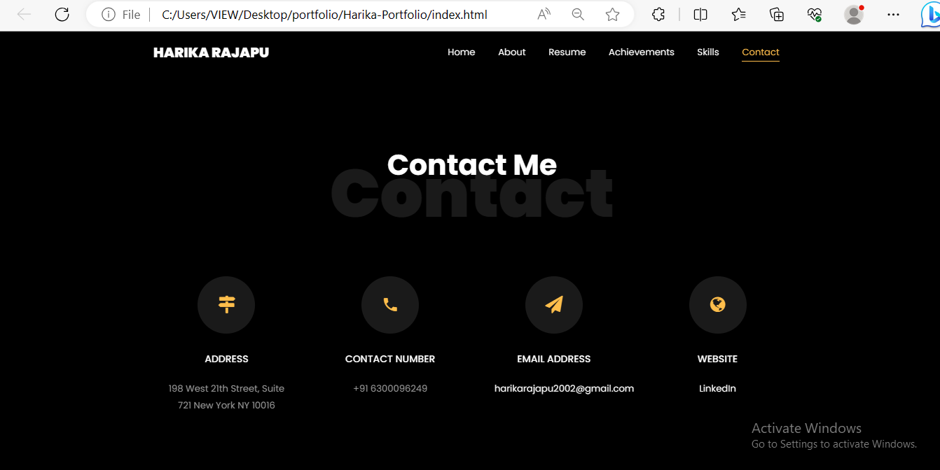
RESULTS
SKILLS CONTACT PAGE

Slide 12
LINKS
PORTFOLIO WEBSITE : Portfolio Website-HarikaRajapu
GITHUB : https://github.com/harika-rajapu/Technical_Portfolio/tree/main
LINKEDIN : https://www.linkedin.com/in/harika-rajapu-a89203266

Slide 13
THANK YOU

