Slide 1
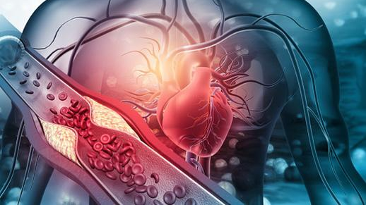
PREDICTION OF HEART DISEASE
By -
Harika Tamma

Slide 2
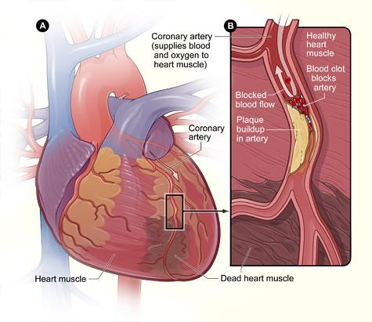
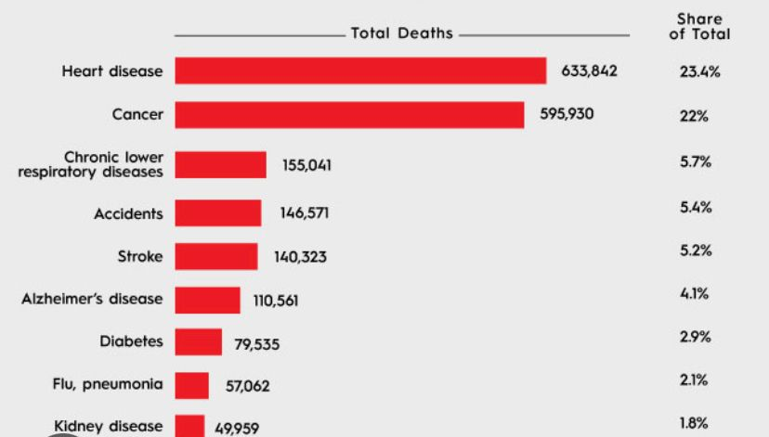
Background
Nowadays, Heart-attack is the most common life- threatening problem all over the world.
Heart disease - the number one killer of both men and women in the United States.
In united states someone has a heart attack every 40 seconds. Every year, about 805,000 people in the United States have a heart attack. Of these, 633,842 are deaths recorded

Slide 3
Problem Statement
The project aims to develop and implement machine learning-based predictive models to accurately identify individuals at high risk of heart diseases. By leveraging demographic, clinical, and lifestyle data, the objective is to create robust models capable of early detection and personalized risk assessment, ultimately enabling proactive interventions and improving patient outcomes.
Research questions-
How do different machine learning algorithms compare in terms of their predictive performance for identifying individuals at risk of developing heart disease?
What are the most influential clinical and demographic factors associated with the occurrence of heart disease, as identified by predictive modeling techniques?
Which algorithm best suits the model?

Slide 4

Importance
Limited number of cardiac experts available.
- As per cdc.gov around 8 Lac people had heart attack in last 2 years.
- Number of cardiologists in US is very minimal
Results will be delivered faster
Extended access to healthcare
Predict Severity – Predict causes

Slide 5

Potential Datasets
Framingham dataset is used for the project which is available for download from University of Washington’s Bio-Statistics Class.
It has 4240 records and 16 features associated to it.
Data Size:

Slide 6
Dataset Information
NOMINAL:
sex: Male(1) or Female(0)
currentSmoker: Whether the patient is smoker or not. Yes(1) and No(0)
BPMeds: Whether the patient was on blood pressure medications. Yes(1) and No(0)
prevalentStroke: Whether the patient had a stroke before. Yes(1) and No(0)
prevalentHyp: Whether the patient has history of Hypertension. Yes(1) and No(0)
diabetes: Whether the patient has diabetes. Yes(1) and No(0)
TenYearCHD: This is our target variable which we will be predicting. Yes(1) and No(0)
ORDINAL:
education: Defined in classes 1-4. Tells us how much our patient is educated.
CONTINUOUS:
age: Contains ages of our patients in whole numbers.
cigsPerDay: Contains the average of cigarettes smoked by the patients in one day.
totChol: Contains total cholesterol level of each patient.
sysBP: Contains systolic blood pressure levels of each patient.
diaBP: Contains diastolic blood pressure levels of each patient.
BMI: Contains body mass index of each patient.
heartRate: Contains the average heart rate of the patient.
glucose: Contains the glucose level of each patient.

Slide 7
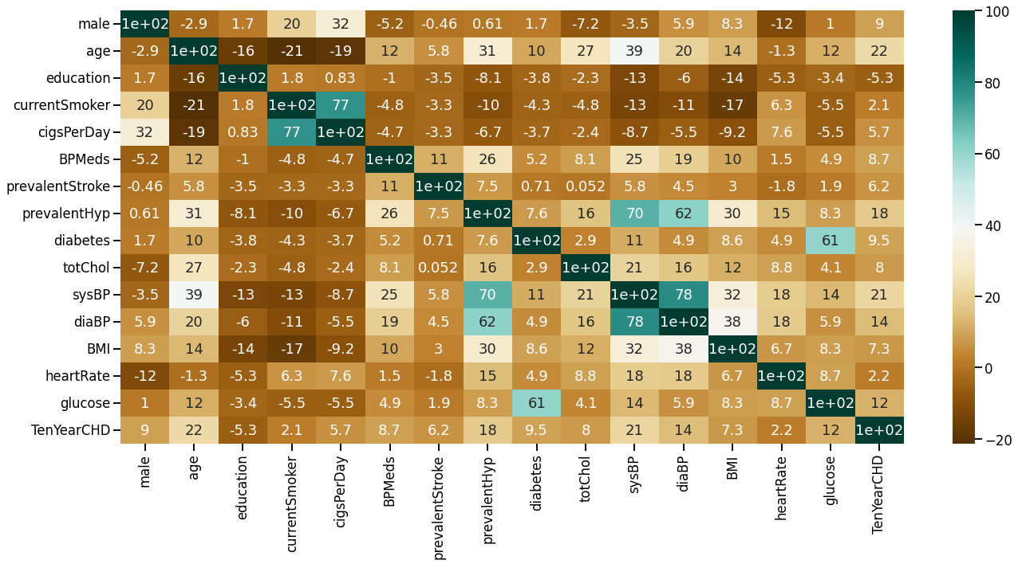
Exploratory Data Analysis: Different data analysis has been done for feature selection to see the impact on prediction.
Heatmap to explain which features are relevant for the prediction

Slide 8
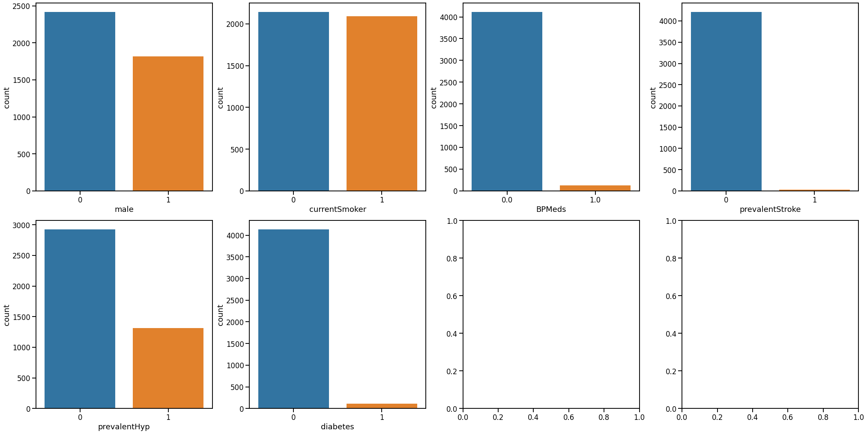
Count plot between the categorical features

Slide 9
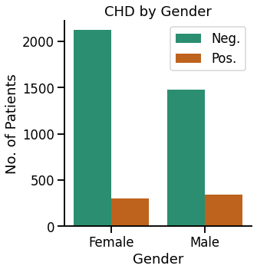
Bivariate Analysis plot Gender wise absence / presence of Chronic Heart Disease (CHD)

Slide 10
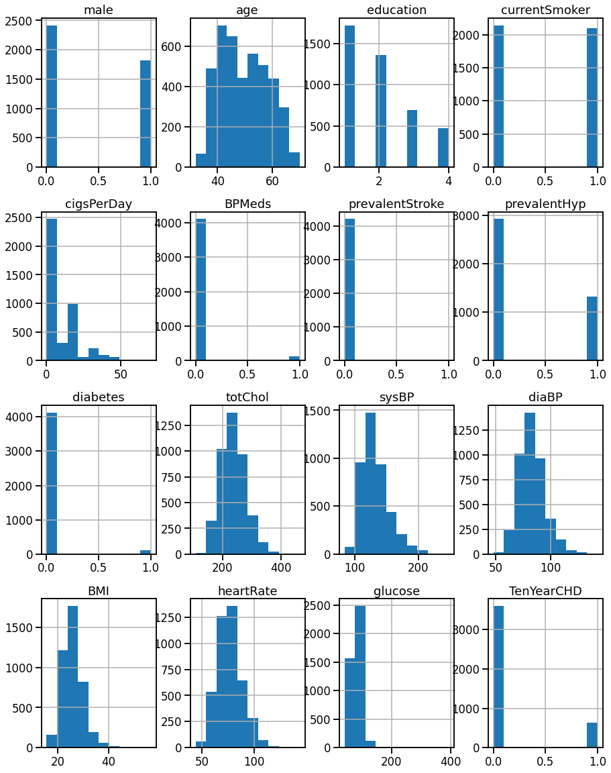
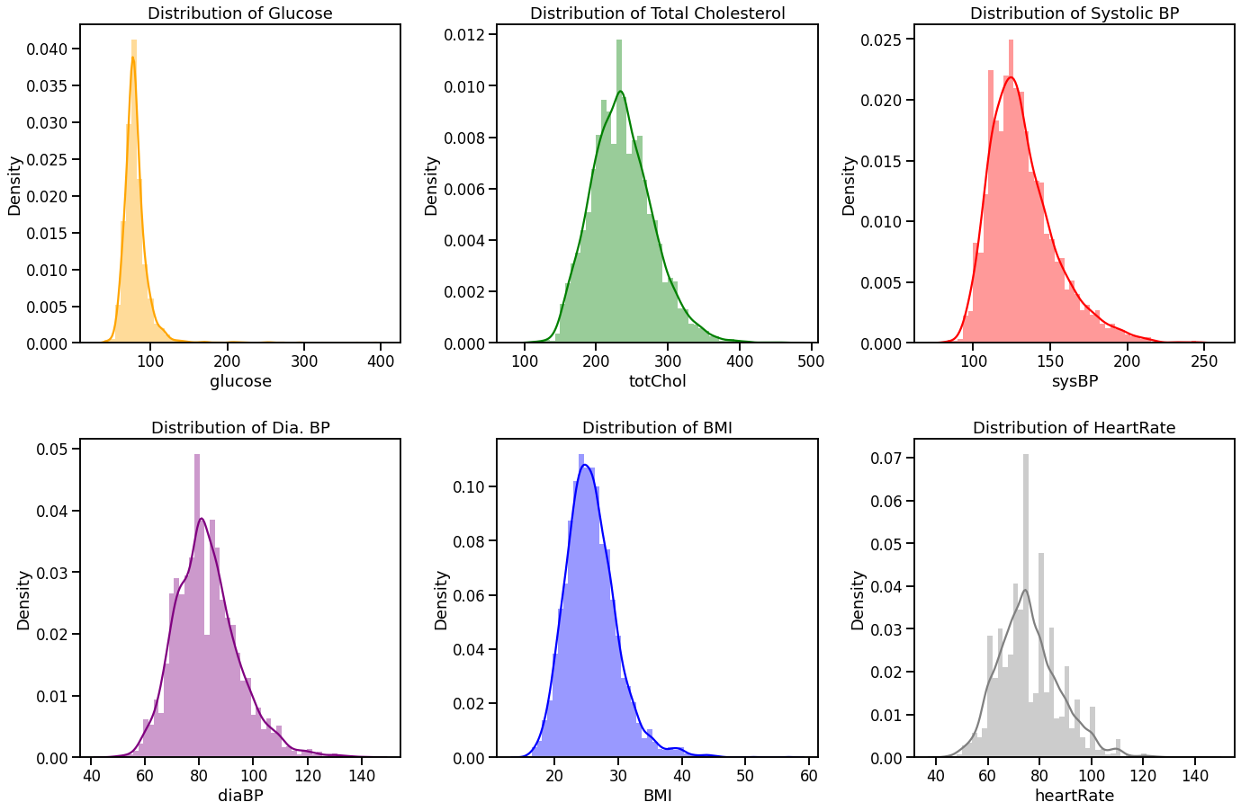
Distributions of Features

Slide 11
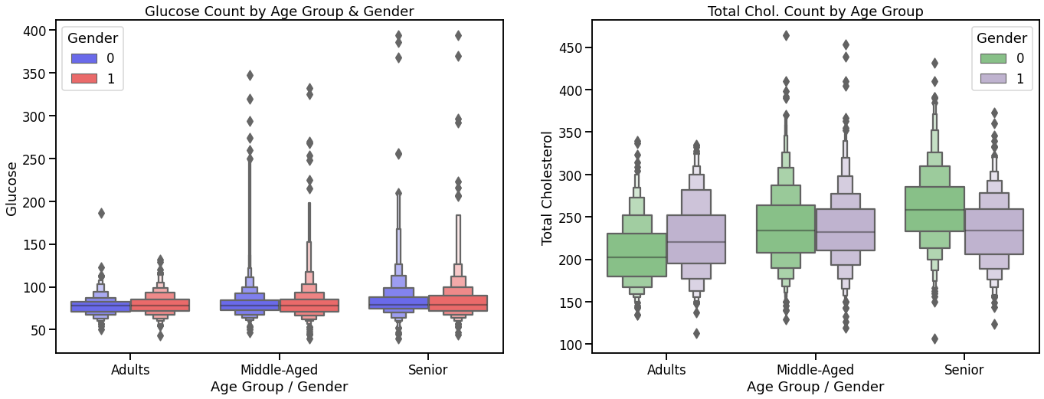
Plots against Glucose Count & Total Cholesterol Count by Age Group & Gender

Slide 12
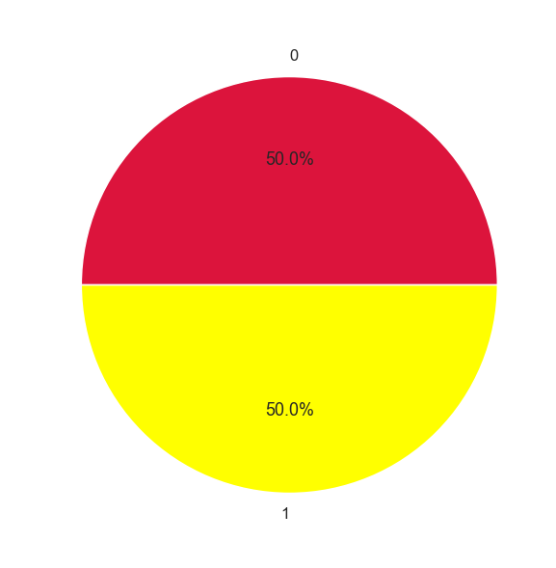
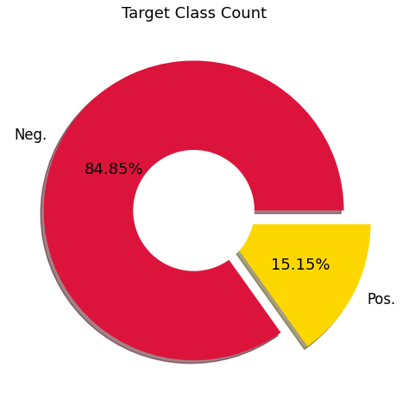
Target class count
Before Resampling
After Resampling

Slide 13
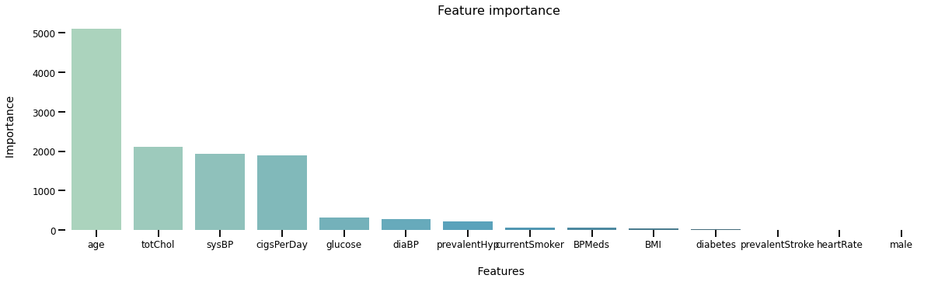
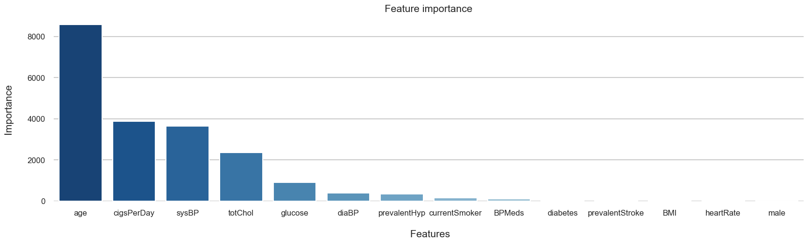
Feature Importance
Before Resampling
After Resampling

Slide 14
Models Explored
Before Resampling :
Models | Accuracy
Logistic Regression | 85%
Random Forest | 85%
K – Nearest Neighbour | 76%
Gradient Boosting Classifier | 85%
Support Vector Classifier | 85%
Decision Tree | 76%
Random forest Classifier has been used for streamlit application( Testing purpose)

Slide 15
After Resampling :
Models | Accuracy
Logistic Regression | 40%
Random Forest | 97%
K – Nearest Neighbour | 98%
Gradient Boosting Classifier | 97%
Support Vector Classifier | 40%
Decision Tree | 98%
Decision Tree Classifier has been used for streamlit application

Slide 16
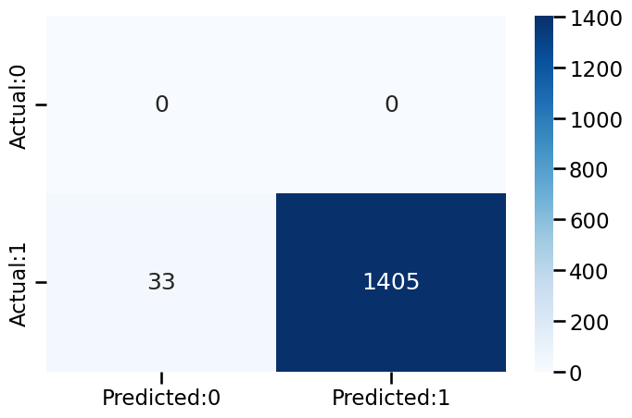
Confusion matrix of Decision Tree Classifier:
Classification report:
Precision recall. f1-score. support
0 0.00 0.00 0.00 0
1 1.00 0.98. 0.99 1438
accuracy 0.98 1438
macro avg 0.50 0.49 0.49 1438
weighted avg 1.00. 0.98 0.99 1438

Slide 17
Streamlit Heart Disease Prediction App Overview:
Input: Users can input their age, smoking status, medication usage, medical history, and various health metrics like cholesterol, blood pressure, BMI, and glucose level.
Prediction: After clicking the "Predict" button, the app displays the predicted risk of heart disease based on the user's input. If the risk is high, an error message is shown, advising the user to consult a doctor. If the risk is low, a success message is displayed, encouraging the user to stay healthy.
Output: Users receive an immediate prediction of their heart disease risk, categorized as high or low, along with guidance on necessary actions.
User-Friendly Interface: Intuitive sliders and dropdown menus make it easy for users to input their information and obtain predictions with just a click.
Error Handling: The app ensures smooth user experience by handling errors gracefully and prompting users to try again if necessary.
Conclusion: The Streamlit app provides a convenient tool for individuals to assess their heart disease risk and take proactive steps towards better health.

Slide 18
CONCLUSION
Our project on the prediction of heart disease harnesses the power of machine learning to address a critical health challenge.
Through comprehensive analysis and model development, we have created robust predictive models capable of accurately identifying individuals at high risk of heart disease.
The development of our Streamlit Heart Disease Prediction App provides users with a convenient tool for assessing their heart disease risk and taking proactive steps towards better health.

Slide 19

Thank you

