Slide 1
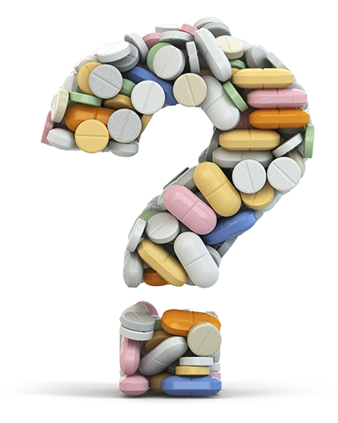
Sentiment Analysis of Drug Reviews using Machine Learning Algorithms
GUIDED BY
DR. THIAGO E. A. OLIVEIRA
PRESENTED BY
HARIKA KUDARVALLI (0887033)

Slide 2

CONTENTS
Introduction
Literature Review
Dataset
Flowchart
Algorithms
Comparison
Conclusion
Future Work

Slide 3
INTRODUCTION
SS
Machine Learning - Machine learning is a method of data analysis that automates analytical model building.
Sentiment Analysis - Sentiment analysis (also known as opinion mining or emotion AI) refers to the use of natural language processing, text analysis, computational linguistics, and biometrics to systematically identify, extract, quantify, and study affective states and subjective information.
Notes:
Isn’t it difficult to search different reviews about medicines? Just to buy a phone we search 10-20 sites for the reviews why not with our medicines which affect our health. Applying different algorithms and doing analysis on this dataset gives us important insights . This is kind of related to my future work. Lets come back to what I did presently.

Slide 4
LITERATURE REVIEW
Aspect-Based Sentiment Analysis of Drug Reviews Applying Cross-Domain and Cross-Data Learning. [1]
Approaches to Cross-Domain Sentiment Analysis: A Systematic Literature Review. [2]
Patient opinion mining to analyze drugs satisfaction using supervised learning. [3]
Analysis of the effect of sentiment analysis on extracting adverse drug reactions from tweets and forum posts. [4]
Notes:
After reading multiple journal papers on this domain i.e. in medical field, I could draw some conclusions and boost my project.
The authors of this paper are the original authors for my dataset too. They have extensively explained about their dataset in their original paper. Their research was more on cross domain and cross data analysis as the title says and they had applied logistic regression to build their model.
The second paper is more of a survey where they have extensively studied almost 30 different journal papers on cross domain sentiment analysis, different datasets and methods used and have summarized their work.
Third paper is kind of a sentiment analysis on a drug review dataset where they have compared only 2 drugs. They have performed probabilistic neural network (PNN) and radial basis function neural network (RBFN) where RBFN outperforms the statistical approach.
Fourth paper focuses on adverse drug reactions and have researched on ADRMine (extracting ADRs). They retrieved their data from twitter posts and DailyStrength posts and applied sentiment analysis.

Slide 5
DATASET
Patient reviews on specific drugs along with related conditions
A 10-star patient rating reflecting overall patient satisfaction.
Obtained by crawling online pharmaceutical review sites.
Why?
Perform Sentiment Analysis
Cross Domain Analysis (Transferability)
Multiple Data Sources (Transferability – Drug.com & Druglib.com)

Slide 6
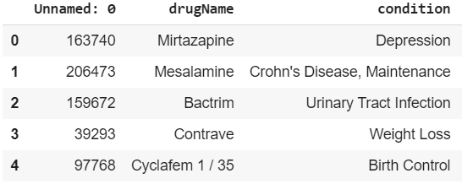
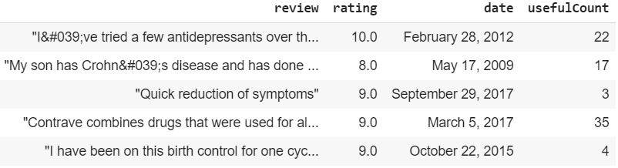
DATASET
Attributes
uniqueID
drugName
condition
review
rating
date
usefulCount

Slide 7
FLOWCHART
Data Retrieval
Data Preprocessing
Data Visualization
Evaluation Metrics
Training & Testing
Algorithms
Comparison

Slide 8

ALGORITHMS
Random Forest
Source - https://medium.com/@williamkoehrsen/random-forest-simple-explanation-377895a60d2d
Notes:
Classification and Regression Algorithm.
Collection of decision trees working as an ensemble.
Each tree will give out a prediction .
Majority one will be the final prediction.
Not a good regression algorithm.
Less control on what model does – parameters or random seeds.

Slide 9

RESULTS
Classification Report for RANDOM FOREST
 | Precision | Recall | F1-Score
0 | 0.33 | 0.71 | 0.46
1 | 0.94 | 0.77 | 0.86

Slide 10
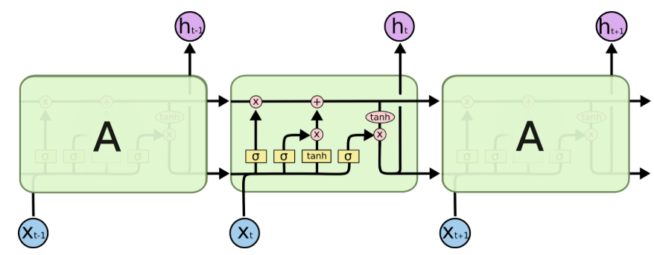
ALGORITHMS
Long Short - Term Memory (LSTM)
Source - https://www.knime.com/blog/text-generation-with-lstm
Notes:
Deep Learning Neural Network
Introduced to solve vanishing and exploding gradient in RNN.
Rather than storing entire history, LSTM can selectively remember & forget data.
Memory blocks – storing, Gates – manipulation (forget, input, output)
Longer to run and deplete more memory

Slide 11
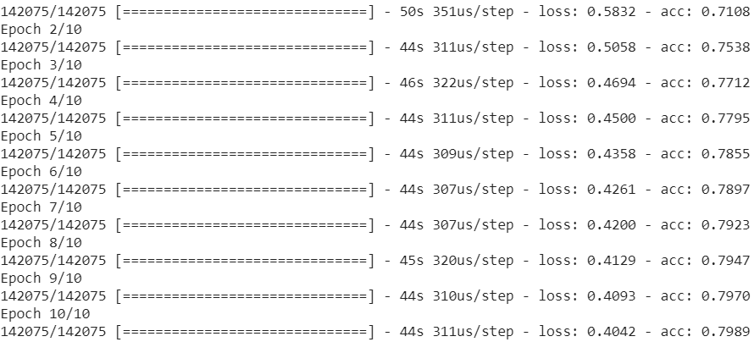
RESULTS
Training

Slide 12

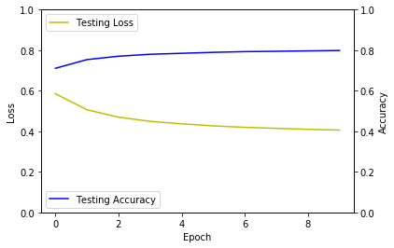
RESULTS

Slide 13
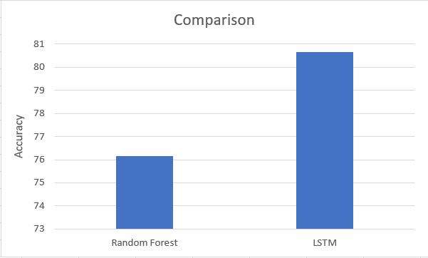
COMPARISON
Notes:
There is no vast difference in our observation but as you can see:
Random Forest = 76.15 %
LSTM = 80.65 %
Random forest works really good with tabular or structured data. And our data is structured. If in place of text we had images, audio or signals to process, there would be vast difference in our results. Because neural networks wonders with unstructured data.
Random Forest = better with tabular data

Slide 14
CONCLUSION
Sentiment Analysis on drug reviews.
Machine Learning vs Deep Learning
LSTM outperforms Random Forest

Slide 15
FUTURE WORK
Part 1
CNN
Comparison (Other metrics)
Predictions
Part 2
Web Application

Slide 16
REFERENCES
[1] Felix Graber, Hagen Malberg, Surya Kallumadi, and Sebastian Zaunseder. Aspect-Based sentiment analysis of drug reviews applying cross-Domain and cross-Data learning. ACM International Conference Proceeding Series, 2018-April:121–125, 2018.
[2] Tareq Al-Moslmi, Nazlia Omar, Salwani Abdullah, and Mohammed Albared. Approaches to Cross-Domain Sentiment Analysis: A Systematic Literature Review. IEEE Access, 5:16173–16192, 2017.
[3] Vinodhini Gopalakrishnan and Chandrasekaran Ramaswamy. Patient opinion mining to analyze drugs satisfaction using supervised learning. Journal of Applied Research and Technology, 15(4):311–319, 2017.
[4] Ioannis Korkontzelos, Azadeh Nikfarjam, Matthew Shardlow, Abeed Sarker, Sophia Ananiadou, and Graciela H. Gonzalez. Analysis of the effect of sentiment analysis on extracting adverse drug reactions from tweets and forum post. Journal of Biomedical Informatics, 62:148–158,2016.

Slide 17
THANK YOU!

