Slide 1

LEAD QUALITY DATA ANALYSIS AND OPTIMIZATION STRATEGY
Optimizing Lead Quality: A Data Driven Path to Enhanced CPL
Name: Harika
Data Analyst at aarki

Slide 2
Executive Summary: Key Insights & Strategic Opportunity
Our objective was to analyze ~3,000 leads to understand quality trends, identify key drivers, and assess the feasibility of a 20% lead quality improvement to secure a 20% CPL increase from $30 to $33.
Analysis revealed that lead quality has shown a slight upward trend over the observed period, with noticeable peaks in even-numbered months (April, June, August), suggesting cyclical performance patterns, with a close rate of ~11%.
Crucially, I've identified several significant drivers of lead quality notably, specific Widgets, partners, Advertisingcampaigns and marketing campaigns which are consistently yielding quality leads
The exciting news is that achieving the target 9.6% lead quality (from our current ~8.0%) appears feasible. This can be accomplished by reallocating traffic from low-performing segments to proven high-performing sources

Slide 3
Agenda: Analytical Journey
Understanding the Challenge & Our Approach
Trend Analysis: Is Lead Quality Evolving?
Uncovering Quality Drivers: What Makes a Good Lead?
Ad Creative Performance (widgets, partners, campaigns)
Traffic Source & Context
Deep Dive: Search Keyword Insights
Debt-level analysis
The Opportunity: Pathway to a 9.6% Quality Rate.
Actionable Recommendations & Next Steps
Open Discussion (Q&A)

Slide 4
The Goal: Quality Leads, Better Returns
I was tasked with analyzing lead data to answer three key questions
1. Are we seeing any lead quality trends over time (improving, declining)? Are they stastistically significant?
2. What can we learn about the drivers of "lead quality" from this dataset? What segments - where the ad was shown, what kind of person filled out the ad, what kind of ad did they see - have differing lead quality rates?
3. If advertiser says they will increase our CPL by 20% (i.e., $30 to $33) if we increase our lead quality by 20% (i.e., from 8.0% to 9.6%), do we see any opportunities to do that here? What kinds of things could we do?
'Good Quality Leads': For this analysis, 'good quality' leads include those 'Closed' as customers, or in 'EP Sent,' 'Received,' or 'Confirmed' statuses, aligning with the advertiser's positive indicators. Our baseline quality rate is 8.11%
"Methodology: I employed [tools, e.g., Python with Pandas for data manipulation and Seaborn/Matplotlib for visualization, and Excel for pivot analysis]. Key steps included data cleaning, data exploration, feature extraction from various attributes.

Slide 5
Lead Quality Trend: A Look Over Time

Slide 6
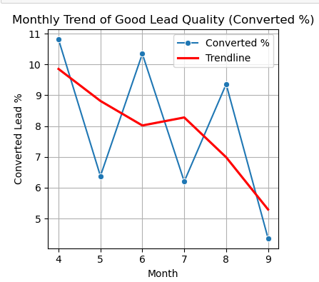
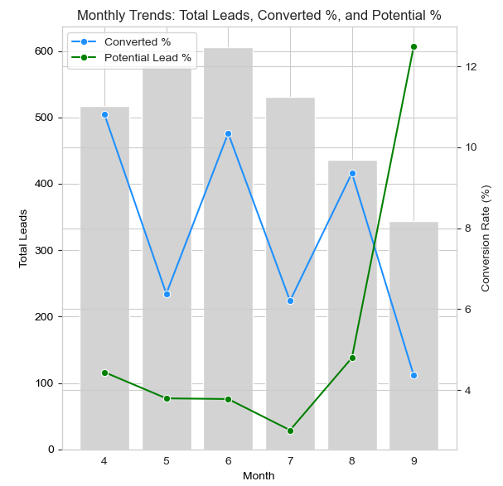
Lead Quality
As we can see, lead quality has followed a cyclical pattern, with higher conversion rates observed in months 4, 6, and 8, and noticeable dips in the alternating months (5, 7, and 9).
While we reached as high as 10.9%, the recent downward trend brings us below 5% by 9th month a gradual decline in lead quality.
We can observe a promising upward trend in Potential Leads (EP Sent, Received, Confirmed) over time indicating more users are progressing into the sales funnel. With targeted follow-up and nurturing, this growing pool of engaged leads an opportunity to reach the 9.6% target.
Assumptions to reach the target 9.6% lead quality?
This observation tells us that while we have peak-performing periods, the overall lead quality isn’t improving organically. In fact, the decline underscores the need for proactive optimization — particularly in identifying drivers that are working in high-performing months and converting potential leads will stabilize and raise our baseline conversion rate closer to the 9.6% target.

Slide 7
Uncovering Quality Drivers: What Makes a Good Lead ?

Slide 8
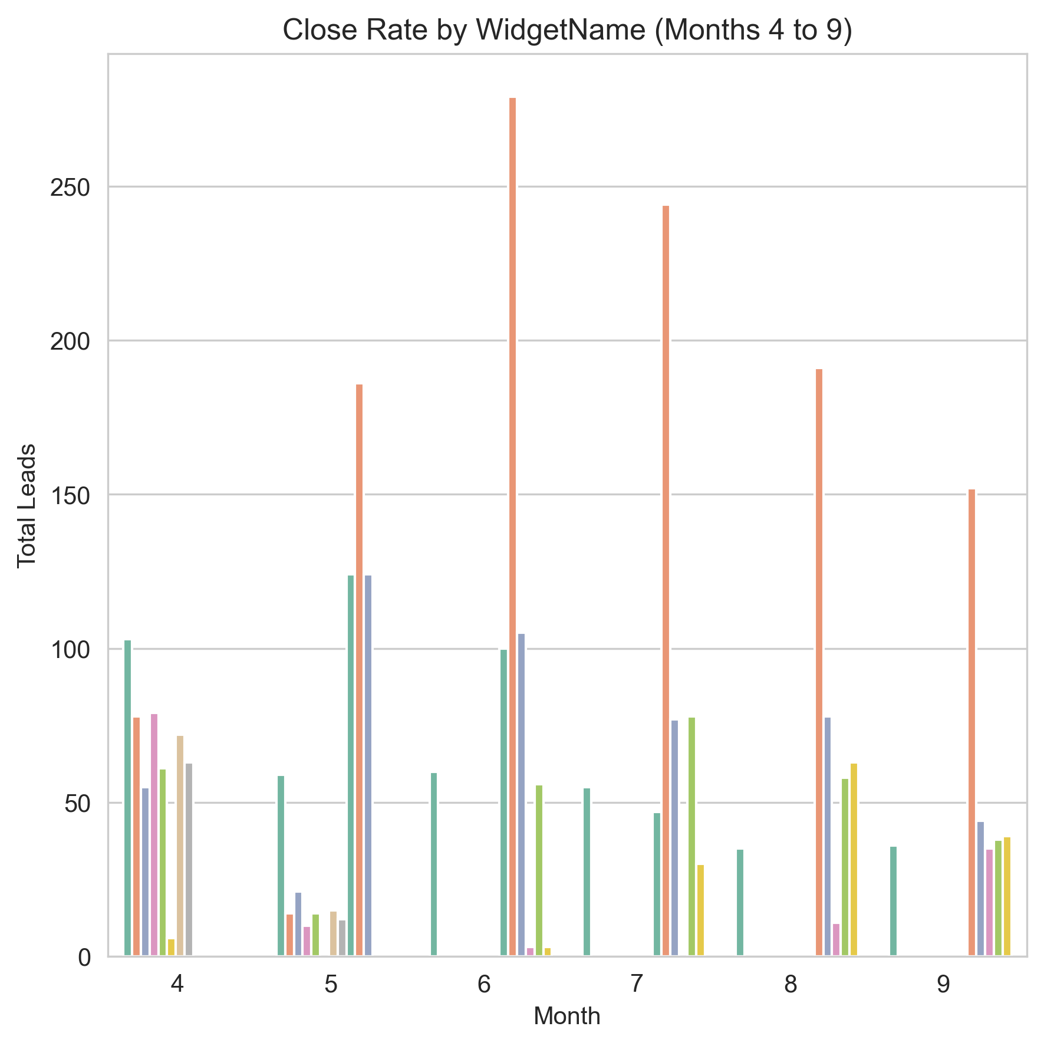
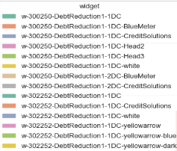
1. Impact of Creativity
Drilling into ad creatives, analyzed WidgetName to understand how different creative structures and designs impact lead quality.
Key findings is that certain widgets, consistently rank among the top performers across multiple months. This suggests that these creative formats are more resilient to variation in traffic conditions and audience intent. The Top 5 are below
w-300250-DebtReduction1-1DC-CreditSolutions,
w-300250-DebtReduction1-1DC-white,
w-300250-DebtReduction1-1DC,
w-300250-DebtReduction1-1DC-Head3
Implication: Optimizing ad creative structure by focusing on proven, high-performing widgets presents a clear and scalable opportunity to increase lead quality — without requiring additional volume or budget and helps us reach our goal to 9.6%

Slide 9
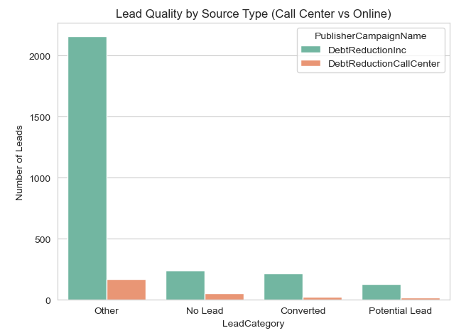
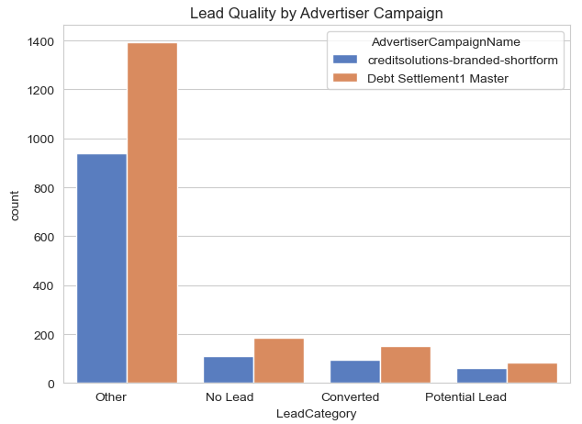
2.Campaign Influence on Lead Quality
Sourcing and campaign plays a major role in determining lead quality can observe Online form submission
Publisher Campaigns:
Online form submissions show a higher conversion rate compared to Call Center–entered leads, indicating stronger user intent and engagement in self-submitted leads online
Branded vs. Generic Advertising Campaigns:
Leads generated through branded campaigns achieved better conversion rates (6.25%) than those from generic forms (4.6%), suggesting that brand visibility enhances trust and lead quality.
Implication:
To improve overall lead quality, we recommend strategic reallocation of spend toward high-performing partners and branded creatives, while continuing to optimize the lead capture experience for online users and help us achieve 9.6% goal

Slide 10
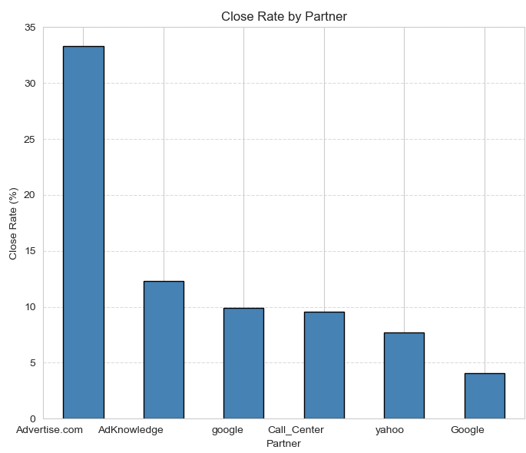
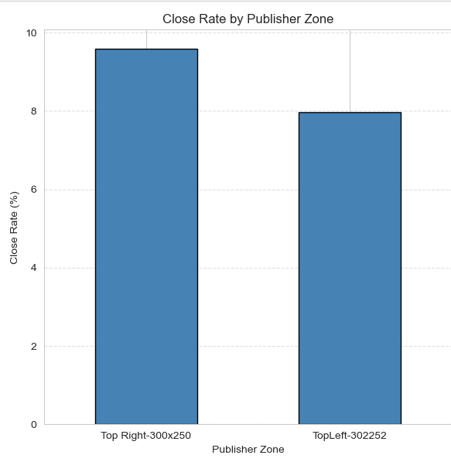
3. Partner Performance & Ad placement
Partner Performance:
Certain traffic partners significantly outperform others in terms of lead quality. For example, Advertise.com leads convert at 30–35%, while AdKnowledge delivers consistent results above 12%. Partners like Google and Call Center follow with ~10% conversion, whereas several others fall below 5%.
Ad Placement:
Ad placement location has a direct impact on lead quality. While most of our impressions are served on the top-left of the page, but interestingly the highest-performing leads , particularly those who convert ,originate from ads placed on the top-right.
Implications:
Recommend to prioritize top-right ad placements where possible, as this zone consistently delivers higher lead quality and by shifting budget toward top-performing partners like Advertise.com and AdKnowledge, we can accelerate progress toward the 9.6% conversion target

Slide 11
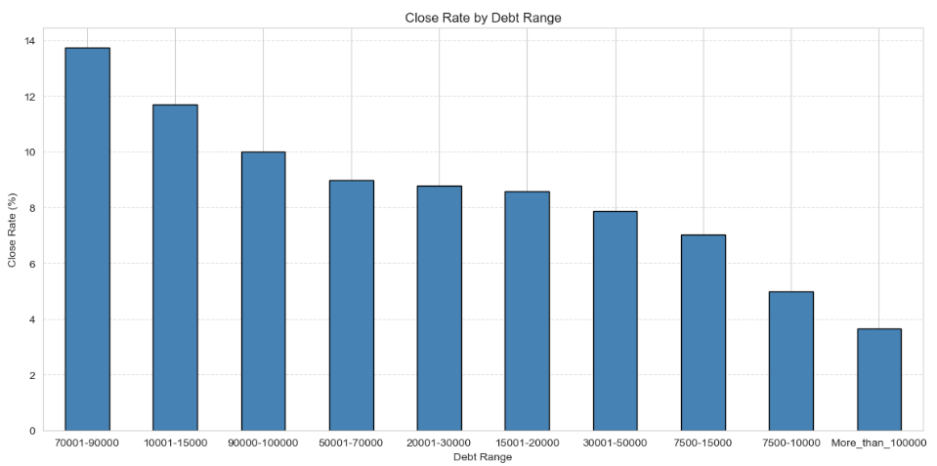
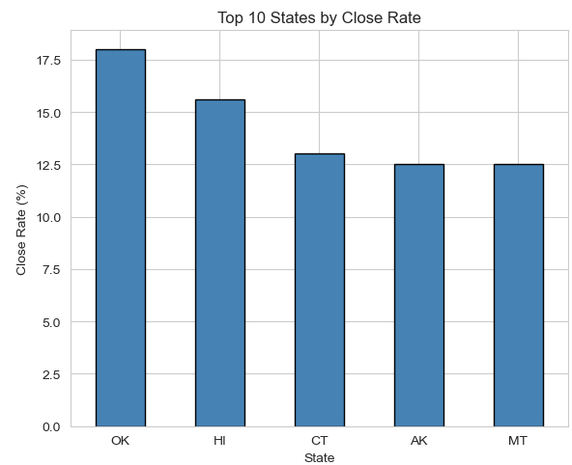
4. Debt level and Performing States
Debt Level analysis
Lead quality strongly correlates with declared debt level. From the analysis, leads with a debt range of 70,001–90,000 show the highest conversion rates, indicating strong intent
Additional strong performance is observed among users with debt between 10,001–15,000 and 90,000–100,000, making them high-potential segments for targeting and campaign refinement.
Highest performing States:
Certain states consistently produce higher-quality leads, with Oklahoma with conversion rate of 17.5%, Hawaii at 15%, Connecticut at 12.5%, showing the highest conversion rates. This performance may be driven by factors including strong advertiser presence, favorable economic fit
Implication
Prioritizing traffic and creative strategies that attract users in high-converting debt ranges — particularly $70K–$90K and to prioritize ad spend and campaign focus in these top-performing states — to boost overall lead quality and move closer to the 9.6% CPL goal.

Slide 12
Deep Dive: Lead Quality Driver Insights
Ad Creative & Widget Performance:
Specific creative formats consistently attract high-quality leads, indicating strong creative-market
Traffic Source & Partner Influence:
Partners like Advertise.com and AdKnowledge deliver superior conversion rates (30–35% and 12%+ respectively), highlighting opportunities for reallocation.
Geographic Signals:
States such as OK, HI, CT, AK, and MT show above-average conversion performance, suggesting favorable audience targeting in these regions.
Debt Range Insight:
Users with declared debts in the $70K–90K range are the most likely to convert, making them prime candidates for audience targeting and tailored messaging.
Campaign Type & Branding:
Branded campaigns outperform generic ones, and online form submissions outperform call center entries, signaling higher user intent from digital channels.
Search Intent Clarity:
Keywords that signal urgency (e.g., ‘get debt help’) drive higher lead quality than broad informational queries.
Address & Phone Score Paradox:
Interestingly, lower Address and Phone Scores — typically considered “lower quality” data — correlate with higher conversion rates

Slide 13
The Opportunity
The Pathway to 9.6% CPL
If we increase the share of leads from high-performing widgets (currently 18% of volume, converting at ~12–15%),
And scale up lead flow from top partners such as Advertise.com (30–35% quality rate) and AdKnowledge (12%+),
While reducing volume from low-performing creatives and campaigns (under 5% close rate), increases the quality leads
And concentrating on debt ranges between $70K–90K and high-performing states (OK, HI, CT, MT, AK)

Slide 14
Actionable Recommendations
Scale up
Scale up use of consistently high-converting widgets like w-300250-DebtReduction1-1DC-CreditSolutions, white, and Head3.
Increase
Increase spend with top-performing partners: Advertise.com, AdKnowledge, and Google Search.
Focus
Focus campaigns on OK, HI, CT, AK, and MT, where leads are converting at significantly higher rates.
Prioritize
Prioritize acquisition of leads declaring debt between $70K–$90K — highest conversion range.
Refine
Refine keyword strategy to focus on high-intent search queries (e.g., “get debt help now”) as exact match
Follow up
Follow up quickly on potential leads (EP Sent/Received/Confirmed) — a growing segment of leads "stuck" mid-funnel.

Slide 15
Conclusion
In summary, our analysis demonstrates that lead quality is influenced by a range of identifiable factors, from ad creative to traffic source and user intent.
"We've identified clear, actionable opportunities to elevate our overall lead quality to the 9.6% target, thereby unlocking a valuable CPL increase.

Slide 16
Q&A

Slide 17
Thank You
Case Study by:
Harika Mangu
Data Analyst at aarki

