Slide 1

Exploratory Data Analysis(EDA)
by
HARIKA KUDUMULA

Slide 2
Background
The Indian Premier League (IPL),is a professional Twenty20 cricket league in India, founded by the Board of Control for Cricket in India (BCCI) in 2008.
When?
April and May of every year
Who?
Teams representing 8 Indian cities and other states.
Seasons?
2008 - 2018 (eleven till date)

Slide 3

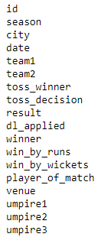
Data Profile
Data Structure
Categorical and numerical data
Excel Sheet containing 696 records and 18 features
Data Types
Integer
Object
Missing values
Present

Slide 4
Data Preprocessing
Data Normalization
Date variable is considered as categorical variable and has different format for 2018 season data → Convert to date format
ID column have discontinuous values (Season 2018)
(in range of 7000 - 7953) → Sorted by date & reassigned
Teams(14 distinct count), cities , venues had alias names → Replaced aliases
Missing Data and its imputation
Umpire 3 has 91.4% missing data → Deleted umpire 3 data
City column has 7 missing values → Find out by using venue details
Umpire 1,2 have 1 missing value → Replaced with season MODE

Slide 5
Problem statement
Understanding the IPL data by doing Exploratory Data Analysis and
- Finding patterns
- Determining relationships
- Preliminary understanding of important features in the data.

Slide 6
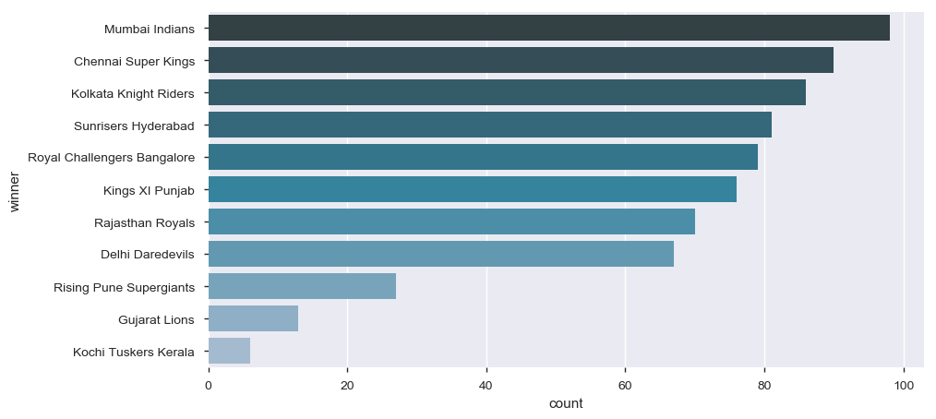
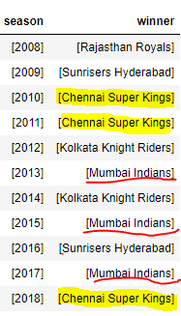
Best Teams
Most successful IPL Team –Mumbai Indians

Slide 7
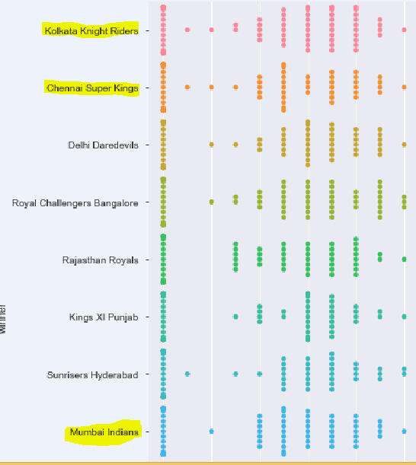
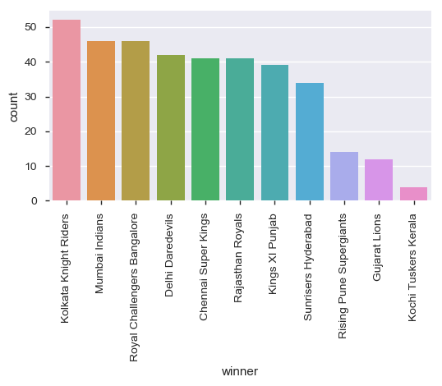

Best Chasing Teams

Slide 8
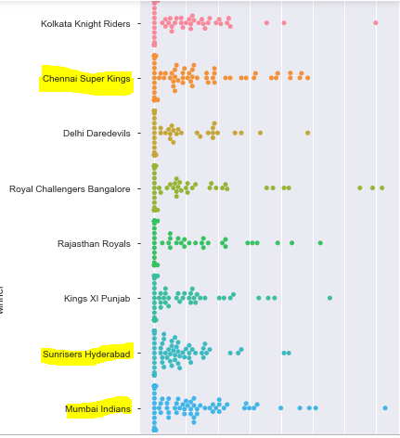
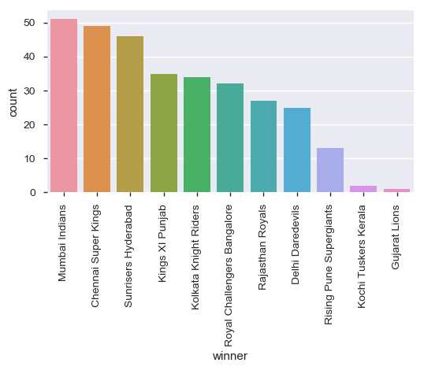

Best Defending Teams
Notes:
Mumbai Indians 146 , Royal Challengers Bangalore 144, 138 ,130, Kolkata Knight Riders 140

Slide 9
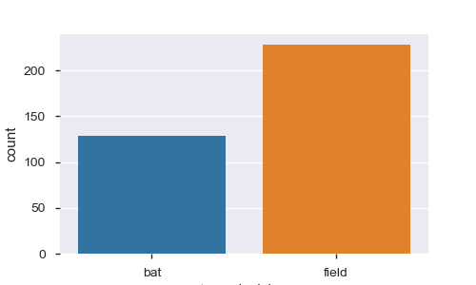
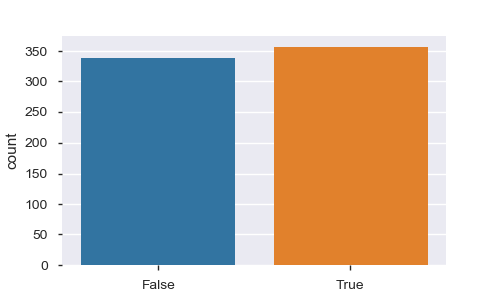
Toss Decision
What toss decision helped toss winner to win the match ?
Has toss winning helped in match winning?

Slide 10
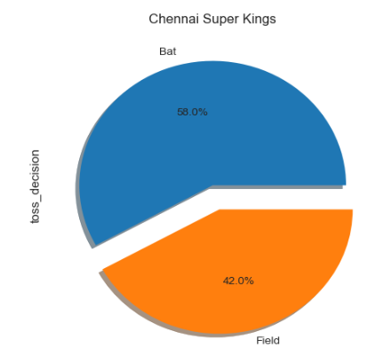
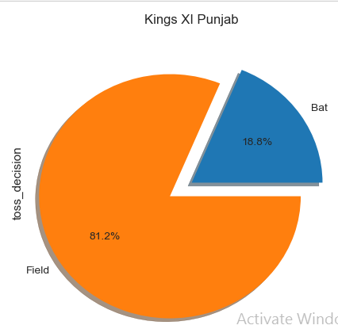
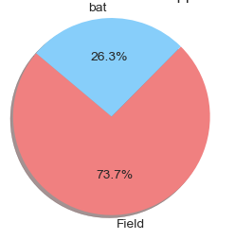
Toss Decision
What toss decision helped toss winner to win the match ?
Influence of toss decision on Duckworth–Lewis method applied matches
Notes:
For only Chennai Super Kings decision to bat first helped winning the matches, for rest of all teams fielding first helped in winning matches.

Slide 11
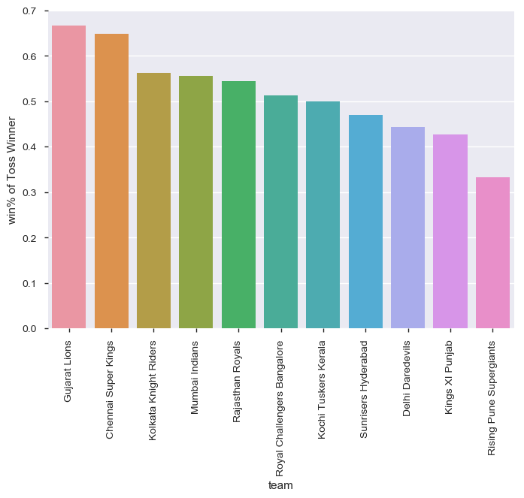
Win percentage of teams who won the toss

Slide 12
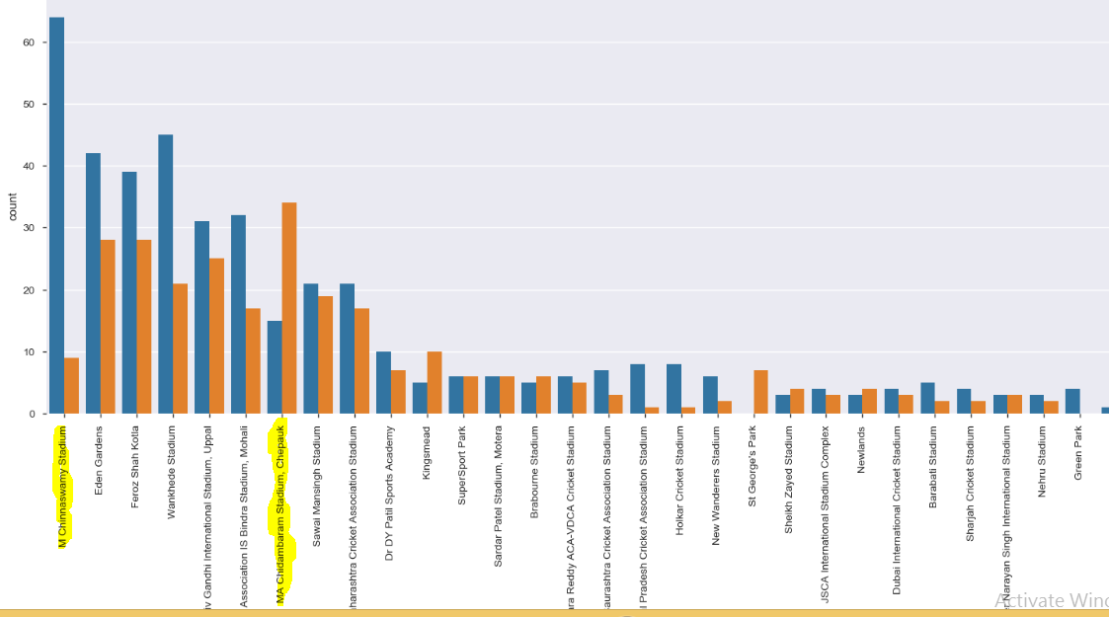
Toss Decision by venues
Notes:
M Chinnaswamy stadium - best batting pitch(4/5 win_by_runs). MA Chidambaram stadium , chepauk - best bowling pitch.

Slide 13
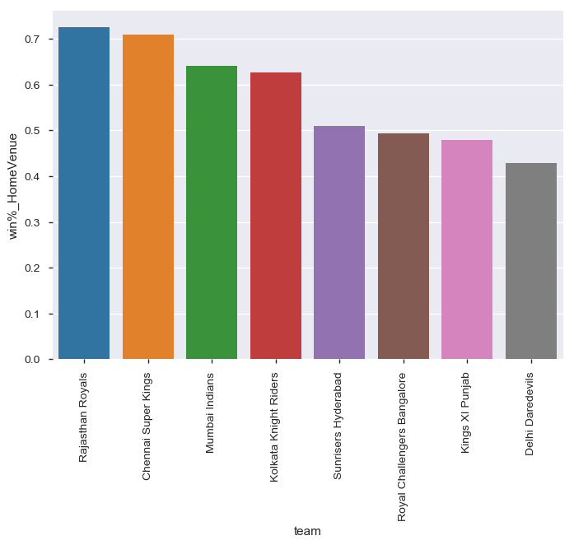
Influence of Home Venue on winning

Slide 14
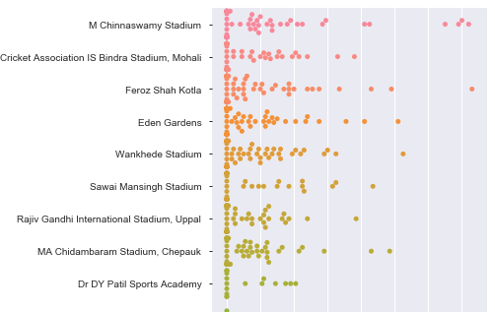

Best defending venues
Notes:
1.Eden gardens 2.feroz shah kotla 3.chidambaram stadium

Slide 15
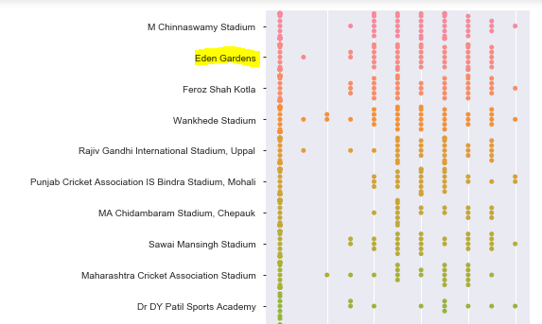

Best Chasing venues

Slide 16
Conclusion
Mumbai Indians and Chennai Super Kings are both best chasing teams as well as defending teams, which justifies they being most title winners.
Toss Decision of fielding first positively influences almost all IPL teams in all seasons.
Home Venue has positive correlation with winning chances for major teams.
Venue, toss decision has strong influence on the outcome of the match. Hence are important features for prediction models.

Slide 17
Actionable Items
Venue, toss winner, toss decision have strong correlation with result of the match, hence these three variables should be included in any kind of prediction modelling on this data.
As we have seen Mumbai Indians and Chennai Super Kings are the best teams, any marketing company can tap their reputation for promotion of their goods and services.

