Slide 1

WELCOME
criteria
CLOUDOC
end
pro&con
goals
code
about
Positive wellness

Slide 2
MESSAGE FROM current health scenario of India
India has over a million modern medicine doctors for over 1.3 billion population. So where does the 900 million rural population turn for treatment if 70% doctors occupy urban sector.
end
goals
criteria
Pro&con
code
about

Slide 3
Our Inspiration
So our project concentrates on designing a GUI, to provide rural population with the same effect as such of urban people.
Nurse collects details of patient in GUI which has inbuilt disposable and non-disposable files.
end
goals
criteria
Pro&con
code
about

Slide 4


1
2
3
end
PATIENT
NURSE
DOCTOR
criteria
Pro&con
goals
code
about
GIVES THE DETAILS TO THE ADMIN
COLLECTS THE DETAILS OF THE PATIENT LIKE SYMPTOMS AND SENDS TO DOC
GETS THE MAIL AND GIVES TREATMENT

Slide 5
NURSE
DOCTOR
PATIENT
No manual mistakes as everything is automated from creating the patient file to disposing them
No blame on admin for losing documents
No need to remember n number of doc mail ID.
*Doesn’t have to check for mails.
*just have to enter token number
He gets surety treatment
No loss of details
Will be provided with copy
end
criteria
Pro&con
goals
code
about

Slide 6

end
criteria
Pro&con
goals
code
about
JAVA
SWING
For security
For rich GUI

Slide 7
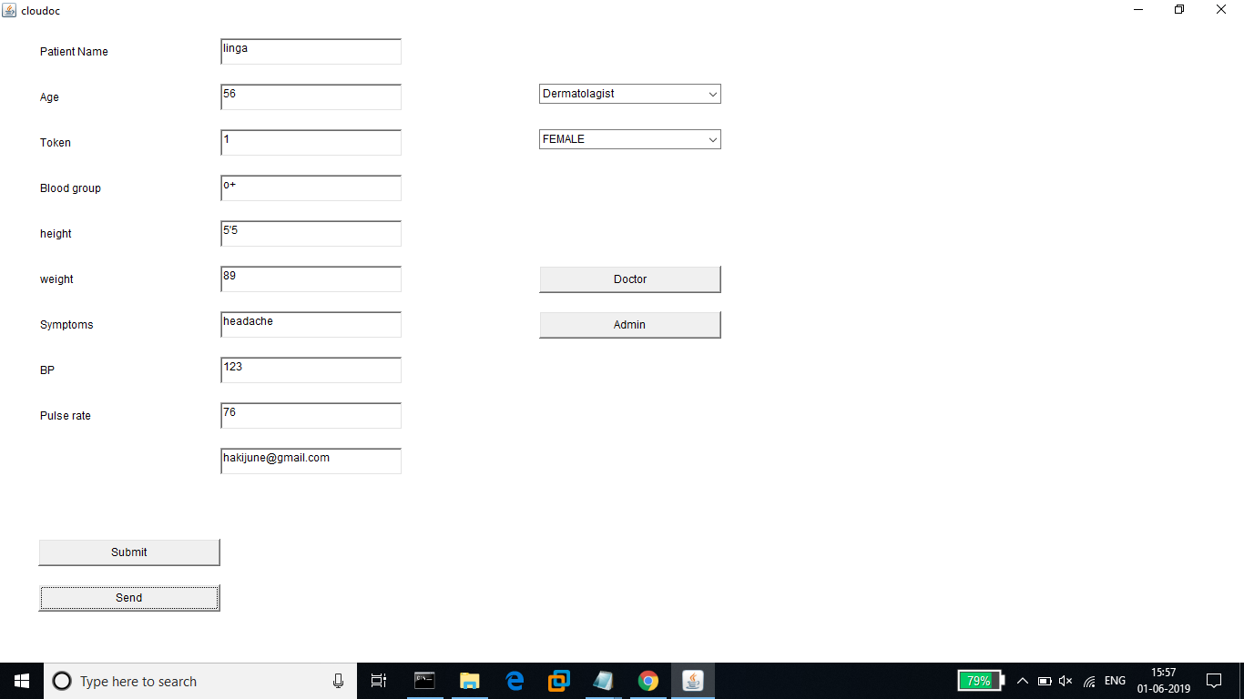
end
criteria
Pro&con
goals
about

Slide 8
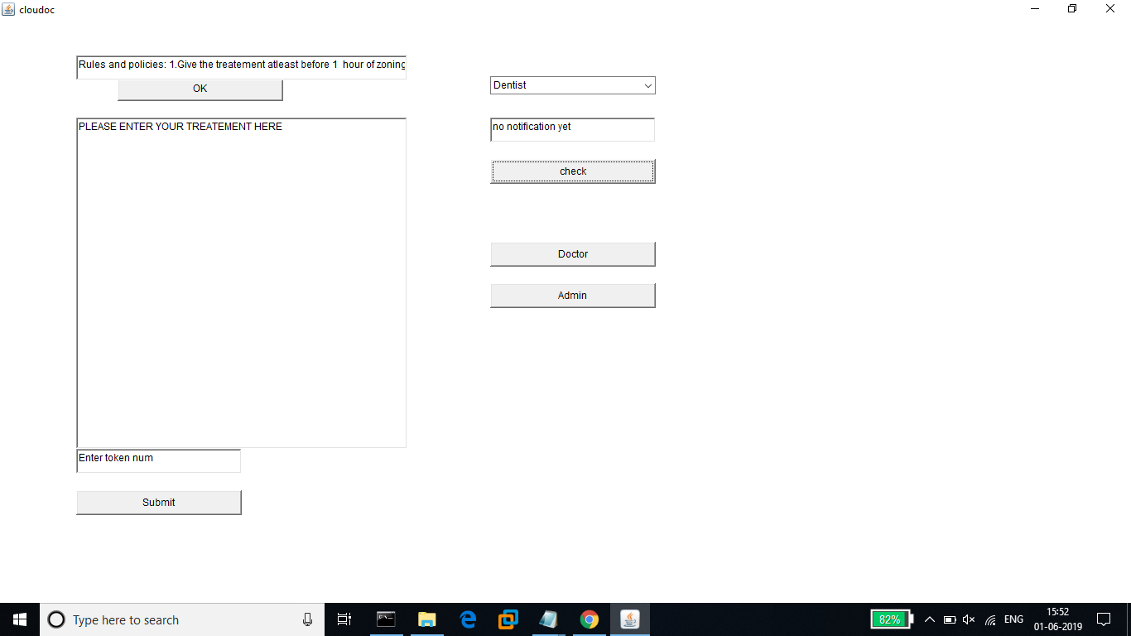
end
criteria
Pro&con
goals
about

Slide 9
end
criteria
Pro&con
goals
code
about

Slide 10
end
Pro&con
criteria
goals
code
about

Slide 11
end
criteria
Pro&con
goals
code
about

