Slide 1
File Recovery System
Using Cryptographic Algorithms

Slide 2
Introduction
The rising issues of stealing sensitive data owned by individuals is a common problem in real life scenarios as well as in storage security. The needs and security of public-class is still not to the fullest.
So, encrypting the file systems would entitle flexibility to the public class users.
The study estimated the average worth of a single stolen laptop to be about a million dollars.

Slide 3
The security of the algorithm lies in the ability of an algorithm to generate ciphertext.

Slide 4
Algorithm
A more secure encryption algorithm is AES – Advanced Encryption Standard which is a symmetric encryption algorithm
A secret key is used for the both encryption and decryption of data. Only someone who has access to the same secret key can decrypt data. AES encryption provides strong protection to your data.

Slide 5
Java provides a number of helper classes for AES encryption such as: 1. Cipher (for encryption/decryption), 2. SecretKey (represents the shared secret key) and 3. KeyGenerator (generates the shared secret key). Also note that both secret key and encrypted data is binary data and hence cannot be printed directly.

Slide 6
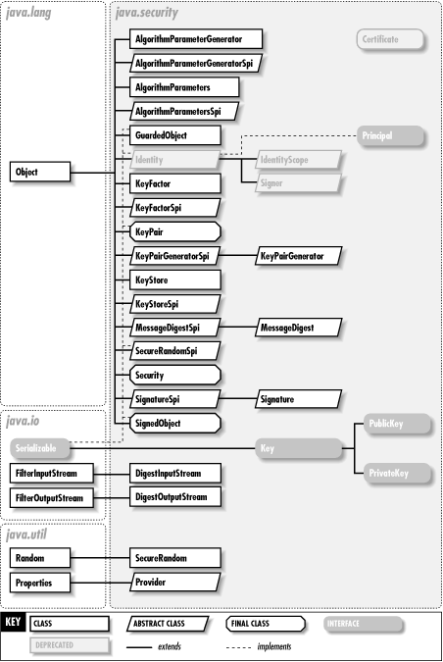

Slide 7
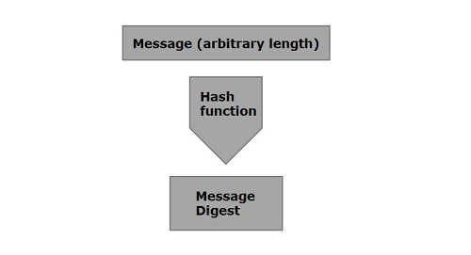
To calculate cryptographic hashing value in Java, MessageDigest Class is used, under the package java.security.
SHA is cryptographic hash function which takes input as 20 Bytes and rendered the hash value in hexadecimal number

Slide 8
Application:
Cryptography
Data Integrity
Values returned by a hash function are called message digest or simply hash values
A message digest is a cryptographic hash function containing a string of digits created by a one-way hashing formula. Message digests are designed to protect the integrity of a piece of data or media to detect changes and alterations to any part of a message.

Slide 9
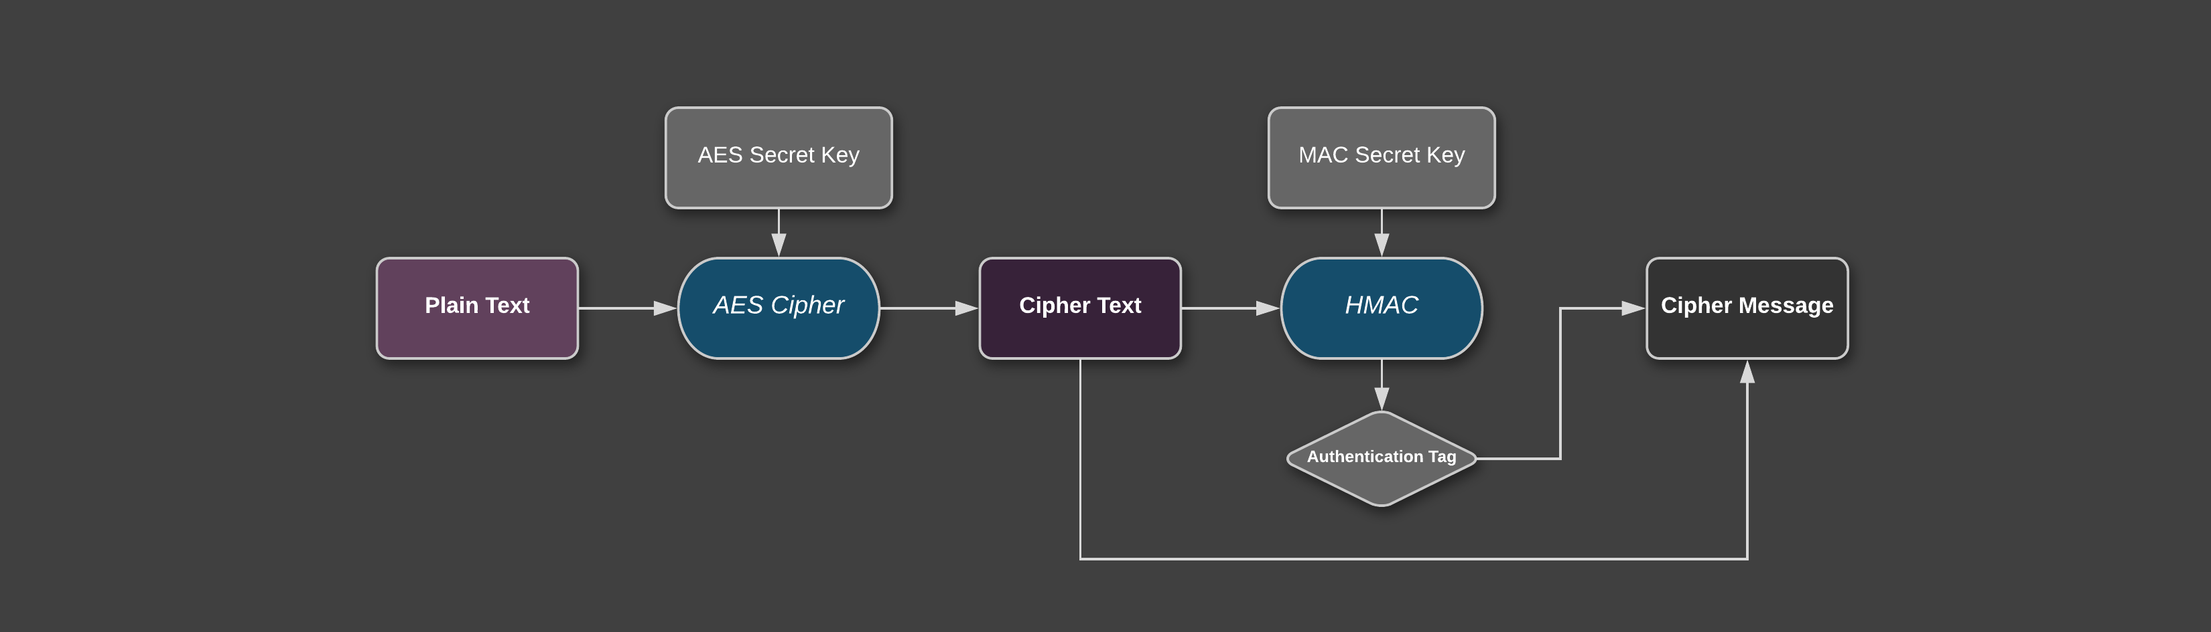

Slide 10
Conclusion
Here, we formalize general encryption model for storage security. We present the design and implementation to ensure flexibility, transparent usage of this model.
This system will not prevent from attacks but it will protect the data from being exposed to unauthorized parties.
Data is in encrypted form which makes them inadequate to read them, and if local administrative is unable to physically access the file, then for the file recovery there is a backup button setup where he can retrieve his lost data back with key management system.

Slide 11
So third parties are not benefited even if they steal them and also owner will have back his data back with just key management and backup setup.
Encrypting file system enhances an advanced key management scheme to provide a high grade of security while remaining transparent and easily usable.
For Decryption of files, only local administration is only capable of retrieving the data.

