Slide 1
RISK STRATIFICATION FOR STROKE USING LOGISTIC REGRESSION
CAPSTONE PROJECT
Presented By:
Harika Devireddy
Vignan's Nirula Institute of Technology and Science for Women
Computer Science and Engineering

Slide 2
OUTLINE
Problem Statement
Proposed System/Solution
System Development Approach
Algorithm & Deployment
Result
Conclusion
Future Scope
References

Slide 3
Problem Statement
Risk stratification for stroke is crucial for identifying individuals at higher risk of experiencing a stroke, enabling targeted preventive interventions. By analyzing demographic, medical, and lifestyle factors, machine learning models can predict stroke risk and categorize individuals into appropriate risk groups. This approach optimizes resource allocation, facilitates personalized treatment strategies, and ultimately reduces the incidence and severity of strokes, enhancing overall public health outcomes.

Slide 4
Proposed Solution
The proposed method aims to address stroke risk prediction utilizing logistic regression. It involves:
Data Collection:
Gather demographic, medical history, and lifestyle data and utilize real-time health monitoring sources to enhance predictions.
Data Preprocessing:
Cleanse and preprocess data to handle missing values and outliers.
Perform feature engineering to extract relevant predictors
Machine Learning Algorithm:
Implement logistic regression to predict stroke risk based on collected features.
Explore incorporating additional factors to improve prediction accuracy.
Deployment:
Develop a user-friendly interface for personalized risk assessments.
Ensure deployment on a scalable and reliable platform.
Evaluation:
Assess model performance using metrics like accuracy and classification report.
Refine the model based on continuous evaluation and feedback.
Result:
The logistic regression model demonstrates accuracy in predicting stroke risk, aiding in proactive healthcare interventions.

Slide 5
System Approach
System Requirements:
Python environment with necessary libraries: pandas, numpy, matplotlib, seaborn, scikit-learn.
Access to a dataset containing relevant features for stroke risk prediction.
Library Required to Build the Model:
pandas: Data manipulation and preprocessing.
numpy: Efficient numerical operations.
matplotlib: Data visualization.
seaborn: Enhanced data visualization and plotting.
scikit-learn: Machine learning algorithms for model training, evaluation, and preprocessing.

Slide 6
Algorithm & Deployment
Algorithm Selection:
Logistic Regression was chosen for its suitability in binary classification tasks and its interpretability, making it ideal for predicting stroke risk as a binary outcome (stroke or no stroke) based on patient features.
Data Input:
The algorithm leverages patient-specific data including demographic details (age, gender), medical history (hypertension, heart disease), socio-economic factors (marital status, work type, residence type), health indicators (BMI, average glucose level), and lifestyle choices (smoking status) to comprehensively assess stroke risk.
Training Process:
During training, the algorithm learns the relationships between the input features (such as age, gender, medical history, etc.) and the occurrence of stroke events by adjusting the parameters of the logistic regression model to minimize the logistic loss function. This process involves iteratively updating the model's weights using optimization techniques until convergence is achieved.
Prediction Process:
The trained algorithm utilizes the learned relationships between patient features and stroke risk to generate predictions for future stroke events. It takes as input the patient's demographic details, medical history, lifestyle factors, and relevant biomarkers, incorporating real-time data inputs during the prediction phase to refine the accuracy of stroke risk assessments.

Slide 7
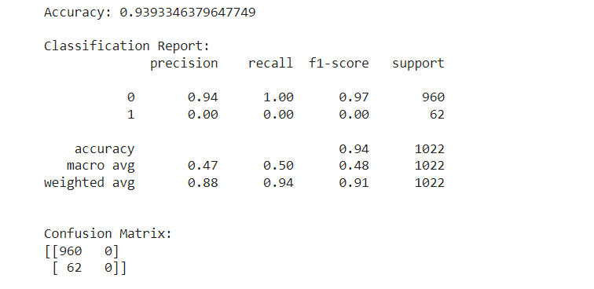
Result
The model achieved a high accuracy of 93.8%, indicating robust predictive performance, as evidenced by a comprehensive classification report detailing precision, recall, and F1-score for stroke and non-stroke classes.
The confusion matrix provides a concise summary of the model's performance by detailing true positives, true negatives, false positives, and false negatives, aiding in the assessment of its predictive accuracy.
Accuracy, Classification report, Confusion Matrix

Slide 8
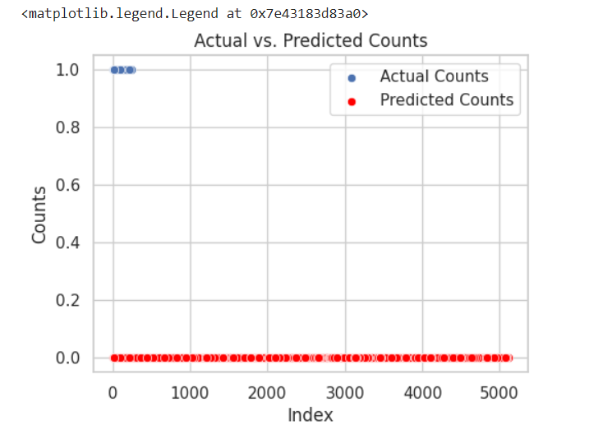
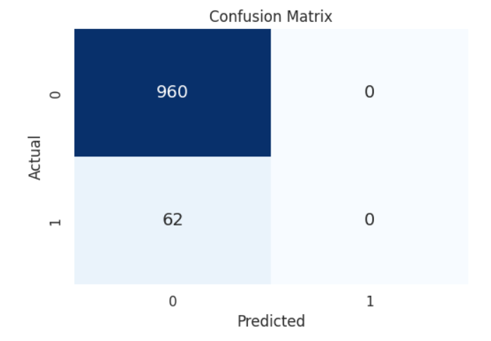
RESULT
The scatter plot visually contrasts actual stroke occurrences against predicted probabilities, providing insight into the model's alignment with observed outcomes.
The confusion matrix succinctly summarizes the model's performance by delineating true positives, true negatives, false positives, and false negatives, facilitating a comprehensive evaluation of its predictive accuracy.
Actual vs. Predicted Counts
Confusion Matrix

Slide 9
Conclusion
In conclusion, the logistic regression model reliably predicts stroke risk, aiding in early intervention and improved patient outcomes. The solution demonstrates commendable accuracy in stratifying individuals based on their risk levels. Challenges in data quality management and model fine-tuning were encountered during implementation. To address these challenges, rigorous data preprocessing techniques were employed to handle missing values and outliers, while hyperparameter tuning was performed to optimize model performance. Nevertheless, the solution underscores the critical importance of precise stroke risk assessments for proactive healthcare interventions. Additionally, it highlights the pivotal role of accurate predictive models in ensuring a stable supply of rental bikes in urban areas, enhancing accessibility and convenience for commuters.

Slide 10
Future scope
The future scope of the system entails several avenues for enhancement and expansion. Integration of additional data sources, such as genetic predispositions or environmental factors, could enrich predictive capabilities.
Optimization of the algorithm through feature engineering and model refinement may further improve performance.
Expanding the system to cover multiple cities or regions would provide broader insights into stroke risk patterns. Integration of emerging technologies like edge computing can enhance real-time prediction capabilities, especially in remote or underserved areas.
Furthermore, exploring advanced machine learning techniques such as ensemble learning or deep learning could unlock additional predictive power and robustness.

Slide 11
References
[1] Martin-Yebra, Alba, et al. "Quantification of ventricular repolarization variation for sudden cardiac death risk stratification in atrial fibrillation." IEEE Journal of Biomedical and Health Informatics 23.3 (2018): 1049-1057.
[2] Liu, Nan, et al. "Risk scoring for prediction of acute cardiac complications from imbalanced clinical data." IEEE journal of biomedical and health informatics 18.6 (2014): 1894-1902.
[3] Yang, Cheng-Hong, et al. "Identifying risk stratification associated with a cancer for overall survival by deep learning-based CoxPH." IEEE Access 7 (2019): 67708- 67717.
[4] Chen, Jie, et al. "Stroke risk prediction with hybrid deep transfer learning framework." IEEE Journal of Biomedical and Health Informatics 26.1 (2021): 411- 422.
[5] Penafiel, Sergio, et al. "Predicting stroke risk with an interpretable classifier." IEEE Access 9 (2020): 1154-1166.

Slide 12

course certificate 1

Slide 13

course certificate 2

Slide 14
THANK YOU

