Slide 1
Adult Dataset
TEAM:
Ajay M
Anil G
Harika Kanthi P
Laxminarayana A
Utthejh G
Vivek M
Mentor: Mr. Srikar Muppidi

Slide 2

INTRODUCTION
Dataset is extracted from 1994 US Census data
Income depends various factors such as such as age, education, occupation, marital status, etc.
Problem: Train the binary classifier to predict if an individuals’ income is above or below $50K
Solution: Helping government agencies to target government-sponsored programs
Affordable Care Act

Slide 3
ECONOMIC PERSPECTIVE
Median Household Income of USA (1994): $34,076
Median Household Salary of USA (2019): $63,030
$50,000 (1994) is $87,083 (2020)
Affordable Care Act 2020 (Cutoff):
Single: $49,960
Household: $85,320 for a family of three

Slide 4
DATA DESCRIPTION
Name | Description | Name | Description
Age | Age of the individual | Marital Status | Marital Status of the individual
Capital Gain | Capital gains received | Native Country | Native Country of the individual
Capital Loss | Capital loss incurred | Occupation | Occupation of the individual
Education | Highest education level | Race | Race of individual
Education - num | Number of years of education | Relationship | Type of relationship
Fnlwgt | Weighted value computed by the Census Bureau | Sex | Sex of the individual
Hours Per Week | Average number of hour working per week | Work class | Class of work of the individual
Income (Target Variable )

Slide 5
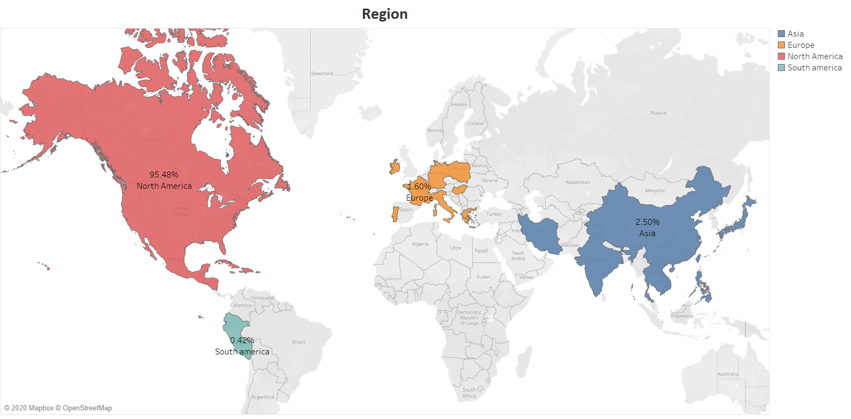
Exploratory Data Analysis

Slide 6
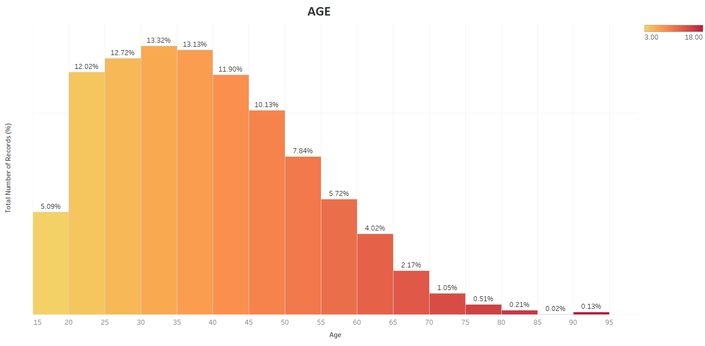
Exploratory Data Analysis

Slide 7
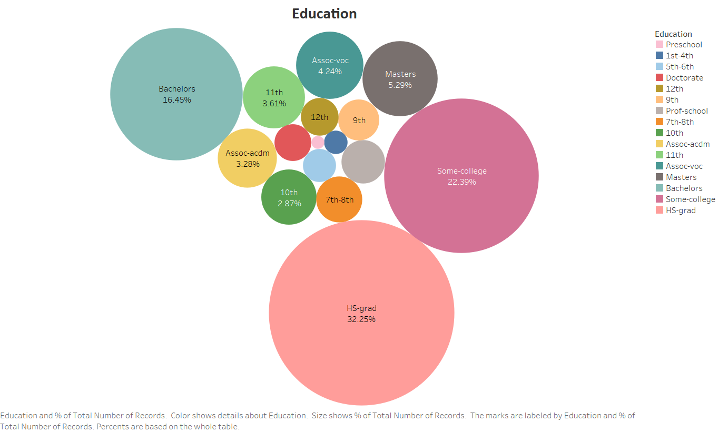
Exploratory Data Analysis

Slide 8
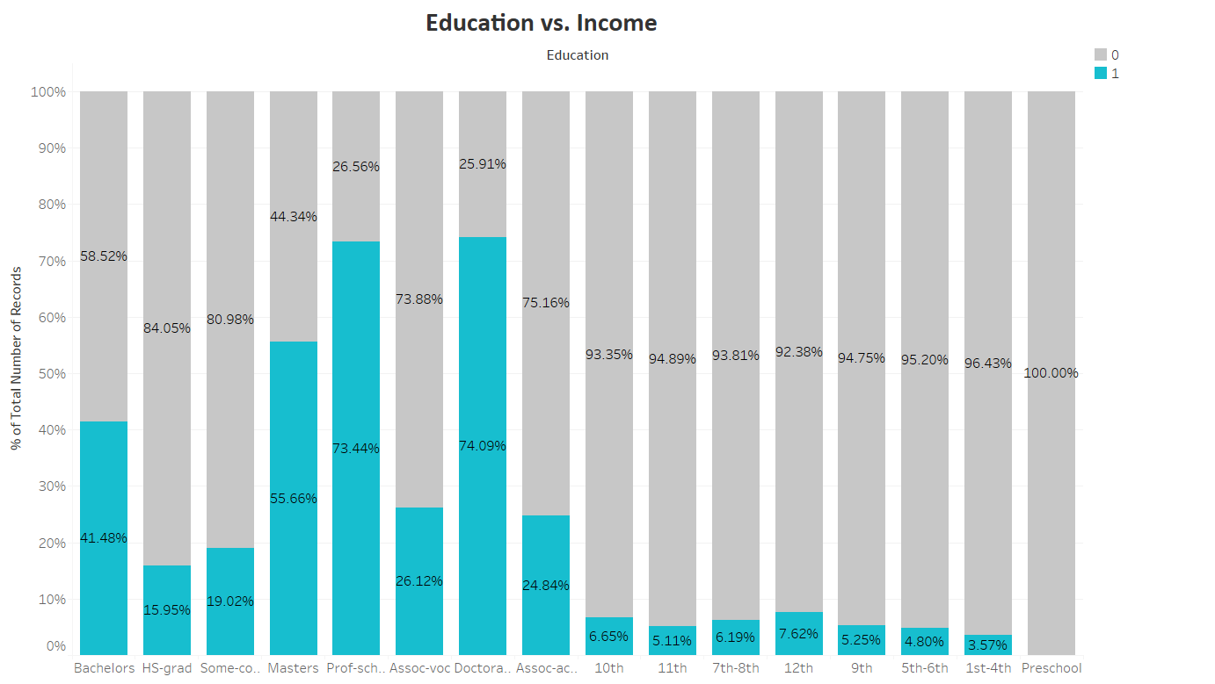
Exploratory Data Analysis

Slide 9
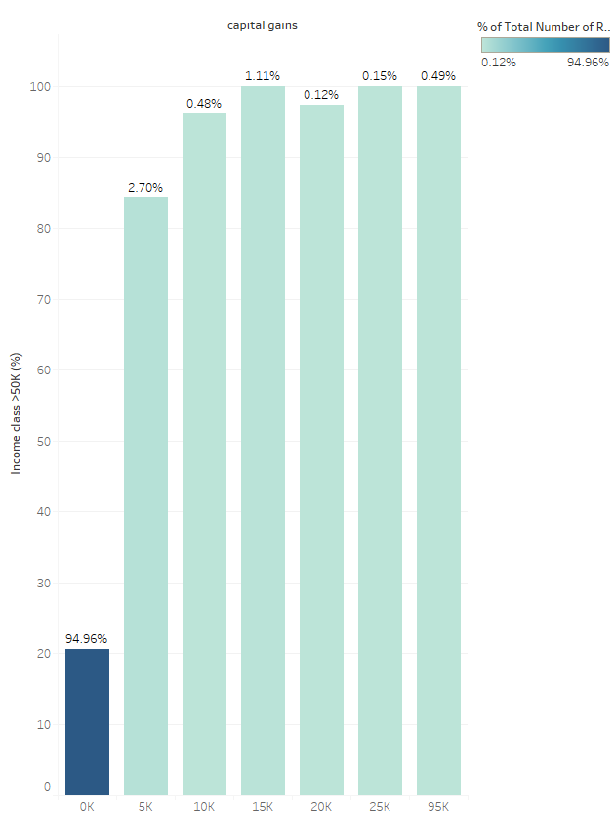
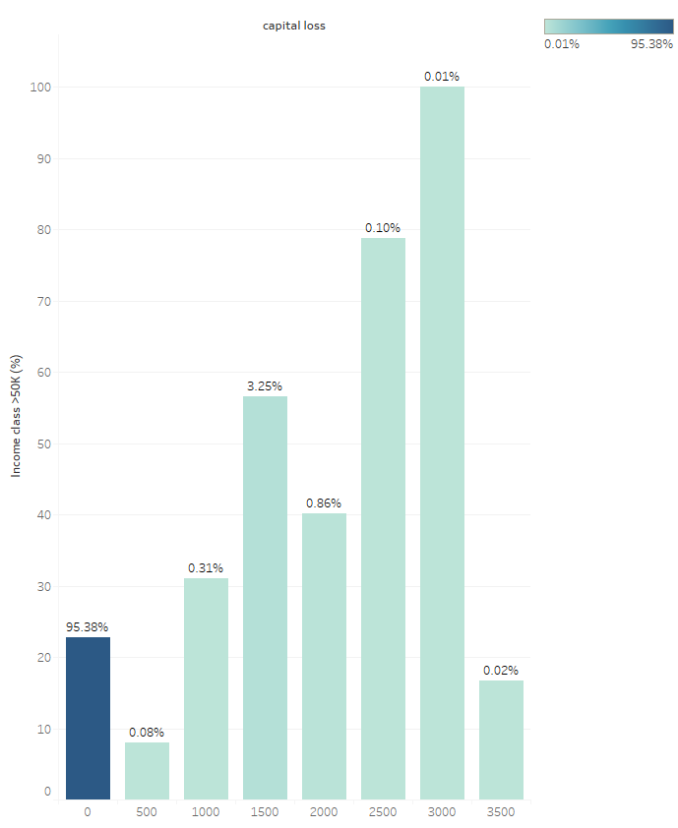
Exploratory Data Analysis
Capital Gains and Income
Capital Loss and Income

Slide 10
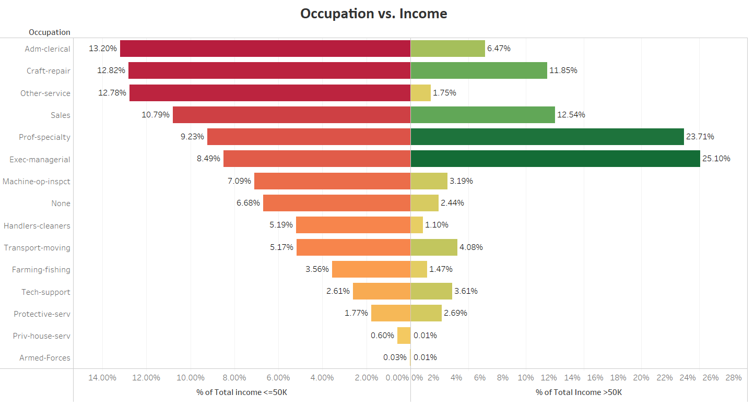
Exploratory Data Analysis

Slide 11
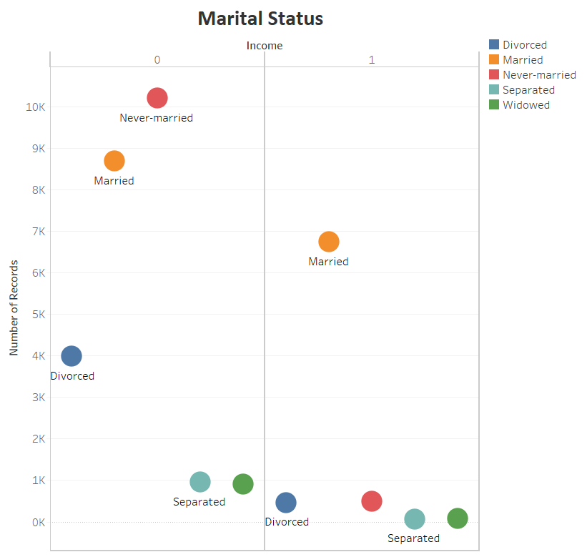
Exploratory Data Analysis

Slide 12
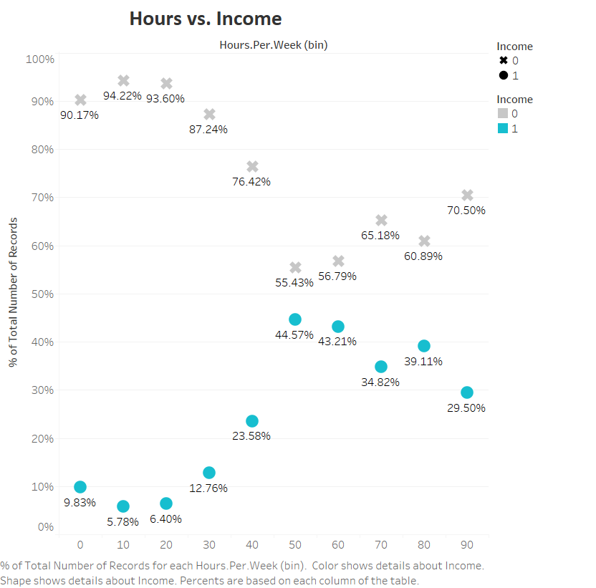
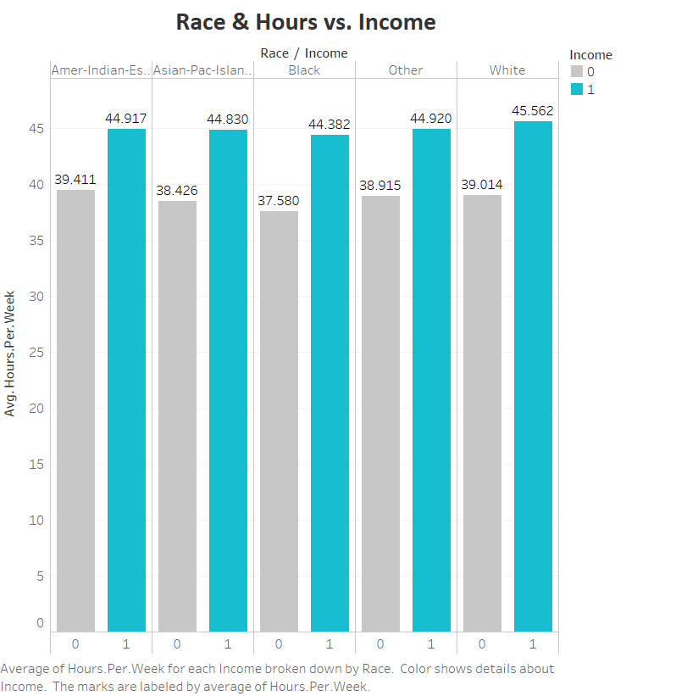
Exploratory Data Analysis

Slide 13
STATISTICAL TESTING
Features | Statistics | P-Value | Significant
Age | 1876.135332 | 0.000000e+00 | Yes
Education num | 3819.914386 | 0.000000e+00 | Yes
Capital gain | 1551.576577 | 0.000000e+00 | Yes
Hours per week | 1676.548626 | 0.000000e+00 | Yes
Marital status | 6061.747963 | 0.000000e+00 | Yes
Occupation | 3687.620651 | 0.000000e+00 | Yes
Relationship | 6233.840454 | 0.000000e+00 | Yes
Sex | 1413.146829 | 2.921492e-309 | Yes
Work class | 804.157527 | 1.946096e-170 | Yes
Capital Loss | 694.724841 | 2.182812e-151 | Yes
Race | 304.241374 | 1.317829e-64 | Yes
Native Country | 317.736675 | 6.221222e-45 | Yes
fnlwgt | 2.420095 | 1.197982e-01 | NO

Slide 14
DATA CLEANING
Education Number and Education
Misclassification
Omitting
Null value imputation
USA data
K Nearest Neighbors Imputation
Work class
5.6%
Country
2%
Occupation
5.6%

Slide 15
DATA PREPARATION
Feature creation
Feature Selection
Data Scaling
Standardisation
Statistical Testing
ARSC

Slide 16
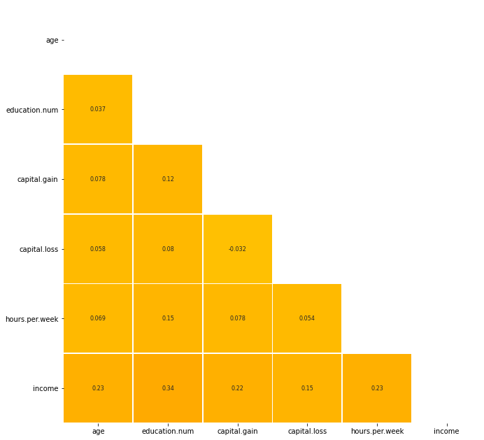
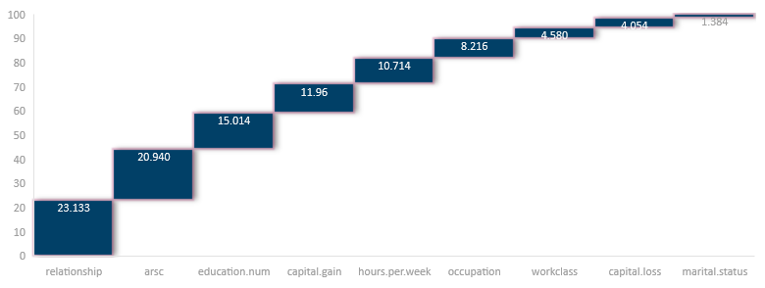
MODEL BUILDING
CORRELATION
FEATURE IMPORTANCES
Data | Logit Accuracy | Train Accuracy | Test Accuracy | ROC_AUC | F1 Score
Dropping NA | 0.324122 | 0.979633 | 0.809261 | 0.739861 | 0.610911
USA data | 0.328292 | 1.000000 | 0.801139 | 0.741249 | 0.613063
KNN imputation | 0.317102 | 0.984735 | 0.817836 | 0.755650 | 0.626918
KNN with ARSC | 0.324965 | 0.978010 | 0.863852 | 0.778724 | 0.687852

Slide 17
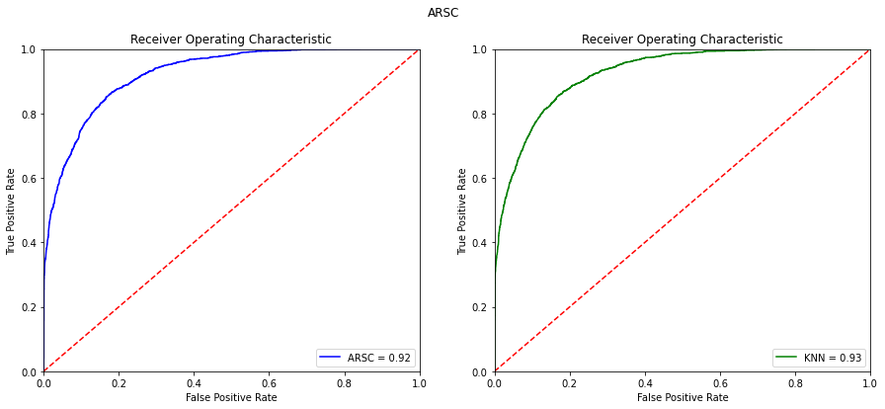
MODEL BUILDING
Classifier used: Gradient Boosting
Evaluation metric : ROC AUC (Receiver Operating Characteristic Area under the curve)
Data | Train Accuracy | Test Accuracy | ROC_AUC | F1 Score
Dropping NA | 0.886194 | 0.866457 | 0.795094 | 0.712272
USA data | 0.866291 | 0.862637 | 0.777618 | 0.687924
KNN imputation | 0.872318 | 0.869549 | 0.789358 | 0.700845
KNN with ARSC | 0.861940 | 0.827540 | 0.830853 | 0.700384

Slide 18
Thank You

