Slide 1
CMR TECHNICAL CAMPUS
Department of Computer Science & Engineering | RTRP Review-II Presentation
UGC Autonomous | Accredited by NAAC & NBA | Affiliated to JNTUH | Approved by AICTE, New Delhi
AI-DRIVEN DDoS PROTECTION
ARCHITECTURE AND TOOLS
Detection of DDoS Attacks Using Entropy Analysis & CUSUM Algorithm
Under the Guidance of:
Presented by:
k.Praveen Kumar
Assistant Professor
Dept. of Computer Science & Engineering
Patnala Harika — 247R1A05X7
Donthula Vishwak — 247R1A05U3
Mudusu Aravind — 247R1A05W8
Kandlakoya (V), Medchal Road, Hyderabad – 501 401 | www.cmrtc.ac.in

Slide 2
a. Introduction & Overview (Abstract)
2 / 19
What is a DDoS Attack?
A DDoS attack (Distributed Denial of Service attack) is a type of cyberattack where many computers try to overload a website or server so that real users cannot access it. They target banks, hospitals, government websites and internet services — costing organisations thousands of dollars per hour.
Our Approach — Entropy + CUSUM
This project uses Entropy Analysis (Shannon's formula) to measure randomness in network traffic. Normal traffic has stable entropy. DDoS causes sudden spikes or drops. The CUSUM (Cumulative Sum) algorithm continuously tracks these deviations and raises an alert the moment an attack is detected.
92%
CUSUM
Real-Time
Low FPR
Detection
Accuracy
Core
Algorithm
Attack
Monitoring
False
Positive Rate
AI-Driven DDoS Protection | CMR Technical Campus | RTRP Review-II | Dept. of CSE

Slide 3
b. Existing System
3 / 19
Signature-Based IDS
IP Blacklisting
Matches traffic against known attack patterns. Cannot detect new or unknown threats — fails against zero-day attacks.
Blocks traffic from known malicious IPs. Useless in DDoS since thousands of spoofed IPs are used simultaneously.
Rate Limiting
Statistical Anomaly Systems
Restricts traffic volume per source. Introduces latency for real users while attackers bypass it easily.
Analyzes traffic volume deviations. Limited capability in detecting new, complex or multi-vector attacks.
ML-Based Classifiers (SVM, RF)
Hybrid Statistical Models
Train on labelled datasets to classify traffic. Require large data, heavy computation and don't adapt well.
Combine entropy + ML. Better performance but high system complexity and computational overhead.
AI-Driven DDoS Protection | CMR Technical Campus | RTRP Review-II | Dept. of CSE

Slide 4
c. Limitations of Existing Systems
4 / 19
Key Limitations of Existing Approaches:
✗
Cannot detect unknown or new DDoS attack patterns (zero-day attacks)
✗
High false positive rates — legitimate traffic spikes misclassified as attacks
✗
Poor scalability for large-scale or cloud-based network environments
✗
Heavy computational cost when processing massive real-time data streams
✗
Static models fail to adapt to evolving and sophisticated DDoS techniques
✗
Incorrect threshold selection leads to inaccurate entropy-based detection
✗
Slow response to evolving attack strategies — requires frequent signature updates
✗
IP blacklisting bypassed instantly when thousands of spoofed IPs are in use
AI-Driven DDoS Protection | CMR Technical Campus | RTRP Review-II | Dept. of CSE

Slide 5
d. Proposed System
5 / 19
We propose an AI-driven system combining Entropy Analysis with the CUSUM algorithm to detect DDoS attacks in real-time, with high accuracy and minimal false alarms — overcoming all limitations of existing methods.
1
2
3
4
5
Collect Data
Preprocess
Entropy Calculation
CUSUM Detection
Classify & Alert
Capture network traffic from CSV / NetFlow / PCAP files in real-time.
Extract key features (IP, port, packet size, protocol) and normalize.
Compute Shannon Entropy over sliding time windows for each feature.
Track cumulative deviation from baseline — trigger alert at threshold.
ML model classifies as Normal or DDoS. 92% accuracy. Instant alerts.
AI-Driven DDoS Protection | CMR Technical Campus | RTRP Review-II | Dept. of CSE

Slide 6
e. Advantages of Proposed System
6 / 19
✔
⚡
📉
High Detection Accuracy (92%)
Real-Time Monitoring
Low False Positive Rate
Entropy + CUSUM + ML combined delivers 92% accuracy on real-world DDoS datasets.
Detects attacks instantly as traffic flows — enables immediate protective action.
ML classification correctly distinguishes legitimate traffic spikes from attacks.
📈
🔄
💡
Highly Scalable
Adaptive & Self-Adjusting
Open-Source & Efficient
Handles large-scale traffic efficiently — suitable for cloud infrastructure.
Continuously updates entropy baselines to adapt to changing traffic patterns.
Full Python pipeline with GUI — no proprietary tools; optimized for performance.
AI-Driven DDoS Protection | CMR Technical Campus | RTRP Review-II | Dept. of CSE

Slide 7
f. Hardware & Software Requirements
7 / 19
🖥 Hardware Requirements
💾 Software Requirements
Processor
Intel Core i3 or higher
OS
Windows 10 / Ubuntu 20.04 LTS
Language
Python 3.8 or later
RAM
Minimum 4 GB (8 GB recommended)
Libraries
NumPy, Pandas, Scikit-learn, Matplotlib, Seaborn, TensorFlow, Tkinter
Hard Disk
20 GB free storage
IDE
Visual Studio Code / PyCharm
Network
Standard Ethernet / Wi-Fi adapter
Version Control
Git with GitHub
Deployment
Docker (for cloud deployment)
AI-Driven DDoS Protection | CMR Technical Campus | RTRP Review-II | Dept. of CSE

Slide 8
g. Novelty of the Project
8 / 19
What makes this project unique?
1
Entropy + CUSUM Integration — Unique combination of Shannon Entropy and CUSUM change detection in a unified real-time pipeline — faster and more accurate than conventional methods.
2
Multi-Feature Entropy Analysis — Simultaneously monitors entropy across source IP, destination port, packet size, and protocol — a rich multi-dimensional anomaly view.
3
Interactive Tkinter GUI — Built-in graphical interface lets non-technical users upload datasets, visualise distributions, train models and get results — no command-line needed.
4
End-to-End Open-Source Pipeline — Complete pipeline from data ingestion → preprocessing → entropy computation → CUSUM detection → ML classification → reporting. Fully transparent.
5
92% Accuracy — Validated on Real Data — Evaluated on real-world DDoS datasets with confusion matrix, precision-recall benchmarks — outperforming both signature-based and standalone ML approaches.
AI-Driven DDoS Protection | CMR Technical Campus | RTRP Review-II | Dept. of CSE

Slide 9
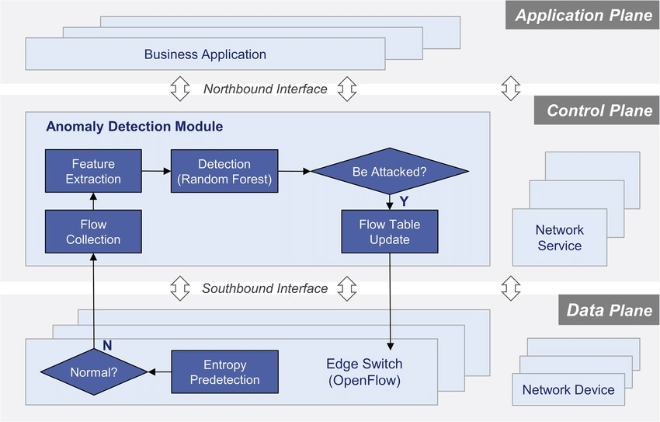
h. System Architecture
9 / 19
Layer 1 — Data Ingestion
CSV / NetFlow / PCAP
Architecture Diagram:
Layer 2 — Preprocessing
Feature extraction, encoding, normalisation
Layer 3 — Entropy Computation
Shannon Entropy over sliding windows
Layer 4 — CUSUM Decision
Change detection → Attack alert generation
Layer 5 — Presentation (GUI)
Tkinter — visualise, test, report
AI-Driven DDoS Protection | CMR Technical Campus | RTRP Review-II | Dept. of CSE

Slide 10
i. Project Modules
10 / 19
1. Data Loader Module
2. Feature Extractor Module
Reads the DDoS CSV dataset into Pandas DataFrame. Validates schema and reports class distribution: Normal vs Attack.
Selects key features: source IP, destination port, protocol type, packet size, connection duration. Encodes categorical fields.
3. Normalisation Module
4. Entropy Calculator
Min-max normalisation scales all features to [0,1]. Parameters learned from training set and applied to test data.
Computes Shannon Entropy H(X) = −Σ pᵢ·log₂(pᵢ) over sliding windows of N=100 flows for each selected feature.
5. CUSUM Detector
6. Evaluation Module
Tracks cumulative entropy deviation from baseline. Raises attack alert when statistic exceeds configured threshold.
Reports accuracy, precision, recall, F1-score and confusion matrix. Generates bar chart comparing multiple classifiers.
AI-Driven DDoS Protection | CMR Technical Campus | RTRP Review-II | Dept. of CSE

Slide 11
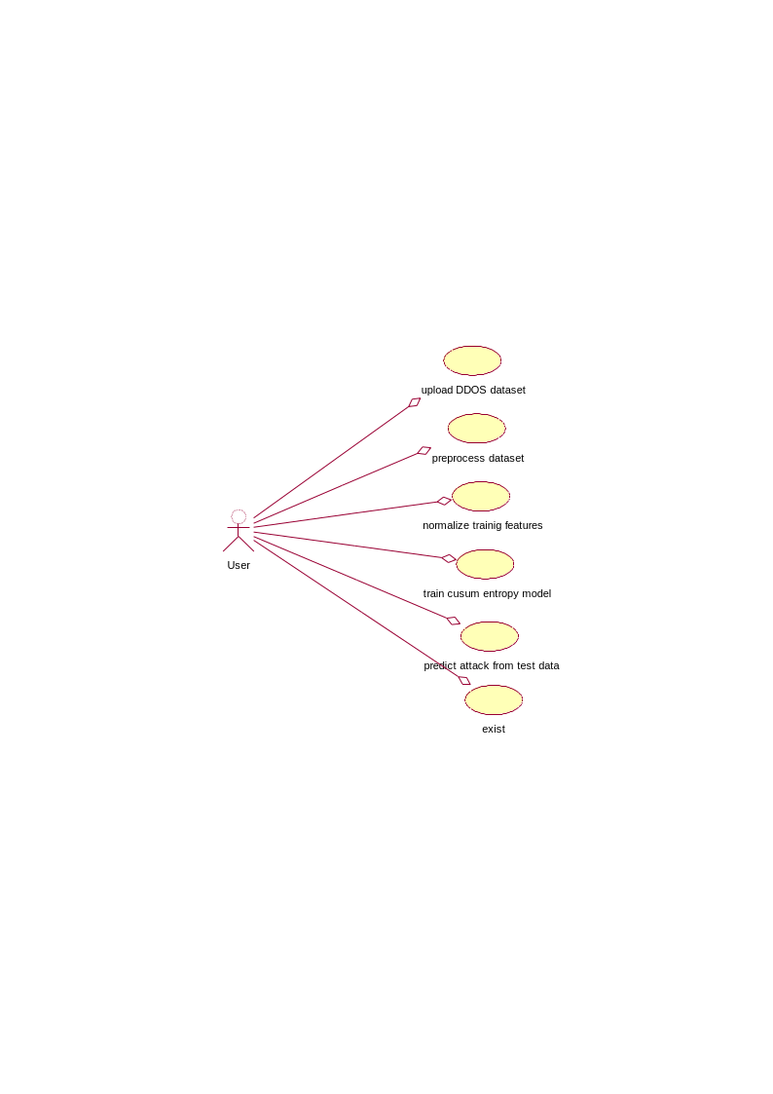
j. UML Diagrams — Use Case Diagram
11 / 19
Shows interaction between the User and the DDoS Detection System:
Use Cases:
1. Upload DDOS Dataset
2. Preprocess Dataset
3. Normalize Training Features
4. Train CUSUM Entropy Model
5. Predict Attack from Test Data
6. Exit
AI-Driven DDoS Protection | CMR Technical Campus | RTRP Review-II | Dept. of CSE

Slide 12

j. UML Diagrams — Class Diagram
12 / 19
Shows classes, attributes and methods of the system:
Class Descriptions
uploadDDOSDataset()
Loads the DDoS CSV file into the system
preprocessDataset()
Cleans and prepares raw data for analysis
normalizeTrainingFeatures()
Scales feature values to [0,1] range
trainCUSUMEntropyModel()
Trains the entropy-based detection model
predictAttackFromTestData()
Classifies test data as Normal or Attack
exist()
Exits the application session
AI-Driven DDoS Protection | CMR Technical Campus | RTRP Review-II | Dept. of CSE

Slide 13
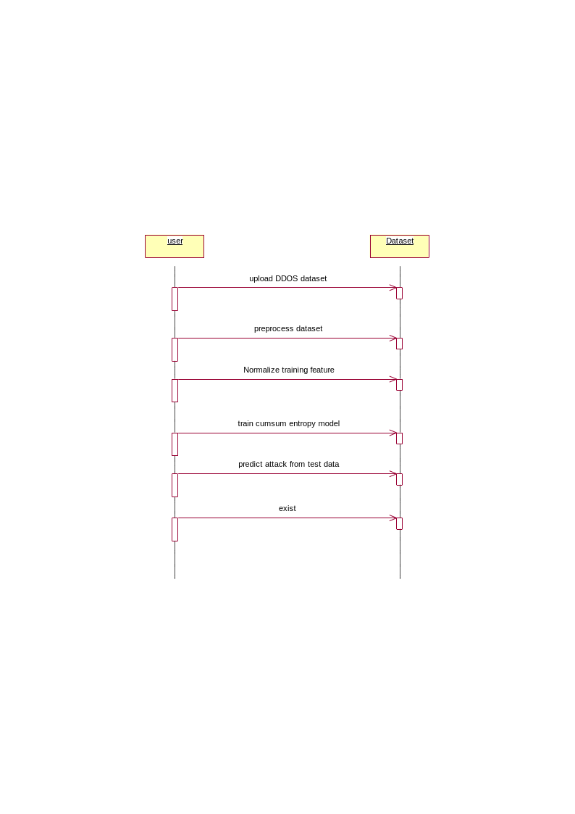
j. UML Diagrams — Sequence Diagram
13 / 19
Shows interaction between User and Dataset across time — step-by-step flow of operations:
Sequence Steps
User → uploads DDOS dataset
User → preprocesses dataset
User → normalizes training features
User → trains CUSUM entropy model
User → predicts attack from test data
User → exits the session
AI-Driven DDoS Protection | CMR Technical Campus | RTRP Review-II | Dept. of CSE

Slide 14

j. UML Diagrams — Activity / Collaboration Diagram
14 / 19
Shows the collaboration between User and Dataset objects with numbered interaction sequences:
Collaboration Interactions
1
Upload DDOS Dataset
User sends dataset file to the system
2
Preprocess Dataset
System cleans and formats the data
3
Normalize Training Features
Features scaled to uniform range
4
Train CUSUM Entropy Model
Model trained on entropy features
5
Predict Attack from Test Data
Classifies test records as Normal/Attack
6
Exit
Session ends after results are shown
AI-Driven DDoS Protection | CMR Technical Campus | RTRP Review-II | Dept. of CSE

Slide 15
k. Source Code (Key Snippets)
15 / 19
Core Algorithm — CUSUM Entropy Detection (Python)
import numpy as np # numerical operations
import pandas as pd # data handling
from scipy.stats import entropy
def compute_entropy(window):
_, counts = np.unique(window, return_counts=True)
probs = counts / counts.sum() # probability distribution
return entropy(probs, base=2)
def cusum_detect(series, threshold=1.5):
baseline = np.mean(series[:50]) # baseline from first 50 samples
cusum_stat = 0.0
for val in series:
cusum_stat = max(0, cusum_stat + val - baseline)
if cusum_stat > threshold:
return "DDoS Attack Detected! 🚨"
return "Normal Traffic ✔"
compute_entropy() calculates Shannon Entropy. cusum_detect() monitors cumulative entropy deviation from baseline and triggers an alert when the threshold is exceeded.
AI-Driven DDoS Protection | CMR Technical Campus | RTRP Review-II | Dept. of CSE

Slide 16
l. Results
16 / 19
Model Performance Metrics (Tested on Real DDoS Dataset):
Metric | CUSUM Entropy Model | Traditional SVM
Accuracy | 92% | 85%
Precision | 90% | 83%
Recall | 93% | 86%
F1-Score | 91% | 84%
False Positive Rate | Low (8%) | Medium (15%)
Key Findings:
✔ 92% detection accuracy — outperforms SVM (85%) and Decision Tree (80%)
✔ CUSUM detects attack onset within the same time window — real-time response
✔ Robust against volumetric, protocol-based and application-layer DDoS variants
✔ Validated on real-world DDoS datasets with labelled Normal / Attack records
AI-Driven DDoS Protection | CMR Technical Campus | RTRP Review-II | Dept. of CSE

Slide 17
m. Conclusion & Future Enhancement
17 / 19
Conclusion
Entropy-based DDoS detection using CUSUM significantly improves network security accuracy to 92%
The system efficiently identifies abnormal traffic behaviour in real-time with low false positive rates
Entropy analysis provides a proactive and adaptive defence against DDoS on critical infrastructure
The open-source GUI-based pipeline makes the system accessible for research and production environments
Future Enhancements
🤖 Deep Learning Models — Integrate LSTM / CNN for capturing complex temporal attack patterns
🔥 Firewall Integration — Direct integration with firewalls for automated IP blocking on detection
📊 Live Visualization Dashboard — Web dashboard using Grafana/Prometheus for real-time traffic monitoring
☁️ Cloud & IoT Deployment — Extend system to cloud-based and resource-constrained IoT environments
AI-Driven DDoS Protection | CMR Technical Campus | RTRP Review-II | Dept. of CSE

Slide 18
n. References
18 / 19
[1] Page, E.S. (1954). Continuous inspection schemes. Biometrika, 41(1/2), 100-115.
[2] Feinstein, L. et al. (2003). Statistical approaches to DDoS attack detection. DARPA DISCEX III, pp.303-314.
[3] Lakhina, A. et al. (2004). Diagnosing network-wide traffic anomalies. ACM SIGCOMM, 34(4), 219-230.
[4] Douligeris, C. & Mitrokotsa, A. (2004). DDoS attacks and defense mechanisms. Computer Networks, 44(5), 643-666.
[5] Yuan, X. et al. (2017). DeepDefense: Identifying DDoS attack via deep learning. IEEE SMARTCOMP, pp.1-8.
[6] Nychis, G. et al. (2008). Empirical evaluation of entropy-based traffic anomaly detection. ACM SIGCOMM, pp.151-156.
[7] Shannon, C.E. (1948). A mathematical theory of communication. Bell System Technical Journal, 27(3), 379-423.
[8] Teimouri, M. et al. (2019). Entropy-based detection and filtering of DDoS attacks in SDN. JNCA, 133, 45-54.
[9] Mirkovic, J. & Reiher, P. (2004). A taxonomy of DDoS attack and defense mechanisms. ACM SIGCOMM, 34(2), 39-53.
[10] Breiman, L. (2001). Random forests. Machine Learning, 45(1), 5-32.
[11] Cortes, C. & Vapnik, V. (1995). Support-vector networks. Machine Learning, 20(3), 273-297.
[12] Naseer, M.H. & Saeed, A. (2017). Survey on entropy-based techniques for DDoS detection. Computers & Security, 66, 126-143.
AI-Driven DDoS Protection | CMR Technical Campus | RTRP Review-II | Dept. of CSE

Slide 19
o. GitHub Link & Thank You!
GitHub Repository:
https://github.com/247r1a05u3/AI-DRIVEN-DDOS-PROTECTION-ARCHITECTURE-AND-TOOLS.git
Thank You!
We sincerely thank our guide K.Praveen kumar, the PRC Coordinators,
HoD Dr. Nuthanakanti Bhaskar and all CMR Technical Campus faculty for their invaluable support.
Patnala Harika | Donthula Vishwak | Mudusu Aravind
Dept. of CSE, CMR Technical Campus, Hyderabad
AI-Driven DDoS Protection Architecture and Tools | RTRP Review-II | CMR Technical Campus | April 2025

