Slide 1
🛍️ Customer Analytics Project
Revenue Prediction | Purchase Prediction | Customer Segmentation

Slide 2
Project Overview
• Objective: Build ML models for customer analytics
• Dataset: E-commerce transactional data
• Tasks: Regression, Classification, Clustering
• Tools: Python, Scikit-learn, Streamlit

Slide 3
Models Used
• Regression: Random Forest Regressor
• Classification: Random Forest Classifier
• Clustering: KMeans (k=3)
• Preprocessing: ColumnTransformer (Scaling + OneHotEncoding)

Slide 4
Methodology
1. Data Preprocessing
– Handled numerical & categorical features
– Created 'purchase' column for classification
2. Model Training
– Regression: Predict revenue
– Classification: Predict purchase behavior
– Clustering: Customer segmentation
3. Evaluation & Deployment
– Metrics calculated
– Streamlit app built for predictions

Slide 5
Evaluation Metrics
📊 Regression:
• RMSE: 0.01
• MAE: 0.00
• R²: 1.00
🛒 Classification:
• Accuracy, Precision, Recall, F1, ROC-AUC
• (⚠️ Only one class found in dataset)
👥 Clustering:
• Silhouette Score, Davies-Bouldin Index
• (⚠️ Some categorical conversion issues)

Slide 6
Streamlit Application
• Built interactive app with 3 tabs:
1. Revenue Prediction (Regression)
2. Purchase Prediction (Classification)
3. Customer Segmentation (Clustering)
• CSV upload and manual input supported
• Downloadable predictions

Slide 7
Key Findings
• Regression model performed exceptionally (R² ≈ 1)
• Classification model faced data imbalance (single class)
• Clustering model highlighted customer groups, but preprocessing needed for categorical data
• Streamlit app successfully integrates all models

Slide 8
Conclusion & Next Steps
✅ Developed ML models for customer analytics
✅ Built Streamlit app for real-time predictions
Next Steps:
• Improve classification dataset (balance classes)
• Enhance clustering with PCA/embedding
• Deploy app on cloud (Streamlit Cloud / AWS / GCP)

Slide 9
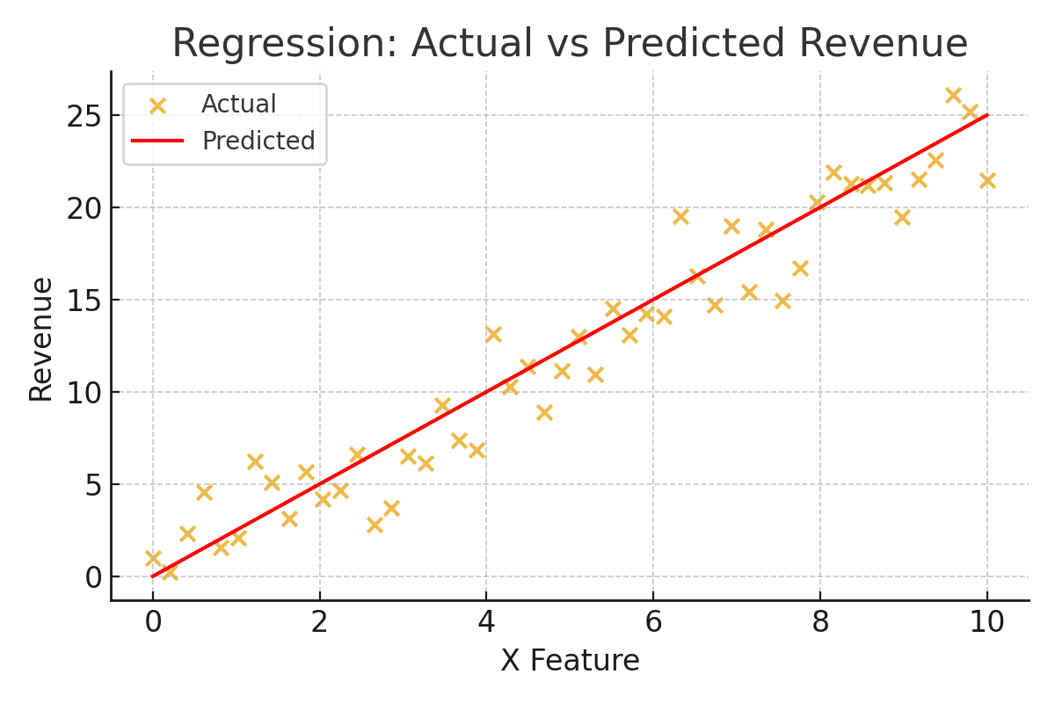
Regression Results

Slide 10
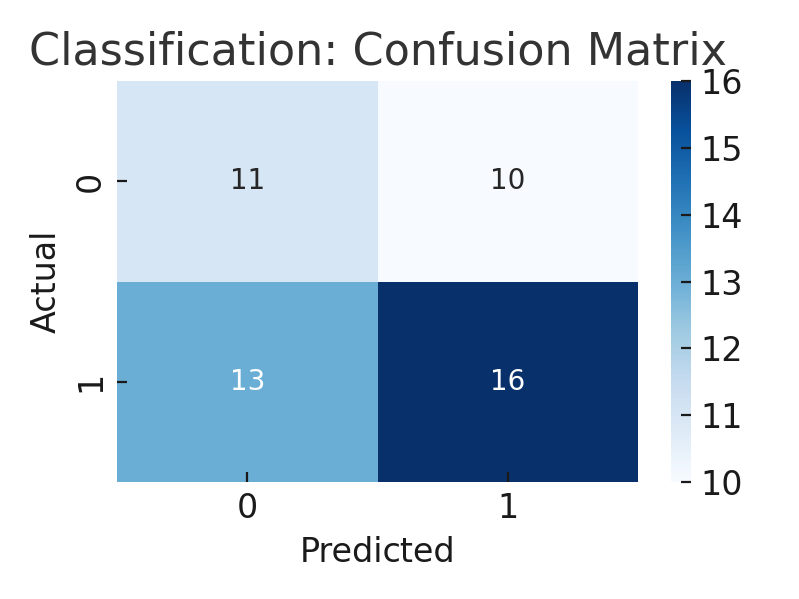
Classification Results

Slide 11
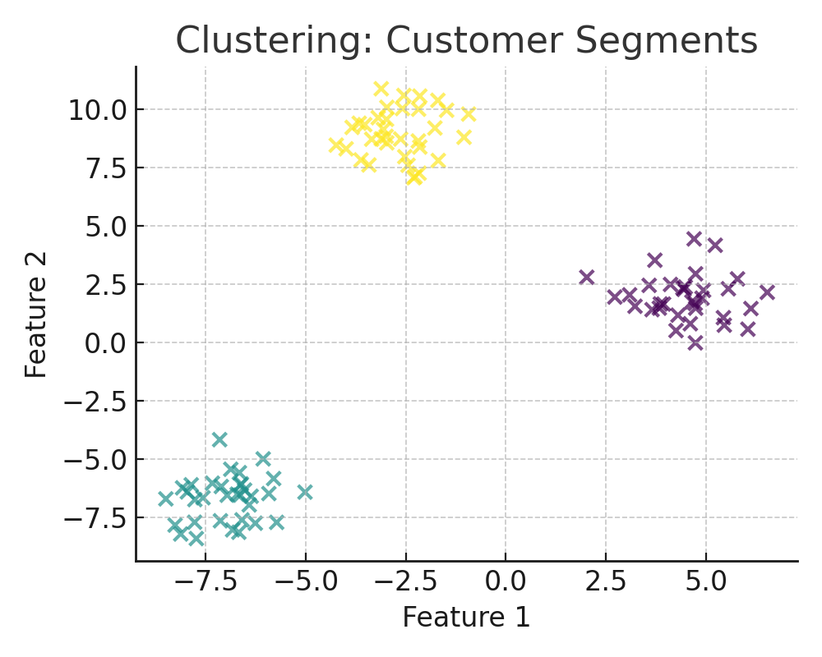
Clustering Results

