Slide 1

SMART PRICE COMPARATOR
Name:V.Harika
Reg.No:43110995

Slide 2
AGENDA
Abstract
Existing system
Proposed system
Advantages
Disadvantages
Hardware requirements
Software requirements
Module description
Sample output(screenshot)
Conclusion

Slide 3
Problem Statement
In the current digital era, online shoppers often visit multiple e-commerce sites to check and compare prices manually. This process is time-consuming and inefficient. There is no single platform that provides accurate, real-time comparison data for products across different websites. The Smart Price Comparator aims to address this problem by developing a centralized, automated solution using Java Full Stack technologies.

Slide 4
Abstract
The Smart Price Comparator system is designed to compare the prices of similar products across multiple e-commerce platforms and present the best available options to users. The project uses Java (Spring Boot) for backend processing, MySQL for data storage, and HTML/CSS/JavaScript for frontend development. It ensures users can make smarter and faster buying decisions with a single click.

Slide 5
Existing System
In the existing system, users manually visit various e-commerce platforms to compare prices, specifications, and reviews. This manual process is time-consuming, error-prone, and lacks a consolidated interface for comparison. There is no automation or centralized platform to assist users efficiently.

Slide 6
Proposed System
The proposed Smart Price Comparator system simplifies and automates the price comparison process. It retrieves data from multiple e-commerce websites through APIs or web scraping and displays the results in a unified dashboard. Users can easily search for products, view prices from different sources, and make quick purchase decisions.

Slide 7
Advantages
Time-saving automated comparison system
Centralized data from multiple sources
Easy-to-use interface
Provides accurate and real-time data
Improves user decision-making and convenience

Slide 8
Disadvantages
Depends on stable internet connectivity
Data accuracy depends on website API availability
Web scraping may require frequent maintenance if site structures change

Slide 9
Hardware & Software Requirements
**Hardware Requirements:**
- Processor: Intel i3 or higher
- RAM: 4GB or more
- Hard Disk: 100GB or more
**Software Requirements:**
- Operating System: Windows / Linux / macOS
- Backend: Java, Spring Boot
- Frontend: HTML, CSS, JavaScript
- Database: MySQL
- Tools: VS Code, GitHub, Postman, Maven

Slide 10
Modules & Description
User Module: Allows users to search and compare products.
Admin Module:Manages and updates product data.
Comparison Module:Fetches and compares prices across multiple sites.
Database Module:Stores product and user information securely.
Authentication Module:Manages login, registration, and access control.

Slide 11
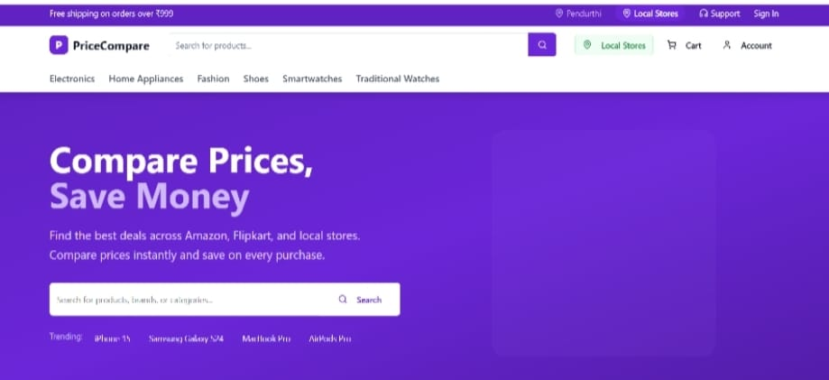
Sample Output (Screenshot Placeholder)

Slide 12
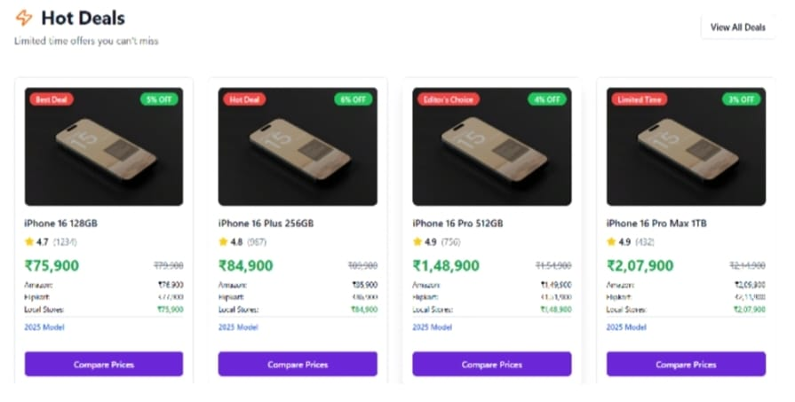

Slide 13
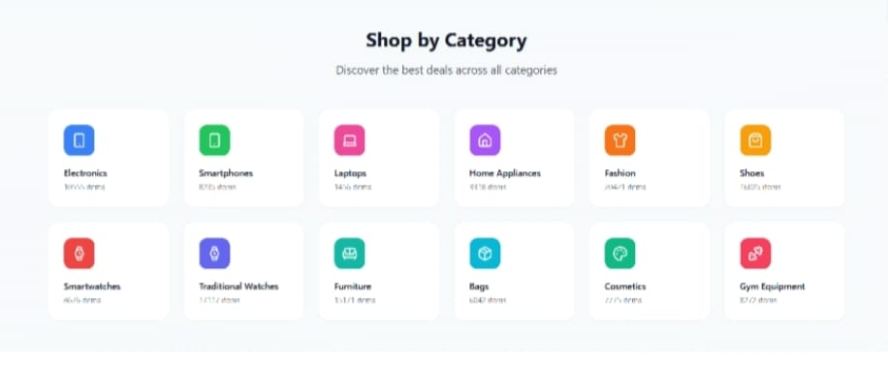

Slide 14
Conclusion
The Smart Price Comparator system successfully automates price comparison using Java Full Stack technologies. It reduces user effort, improves shopping efficiency, and provides real-time, accurate price comparisons. This project demonstrates the power of full stack development in solving real-world problems effectively.

