Slide 1
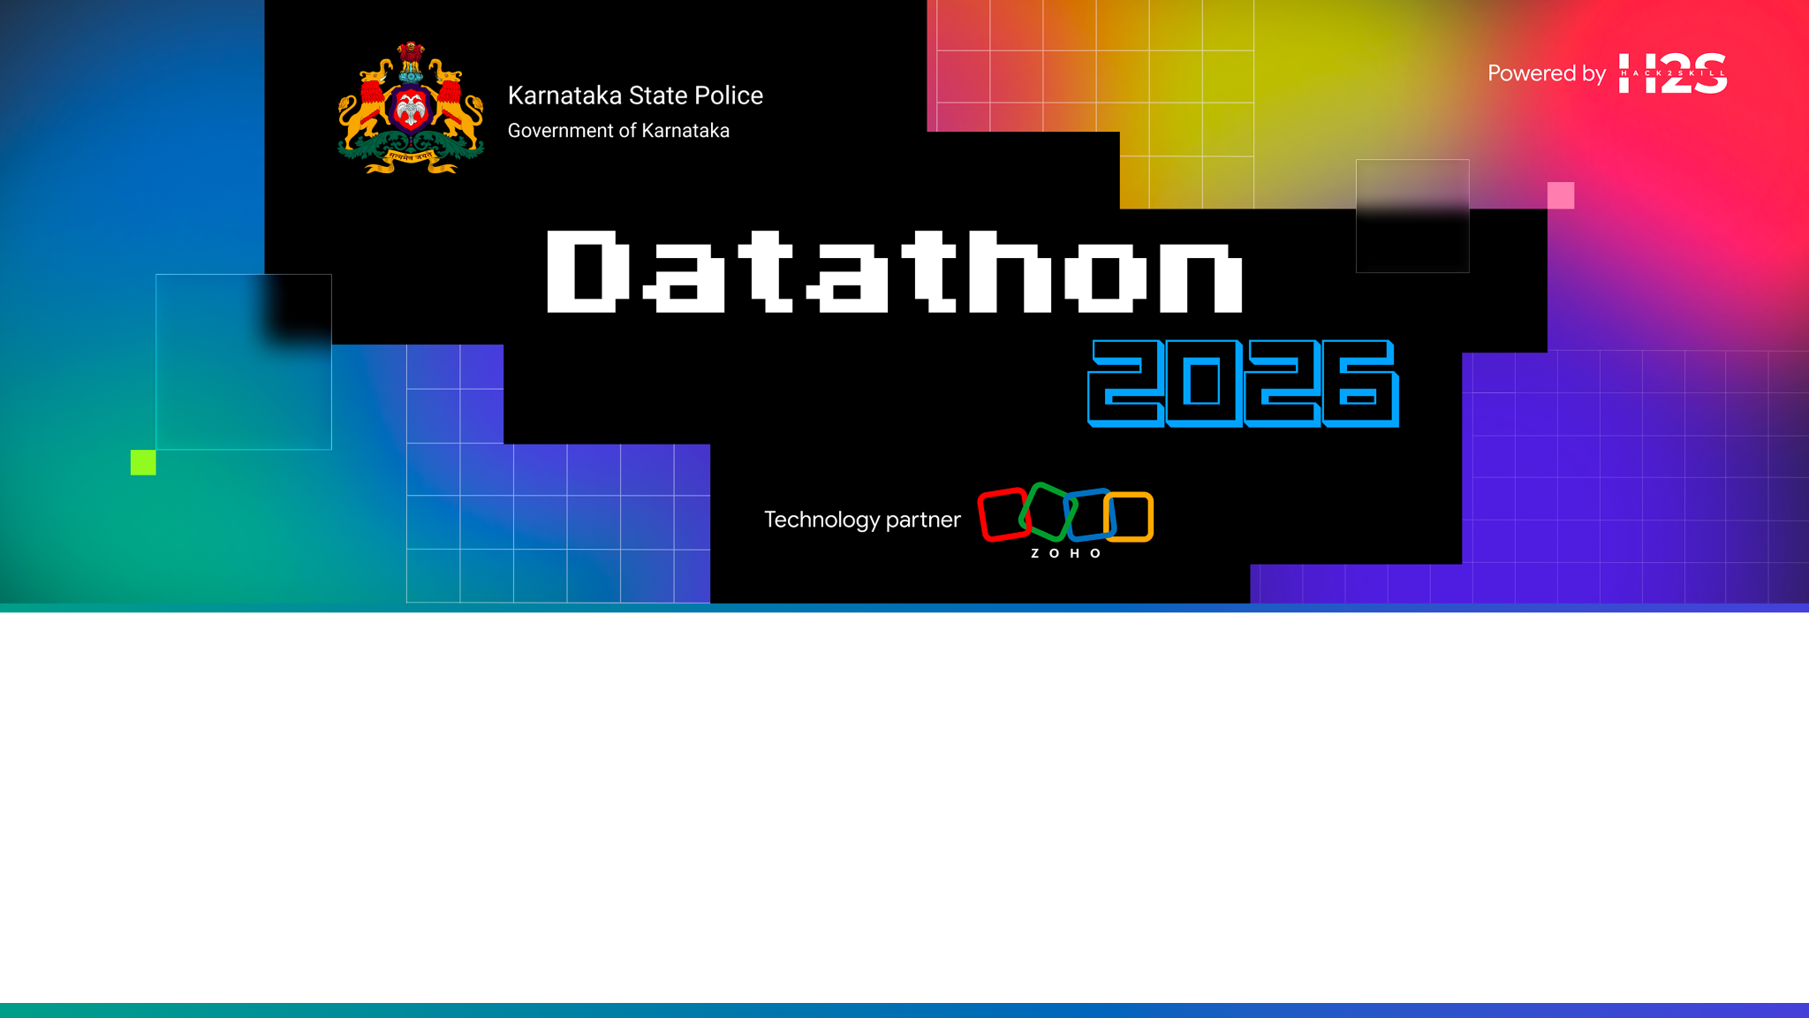
Team Details
  Team name: TRINETRA
  Team leader name: [PLACEHOLDER — confirm team leader name]
  Team size: [PLACEHOLDER — confirm team size]
  Problem Statement: KSP Datathon 2026 — Challenge 01 (Intelligent Conversational AI over the crime database) AND Challenge 02 (AI-driven Crime Analytics & Visualization platform).

Slide 2
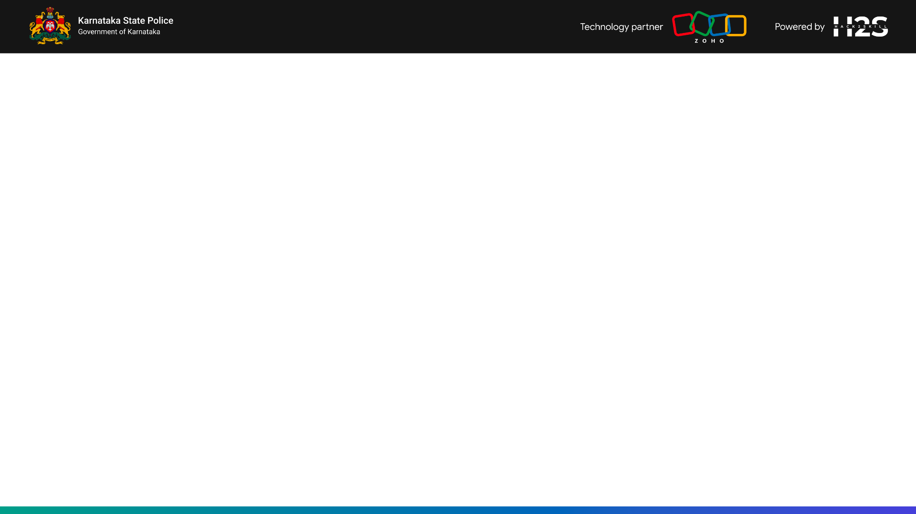
Brief about the solution
TRINETRA ("third eye") is one Intelligence Engine with two faces:
Copilot (Challenge 01): a conversational AI over the Karnataka Police FIR database — English + Kannada, voice-enabled, with cited answers, the SQL shown, charts, and downloadable PDF briefs.
War Room (Challenge 02): an analytics platform — geospatial hotspot maps, criminal-network graph, anomaly alerts, detection-quality and response-lag panels, and district drilldowns.
Both faces call the SAME engine API, so one ML brain powers both challenges. A trust spine (cite · explain · audit · RBAC · ethics) runs through every answer.

Slide 3
Opportunities
  How different is it from any of the other existing ideas?
  How will it be able to solve the problem?
  USP of the proposed solution
USP — the Trust Spine makes answers actionable AND court-defensible:
Cite: every answer carries source FIR row IDs.
Explain: the exact SQL / query that produced the answer is shown.
Audit: every question, query, role and data scope is logged.
RBAC: a scope WHERE clause is injected by role (SHO→station, DCP→district, ADGP→state).
Ethics: demographics framed as victimization not profiling; presumption-of-innocence on accused; no person-level prediction.
Differentiator: unlike static dashboards, a cop can act on it Monday morning and defend it in court. One engine serves both challenges.

Slide 4
List of features offered by the solution
Engine modules (one brain behind a Router agent):
Text→SQL (safe, parameterized, whitelisted, RBAC-injected) · RAG over BriefFacts (similar MO) · Criminal-network graph (gangs, kingpins, repeat offenders).
Hotspot forecast · Anomaly watch · Patrol risk score · Detection-quality (false-case / undetected) · Response-lag · Socio-economic (guardrailed) · PDF brief generator.
Copilot face: chat + voice + Kannada, citations, explainable SQL, charts, PDF export.
War Room face: hotspot maps, network graph, anomaly alerts, detection-quality and response-lag panels, risk scores, drilldowns.

Slide 5
Process flow diagram or Use-case diagram
Use-case flow (every request rides the trust spine):
1. Officer signs in → RBAC resolves their data scope (station / district / state).
2. Question (typed or spoken, EN/KN) → Router agent reads intent and picks the right module.
3. Module runs (e.g. Text→SQL builds safe SQL with the scope WHERE injected; graph/forecast/anomaly as needed).
4. Answer is composed with cited FIR IDs + the SQL shown + a chart + a confidence/caveat line.
5. The question, query and scope are written to the Audit Log; an optional PDF brief can be downloaded.

Slide 6
Wireframes/Mock diagrams of the proposed solution (optional)

Slide 7
Architecture diagram of the proposed solution
Two front-ends (Copilot + War Room) → API Gateway → Intelligence Engine → Data Store.
Intelligence Engine (Catalyst Functions + AppSail): a Router agent selects and composes modules — Text→SQL, RAG, Graph, Forecast, Anomaly, Risk, Detection-quality, Response-lag, Socio-economic, Brief generator.
Trust layer wraps every module: cite · explain · audit · RBAC · guardrails.
Data Store holds FIR rows + audit log; QuickML serves vector/RAG/LLM; Stratus + Cache support storage and speed.
Prototype today: FastAPI engine + SQLite + React/Vite SPA, a 1:1 stand-in for the Catalyst services above.

Slide 8
Technologies to be used in the solution
Backend / Engine:
Python, FastAPI, Uvicorn, SQLite, scikit-learn, NetworkX, pandas, Faker, reportlab.
Frontend:
React 18, Vite 5, TypeScript, Leaflet (maps), Recharts (charts), vis-network (graph).
Target platform: Zoho Catalyst (Data Store, Functions/AppSail, Slate, QuickML, Zia AutoML, Zia Services, SmartBrowz, Authentication, API Gateway, Stratus, Cache, Cron, Signals, Pipelines).

Slide 9
List down Catalyst Services being used in the solution
Mandatory Zoho Catalyst service mapping (full detail in CATALYST_MAPPING.md):
Web Client Hosting / Slate — the two front-ends.
Functions + AppSail — engine modules; heavy graph/ML on AppSail.
Circuits — Router pipeline orchestration.
Data Store — FIR data + full-text + audit log.
QuickML — vector / RAG / LLM serving (Text→SQL).
Zia AutoML — patrol risk scoring; Zia Services — Kannada STT/TTS/translate + OCR.
SmartBrowz — PDF briefs; Authentication — login/RBAC; API Gateway — routing/throttling.
Stratus — object storage; Cache — query cache; Cron→Mail/Push — proactive briefings.
Signals + Event Functions — new-FIR auto-anomaly; Pipelines — CI/CD.

Slide 10
Estimated implementation cost (optional)

Slide 11

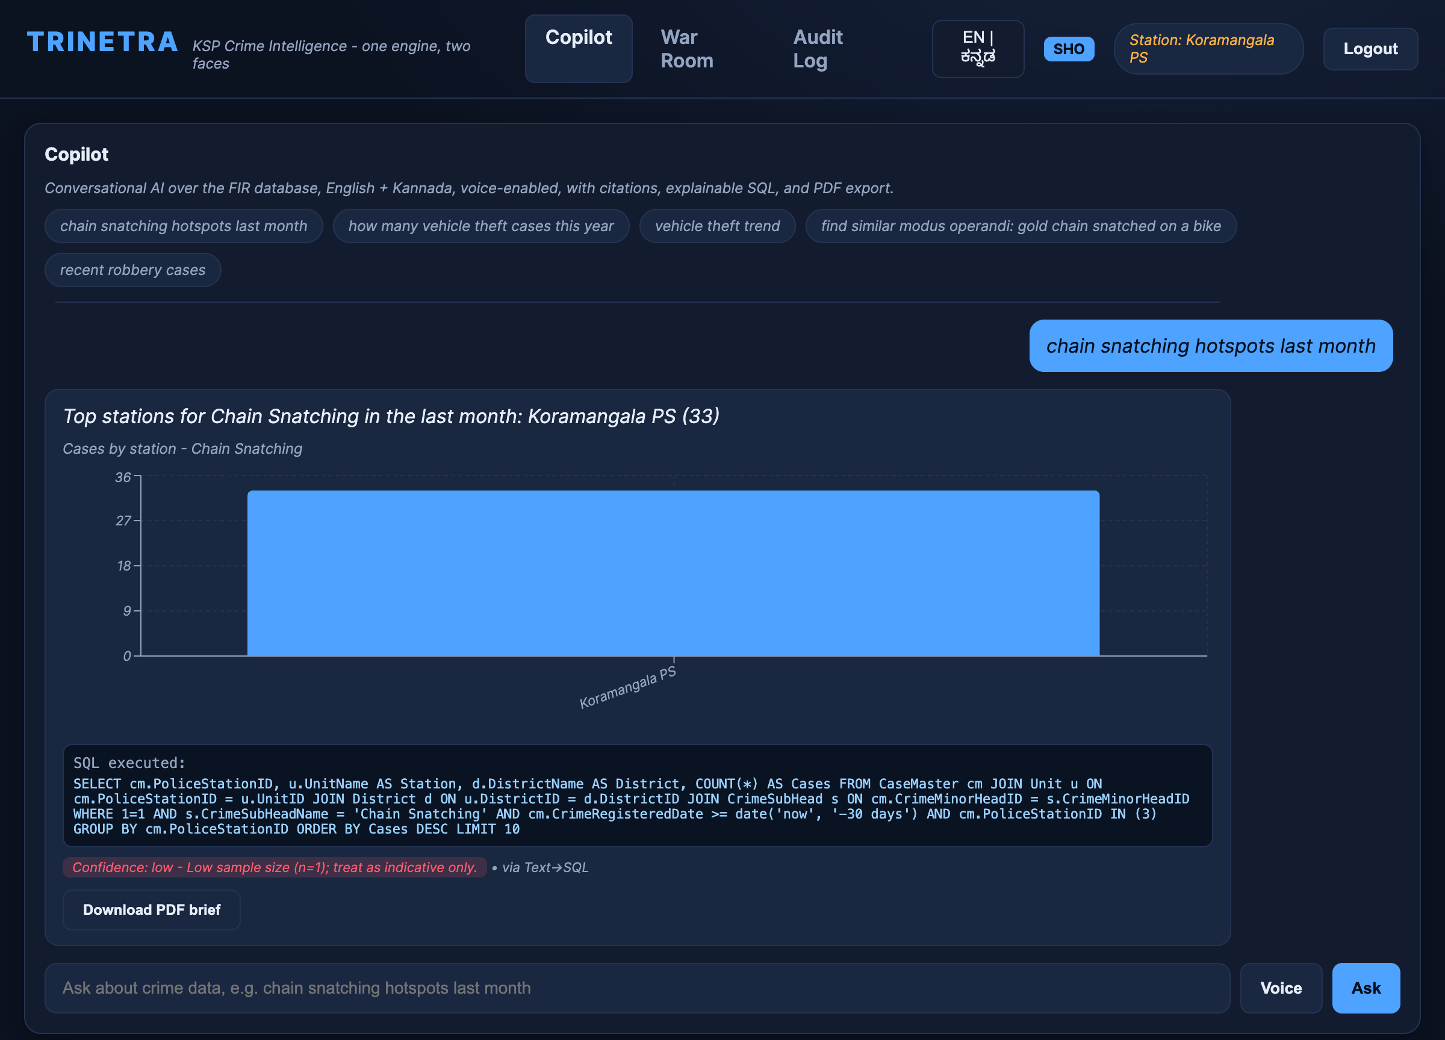
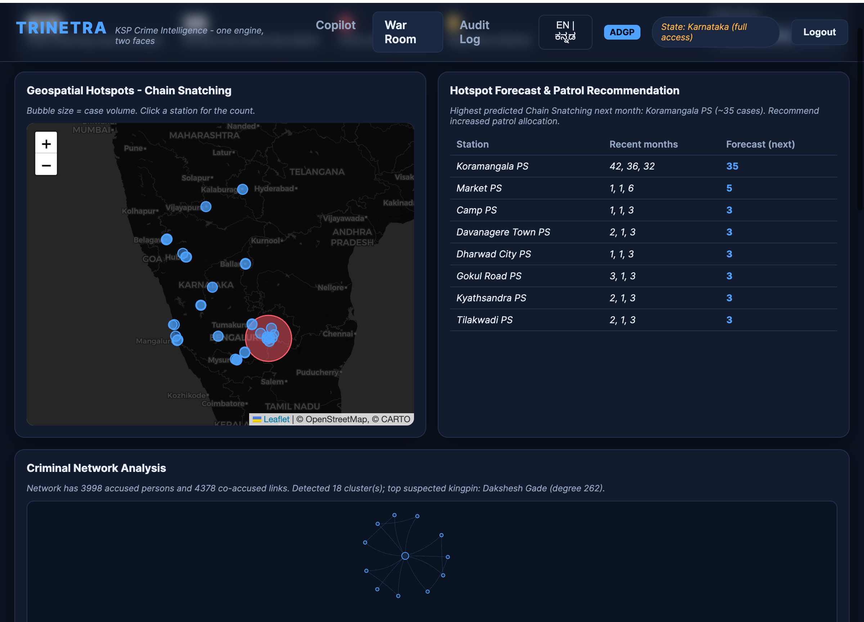
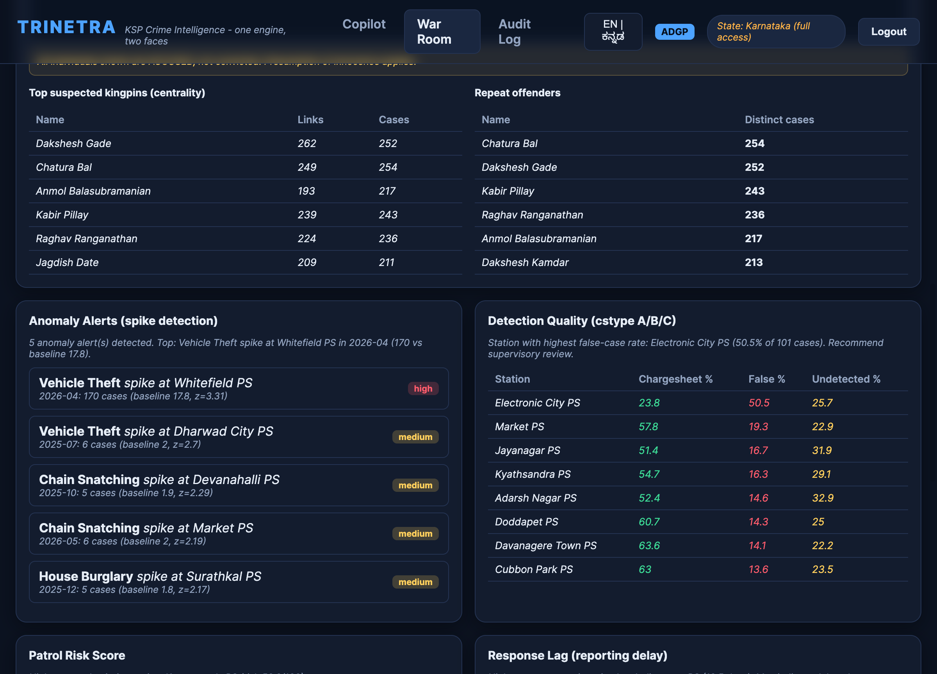
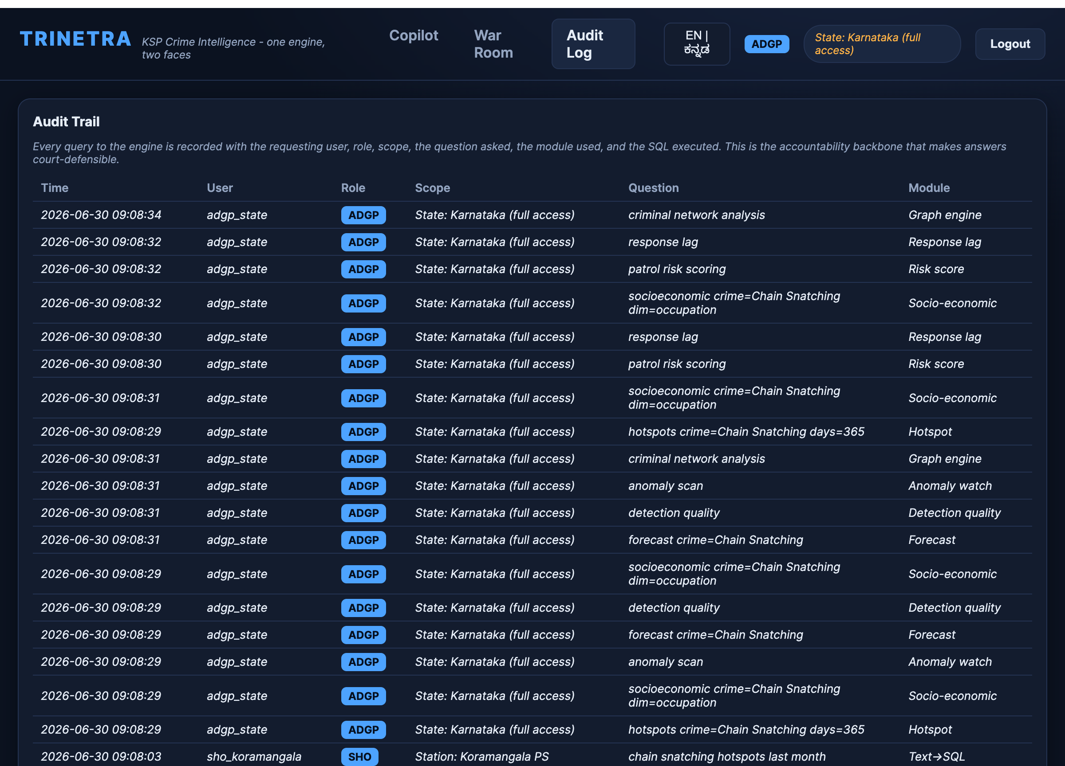
Snapshots of the prototype
Snapshots (L→R, top→bottom): Login — RBAC role selection · Copilot — cited answer + SQL + chart + confidence · War Room dashboard · Criminal network — kingpins + repeat offenders · Audit Log

Slide 12
Prototype Performance report/Benchmarking
Prototype performance / benchmarking:
Dataset: 4000 synthetic FIRs across 40 police stations and 15 districts, generated on the real KSP FIR ER schema.
Planted, verifiable demo signals: Koramangala chain-snatching hotspot; Whitefield April vehicle-theft spike; Electronic City ~50% false-case cluster; Indiranagar response-lag outlier; gangs + repeat offenders in the graph.
Engine is deterministic and fully offline — sub-second response on a laptop, no external API calls in the demo path.
Quality: 13/13 engine smoke tests passing (RBAC scope narrowing, citations, SQL returned, planted-fact discovery, bias/innocence disclaimers).

Slide 13
Provide links to your:
GitHub Public Repository
Demo Video Link (3 Minutes)
Deployed Link
GitHub Public Repository: https://github.com/EshaaSumesh/KSP
Demo Video Link (3 minutes): [PLACEHOLDER — record + paste public Drive/YouTube link]
Deployed Link: [PLACEHOLDER — pending Zoho Catalyst deployment; see CATALYST_MAPPING.md]

Slide 14
Additional Details/Future Development (if any)
Future development (full honest gap list in gaps.md):
Deploy end-to-end on Zoho Catalyst (Data Store, Functions/AppSail, Slate, API Gateway, Authentication).
Integrate real KSP FIR data when released (swap the synthetic generator).
Real LLM Text→SQL via QuickML (replace deterministic intent matching); real Zia Kannada STT/TTS/translate.
Upgrade forecast to Prophet/LightGBM and risk to Zia AutoML; vector RAG store.
Wire Cron proactive briefings + Signals auto-anomaly; expand tests + Pipelines CI/CD.
Produce the demo video and fill the live deployed link for submission.

Slide 15
Blank slide

Slide 16


