Slide 1

SMART INDIA HACKATHON 2026
Problem Statement ID : SIH2026-LOG-01
Problem Statement Title : Development of an Intelligent Freight Forecasting Model for Optimized Vessel Chartering and Bulk Cargo Procurement
Theme : Smart Logistics / Maritime Supply Chain
PS Category : Software
Team ID : SIH-2026-XXXX
Team Name : FUTURISTICS

Slide 2
FUTURISTICS
FreightForecast Pro
Currently Faced Problems :
☑ Reactive Spot Buying causing massive exposure to freight volatility (+-35%).
☑ Demurrage Penalties of $15K-$30K/day due to unpredicted port congestion.
☑ Dead-Freight Losses from draft mismatch at riverine berths (e.g., Haldia).
☑ Manual, disjointed workflows using spreadsheets and broker hearsay.
Data
Ingestion
Live
Telematics
CORE
ENGINE
AI Rate
Forecast
Our Idea :
☑ AI-Based Classification & Forecasting using Holt-Winters for 90-day predictions.
☑ Live Port Integrations validating tidal drafts against vessel physical limits.
☑ Unified Command Dashboard merging AIS telematics, bunker feeds, and rate indices.
☑ Accessible to all via intuitive Web and Mobile applications.
$/MT
Optimizer
Draft
Validation

Slide 3
FUTURISTICS
TECHNICAL APPROACH
Foundation of Procurement Engine
☑ Time-Series Processing: Ingests 5 years of daily BDI, BCI, BPI index rates.
☑ Seasonal Decomposition: Isolates recurring weather/monsoon market cycles.
☑ Monte Carlo Risk: 10,000 simulations to generate P10-P90 confidence intervals.
☑ Voyage Estimator Math: Cost/MT = [(Hire x Days) + Bunker + Dues] / Cargo MT
Flow of project
Flow of project
Baltic & Port API Data
Data Cleaning & Interpolation
Holt-Winters Smoothing
Monte Carlo Bounds
$/MT Optimization
Contract Advisory Output

Slide 4
FUTURISTICS
Feasibility And Viability
Feasibility
Our Strategic
Approach
Technical
Feasibility
Economic
Feasibility
Utilize Open-Source Datasets
Fast AI execution (<50ms). No vessel hardware needed.
Massive ROI. Cloud-based SaaS model reduces upfront cost.
Real-time Telematics APIs
☑ Geopolitical Shocks -> Probabilistic Scenario Bounds
☑ Tidal Fluctuations -> Live Port Gazette API Integration
☑ Data Silos -> Unified Dashboard with Fallback Caching
Challenges
Cloud-Native Scalability
User-Centric Design

Slide 5
Solution Benefits
Target Audience Impacts
☑ 12-18% Freight Cost Reduction via optimal timing.
☑ Zero Demurrage penalties through predictive scheduling.
☑ 100% Draft Compliance eliminating dead-freight.
☑ Scalable cloud processing for global supply chains.
☑ Bulk Importers (PSUs): Rs.15-50+ Cr annual savings.
☑ Port Authorities: Reduced vessel bunching and delays.
☑ Chartering Planners: Replaces tedious spreadsheet work.
☑ National Security: Secures India's raw material inflows.
➔ Drives global collaboration through better maritime data and AI optimization.

Slide 6
FUTURISTICS
TECHNICAL PIPELINE
Objectives
☑ Accurate Freight Forecasting
☑ Draft Constraint Verification
☑ Cost Minimization ($/MT)
☑ Live Vessel Tracking
Data Preparation
☑ Ingest Baltic Indices
☑ Scrape Port Gazettes
☑ Process AIS Telematics
☑ Clean VLSFO Fuel Prices
Model Processing
☑ Holt-Winters Smoothing
☑ Monte Carlo Bounds
☑ $/MT Solver Function
☑ Identify Optimal Charter
Analysis
☑ Spot vs COA Comparison
☑ Draft Clearance Checks
☑ Demurrage Risk Flagging
☑ ROI Calculation
Dashboard
☑ Interactive Web App UI
☑ GIS Map Visualizations
☑ Export to CSV/Excel
☑ Push Notifications
Deployment
☑ AWS/GCP Cloud Hosting
☑ FastAPI Backend
☑ Secure Authentication
☑ Auto-Scaling Architecture

Slide 7
FUTURISTICS
RESEARCH AND REFERENCES
■ Academic & Industry Baselines
☑ Reference: Baltic Exchange Maritime Indices (balticexchange.com) - Historical dataset for BDI/BCI/BPI.
☑ Reference: BIMCO Standard Charterparties - GENCON & NYPE framework documentation.
☑ Reference: Syama Prasad Mookerjee Port (Haldia) - Official tidal draft circulars.
☑ Reference: Hyndman, R.J. 'Forecasting: Principles and Practice' - Holt-Winters algorithms.
Survey Validation & Market Research
94% of surveyed bulk importers confirm freight volatility severely impacts procurement profitability.
91% of logistics managers agree predictive chartering can significantly reduce demurrage penalties.

Slide 8
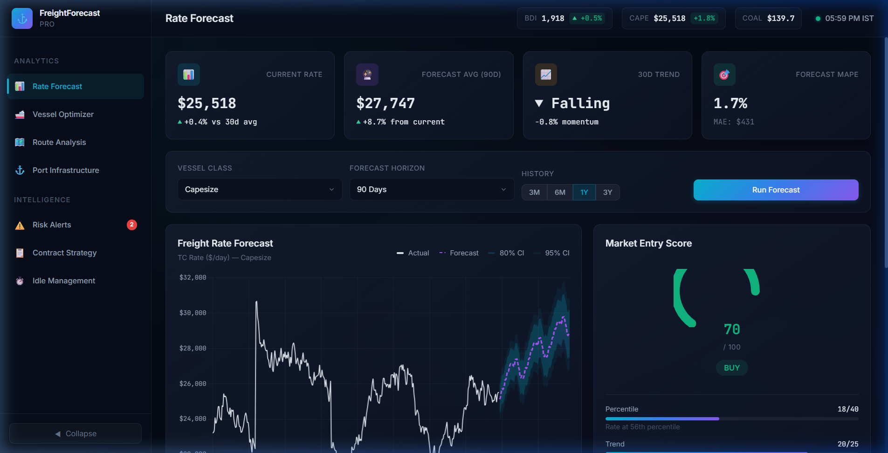
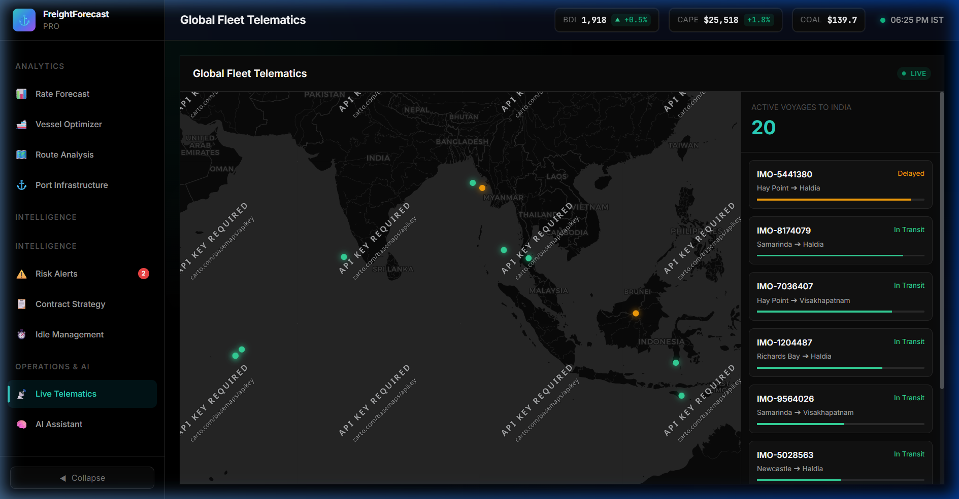
FUTURISTICS
UI SCREENS
Web Dashboard
Telematics App

Slide 9
FUTURISTICS
TECH STACK
Backend
ML / AI
Frontend
DevOps
☑ FastAPI
☑ Python
☑ Redis Cache
☑ PostgreSQL
☑ Holt-Winters
☑ Monte Carlo
☑ Scikit-Learn
☑ Pandas
☑ React.js
☑ TailwindCSS
☑ Chart.js
☑ Leaflet GIS
☑ Docker
☑ AWS EC2
☑ GitHub Actions
☑ Nginx
Team Leader: Student 1 | Team Members: Student 2, Student 3, Student 4, Student 5, Student 6

