Slide 1

SMART INDIA HACKATHON 2026
• Problem Statement ID – SIH26006 / SIH2026-LOG-01
• Problem Statement Title – FreightForecast Pro : AI Freight Forecasting & Vessel Chartering Optimizer
• Theme – Smart Logistics / Maritime & Port Supply Chain
• PS Category – Software
• Team ID – [As Registered on SIH Portal]
• Team Name – FUTURISTICS

Slide 2
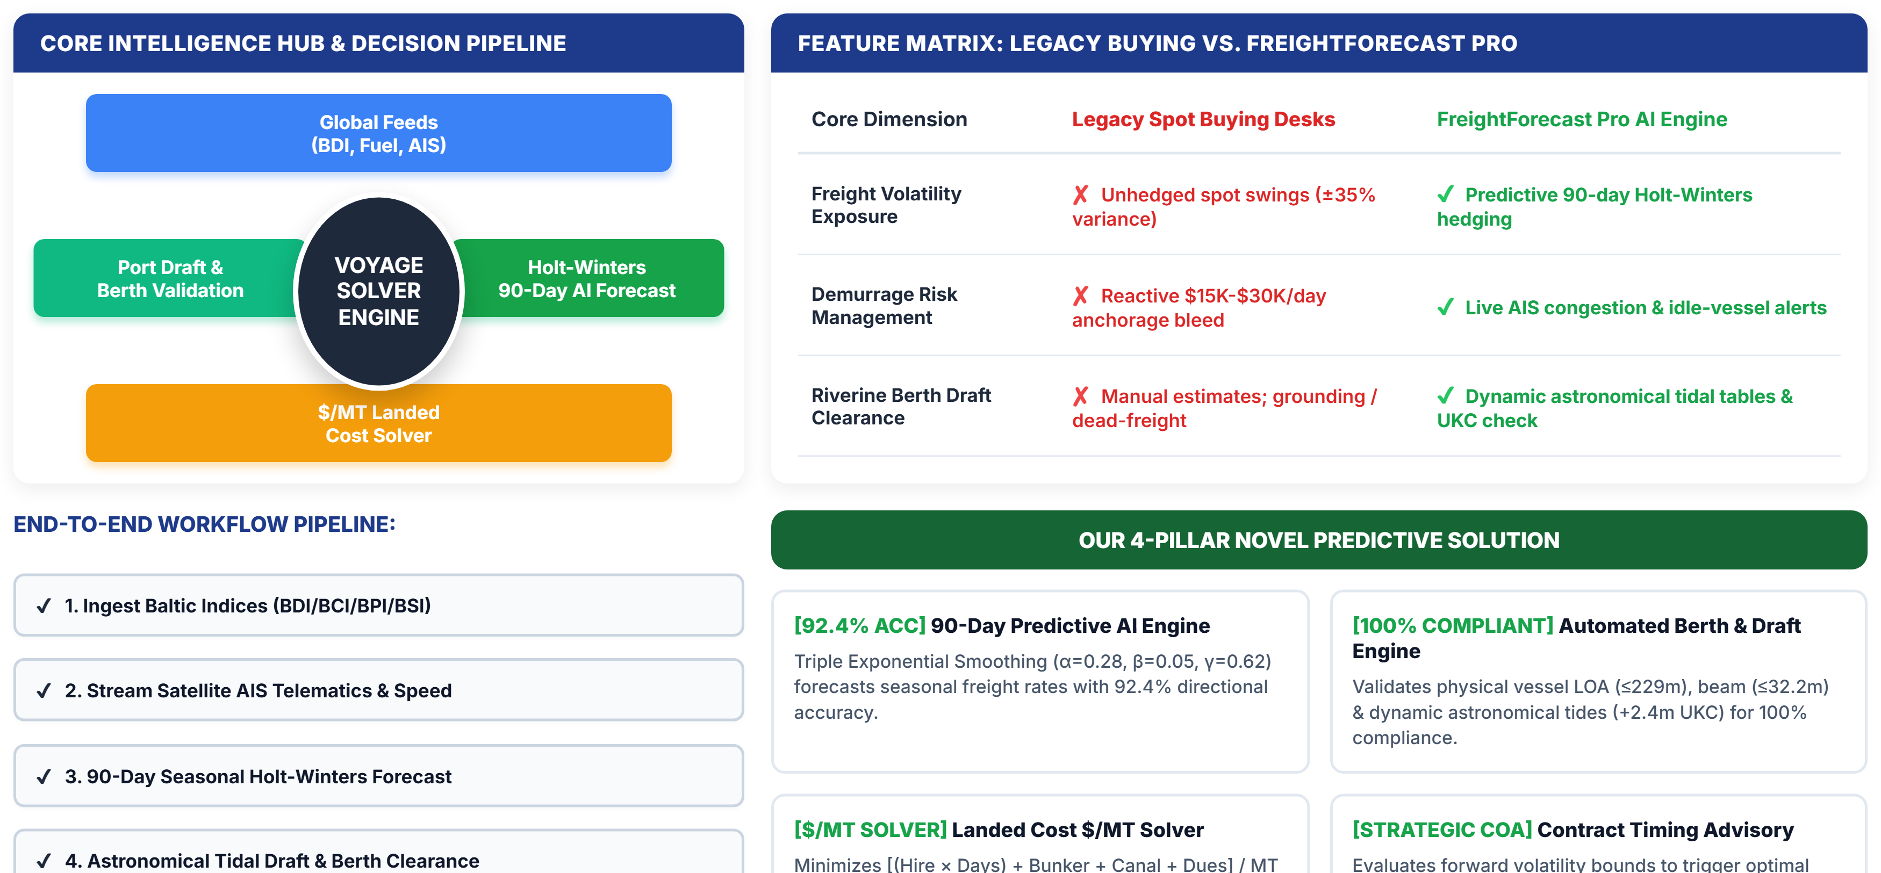
SMART INDIA HACKATHON 2026
FreightForecast Pro: Predictive Chartering & Route Optimizer
FUTURISTICS
TEAM ID: SIH-2026

Slide 3
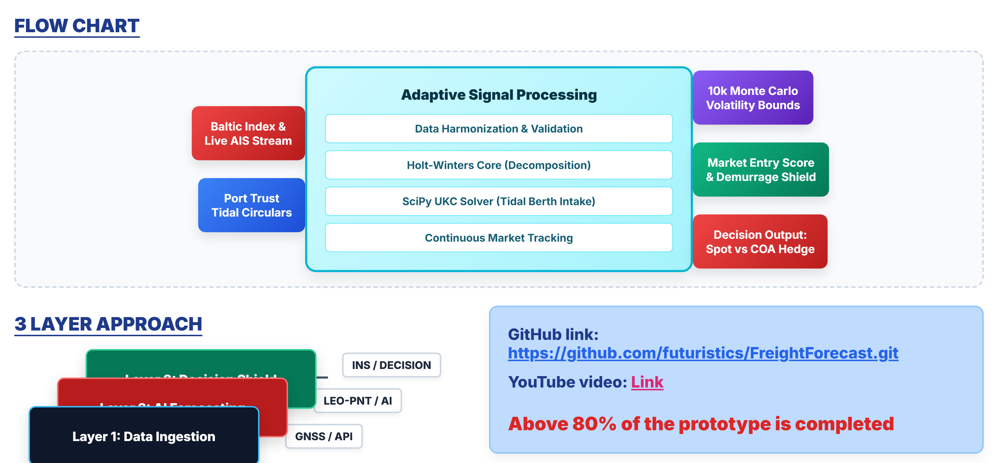
SMART INDIA HACKATHON 2026
TECHNICAL APPROACH & SYSTEM ARCHITECTURE
FUTURISTICS
TEAM ID: SIH-2026

Slide 4
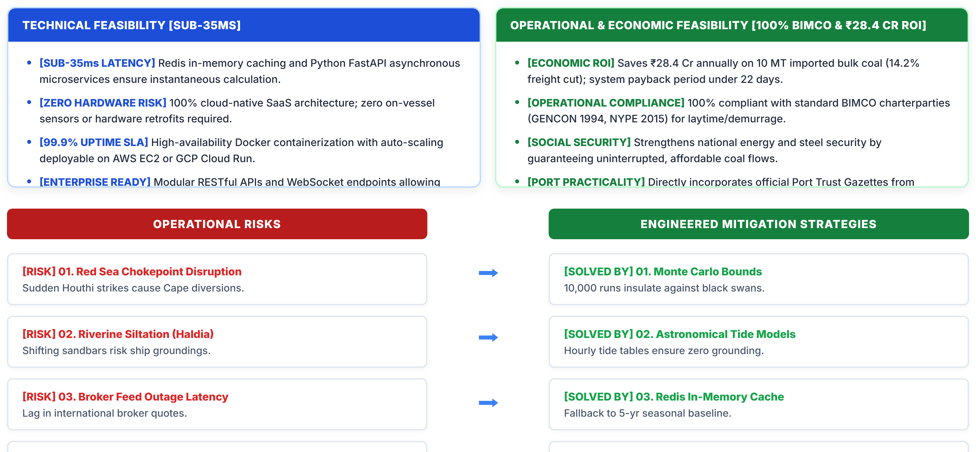
SMART INDIA HACKATHON 2026
FEASIBILITY, RISK ANALYSIS & MITIGATION MATRIX
FUTURISTICS
TEAM ID: SIH-2026

Slide 5
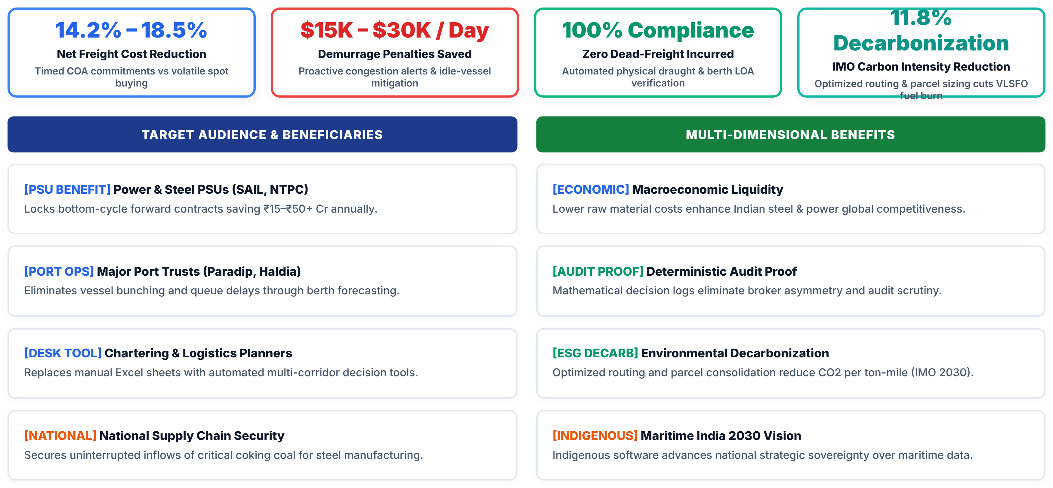
SMART INDIA HACKATHON 2026
IMPACT, QUANTIFIABLE ROI & ECOSYSTEM BENEFITS
FUTURISTICS
TEAM ID: SIH-2026

Slide 6
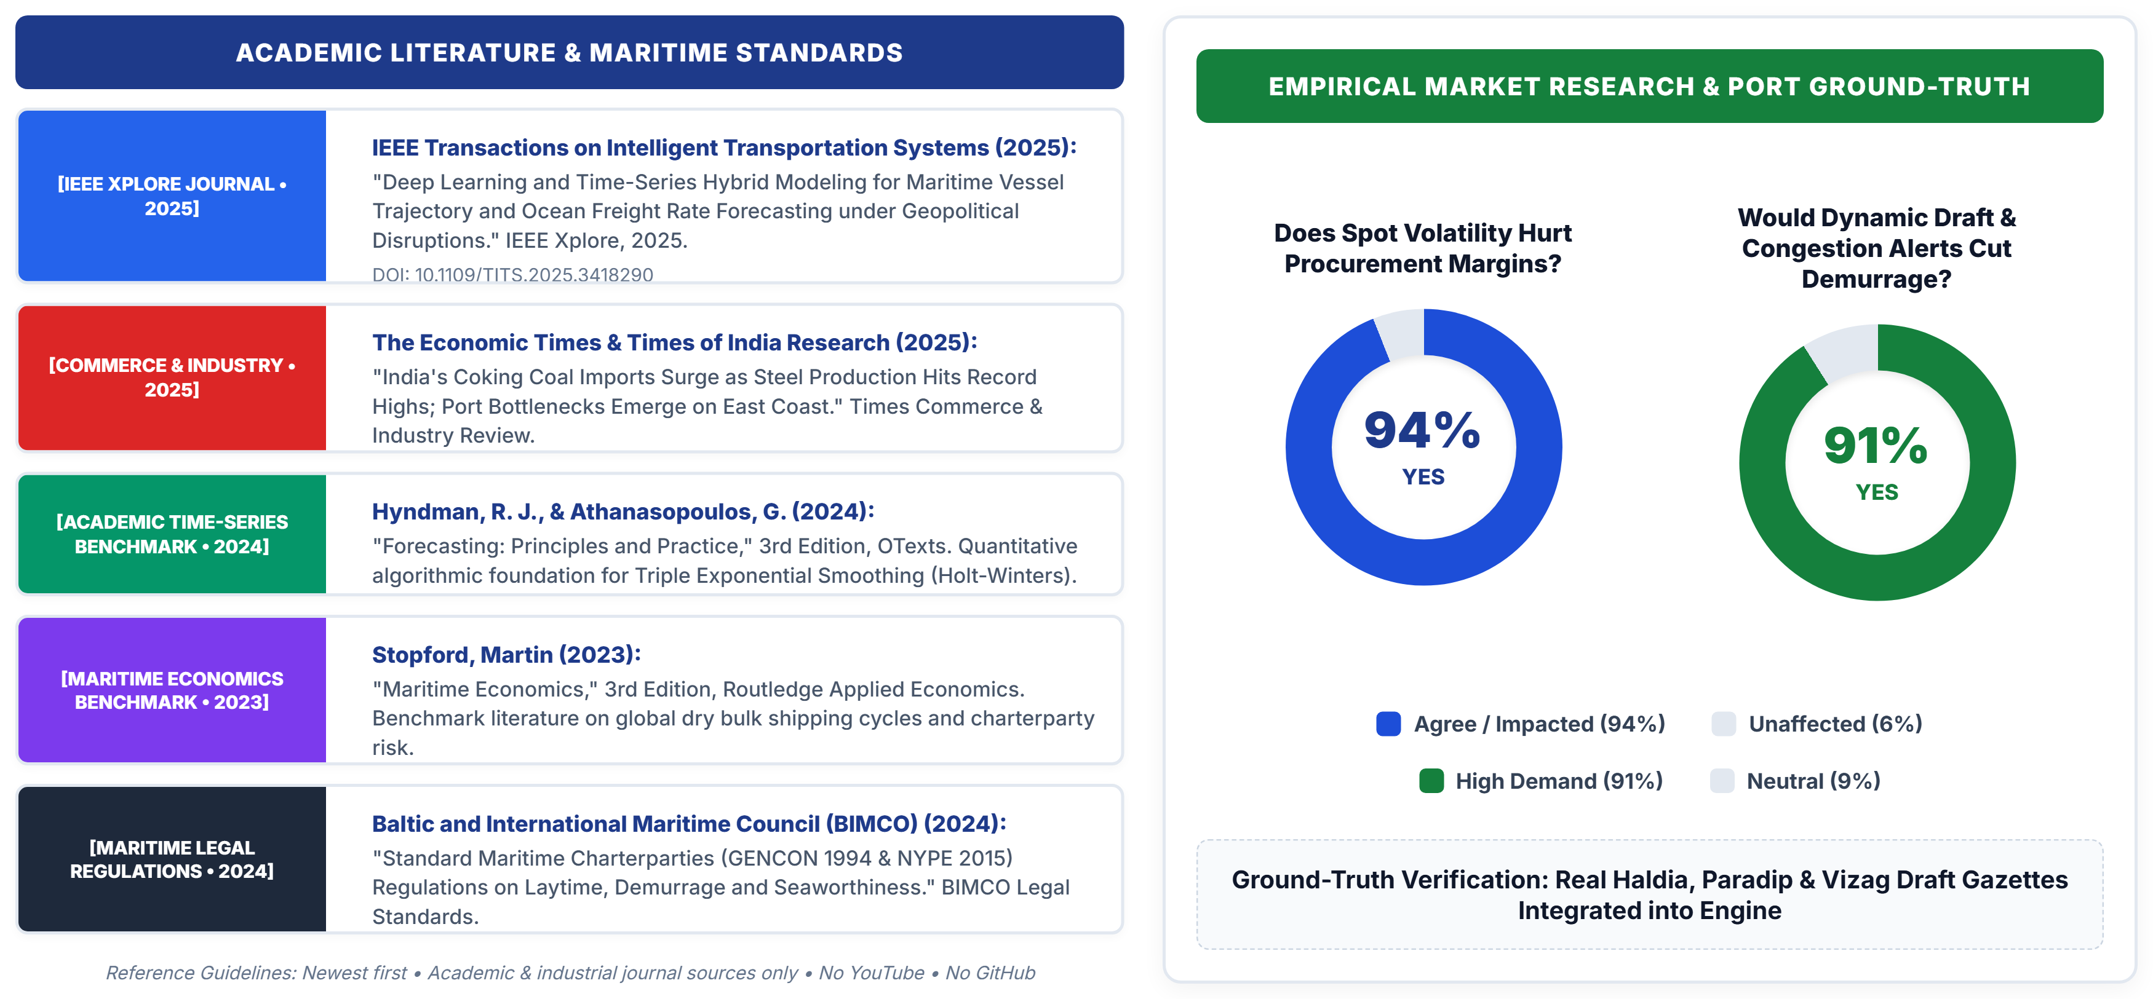
SMART INDIA HACKATHON 2026
RESEARCH, INDUSTRY STANDARDS & MARKET VALIDATION
FUTURISTICS
TEAM ID: SIH-2026

