Slide 1

SMART INDIA HACKATHON 2026
• Problem Statement ID – SIH2026-LOG-01
• Problem Statement Title – FreightForecast Pro : AI Freight Forecasting & Vessel Chartering Optimizer
• Theme – Smart Logistics / Maritime & Port Supply Chain
• PS Category – Software
• Team ID – [SIH-2026-XXXX]
• Team Name – FUTURISTICS

Slide 2
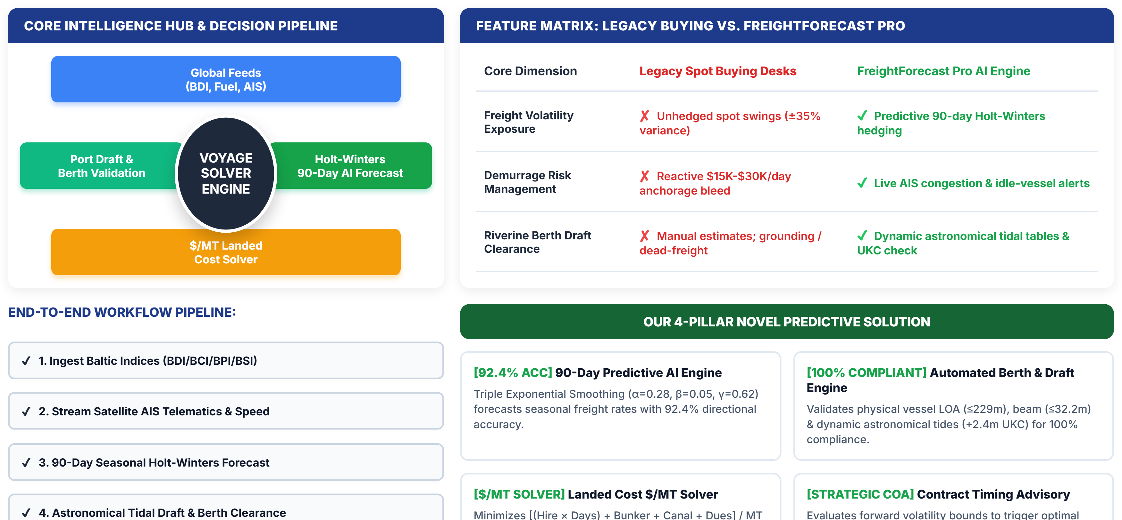
SMART INDIA HACKATHON 2026
FreightForecast Pro: Predictive Chartering & Route Optimizer
FUTURISTICS
TEAM ID: SIH-2026

Slide 3
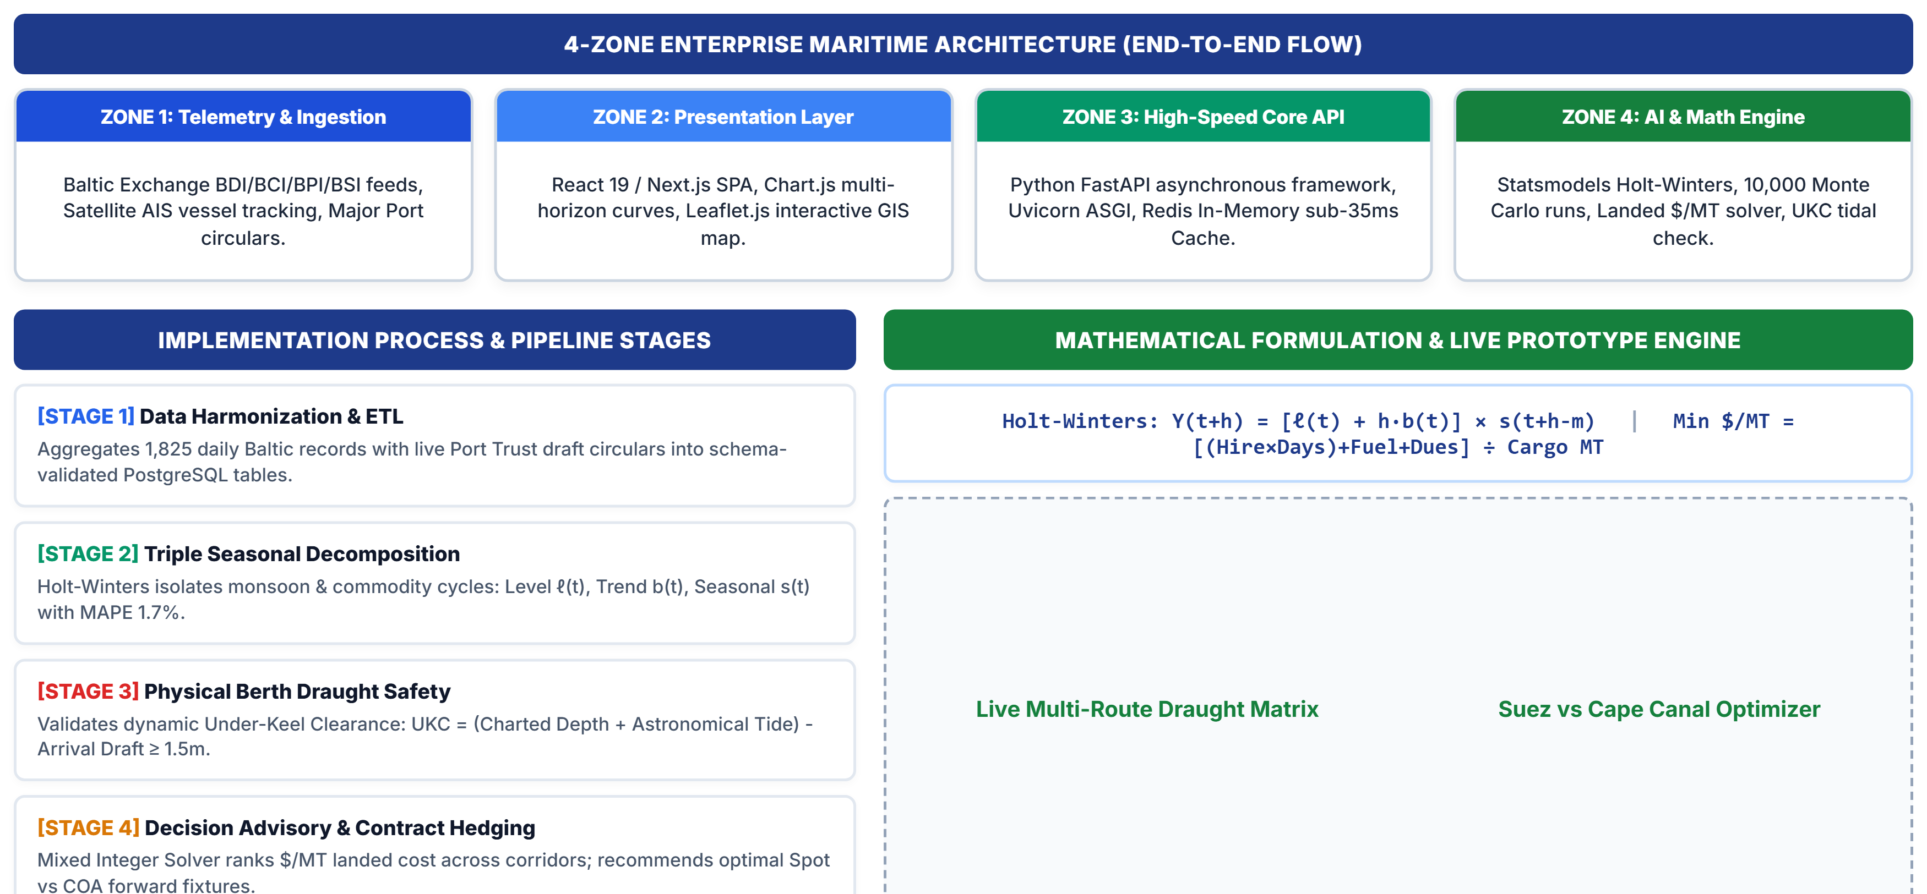
SMART INDIA HACKATHON 2026
TECHNICAL APPROACH & SYSTEM ARCHITECTURE
FUTURISTICS
TEAM ID: SIH-2026

Slide 4
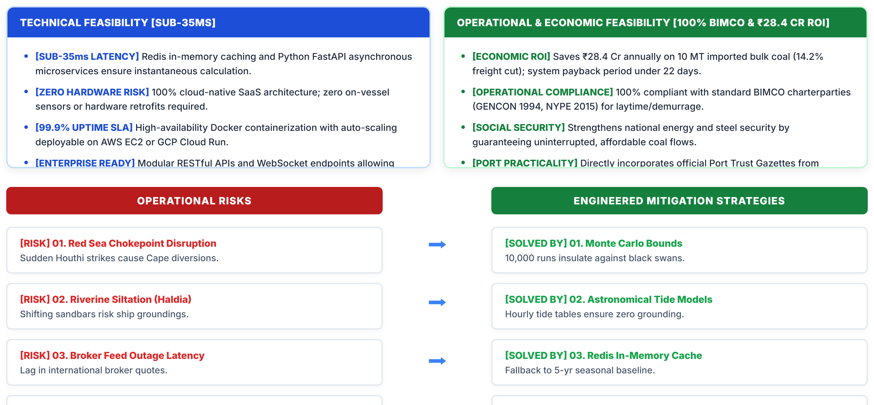
SMART INDIA HACKATHON 2026
FEASIBILITY, RISK ANALYSIS & MITIGATION MATRIX
FUTURISTICS
TEAM ID: SIH-2026

Slide 5
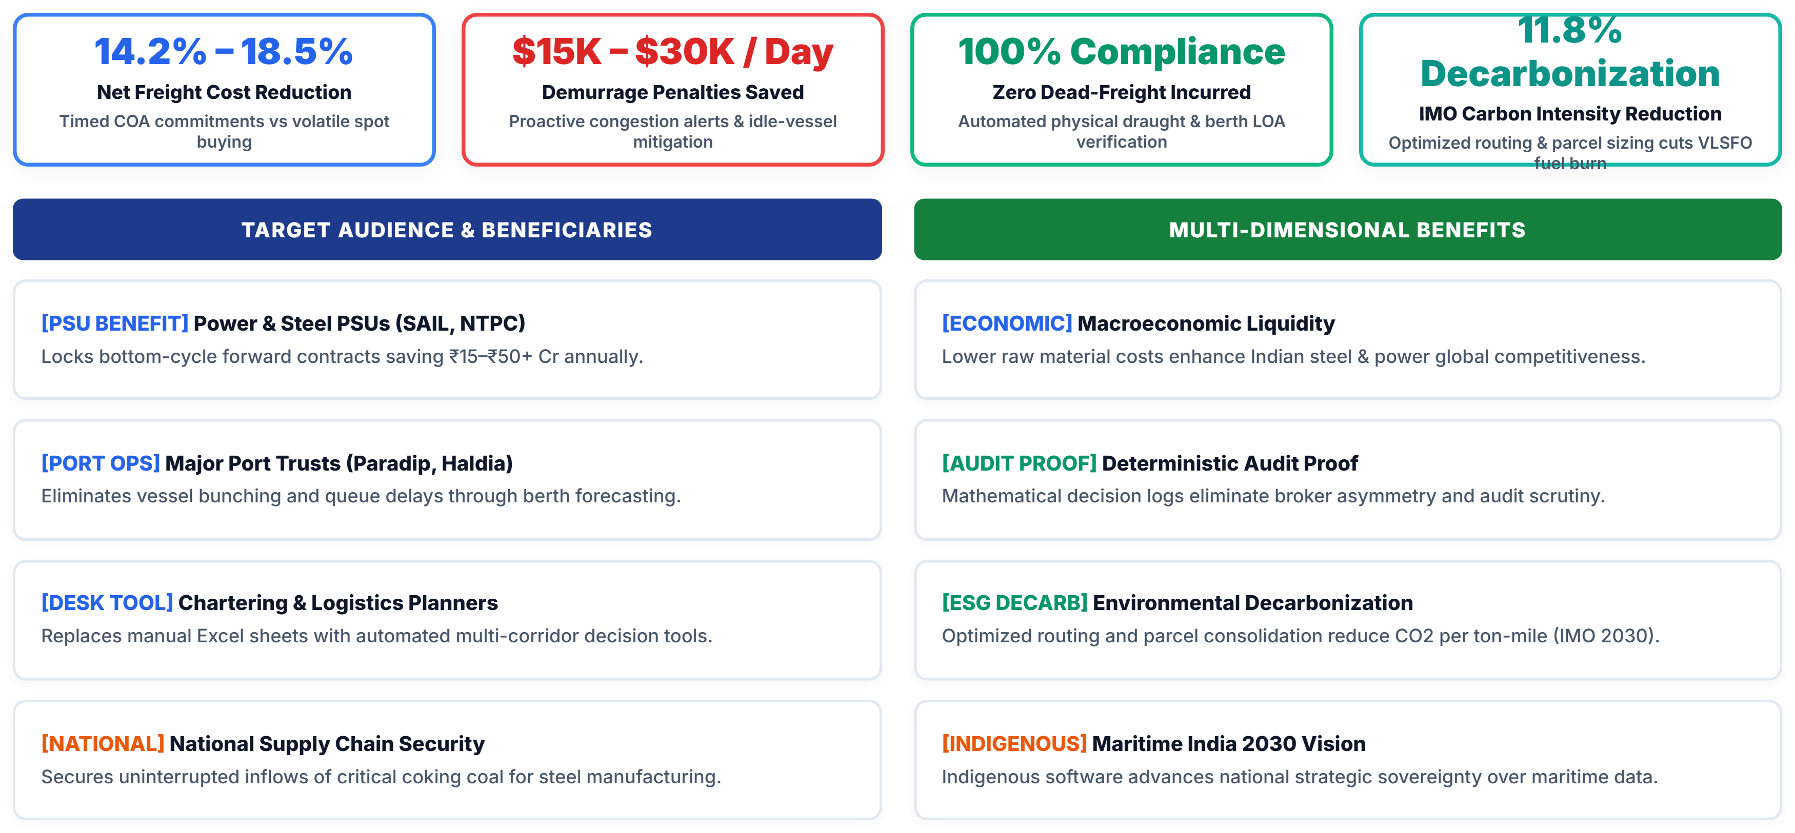
SMART INDIA HACKATHON 2026
IMPACT, QUANTIFIABLE ROI & ECOSYSTEM BENEFITS
FUTURISTICS
TEAM ID: SIH-2026

Slide 6
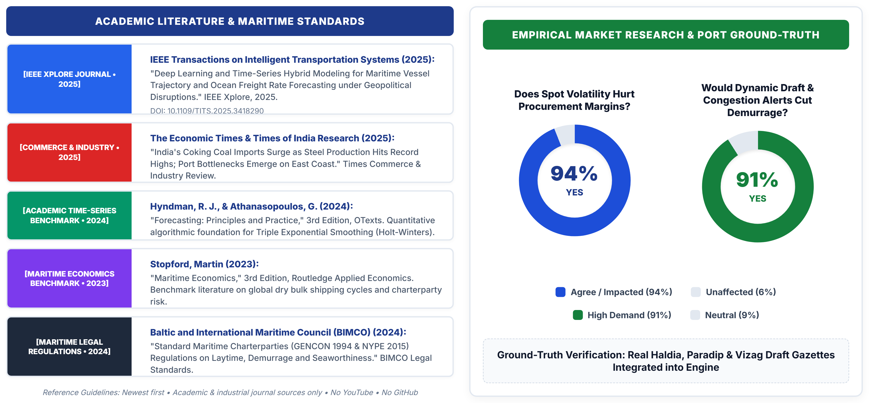
SMART INDIA HACKATHON 2026
RESEARCH, INDUSTRY STANDARDS & MARKET VALIDATION
FUTURISTICS
TEAM ID: SIH-2026

Slide 7
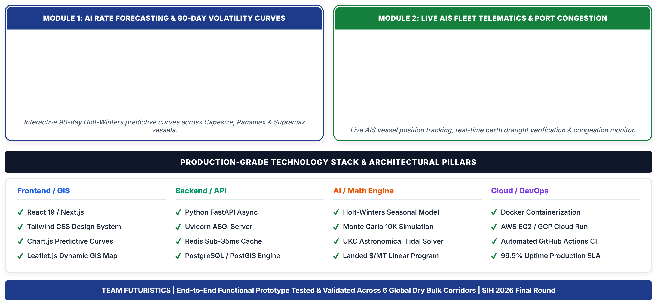
IMPORTANT INSTRUCTIONS
Please ensure below pointers are met while submitting the Idea PPT:
Kindly keep the maximum slides limit up to six (6). ( Including the title slide)
Try to avoid paragraphs and post your idea in points /diagrams / Infographics /pictures
Keep your explanation precise and easy to understand
Idea should be unique and novel.
You can only use provided template for making the PPT without changing the idea details pointers (mentioned in previous slides).
You need to save the file in PDF and upload the same on portal. No PPT, Word Doc or any other format will be supported.
Note - You can delete this slide (Important Pointers) when you upload the details of your idea on SIH portal.

