Slide 1
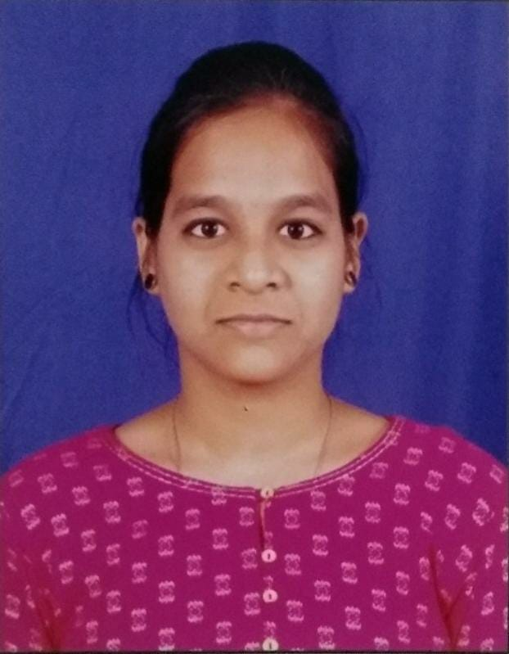
Student Details
Name : Bhuvana Siri Panchumarthy
SKILL BUILD EMAIL ID : bhuvanasiripanchumarthy@gmail.com
COLLEGE NAME : SRK institute of technology
COLLEGE STATE : Andhra Pradesh
INTERNSHIP DOMAIN : : Artificial intelligence and machine learning
INTERNSHIP START DATE : 03-06-2024
INTERNSHIP END DATE : 12-07-2024

Slide 2
PROJECT TITLE/Problem Statement
EMPLOYEE BURNOUT ANALYSIS

Slide 3
AGENDA
Project Overview
Who will be the end user of the project?
Your solution and its value proposition
How did you customize the project and make it your own
Modeling
Results
links

Slide 4
PROJECT OVERVIEW
The Employee Burnout Analysis project aims to identify and address factors contributing to employee burnout within an organization. Data will be collected through surveys, existing records, and interviews, then analyzed using statistical and machine learning techniques to identify patterns and correlations. Visualizations and dashboards will be created to present the findings clearly. The project will provide actionable recommendations to reduce burnout and improve employee well-being. This will help in developing strategic plans for long-term employee satisfaction and productivity enhancement.
The analysis will guide the organization in implementing effective measures to mitigate burnout. Continuous monitoring and feedback mechanisms will be proposed to ensure ongoing improvement in employee well-being.

Slide 5
WHO ARE THE END USERS of this project?
The end users of the Employee Burnout Analysis project include:
Human Resources (HR) Managers: To understand and address factors contributing to employee burnout and improve HR policies and practices.
Organization Executives: To gain insights into overall employee well-being and make strategic decisions to enhance productivity and satisfaction.
Department Heads and Managers: To identify burnout risks within their teams and implement targeted interventions.
Employees: To benefit from improved workplace conditions and support mechanisms aimed at reducing burnout.
Data Analysts and Scientists: To use the findings for further research and development of advanced solutions for employee well-being.

Slide 6
YOUR SOLUTION AND ITS VALUE PROPOSITION
Our solution involves a comprehensive analysis of employee burnout data collected in MS Sheets. Using Python, we have developed a program that identifies the top employees experiencing burnout and visualizes this data through bar graphs. Additionally, the solution generates a decision tree to analyze the complete dataset, providing insights into the factors contributing to employee burnout.
Value Proposition:
Data-Driven Insights: By identifying employees at high risk of burnout, the organization can take targeted actions to support these individuals.
Visual Clarity: Bar graphs and decision trees offer clear, visual representations of burnout data, making it easier for stakeholders to understand and act upon.
Predictive Analytics: The decision tree analysis helps in predicting burnout trends and understanding underlying causes, allowing for proactive measures.
Enhanced Employee Well-Being: By addressing burnout effectively, the organization can improve overall employee satisfaction and productivity.
Strategic Planning: The insights gained from this analysis enable informed decision-making, contributing to better HR strategies and policies aimed at reducing burnout.

Slide 7
How did you customize the project and make it your own
I customized the employee burnout analysis project by developing a Python script tailored specifically to our collected dataset. The script identifies the top employees experiencing burnout and visualizes this data using bar graphs, making the findings easily interpretable. Additionally, I integrated a decision tree model to provide a comprehensive analysis of all the factors contributing to burnout, offering deep insights into the data.
Moreover, I personalized the project by:
Designing Custom Surveys: Created specific questions aimed at capturing relevant burnout factors unique to our organization.
Implementing Targeted Visualizations: Developed unique visualizations that highlight key insights, such as the top 10 employees with the highest burnout scores.
Decision Tree Analysis: Tailored the decision tree to focus on the most impactful factors within our dataset, ensuring the results are highly relevant and actionable for our organization.
Actionable Insights: Translated the findings into specific, actionable recommendations to address and mitigate employee burnout effectively.
This customization ensures that the analysis is directly applicable and valuable to our specific organizational context, providing practical solutions to improve employee well-being.

Slide 8
MODELLING
Data Preparation
Exploratory Data Analysis (EDA)
Model Selection
Training and Validation
Model Evaluation
Visualization
Implementation

Slide 9
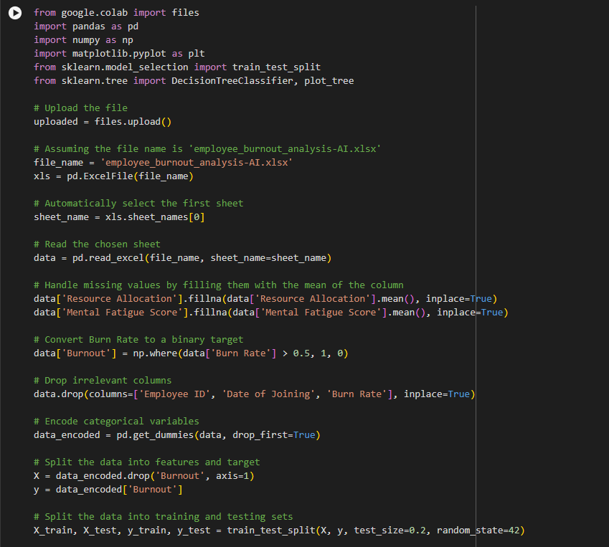
Results

Slide 10
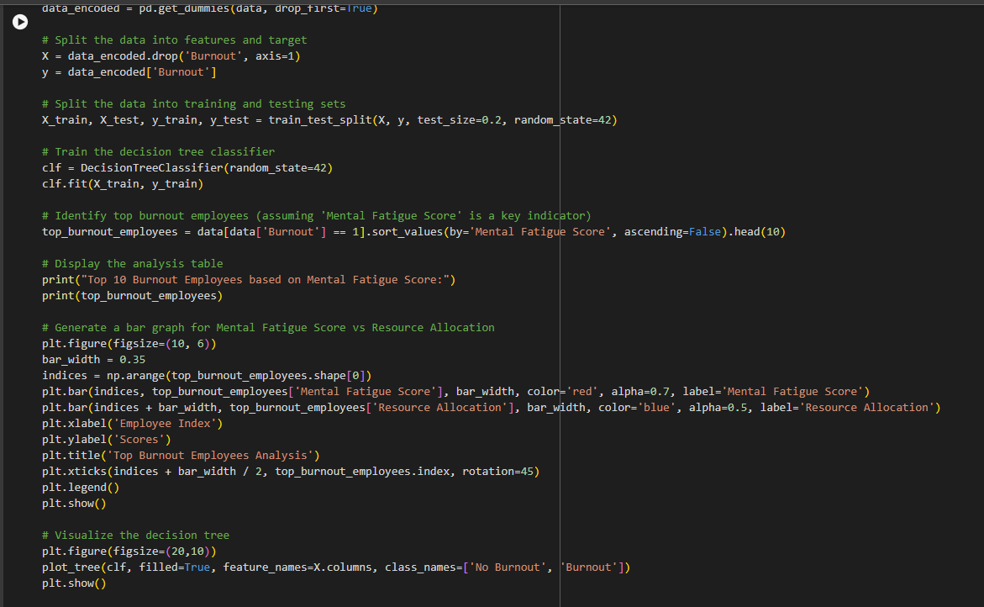

Slide 11
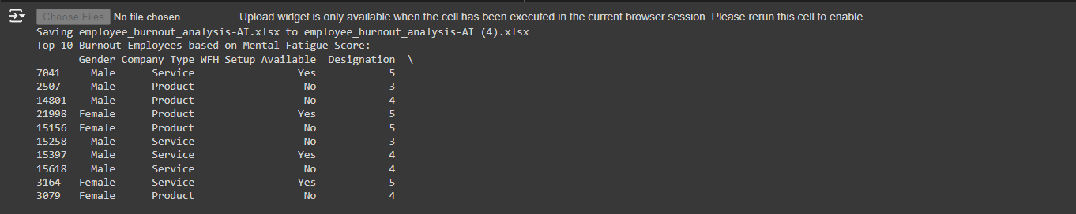
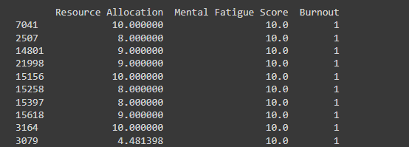

Slide 12
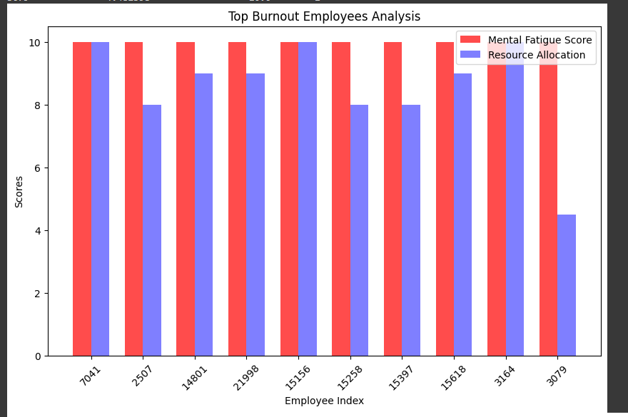

Slide 13
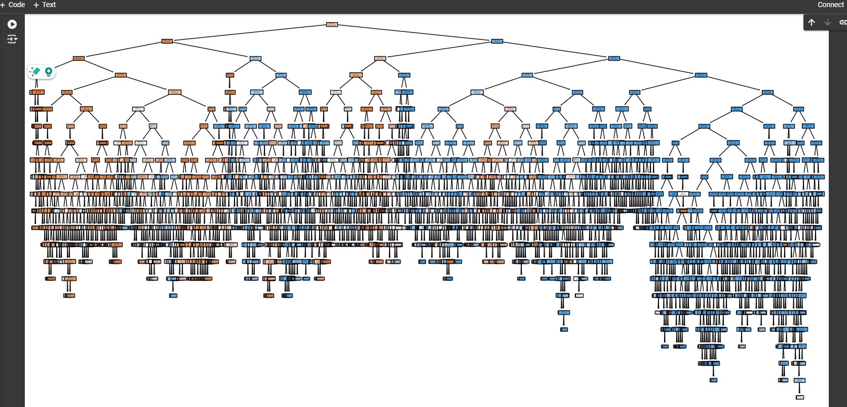

Slide 14
links
https://github.com/Bhuvana-Siri-Panchumarthy/employee-burnout.git

