Slide 1

HEART PULSE MONITORING AND NOTIFICATION SYSTEM USING ARDUINO PROJECT BATCH-90
Team:
Hari Kiran Pendurthi (Team Lead)
Hemanth Sai Gokarakonda
Venkata Siva Sai Kanneganti
Jaswanth Godavarthi
Project Guide : Dr. S. Kavitha

Slide 2
Contents
Abstract
Introduction
Methodology
Objectives
Literature Survey
Planning and Task Distribution
Module Distribution

Slide 3
Components
Hardware Connection
Flow Chart of project
Block Diagram
Front end and Back end
User Stories
Challenges
Motivation and Future Scope

Slide 4
Abstract
The main aim of our project is to detect the heart pulse and if there’s any abnormality in the pulse, then it should send the notification to the concerned person or doctor. Since it is automated, there’s no need of human interaction in between the process. We have taken an actual existing model as our base and its related paper as our base paper. The actual existing model’s proposed approach consists of sensors which measures heartbeat and body temperature of the patient which is controlled by the microcontroller. Both the readings are displayed in LCD monitor. Most health monitoring systems that are used in offline mode and this existing model implements the same. We have taken this as our subject and provided automation. The automation which we have provided is by sending the notifications through online APIs such as Mailgun and Twilio. By this , we as a team have improved the quality of the model as well as implemented our knowledge we have gained in Internet Of Things course. We have used KY-039 Finger Detection Heartbeat Sensor to detect the heart pulse and an Arduino mega 2560 for the interface. Later we have used the online API based web service to send mails and sms regarding the data of the concerned patients. In this way, we are providing a solution to remotely access the heart pulse data of the patients and doctors are benefited the most by our project.

Slide 5
Introduction
Due to Covid-19 pandemic, everyone got effected in many ways and especially patients got effected the most. It’s because patients cannot go to the hospitals and visit their respective concerned doctors and vice versa.
This gave us the idea of our project. With the help of our knowledge in Internet of Things , we as a team have researched many papers and finally came up with our project to help these patients who cannot physically meet the doctors.
Our project is Heart Pulse Detection and Notification System using Arduino. We have used a sensor which checks and produces the data regarding the heart pulse of a human. We have used KY-039 heart beat sensor for this module. It checks the Heart Pulse rate and with the help of an Arduino Mega , it gives us the data.

Slide 6
This data is then automated, that is , with the help of online API services , we have created the bridge of communicating the data from patient’s side to the doctor’s side. We have used Twilio as our SMS related communication service.
We will write a code in Arduino , which acts as an interface between sensor and the online APIs. For this purpose, we have added another component called BOLT Wifi module which provides the necessary requirement in order to connect an Arduino to online and send data to the online APIs.
We have kept certain milestones in our project and also distributed the tasks among our team members.

Slide 7
Methodology
This project is totally based on IOT(Internet of things) and Wireless Communications.
Here we have used hardware components like Arduino board, Pulse sensor, bread board and integrated this to Software like Twilio and Mailgun to provide a completely automated project based on Internet of Things and the data which is collected from the sensor is sent to the doctor by using BOLT IOT WI-FI module where we transfer data wirelessly.
Pre-requisites of this project is to have basic knowledge on connections between wires and Arduino board and also should have the knowledge of online communication services such as Twilio . As we all are from IOT specialization, we have the required knowledge to proceed with this project.

Slide 8
Objectives
AUTOMATED: Automation is one of the emerging technologies now where any given task is automated based upon the requirements of the users. The whole project is completely automated. No human intervention is required for sending the data from the patient to the doctor. SMS and Email alerts are automatically generated using the best in line third party services like Twilio and Mailgun.
EASE OF USE: This project is very simple to use. To use this project no knowledge about the components is required. The patient has to simply put his finger onto a sensor which collects the data and this data is sent to the doctor automatically in the form of an SMS and an E-Mail. So this creates an easy to use and understand environment for the users of this device.
LOW COST: one among the main aim of this project is to provide low cost and user friendly device to measure and keep track of the user’s heart pulse. Generally these machines could cost close to 2000RS. But with the help of Arduino uno and using free services like Twilio and Mailgun the cost is significantly reduced.

Slide 9
Literature survey
We have studied 12 research papers for our project. Out of these 12 papers, we have taken one paper as our BASE paper of our project.
The 12 papers which we referred are:
Remote Patients Monitoring System(Heartbeat and Temperature) using Arduino [BASE PAPER]
Analysis of Heart Rate and Body Temperature from the wireless monitoring system using Arduino.
Continuous Heart Rate and Body Temperature Monitoring System using Arduino UNO and Android Device.
Developing IOT Based Smart Health Monitoring Systems: A Review.
Smart Healthcare Monitoring using IOT.

Slide 10
Development of Smart Healthcare Monitoring System in IoT Environment.
A smart system for remote monitoring of patients and SMS messaging upon critical condition.
Web-based remote monitoring of infant incubators in the ICU.
Applying Telecommunication Technology to Health.
Low Cost Heart Rate Portable Device for Risk Patients with loT and Warning System.
An IoT-Based Smart Framework for Human Heartbeat Rate Monitoring and Control System.
IoT Based Heart Activity Monitoring Using Inductive Sensors.

Slide 11
Planning And Task Distribution
The whole project is divided into 6 modules, and this seven modules are equally distributed among the 4 team members who are going to lead the team in their allotted module. The task distribution is as follows:
Connecting Heart rate sensor module to Arduino.
Coding in Arduino for calculation of Heart Pulse.
Connection of BOLT Wi-Fi Module for Arduino.
Setting up SMS service using Twilio.
Using AWS VPS to run Heart Rate Monitoring Code.
Interlinking every API with each other.

Slide 12
MODULE DISTRIBUTION:
Code for calculating pulse value. – Siva Sai
Code to collect pulse value and check anomaly. – Hari Kiran
Twilio Accounts Handling and implementation.- Jaswanth G
Handling AWS to run Heart Rate Monitoring Code. – Hemanth Sai

Slide 13
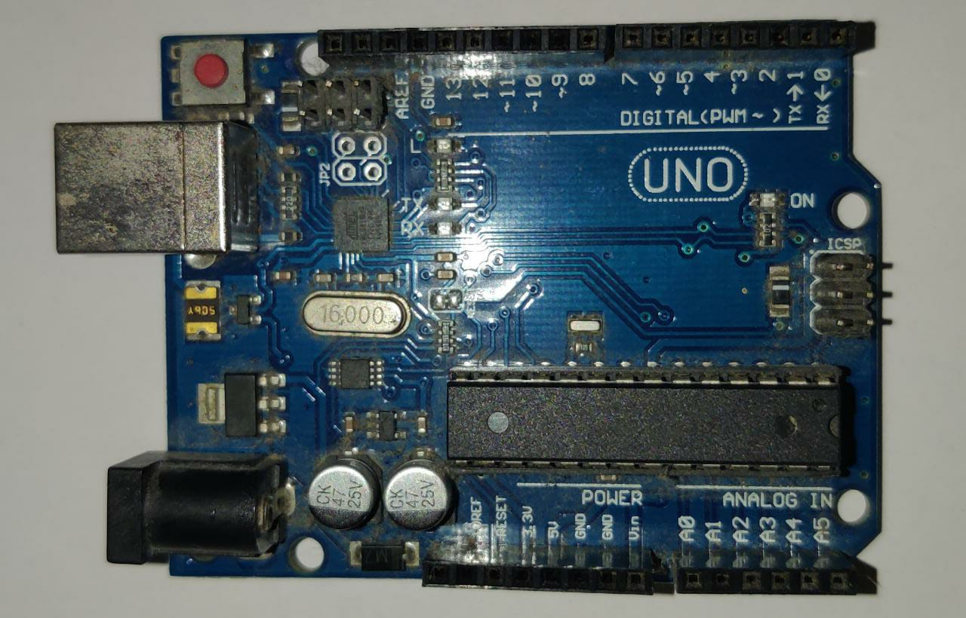
Components
ARDUINO UNO BOARD
Arduino Uno is a microcontroller board based on
the ATmega328P (datasheet). It has 14 digital input/output pins (of which 6 can be used as PWM outputs), 6 analog inputs, a 16 MHz ceramic resonator (CSTCE16M0V53-R0), a USB connection, a power jack, an ICSP header and a reset button.
It can be defined as the brain of our project.

Slide 14
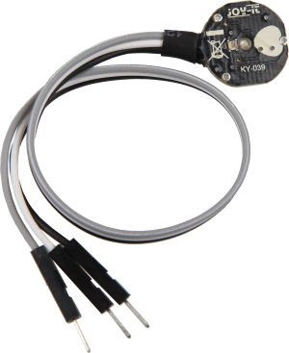
Components
KY039 SENSOR
The KY-039 heartbeat sensor is designed to detect a pulse while a human finger is place between the infrared diode and the photo transistor. The pulse will be represented on the signal output pin.
This sensor works by using a photo transistor to detect the presence of light, in this case how much light is passing through a finger. When blood moves, the amount of light changes and that change can be detected as a pulse.

Slide 15
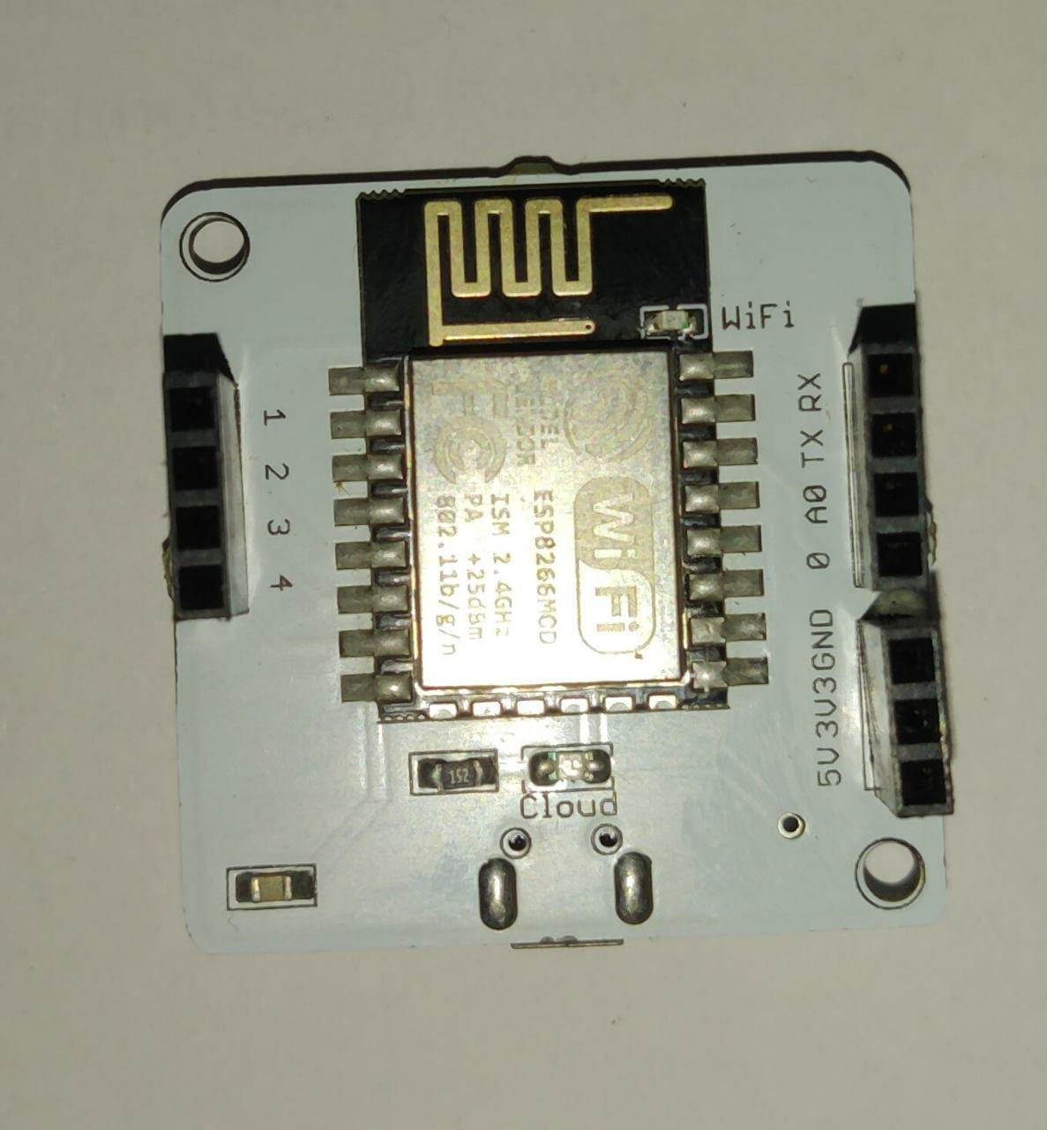
COMPONENTS
WIFI MODULE
Bolt comes with a WiFi /GSM Chip and a cloud platform which helps the enterprise connect their products to the Internet. The chip connects to the cloud out of the box. The Bolt cloud helps users control and monitor the products over the internet, create personalized dashboards to visualise the data, monitor the device health etc.
Bolt Platform takes care of analytics, visualisation, network connectivity, storage, security and scalability, so that the developers can focus on the end application.

Slide 16
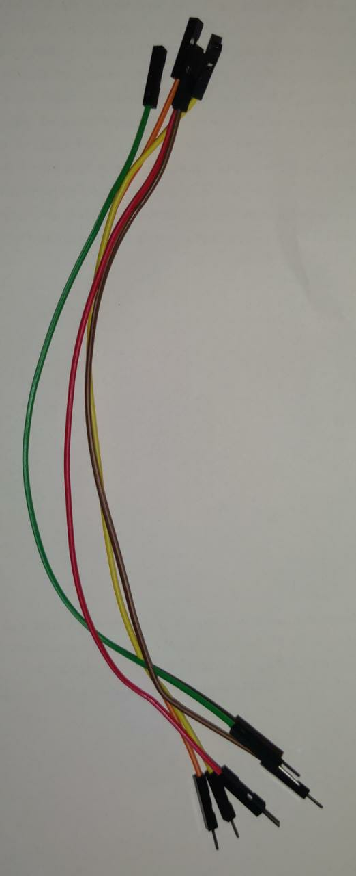
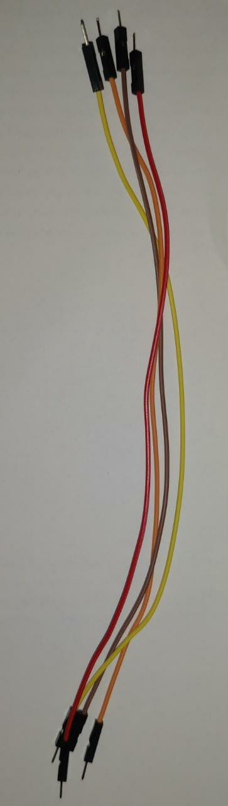
COMPONENTS
JUMPER WIRES
Jumper wires are simply wires that have connector pins at each end, allowing them to be used to connect two points to each other without soldering. Jumper wires are typically used with breadboards and other prototyping tools in order to make it easy to change a circuit as needed.
There are 2 types : male to male wires and male to female wires.

Slide 17
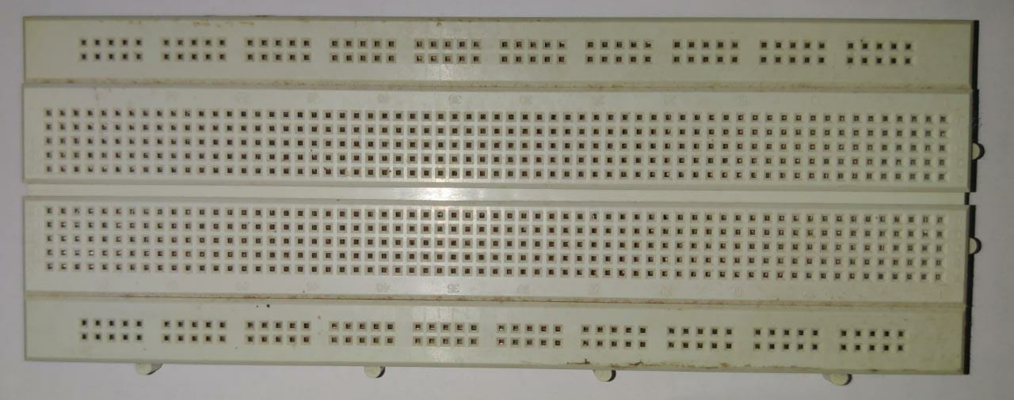
COMPONENTS
BREAD BOARD
A breadboard is a rectangular plastic board with a bunch of tiny holes in it. These holes let you easily insert electronic components to prototype (meaning to build and test an early version of) an electronic circuit, like this one with a battery, switch, resistor, and an LED (light-emitting diode).

Slide 18
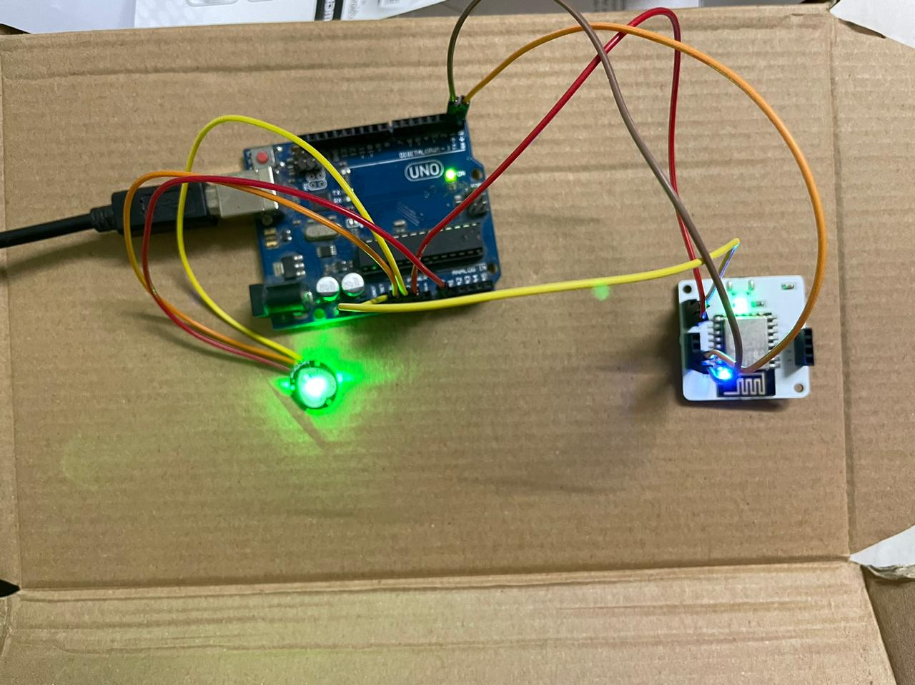
Hardware Connection

Slide 19
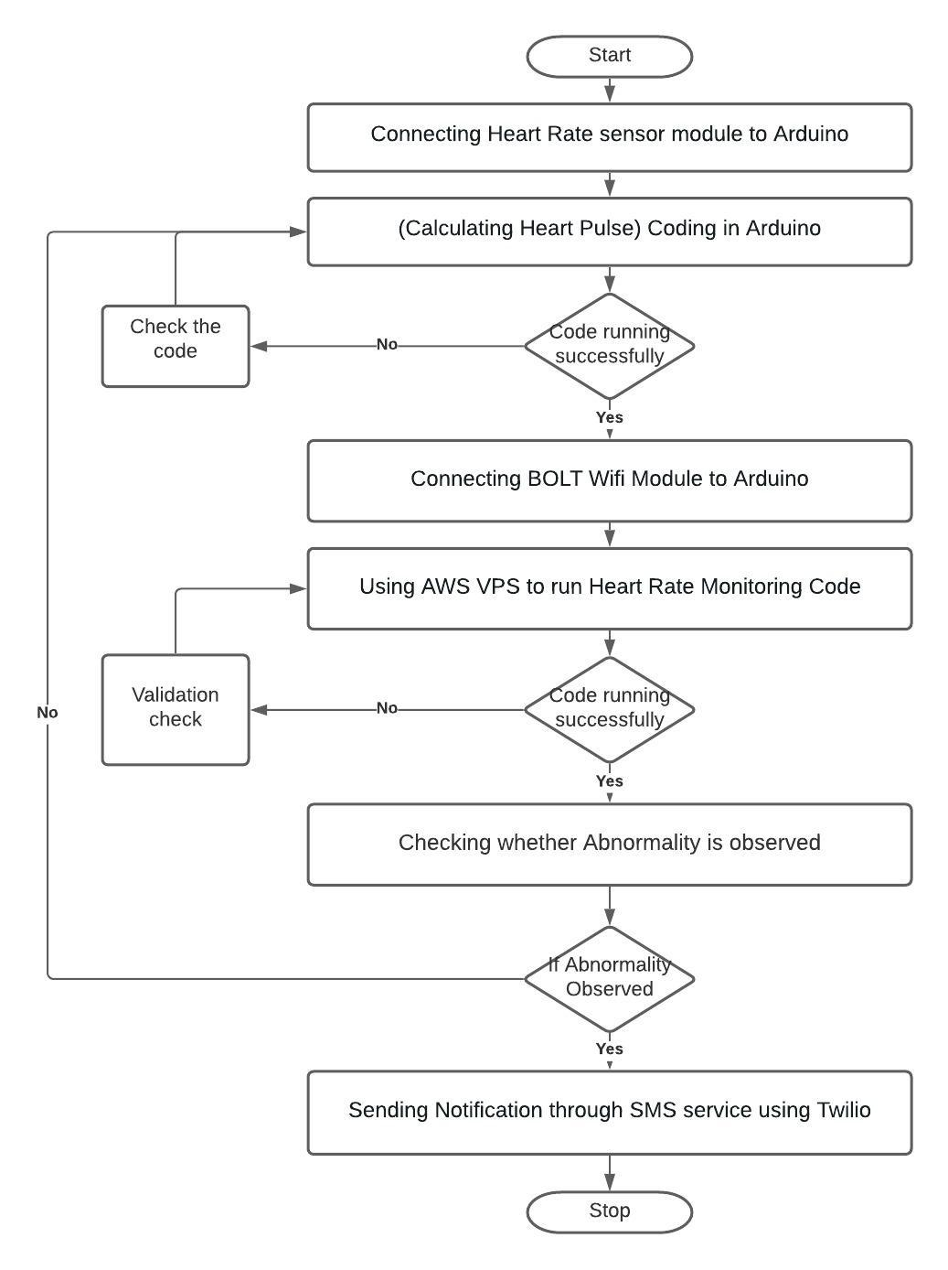
Flow chart

Slide 20
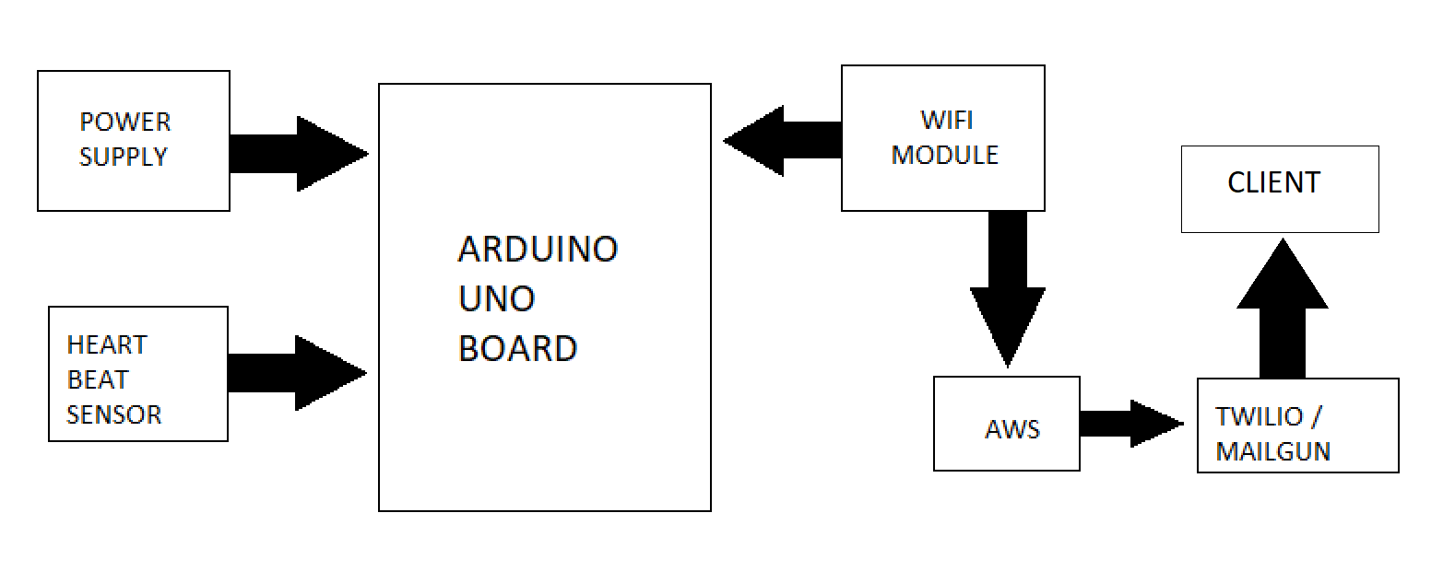
Block diagram

Slide 21
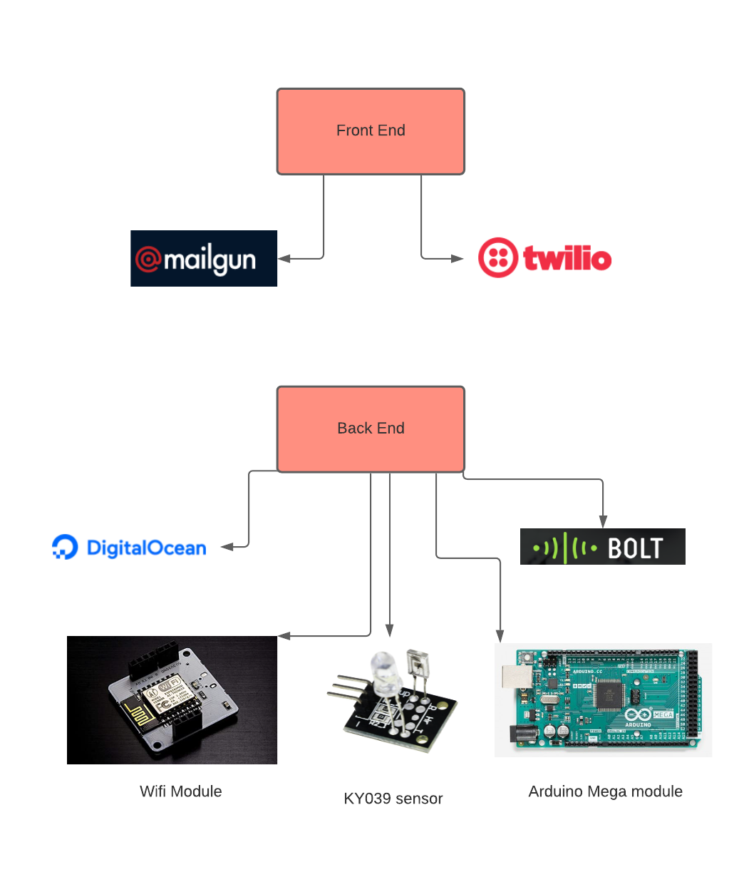


Front end and back end

Slide 22
User stories
As a developer of this project, I will do my best to provide users of this project a simple , seamless and an automated experience. So that the users of the project will not have any trouble using it.
As a patient, I should be able to view my readings and I should receive immediate assistance. So that if there is any emergency the doctor should come to know about this and I should receive assistance immediately.
As a doctor, I should be able to monitor my patients without any interruption and should be notified immediately if there is any anomaly in my patients statistics. So that I provide my assistance to the patient.

Slide 23
challenges
In one of our reference papers two LCD screens and a transceiver is used to transfer the data from one LCD to the other. The distance between the two transceivers should be minimum in order to work. We overcame this challenge by incorporating third party apps like Twilio and Mailgun since we can send SMS and Mail to any person without distance affecting the project.
Initially this project is done by using a raspberry pi this has more computing power but is of high cost. One of the main aim of this project is to reduce the cost. Hence we have used a Arduino Uno board which is cheaper compared to raspberry pi and also has computing power almost equal to the raspberry pi.
In some reference papers they used a GSM module the only disadvantage of using a GSM module is that we need to get a sim card and top it up at regular intervals. Since if there is no balance in the sim card we cannot send message to the doctor, This could prove fatal to the patient. So we used Twilio and Mailgun.

Slide 24
Motivation and future scope
The main motive of our project is to help the patients, especially we have taken heart pulse abnormality as our subject.
With the help of our guide, we could able to understand the overview of our project and how to distribute the tasks among ourselves.
By the end of our project, we as a team are confident that we all shall complete the project in given time and also make sure the project is available and reliable to the users( especially patients).
Future Scope of our project is to create an webpage so that the data collected through the sensor is displayed on a webpage and also stored in database.

Slide 25
Thank you
BATCH-90

