Slide 1

Backbone MVC Framework
Hari Kishore
(hari.k@imaginea.com)

Slide 2
Introduction
GOAL :
  To Implement the QUIZ application using the client side MVC Framework Backbone
  Backbone Features:
    Best suites for Single Page Applications as the end-user clients are more. (e.g Web Browser, Smart Phones, Tablets...)
    Relies on the RESTful services to interact with server for CRUD operations
    Better documentation and APIs are simple to understand
    Unlike other frameworks , configuration is simple and easy to start development
  Lack of Features (Cons) :
    Backbone doesn't provide any option on how to organize the code and hence need to rely on other libraries as per requirements
    No built-in templating system and hence required to rely on third party libraries like underscore, handlebars etc..

Slide 3
Tools / Libraries
Require JS
  To organize the code into set of modules
  To load the modular code and their dependencies asynchronously
  in the browser
Underscore
  To work with Backbone Views templating and
  core utility methods
Jquery
  To deal with DOM Operations, Animation and Event Handling...
JSDOC3
  To generate the API documentation for the developed modules

Slide 4
Development Issues
Module | Problem | Resolution
Model | Each and every time an internal AJAX call is being made after saving the model for any changes even though it is not required. | Overridden the sync method since there is no database to preserve the changes
View | Linking the display of questions based on the timer specified Too clumpsy to handle the entire logic in one view | Implemented the sub view named TimerView and decoupled timer logic with the question view
 | Resetting the view after one iteration of the Quiz. View is not rendering as expected. It happens beacuse of the Single Page App which doesn't reset the state of the application | Implemented the reset method for every view to undelegate, unbind all the events and clear the models attached Now the state of the view will behave like a refresh in the browser
 | No proper mechanism to traverse from one question to another question and maintaining the state of the question display | Implemeted a collection and a mixin to traverse the collection for proper navigation of questions..

Slide 5
Patterns used
Mixin :
  The problem: Sometimes you have the same functionality for multiple objects and it doesn't make sense to wrap your objects in a parent object. For example, if you have two views that share methods but don't -- and shouldn't -- have a shared parent view
  The solution: For this scenario, it's appropriate to use a mixin
  Implementation Classes :
    Animation Mixin which will be shared across views.
    Collection Mixin to traverse the models list

Slide 6
Patterns Used (Contd...)
View Patterns (Sub – View):
The problem: Your view code is starting to bloat as it tries to do too many things in one class.
The solution: Break it apart into smaller sub-views.
Implementation Classes :
    TimerView - will be used by QuizView

Slide 7
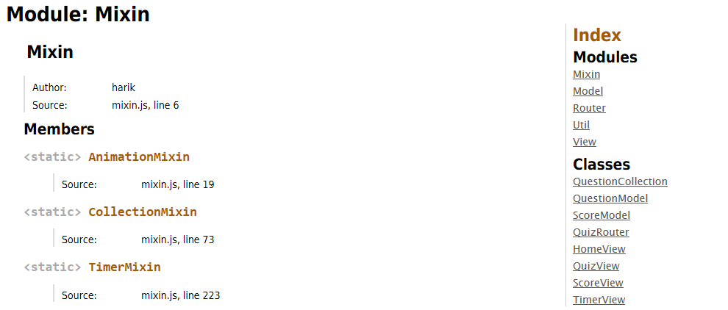
API Cursory Look

Slide 8
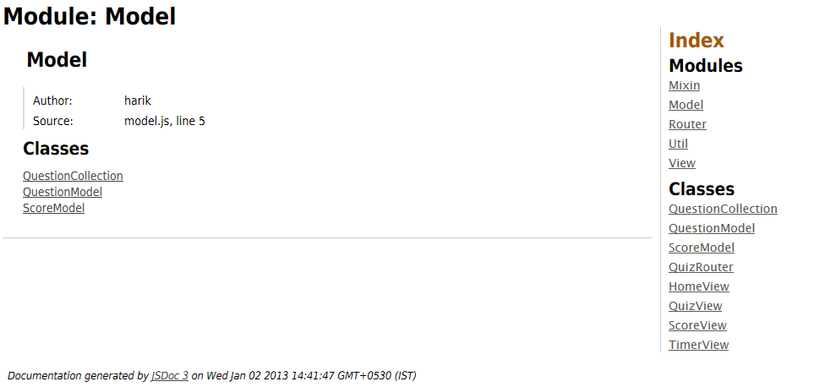
API Cursory Look (Contd...)

Slide 9
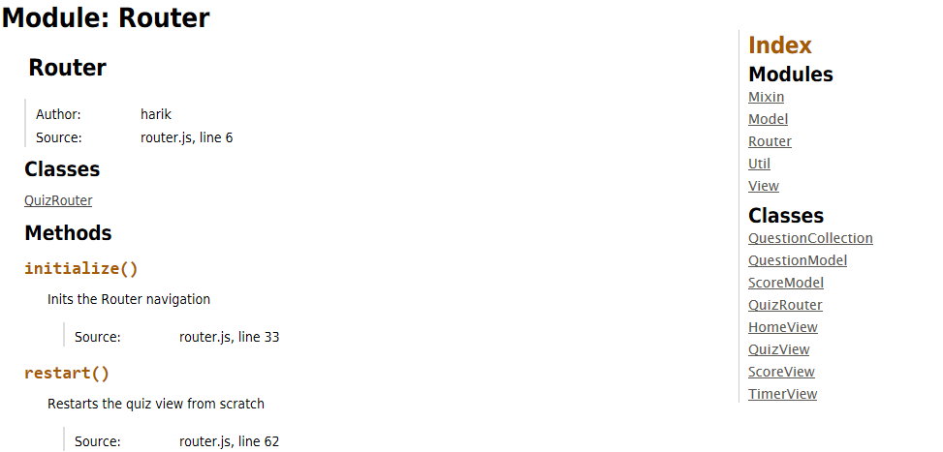
API Cursory Look (Contd...)

Slide 10
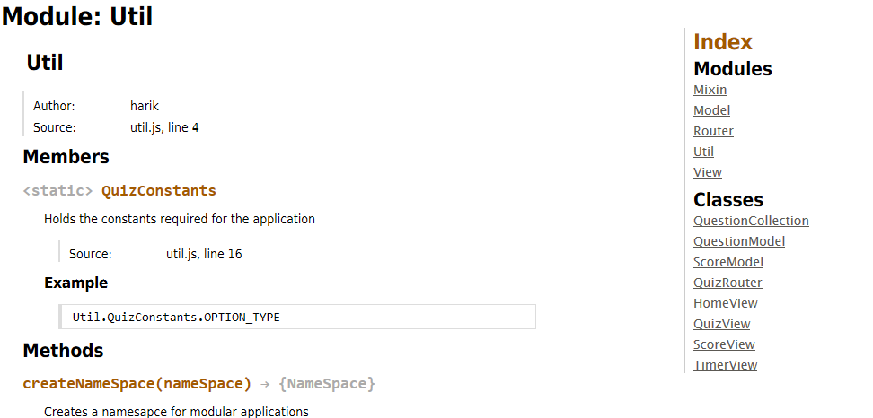
API Cursory Look (Contd...)

Slide 11
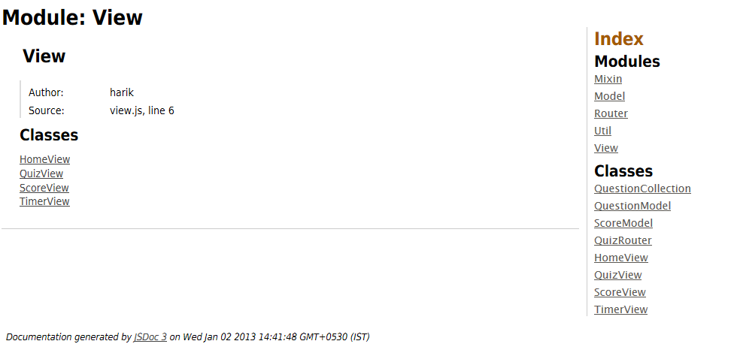
API Cursory Look (Contd...)

Slide 12
Sites to be Referred
1. Backbone + RequireJS
  http://backbonetutorials.com/organizing-backbone-using-modules/
2. Backbone Patterns
  http://ricostacruz.com/backbone-patterns/
3. Backbone Improved App
  http://coenraets.org/blog/2012/01/backbone-js-lessons-learned-and-improved-sample-app/

