Slide 1
Lending Club Case Study
HARINATHA R & HARI KOLAVASI

Slide 2
Objective
The Objective of this case study is to implement EDA technique on a real world problem and understand the insights and present in a business first manner via presentation.
Benefits of the case study:
Gives a idea about how EDA is used in real life business problems.
It also develops a basic understanding of risk analytics in banking and financial services.
How the data is used to minimize loss of money while lending it to clients.
It improves our understating of visualization and what charts to use for real life data.

Slide 3
Business Understanding
The business objective is to take a decision whenever they receive a loan application whether to reject or approve based on certain variables.
Dataset Details:
The data given below contains information about past loan applicants and whether they ‘defaulted’ or not. Data has details regarding approved loan not the rejected ones. It has 3 status of loan which is Fully Paid, Current and Charged-Off.
Data Clean-up and preparation process:
Importing the Data
Removing large null value columns
Removing irrelevant columns
Removing/Fixing null values
Correcting data types and deriving new columns
Filter Data for requirement.
Removing Duplicate Data
Removing outliers

Slide 4
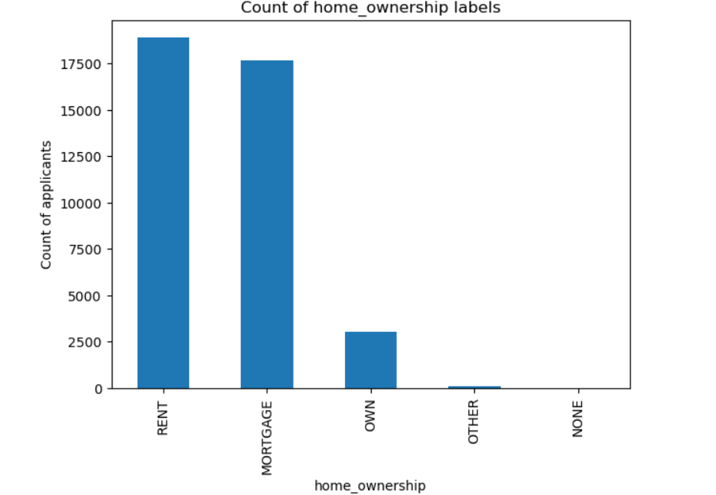
Home ownership of the applicant
Observations: Rent and Mortgage have the highest number of loan applicant covering 90% of our data.
It is fair to assume that, people with own house have better finance management and are less likely to apply for a loan.

Slide 5
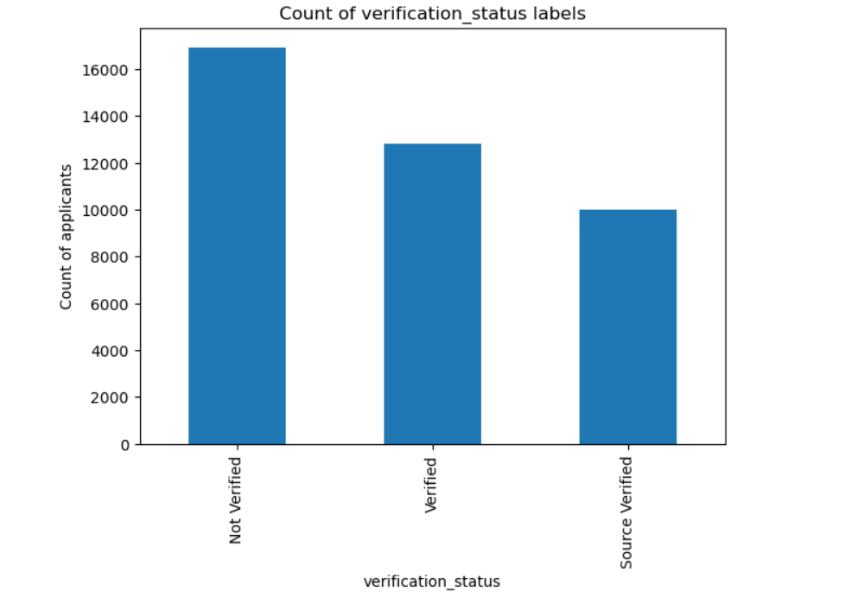
Verification Status of the loan application
Observation: High number of applicants (43%) are not verified before lending a loan which might be risk to the lender.

Slide 6
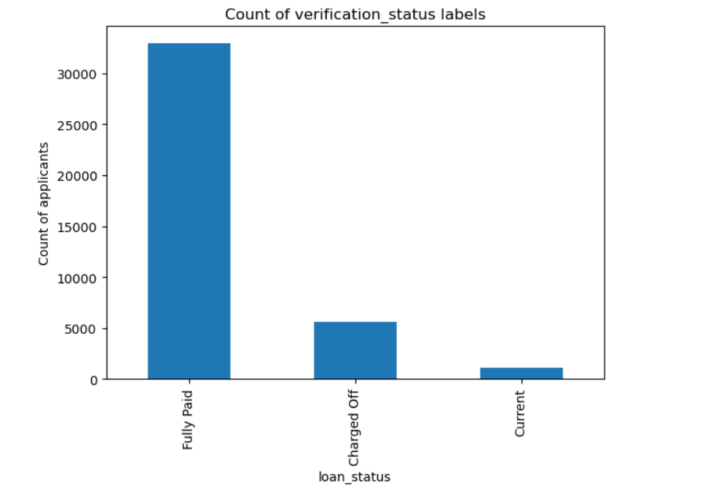
Loan Status - Dependent column
Observations:
The loan approved are majorly of hi High chances of Default for Charged Off applicants.
Applicants who are still paying loan may not be able to pay more installment. Check the eligibility.

Slide 7
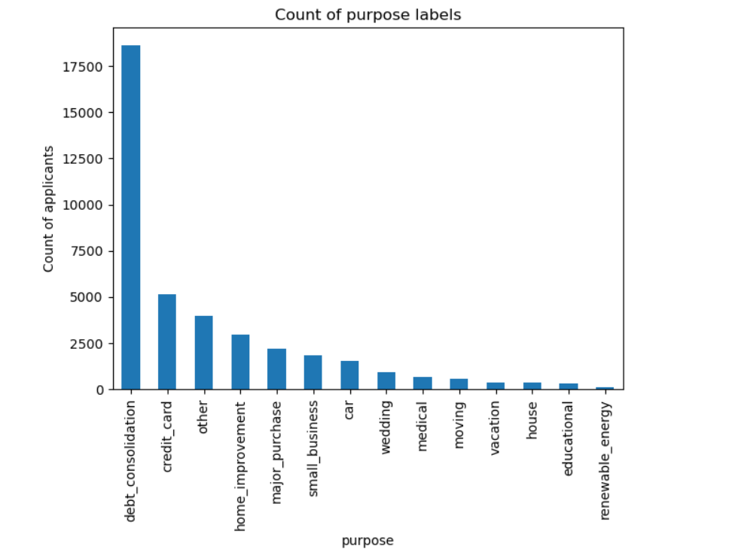
Purpose of the loan given by applicant
Observation: Debt consolidation signifies mismanagement of financials. Be vary of such applications.

Slide 8
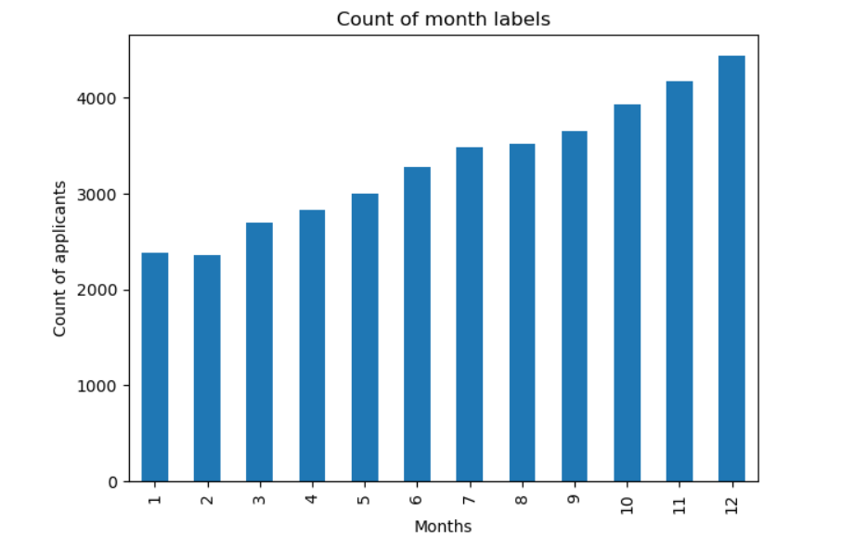
Month on which loan was applied
Observation : More debt at the end of the year indicates more money spent on shopping during year end sales without proper financial planning.

Slide 9
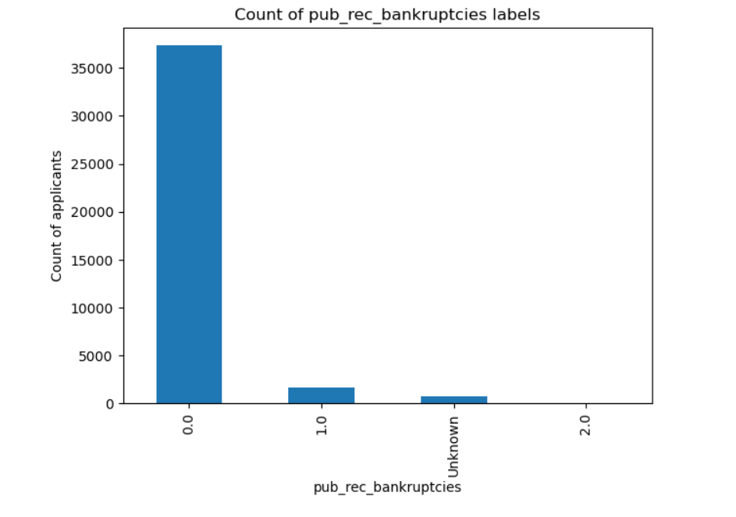
Number of publicly recorded bankruptcies applied by the applicant
Observations:
Most of the applicants haven't filed bankruptcies.
Very few records are available for the labels 1 and 2.

Slide 10
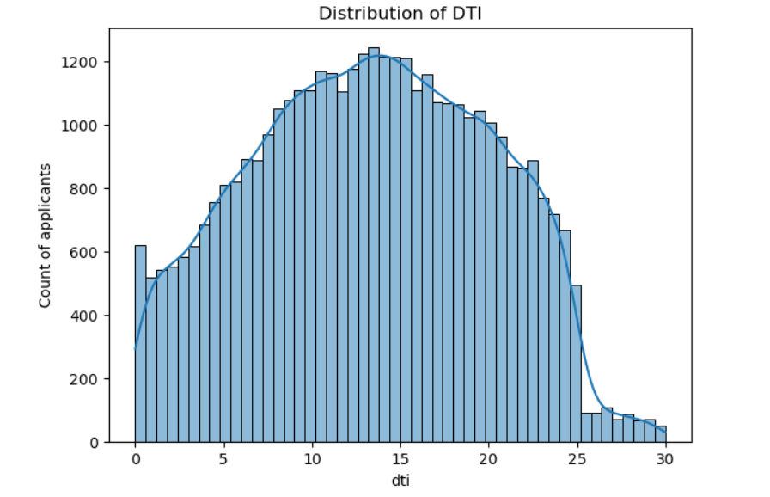
Debt-to-income ratio of the customer
Observation: Dti follows normal distribution !

Slide 11
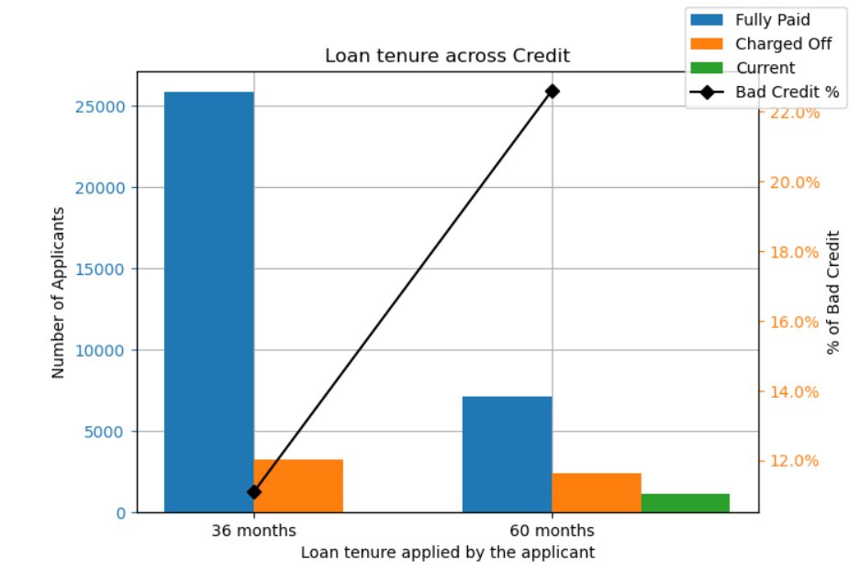
Loan tenure to loan status correlation
Observation: Higher tenure have higher possibility for default.

Slide 12
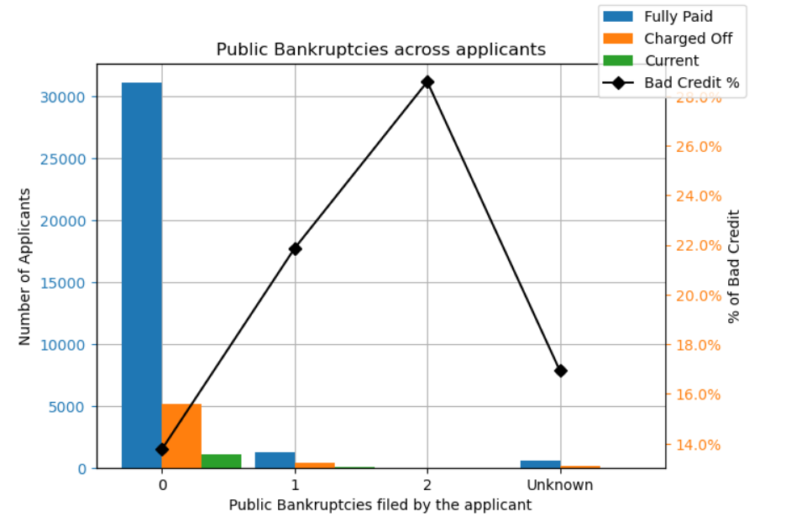
Loan status and public bankruptcies of the applicant correlation
Observation: Applicants with public record of bankruptcies have higher default rates.

Slide 13
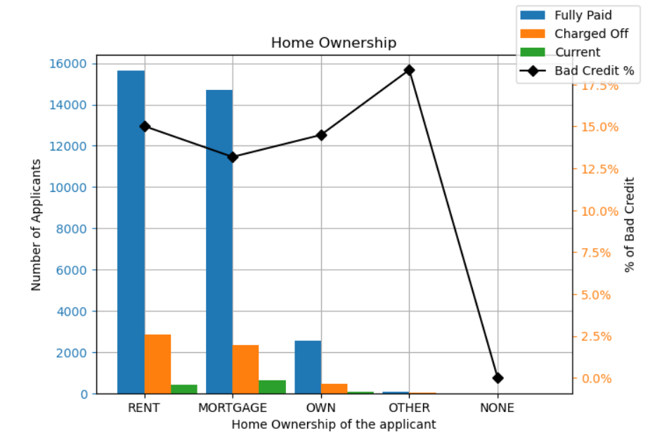
Loan status and home ownership of the applicant correlation
Observation: No trend is observed with home ownership attribute.

Slide 14
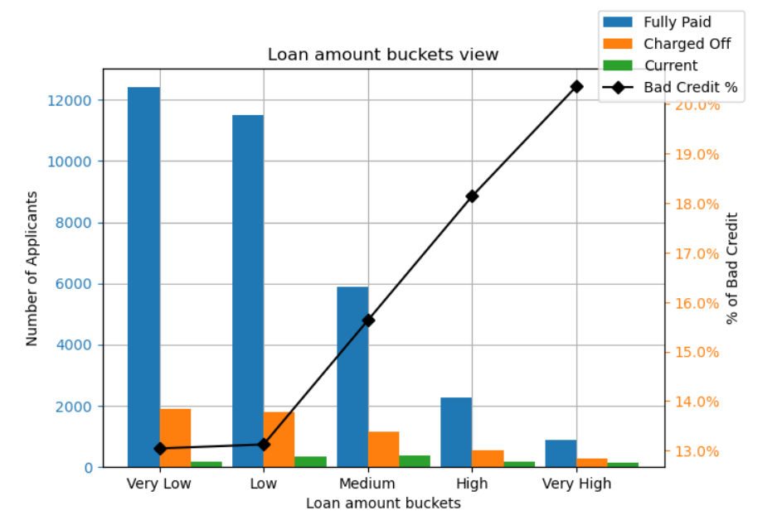
Loan status and loan amount of the applicant correlation
Observation: Very Low and Low loan have lower percentage of defaults. It increase with the loan amounts.

Slide 15
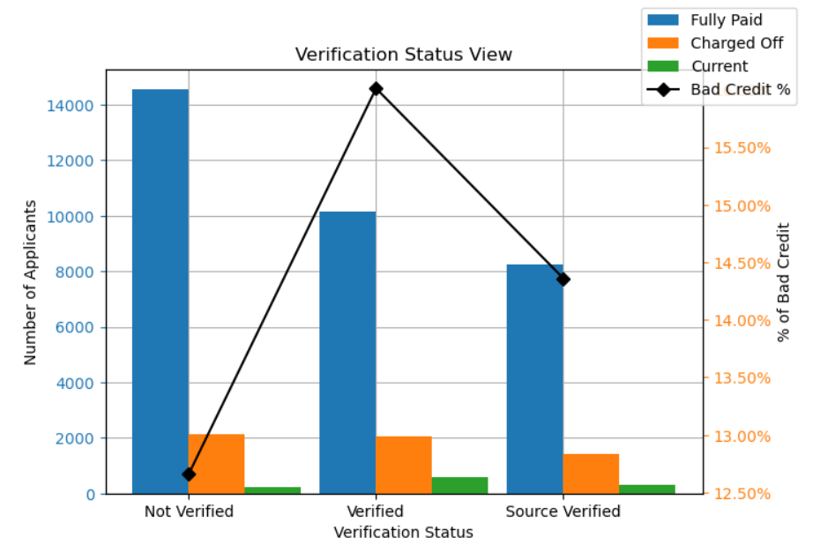
Loan status and Verification Status of the application correlation
Observation: No trend observed using verification status.

Slide 16
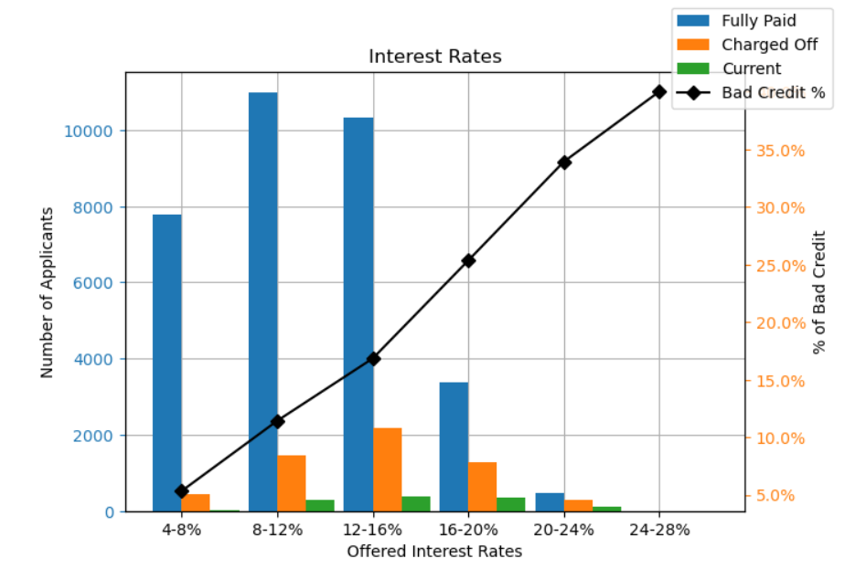
Loan status and interest rates of the loan correlation
Observation: Applicants who availed loans with lower interest rates have lower defaults.

Slide 17
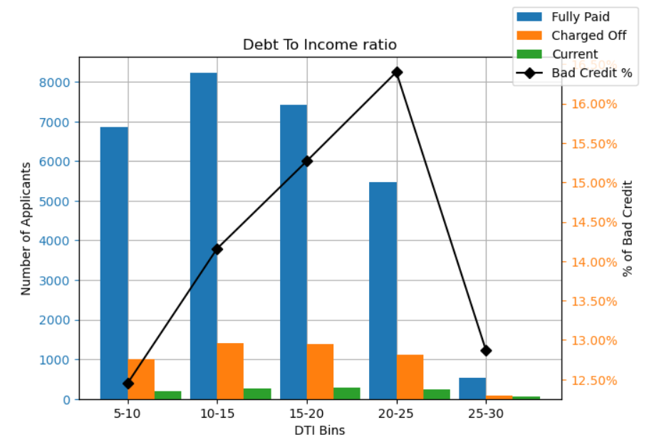
Loan status and debt-to-income ratio correlation
Observation: Debt to income is directly proportional to the bad credit %.

Slide 18
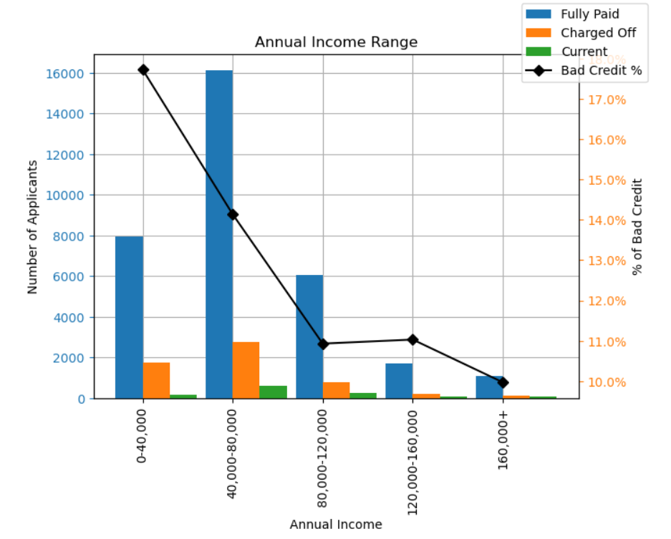
Loan status and annul_inc of the applicant correlation
Observation: Applicants with lower income have higher bad credits %.

Slide 19
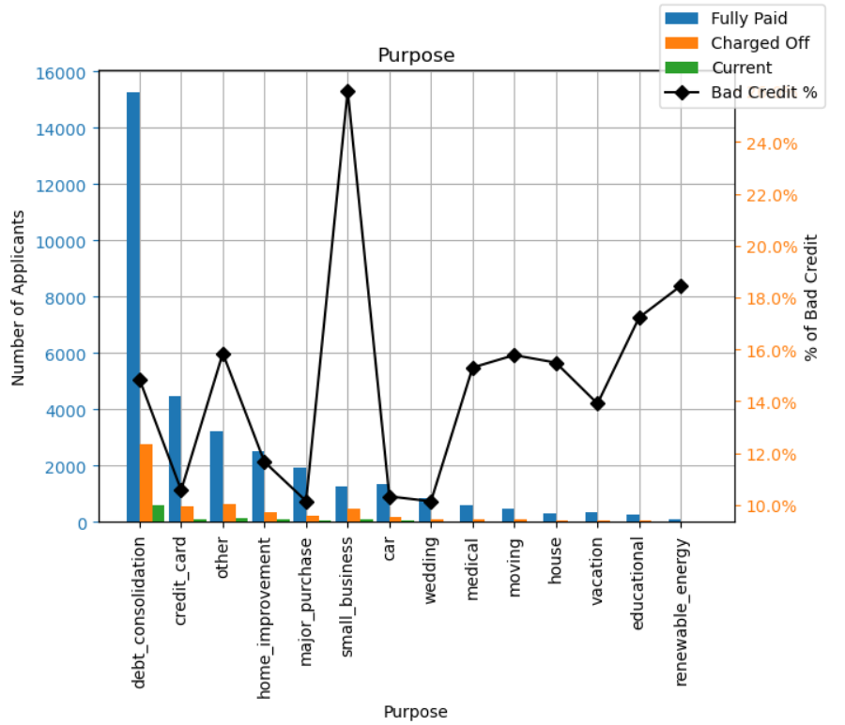
Loan status and purpose of loan correlation
Observation: Small business tend to default more than others. This might be due to the high risk involved in running a business..

Slide 20
Recommendations
Major Driving factor which can be used to predict the chance of defaulting and avoiding Credit Loss:
1. Home ownership of the applicant
2. Verification Status of the loan application
3. Loan Status - Dependent column
4. Purpose of the loan given by applicant
5. Month on which loan was applied
6. Number of publicly recorded bankruptcies applied by the applicant
7. Debt-to-income ratio of the customer
8. Loan tenure to loan status correlation

Slide 21
Recommendations
9. Loan status and public bankruptcies of the applicant correlation
10. Loan status and home ownership of the applicant correlation
11. Loan status and loan amount of the applicant correlation
12. Loan status and Verification Status of the application correlation
13. Loan status and interest rates of the loan correlation
14. Loan status and debt-to-income ratio correlation
15. Loan status and annul_inc of the applicant correlation
16. Loan status and purpose of loan correlation

