Slide 1
PIZZA SALES ANALYTICS
An End-to-End Data Analytics & Business Intelligence Project
SQL SERVER · T-SQL · POWER QUERY · POWER BI · DAX
Hanraj Hari Krishna
Data Analyst | SQL · Power BI · DAX · Tableau · Python

Slide 2
Project Overview
This project analyzes transactional pizza sales data end-to-end — from raw records in SQL Server through to an interactive Power BI dashboard — to turn everyday order data into decisions leadership can act on.
1
Revenue performance
2
Order volume
3
Average order value
4
Monthly trends & seasonality
Why it matters
Top & bottom-performing pizzas
5
Turns raw order-level data into KPIs, rankings, and trend analysis that answer real business questions — not just charts for their own sake.
6
Category & size performance
7
Revenue contribution
8
MoM & YoY performance
02

Slide 3
Tech Stack
The tools carrying data from raw rows to a finished dashboard
DB
TS
PQ
SQL Server
T-SQL
Power Query
Data storage & SQL analysis
Data validation & business analysis
Data transformation
BI
fx
GH
Power BI
DAX
GitHub
Dashboard & visualization
Business calculations & measures
Version control & documentation
03

Slide 4
Project Workflow
Raw sales data moves through six stages to become business insight
1
2
3
→
→
Raw Pizza Sales Data
Data Quality Validation
SQL Server + Advanced T-SQL Analysis
4
5
6
→
→
Power Query Transformation
Power BI Data Model + DAX Measures
Interactive Dashboard → Business Insights
04

Slide 5
SQL Analysis
Techniques demonstrated across the T-SQL scripts
Core SQL
Ranking & Window Functions
Aggregations
ROW_NUMBER
RANK
GROUP BY / HAVING
CASE WHEN
DENSE_RANK
LAG
Joins
LEAD
NTILE
Subqueries
CTEs
Window functions power the leaderboards — ranking pizzas by revenue, comparing order-to-order changes, and bucketing products into performance tiers.
Date functions
CAST / CONVERT
05

Slide 6
Power BI & DAX
The measures and functions behind every dashboard visual
Capability areas
DAX Functions in Use
✓
KPI measures
CALCULATE
FILTER
ALL
✓
Time intelligence (MoM / YoY / YTD)
✓
Revenue ranking
ALLSELECTED
REMOVEFILTERS
TOPN
✓
Revenue contribution
SUMX
AVERAGEX
SELECTEDVALUE
HASONEVALUE
ISINSCOPE
SWITCH
06

Slide 7
Headline KPIs
Pulled straight from the finished Power BI dashboard
$850.64K
21K
50K
$39.84
Total Revenue
Total Orders
Total Pizzas Sold
Average Order Value
Also on the dashboard
Monthly Revenue Trend
Top Pizza Analysis
Category Performance
Size Analysis
Rolling 7-Day Revenue
Revenue Contribution
07

Slide 8
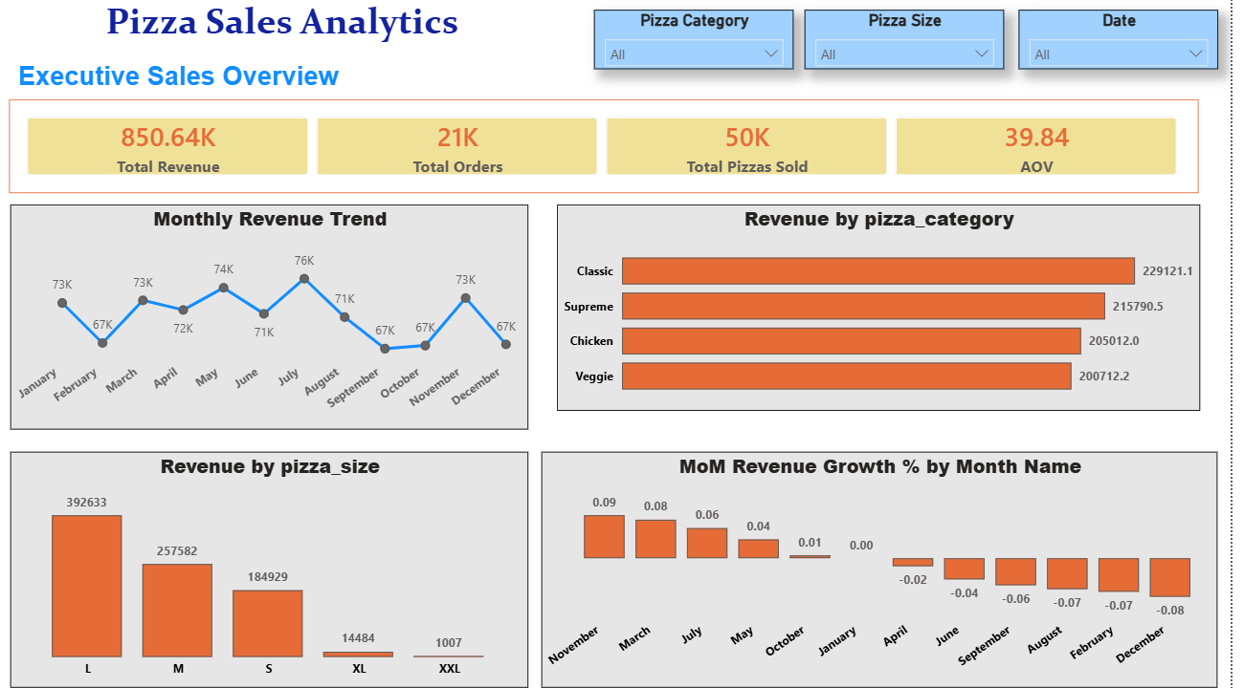
Dashboard — Executive Sales Overview
KPI cards, monthly revenue trend, category & size revenue, MoM growth
08

Slide 9
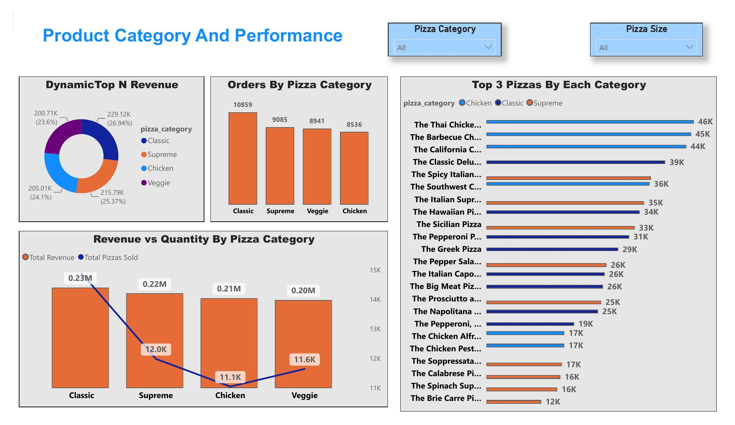
Dashboard — Product Category & Performance
Category revenue share, order volume, top pizzas by category
09

Slide 10
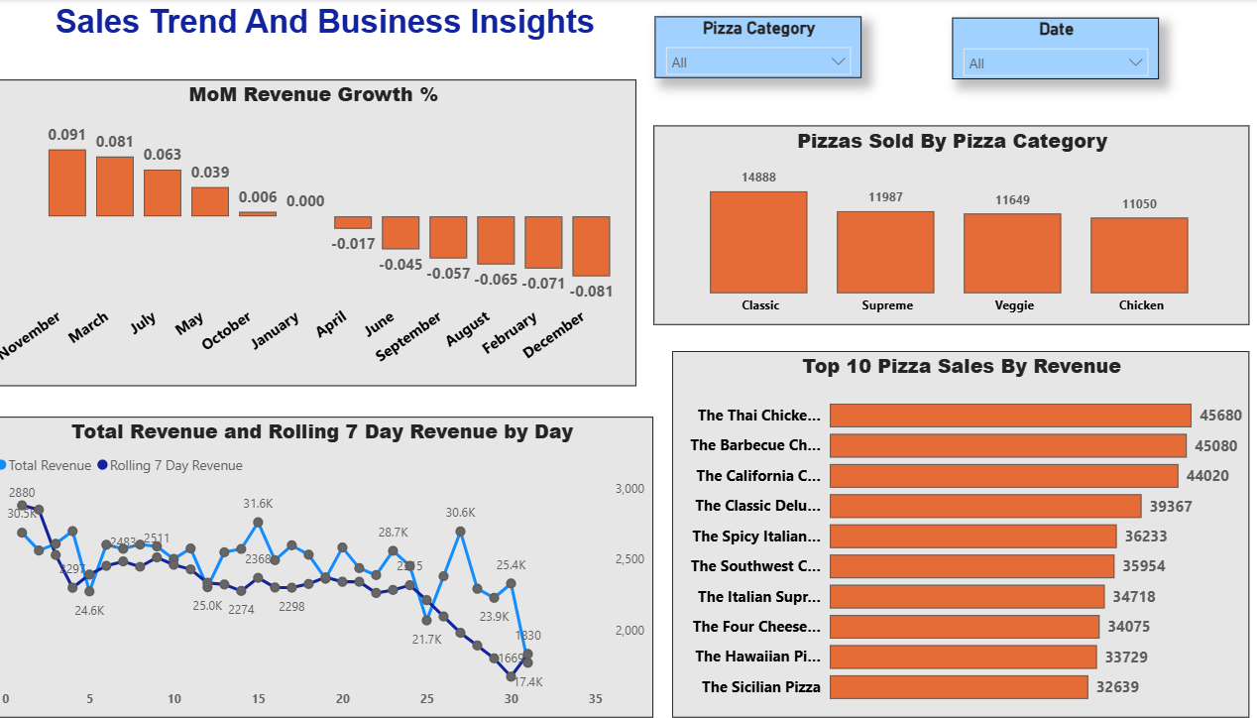
Dashboard — Sales Trend & Business Insights
MoM growth, rolling 7-day revenue, top 10 pizzas, category volume
10

Slide 11
Key Insights from the Data
What the dashboard reveals once the KPIs and charts are read together
Classic leads, but the field is close
Large pizzas drive the business
Classic is the top category at $229.1K (26.9% of revenue); Veggie trails at $200.7K (23.6%) — only a ~3-point spread across all four categories.
Size L accounts for $392,633 in revenue — more than Medium and Small combined — while XL/XXL are negligible.
The Thai Chicken Pizza is the single best seller
Revenue is flat, not growing
It leads all products at $45,680, narrowly ahead of The Barbecue Chicken Pizza ($45,080) and The California Chicken Pizza ($44,020).
Monthly revenue hovers in a narrow $67K–$76K band all year, and MoM growth trends downward — from +9% in November to –8% by December.
Classic also wins on order count
Order economics are steady
Classic logs the most orders (10,859) despite Chicken pizzas placing higher in the individual top-seller list — volume and top-line hits don’t fully overlap.
AOV holds at $39.84 across ~21K orders and 50K pizzas sold — about 2.4 pizzas per order, consistently.
11

Slide 12
Business Questions Answered
What the dashboard lets leadership ask — and get answered instantly
1
What is the total revenue generated?
2
How many orders and pizzas were sold?
3
What is the Average Order Value (AOV)?
4
How does revenue change month over month?
5
Which pizzas generate the highest revenue?
6
Which pizzas have the lowest revenue?
7
Which pizza categories contribute the most revenue?
8
Which pizza sizes are most popular?
9
Which cities/areas generate the highest order volume?
10
What % of revenue does each pizza/category contribute?
11
How does current revenue compare with the previous year?
12
Which products need further business attention?
12

Slide 13
Project Outcome
This project demonstrates an end-to-end analytics workflow — combining SQL, data quality checks, Power Query, Power BI, and DAX — to transform raw transactional sales data into business-focused insight leadership can act on.
HK
Hanraj Hari Krishna
Data Analyst | SQL · Power BI · DAX · Tableau · Python · Advanced Excel
LinkedIn:
linkedin.com/in/hari-krishna-178397145
GitHub:
github.com/harikrishna-analytics
Repo:
Pizza-Sales-Analytics
13

