Slide 1
BAKERY SALES ANALYTICS & INVENTORY LOSS PREVENTION
End-to-End Diagnostic Analytics, Data Quality & Profitability Case Study
• Scope: FMCG Bakery Chain | 16,569 Transactions | $3.44M Gross Revenue | 3 Store Locations
• Architecture: Python (Data Cleaning & Quality) ➔ SQL (PostgreSQL Analytics) ➔ Power BI (Executive Dashboards)
• Core Impact: Diagnosed $1.39M in Inventory Waste and modeled a +$255K Financial Recovery Plan
Prepared By: Hanraj Hari Krishna | Data Analyst | Hyderabad, India
📧 hanrajharikrishna@gmail.com | 🔗 linkedin.com/in/hari-krishna-178397145 | 💻 github.com/harikrishna-analytics

Slide 2
PORTFOLIO CASE STUDY
Executive Summary & Core Business Problem
Macro Financials ($3.44M Sales)
• Total Revenue: $3,444,112.95 generated across 16,569 transactions.
• High Demand: 42,924 units sold with an Average Order Value (AOV) of $207.86.
• Healthy Store Parity: Top sales spread evenly across 3 store locations.
The Net Profit Dilemma (-$230.34K)
• Operational Deficit: Business ran at a net operating loss of -$230,340.
• Demand-Profit Paradox: Top revenue categories (Cakes & Dairy) generated the highest net losses.
• Top-Line Illusion: High gross sales obscured underlying inventory profit drains.
Root Cause: $1.39M Waste Bleed
• Overproduction Exposure: $1.39M spent on expired, unsold inventory.
• Perishability Disconnect: Static production schedules failed to match daily sales velocity.
• Recovery Roadmap: Transition to daily batch baking reclaims ~$486K annually.

Slide 3
PORTFOLIO CASE STUDY
End-to-End Technical Architecture & Data Pipeline
1. PYTHON (ETL & Data Quality)
• Data Ingestion: Cleaned 16,569 rows and 41 attributes from raw store dumps.
• Validation Rules: Enforced data governance, missing value imputation, and type safety.
• Feature Engineering: Programmed margin functions: Net_Profit = Revenue - Cost - Waste.
• Statistical EDA: Identified expiry distribution patterns and waste correlation matrices.
2. SQL (PostgreSQL Warehouse)
• Schema Normalization: Designed Fact_Transactions and Dimension tables (Products, Stores).
• Window Functions: Evaluated category performance using DENSE_RANK() & SUM OVER.
• Aggregation CTEs: Isolated waste costs, loyalty segmentation, and promotional lift.
• Analytical Views: Exported high-performance aggregated analytical views for Power BI.
3. POWER BI (Executive Dashboards)
• Dynamic Dax Modeling: Built measures for MoM revenue change, AOV, and margin %.
• Executive Dashboards: Developed 3 interactive reporting tabs for business leaders.
• Drill-Down Analysis: Created cross-filtering across Season, Festival, Weather, and Store.
• Data Storytelling: Connected operational waste drivers to strategic business decisions.

Slide 4
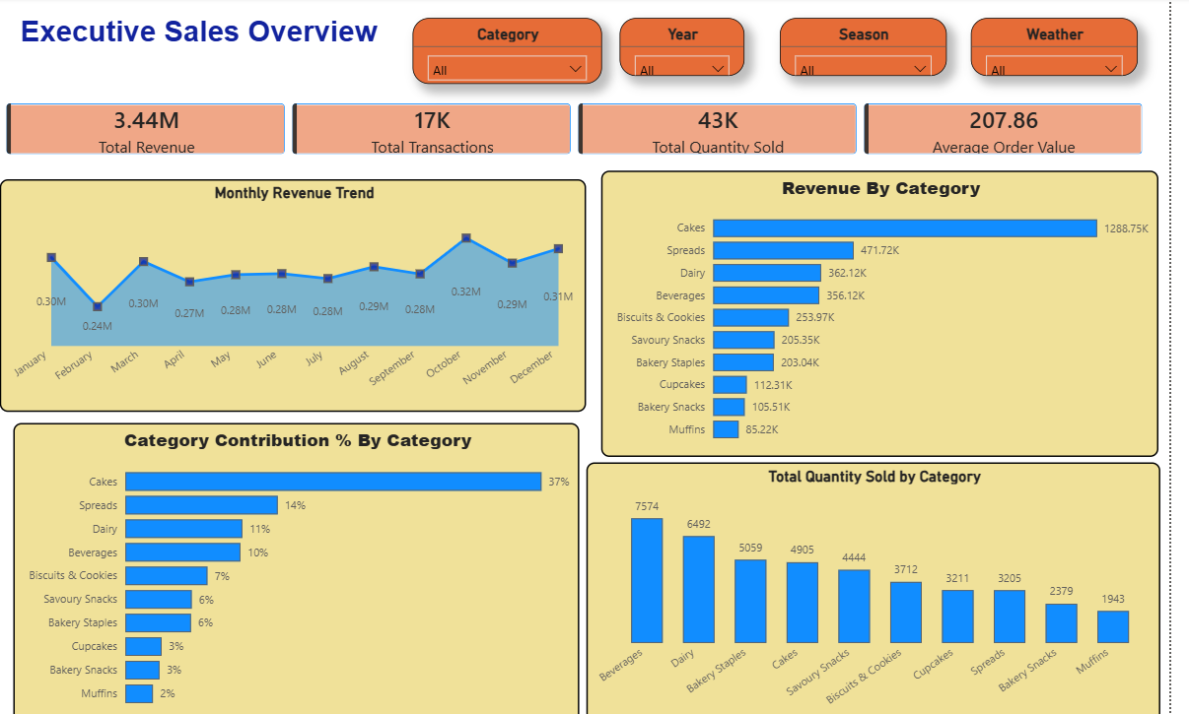
PORTFOLIO CASE STUDY
Dashboard Analysis: Executive Sales Overview

Slide 5
Visual Insights & Revenue Drivers
• Top-Line Gross Sales: $3.44M generated across 17K transactions (16,569 actual) and 43K units.
• Order Economics: Average Order Value (AOV) stands strong at $207.86.
• Dominant Revenue Drivers: Cakes leads gross revenue at $1.29M (37.42%), followed by Spreads ($472K, 13.7%).
• Volume Champion: Beverages drives footfall with 7,574 units sold, outperforming Cakes (4,905 units).
• Demand Consistency: Monthly trends hold a stable baseline ($280K–$320K) with festive peaks in Q4.

Slide 6
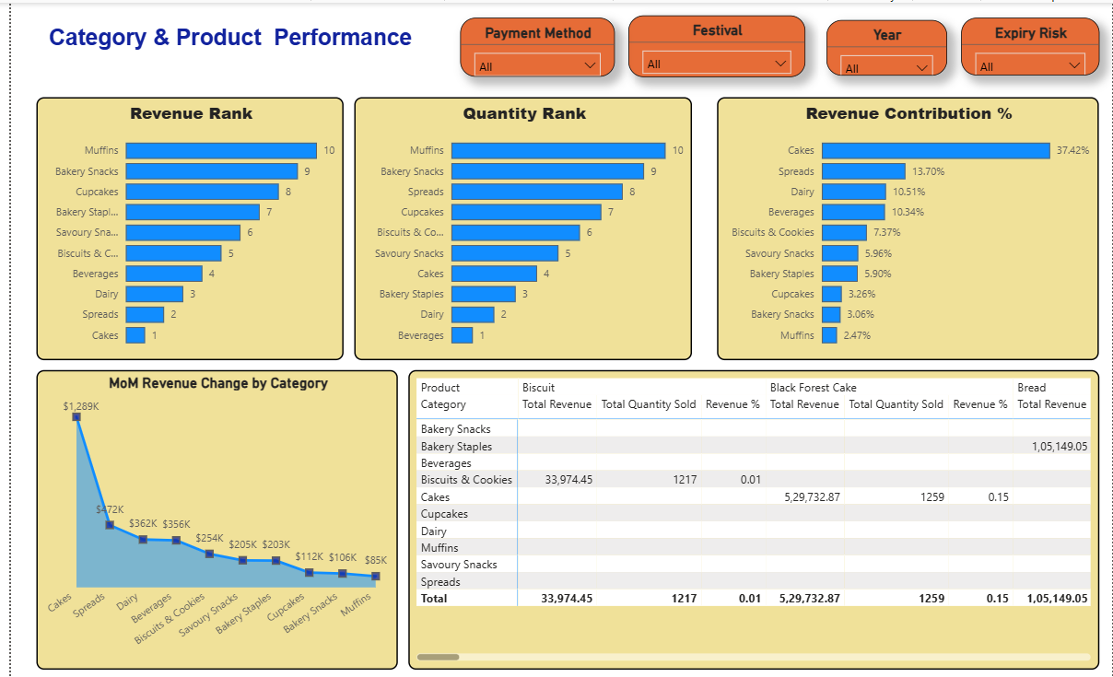
PORTFOLIO CASE STUDY
Dashboard Analysis: Category & Product Performance

Slide 7
Product Profitability Matrix
• Revenue Concentration: Top 3 categories (Cakes, Spreads, Dairy) generate 61.6% ($2.12M) of sales.
• MoM Trajectory: Sharp drop-off from Cakes ($1.29M) down to lower revenue categories like Muffins ($85K).
• Granular Product Highlights:
- Black Forest Cake: $529.7K Sales | 1,259 Units | -$54.9K Net Profit
- Chocolate Cake: $531.1K Sales | 1,217 Units | -$40.0K Net Profit
- Bakery Staples (Bread): $105.1K Sales
• Analytical Conclusion: Revenue rank does not equal profit rank. High-grossing cakes suffer severe margin erosion.

Slide 8
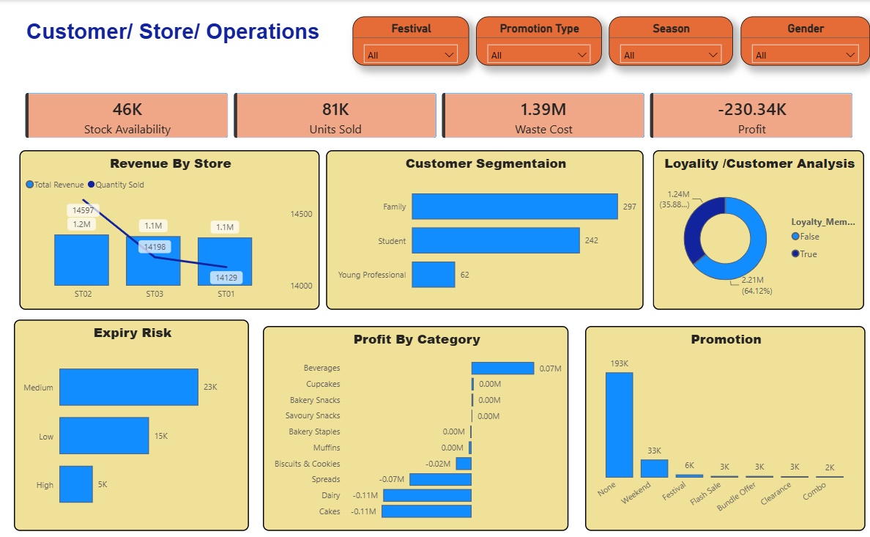
PORTFOLIO CASE STUDY
Dashboard Analysis: Operational Loss & Store Diagnostics

Slide 9
Inventory Bleed & Parity
• Discovered Financial Leak: $1.39M in Waste Costs drives net profit down to -$230.34K.
• Primary Loss Bleeders: Cakes (-$110K loss, $515.6K waste) and Dairy (-$110K loss, $182K waste).
• Store Parity Analysis: Sales are evenly split across ST02 ($1.2M), ST03 ($1.1M), and ST01 ($1.1M), proving system-wide inventory mis-baking.
• Expiry Exposure: 23K items fall under Medium Expiry Risk and 5K items under High Expiry Risk.
• Loyalty Opportunity: Non-loyalty buyers represent 64.12% ($2.21M) of gross revenue.

Slide 10
PORTFOLIO CASE STUDY
Comprehensive Category Financial & Waste Matrix
Category Name | Gross Revenue | Units Sold | Net Profit / (Loss) | Waste Cost Exposure
Cakes | $1,288,747 | 4,905 | -$107,657 | $515,600 (Critical)
Spreads | $471,715 | 3,211 | -$74,018 | $228,000 (High)
Dairy | $362,120 | 6,492 | -$105,527 | $182,000 (High)
Beverages | $356,122 | 7,574 | +$74,824 | $99,200 (Low / Profitable)
Biscuits & Cookies | $253,973 | 3,712 | -$18,558 | $106,700 (Moderate)
Savoury Snacks | $205,350 | 4,444 | +$2,100 | $85,000 (Moderate)
Bakery Staples | $203,040 | 5,059 | +$1,400 | $72,000 (Low)
Cupcakes | $112,310 | 3,205 | +$3,200 | $45,000 (Low)
Bakery Snacks | $105,510 | 2,379 | +$1,100 | $38,000 (Low)
Muffins | $85,220 | 1,943 | -$2,200 | $18,500 (Low)

Slide 11
PORTFOLIO CASE STUDY
Data Quality, Governance & Data Management Protocols
Data Quality (DQ) Enforcement
• Schema Validation: Automated data type checking across all 41 transactional columns.
• Anomaly Detection: Flagged negative transaction totals and unmapped store IDs.
• Null Value Imputation: Imputed missing customer demographic attributes with fallback tags.
• Deduplication: Verified transaction hash keys to prevent duplicate order counting.
Data Governance Framework
• Single Source of Truth: Built a consolidated PostgreSQL warehouse structure.
• Consistent Business Logic: Centralized DAX and SQL measures for Gross Revenue, AOV, and Waste.
• Metadata Documentation: Maintained clear data dictionaries for line-of-business stakeholders.
• Role-Based Access Control: Modeled row-level security for individual store managers.

Slide 12
PORTFOLIO CASE STUDY
Strategic Recommendations & Projected ROI Roadmap
1. Dynamic Daily Batch Baking
Action: Shift short shelf-life items (Cakes & Dairy) from static weekly baking to daily prediction models.
Impact: Reduces waste cost by 35%-40% (~$486K annual savings).
2. High-Margin Product Bundling
Action: Bundle high-demand Beverages (+$74.8K profit) with higher-margin bakery items.
Impact: Boosts average order margin by 12%-15%.
3. Targeted Loyalty Onboarding
Action: Incentivize checkout sign-ups for the 64.12% non-loyalty segment ($2.21M sales).
Impact: Increases customer retention and repeat visits by 20%.
4. Total Financial Turnaround
Action: Execute all recommendations across all 3 stores within a 12-month rollout.
Impact: Flips business from -$230.34K loss to +$255,000 net profit.

Slide 13
ANALYST DETAILS
Candidate Profile & Portfolio Overview
Hanraj Hari Krishna
Data Analyst | Data Management | Data Quality & Governance | SQL | Power BI | Advanced Excel
📍 Location: Hyderabad, India
📧 Email: hanrajharikrishna@gmail.com
🔗 LinkedIn: linkedin.com/in/hari-krishna-178397145
💻 GitHub: github.com/harikrishna-analytics
🛠️ Core Tech Stack: Python (Pandas, Data Cleaning, EDA) • SQL (PostgreSQL Aggregations, CTEs) • Power BI (DAX, Dashboards) • Advanced Excel
🎯 Core Competencies: Data Governance, Data Quality Validation, End-to-End Analytics Pipeline, Root Cause Loss Diagnostics, Financial Recovery Modeling

