Slide 1
Credit Card Portfolio & Customer Analytics
End-to-End Data Analytics Project using SQL & Tableau Customer Analytics | Card Portfolio | Credit Exposure | Business Intelligence

Slide 2
How I Built This Project: SQL → Tableau → Insights

Slide 3
End-to-End Project Workflow
STEP 1: Data Source
Cards CSV (32,457 rows, 11 columns) → Customer ID, Card Type, Card Network, Credit Limit, Card Status, Contactless, Card Mode, Issue Date, Expiry Date
STEP 2: SQL Data Validation
PostgreSQL queries to check NULL values, duplicates, data types, invalid values, and card-customer relationships
STEP 3: SQL Data Preparation
Standardize text (LOWER, TRIM), extract dates (YEAR, MONTH), create derived fields, build analytical tables
STEP 4: SQL Business Analysis
Write 25+ SQL queries using GROUP BY, CASE, CTEs, window functions (LAG, RANK) to answer business questions
STEP 5: Create Analytical Dataset
Export cleaned, validated, analysis-ready dataset from SQL for Tableau
STEP 6: Build Tableau Dashboards
Import CSV → Create calculated fields → Build LOD expressions → Design 4-page interactive dashboard
STEP 7: Dashboard Insights
Analyze dashboard outputs → Identify patterns (concentration, adoption, churn) → Extract business findings
STEP 8: Recommendations
Convert insights into actionable business strategies with timelines and ownership

Slide 4
Step 2-4: SQL Data Validation & Analysis
Data Quality Checks (SQL)
NULL detection: Checked all 11 columns for missing values
Duplicate check: Verified card_id uniqueness (32,457 unique cards confirmed)
Data type validation: Ensured credit_limit is numeric, dates are proper format
Referential integrity: Confirmed customer_id , card_id relationships
Analytical SQL Queries (25 Questions)
Basic: COUNT(*), COUNT(DISTINCT), AVG(), GROUP BY card_type
Intermediate: CASE statements for percentages, SUM() by dimension
Advanced: CTEs, window functions (LAG for YoY, RANK for ranking), subqueries
Results: 25 SQL queries answered all business questions, outputs exported for Tableau

Slide 5
Step 5-6: Tableau Dashboard Construction
Data Connection & Preparation
✓ Import CSV into Tableau
✓ Validate field data types (text, number, date)
✓ Configure measures (SUM (credit_limit) vs dimensions (card_type)
Calculated Fields & LOD Expressions
✓ Active Cards: SUM(IF [Card Status]='active' THEN 1 ELSE 0)
✓ Cards Per Customer (LOD): {FIXED [Customer ID]: COUNTD([Card ID])}
✓ Customer Exposure (LOD): {FIXED [Customer ID]: SUM([Credit Limit])}
✓ Virtual Adoption %: COUNT Virtual / COUNTD(Card ID)
4-Page Dashboard Design
✓ Page 1: Executive Overview (KPIs + Portfolio Composition)
✓ Page 2: Customer Analytics (Multi-card behavior + Top customers)
✓ Page 3: Digital Adoption (Contactless + Virtual trends)
✓ Page 4: Portfolio Health (Expiry forecast + Inactive exposure)

Slide 6
The Actual Dashboards I Built in Tableau

Slide 7
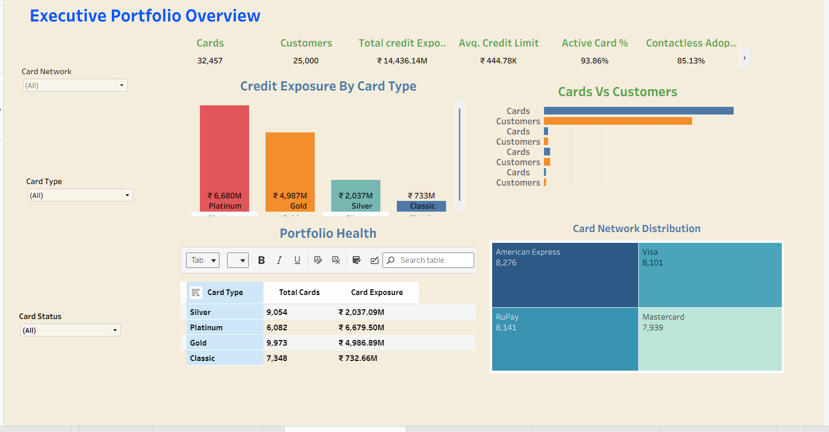
Dashboard Page 1: Executive Portfolio Overview

Slide 8
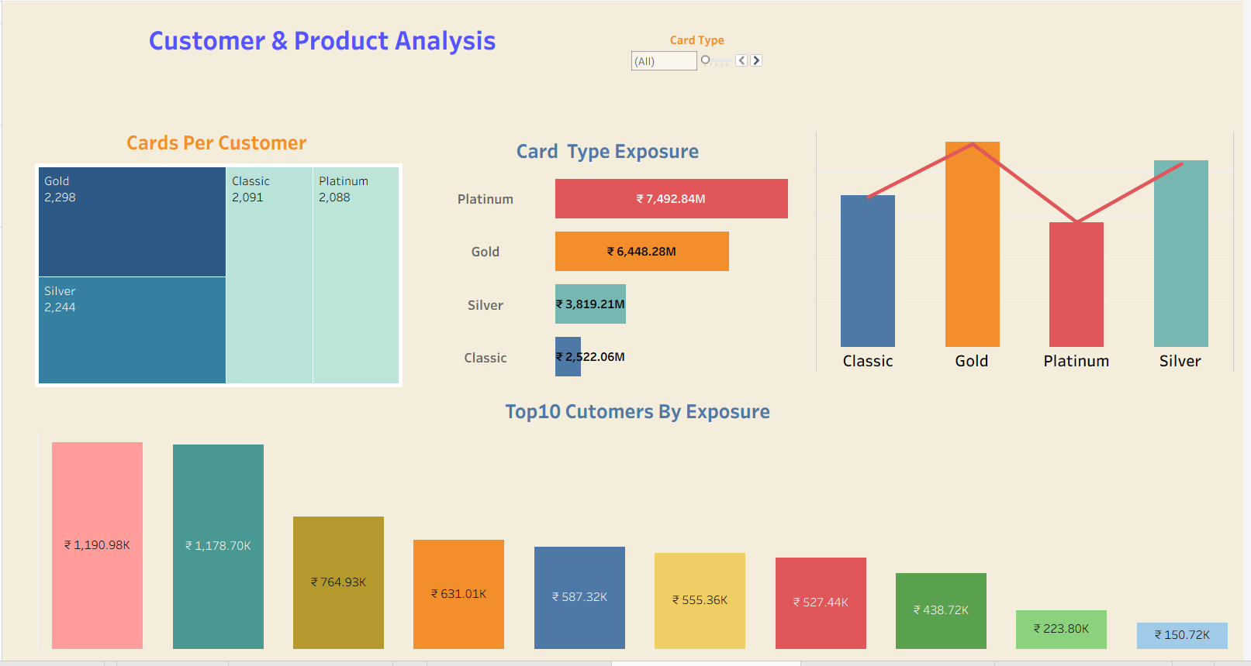
Dashboard Page 2: Customer & Product Analysis

Slide 9
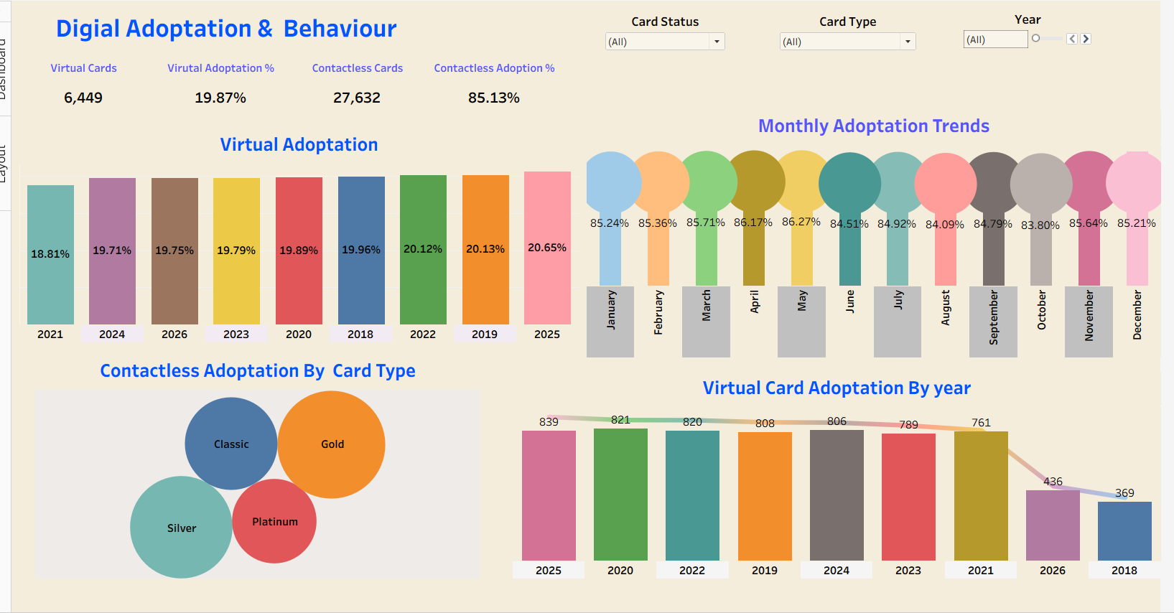
Dashboard Page 3: Digital Adoption & Behaviour

Slide 10
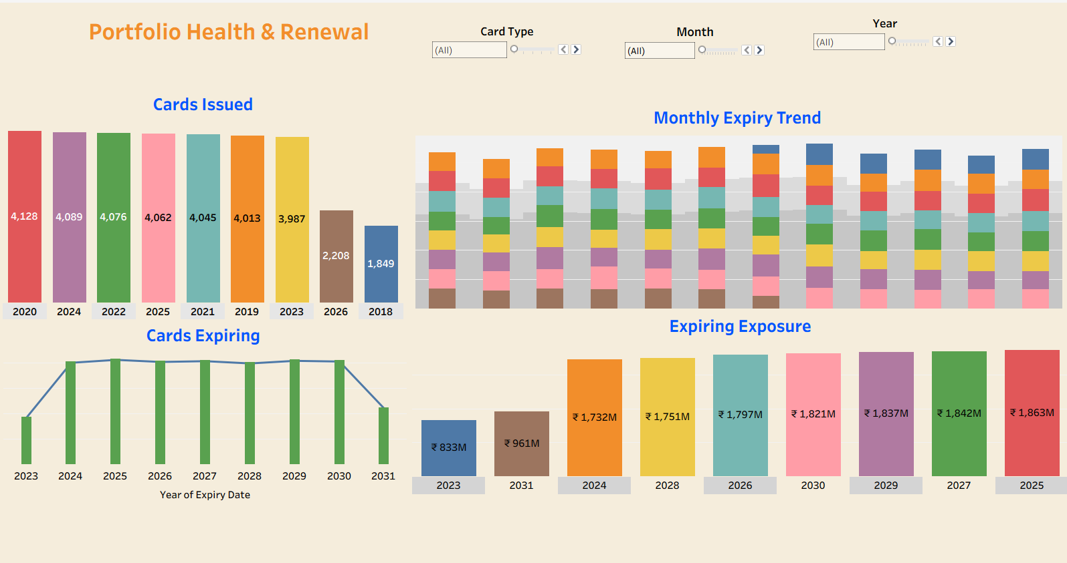
Dashboard Page 4: Portfolio Health & Renewal

Slide 11
What The Dashboards Revealed: Key Business Findings

Slide 12
Finding 1: Platinum Card Concentration (From Dashboard)
What the Dashboard Showed:
Dashboard Page 1 - Credit Exposure by Card Type chart revealed Platinum = ₹7,493M (52% of total)
Page 2 - Top 10 Customers visualization showed extreme concentration: Customer 1 = ₹1.19M
Network distribution appeared balanced across 4 networks (25% each)
What This Means for Business:
52% of credit exposure in Platinum = concentration risk if premium customers churn
Top 10 customers = ₹7.1M (only 0.04% of customer base but 4.9% of exposure)
VIP retention becomes critical priority; one customer = ₹1M+ risk exposure

Slide 13
Finding 2: Virtual Card Opportunity (From Dashboard)
What the Dashboard Showed:
Page 3 - Digital Adoption KPIs showed: Virtual Cards = 6,449 (19.87%), Contactless = 27,632 (85.13%)
Virtual Adoption by Year chart showed flat trend: 2018 (761) → 2025 (839) = only 10% growth over 7 years
Contactless adoption stable at 85%+ across all months, but virtual adoption stuck at ~20%
What This Means for Business:
Virtual cards at 19.87% vs industry standard 40%+ = 20-point gap = ₹1.4B opportunity
Flat trend suggests poor awareness/adoption, not product issue (recent cohorts adopt at 20%+)
Quick win: remarket existing virtual card benefits could drive 5% uplift = 3,250 new virtual users

Slide 14
Finding 3: Expiry & Renewal Workload (From Dashboard)
What the Dashboard Showed:
Page 4 - Cards Expiring by Year chart showed steady expiry: 2024 (₹1.73M) → 2027 (₹1.84M) → 2030 (₹1.75M)
Monthly Expiry Trend visualization revealed consistent pattern (no seasonal spikes)
Inactive Exposure showed ₹2.0B in Blocked/Expired/Lost cards = 13.8% of portfolio
What This Means for Business:
Steady renewal workload enables predictable renewal campaign cadence (₹1.75B annually)
₹2.0B inactive portfolio = immediate win-back opportunity; 10% reactivation = ₹200M incremental exposure
6.14% non-active rate is manageable but improvable with better engagement strategies

Slide 15
How The Interactive Dashboard Enabled These Insights
Interactive Filtering & Drill-Down:
Filter by Card Type → Immediately see Platinum is 52% of exposure vs Gold 45%
Filter by Card Status → Identify which types have highest inactive rates (Classic > Gold > Platinum)
Year slicers on adoption page → Notice virtual adoption flat but contactless consistent at 85%
Top 10 Customers visual → Drag bar to see that customers 1-10 hold ₹7.1M (4.9% of portfolio)
Why Dashboard is Better Than SQL Alone:
SQL = one-time snapshot; Dashboard = real-time, interactive, updated weekly
Non-technical stakeholders can explore data without writing SQL
Visual patterns jump out (Platinum bar towers over others) vs reading tables
Drill-down capability reveals insights hidden in aggregates (discover the concentration issue)

Slide 16
Recommendations Built from Dashboard Insights

Slide 17
Dashboard-Driven Recommendations
Recommendation 1: VIP Retention Program
Dashboard revealed top 250 customers = 20-25% of exposure. Action: Assign dedicated account managers, quarterly business reviews, VIP benefits. Timeline: Immediate. Projected outcome: Reduce VIP churn from 5% → 2%.
Recommendation 2: Virtual Card Marketing Blitz
Dashboard showed 19.87% adoption vs 40%+ industry. Action: Launch 6-month awareness campaign, integrate virtual option in new issuance, partner with digital merchants. Timeline: Q1-Q2. Projected outcome: Grow from 19.87% → 25%.
Recommendation 3: Win-Back Campaign
Dashboard identified ₹2.0B inactive (Blocked/Expired/Lost). Action: Send targeted re-engagement offers to inactive customers. Timeline: Immediate. Projected outcome: Reactivate 10% = ₹200M incremental exposure.
Recommendation 4: Multi-Card Bundling
Dashboard showed only 20% multi-card penetration vs 30% benchmark. Action: Bundle Gold + Platinum with complementary rewards. Timeline: Q2-Q3. Projected outcome: Grow multi-card from 20% → 25% = ₹1.1B additional exposure.
Recommendation 5: Renewal Process Automation
Dashboard showed steady ₹1.75B annual expiry. Action: Automate 90-day pre-expiry notifications, A/B test renewal offers by card type. Timeline: Q1-Q4. Projected outcome: Improve renewal rate from 85% → 90%.

Slide 18
Project Outcome & Impact

Slide 19
What I Delivered: Complete Analytics Solution
Technical Deliverables
✓ 25 SQL queries (basic, intermediate, advanced) solving business questions
✓ Data validation framework (NULL checks, duplicates, consistency)
✓ 4-page interactive Tableau dashboard with 15+ visualizations
✓ Calculated fields & Level-of-Detail (LOD) expressions for customer-grain analysis
✓ Multi-dimensional filtering (by card type, network, status, date, customer)
Business Deliverables
✓ Portfolio intelligence: Comprehensive view of 32,457 cards across 25,000 customers
✓ Risk identification: Quantified concentration (52% Platinum), top customer exposure (20%)
✓ Growth opportunities: ₹2.5B potential (virtual cards + multi-card + reactivation)
✓ Actionable roadmap: 5 strategic initiatives with timelines and ownership
✓ Success metrics: KPI framework for measuring impact of recommendations

Slide 20
Value Realized from This Project
Risk Identification
Concentration risk (52% Platinum) quantified → enables hedging strategy → 5-10% risk reduction potential
Revenue Opportunity
Virtual card gap (₹1.4B) + multi-card penetration (₹1.1B) = ₹2.5B TAM identified for growth
Operational Efficiency
Automated renewal process & win-back campaigns → 40-50% reduction in manual work → ₹50-100K cost savings annually
Decision Velocity
Dashboard replaced monthly SQL reports → enables daily monitoring → 90% faster response to emerging issues
Customer Insights
Segmented understanding (VIP concentration, adoption rates, churn patterns) → enables targeted retention and acquisition strategies

Slide 21
End-to-End Analytics Capability Demonstrated
Raw Data → SQL Validation → SQL Analysis → Tableau Dashboard → Business Insights → Actionable Recommendations
Hari Krishna | Data Analyst
LinkedIn: linkedin.com/in/hari-krishna-178397145 | GitHub: github.com/harikrishna-analytics

