Slide 1
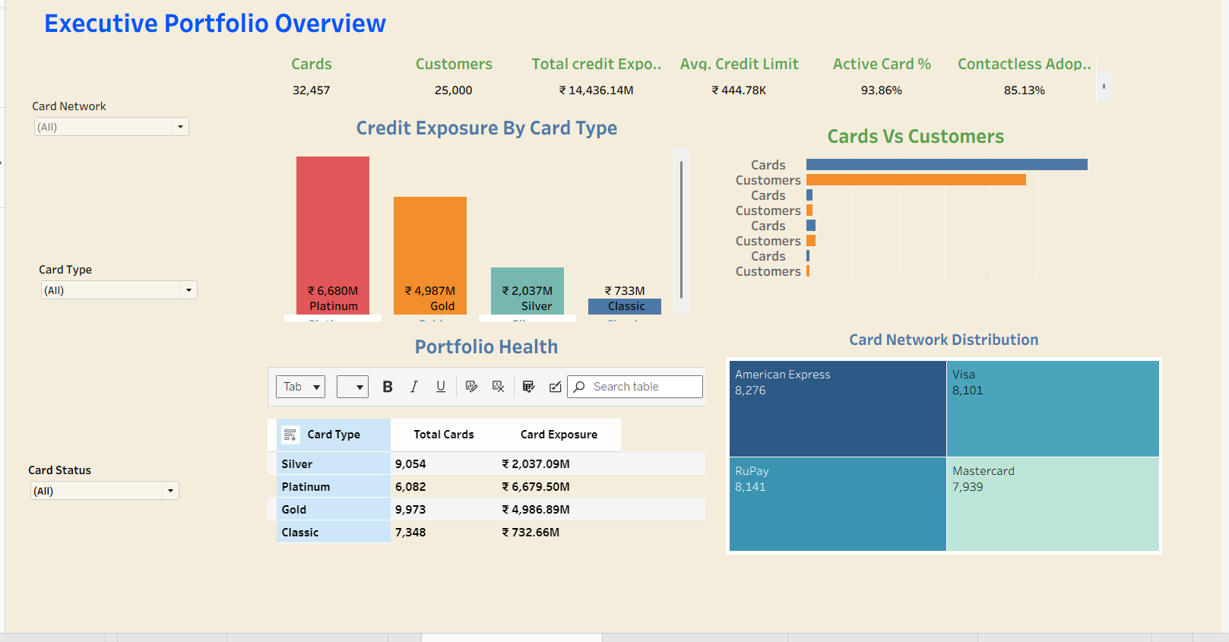
PORTFOLIO PROJECT
Credit Card
Portfolio & Customer
Analytics
SQL + Tableau + business insights
A card-level analytics portfolio that connects exposure, customer behaviour, digital adoption and renewal planning.
Explore the story
Portfolio scale • Product mix
Digital behaviour • Renewal planning
Hari Krishna | Data Analyst
Hyderabad, India
Notes:
[Sources]
Dashboard image: Executive Overview Portfolio.png (user-provided).
Project positioning: Credit_Card_Portfolio_Tableau_Dashboard_Documentation.docx, sections 1-3.
Author profile: HariKrishna Resume.pdf.

Slide 2
PROJECT APPROACH
One card-level dataset, translated into a management story
The dashboard is designed to answer business questions - not simply display SQL results.
1. Prepare
2. Analyse
3. Communicate
32,457 records
10 portfolio fields
One row = one card
→
25 SQL questions
CTEs, joins, windows
Customer-grain checks
→
4 Tableau pages
Focused filters
Decision-ready KPIs
Key modeling rule
Portfolio metrics stay at card grain; customer concentration uses Tableau LOD calculations only where the question requires customer grain.
Credit Card Portfolio & Customer Analytics
02
Notes:
[Sources]
Data grain and dashboard build: Credit_Card_Portfolio_Tableau_Dashboard_Documentation.docx, sections 2-3 and 8-10.
SQL scope: cards_analytics.sql and Card_Analytics_SQL_Questions_1_to_25.pdf.

Slide 3
EXECUTIVE PORTFOLIO OVERVIEW
The portfolio is large, healthy and predominantly contactless
Validated against the supplied card-level CSV.
32,457
25,000
₹14.44B
93.86%
cards in the portfolio
unique customers
total credit exposure
active-card rate
Portfolio health at a glance
Network distribution
30,463 active cards
85.13%
₹13.53B active exposure
contactless adoption
(27,632 cards)
Credit Card Portfolio & Customer Analytics
03
Notes:
[Sources]
Metrics: Cards_Data.csv; calculation: count of Card_ID, distinct Customer_ID, sum/average Credit_Limit and status/contactless proportions.

Slide 4
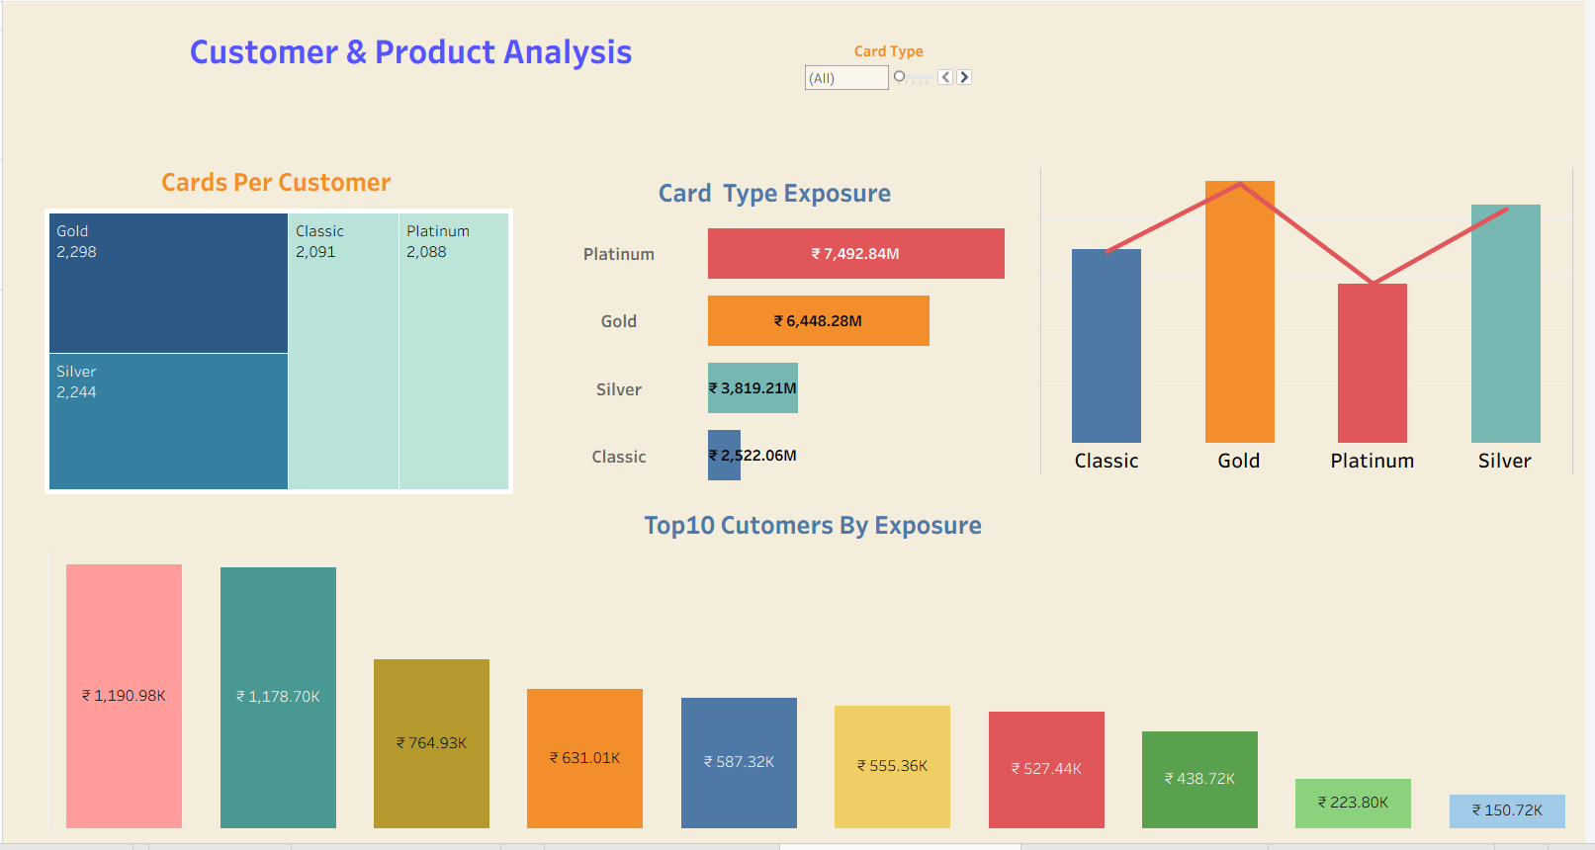
CUSTOMER & PRODUCT ANALYTICS
Platinum drives 46.3% of portfolio exposure with only 18.7% of cards
This concentration is a useful lens for product strategy and exposure management.
Credit exposure by card type (₹B)
Customer behaviour
6,204 customers (24.8%) hold more than one card; the top 1% of customers account for 4.45% of total exposure.
Credit Card Portfolio & Customer Analytics
04
Notes:
[Sources]
Exposure and customer concentration: Cards_Data.csv, grouped by Card_Type and Customer_ID.
Customer-grain method: Credit_Card_Portfolio_Tableau_Dashboard_Documentation.docx, section 5.
Dashboard image: Customer & Product Analysis.png (user-provided).

Slide 5
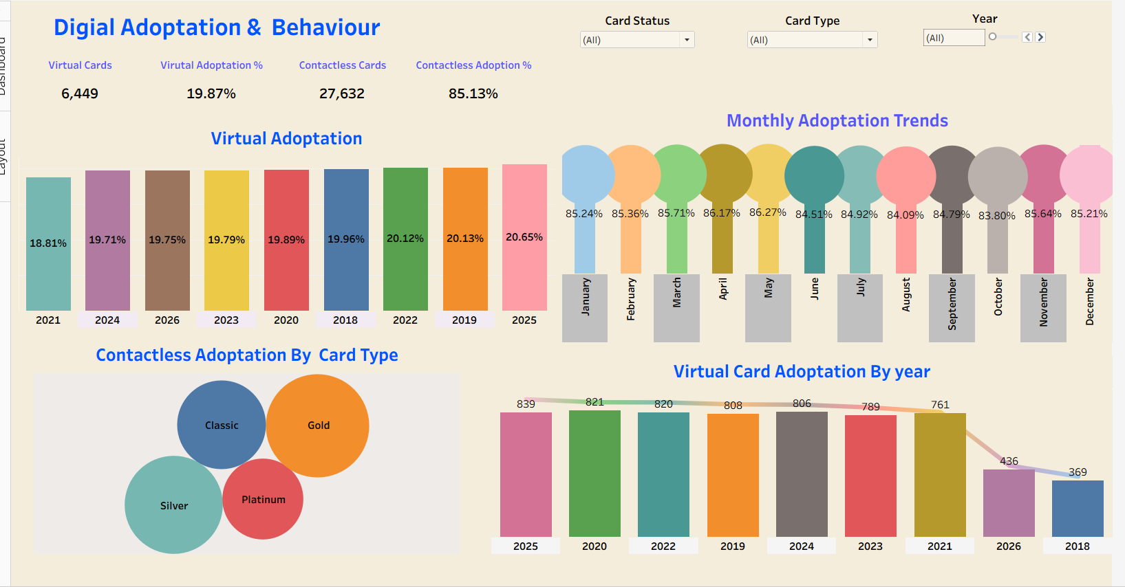
DIGITAL ADOPTION & BEHAVIOUR
Contactless leads; virtual cards are the next opportunity
The portfolio has high contactless penetration and a stable, lower virtual-card mix.
85.13%
contactless adoption
27,632 contactless cards
19.87%
virtual-card adoption
6,449 virtual cards
Credit Card Portfolio & Customer Analytics
05
Notes:
[Sources]
Adoption metrics: Cards_Data.csv, proportions of Contactless = Yes and Card_Mode = Virtual.
Dashboard image: Digital Adoptation & Behaviour.png (user-provided).
Dashboard method: Credit_Card_Portfolio_Tableau_Dashboard_Documentation.docx, section 6.

Slide 6
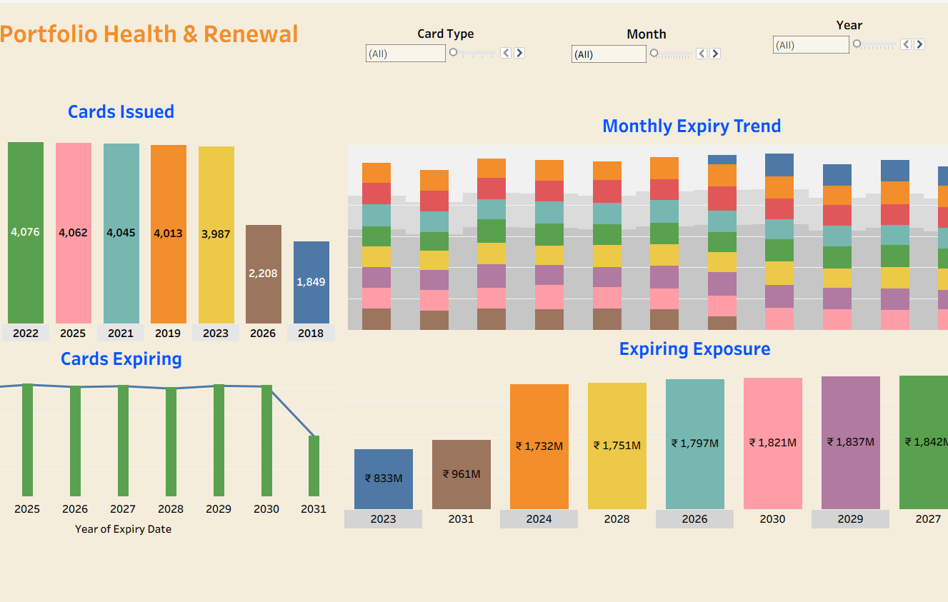
PORTFOLIO HEALTH & RENEWAL
Renewal needs a planned cadence
Expiry and inactive balances show where retention and renewal decisions matter.
Expiring exposure by year (₹B)
₹1.80B
₹0.91B
2026 expiry exposure
inactive-card exposure
Credit Card Portfolio & Customer Analytics
06
Notes:
[Sources]
Expiry and inactive exposure: Cards_Data.csv, grouped by Expiry_Date year and non-active Card_Status.
Dashboard image: Portfolio Health & Renewal.png (user-provided).
Renewal use case: Credit_Card_Portfolio_Tableau_Dashboard_Documentation.docx, section 7.

Slide 7
ANALYTICAL METHOD
SQL establishes the evidence; Tableau makes it explorable
The work combines SQL question design, calculated fields and selective customer-level LOD expressions.
SQL analysis
Tableau modeling
Business outputs
25 questions across portfolio size, exposure, adoption, inactive balances, expiry and customer concentration.
Techniques: aggregates, CTEs, CASE logic, LAG and RANK.
Calculated fields for active, inactive, contactless and virtual KPIs.
LODs used only when grain changes: Cards per Customer and Customer Exposure.
Four connected dashboard pages: executive overview, customer & product, digital adoption, and portfolio health & renewal.
Shared filters preserve exploration context.
Validation principle
Core dashboard totals were reconciled back to the card-level data and SQL outputs before the Tableau story was finalized.
Credit Card Portfolio & Customer Analytics
07
Notes:
[Sources]
SQL methods: cards_analytics.sql and Card_Analytics_SQL_Questions_1_to_25.pdf.
Tableau methods and validation checklist: Credit_Card_Portfolio_Tableau_Dashboard_Documentation.docx, sections 5-6 and 11-14.
Workbook cross-check: Credit Card Portfolio & Customer Analytics.twb.

Slide 8
ABOUT THE ANALYST
Hari Krishna
Data Analyst | Power BI Developer | MIS & Financial Reporting Analyst
I build end-to-end analytics solutions - from SQL data modeling and validation to KPI dashboards that make complex business data decision-ready.
Core strengths
Power BI & Tableau
SQL / PostgreSQL
Power Query & DAX
Python & Excel automation
KPI & management reporting
Connect
hanrajharikrishna@gmail.com
github.com/harikrishna-analytics
linkedin.com/in/hari-krishna-178397145
Thank you
Notes:
[Sources]
Professional profile and core strengths: HariKrishna Resume.pdf.
LinkedIn contact: https://www.linkedin.com/in/hari-krishna-178397145 (user-provided; checked via public LinkedIn search result on 2026-08-13).

