Slide 1
Kubernetes Basics

Slide 2
Prerequisite
Basics Of Container
Setup Minikube (Single node cluster for local development)
Install Docker
Install Virtuabl Box
Start minikube application (minikube start)

Slide 3
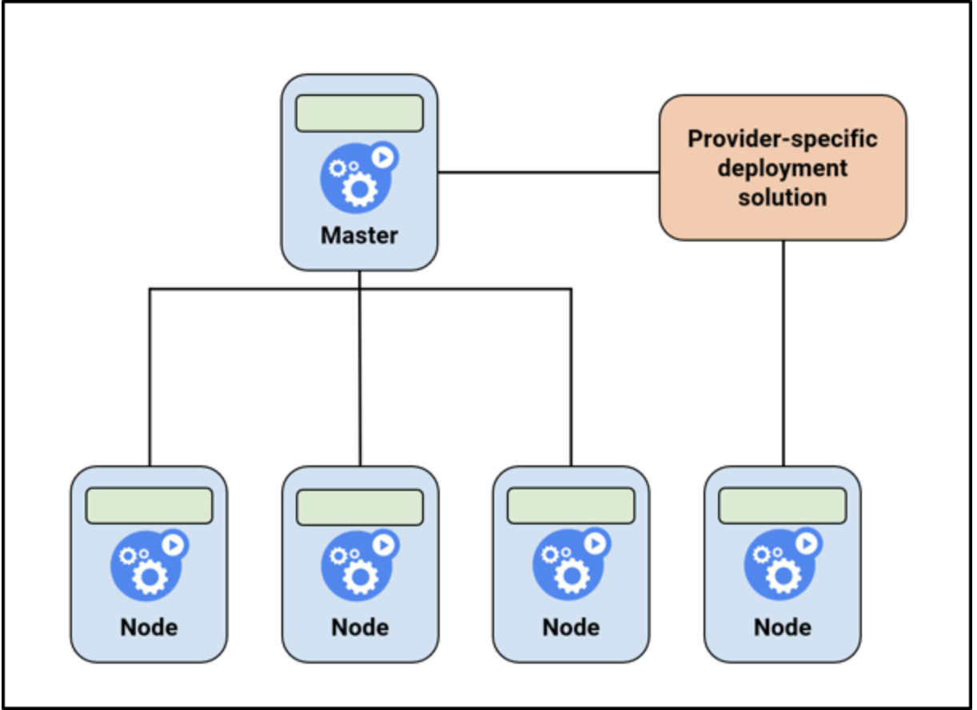
Node

Slide 4
Node continuation….
kubectl get nodes

Slide 5
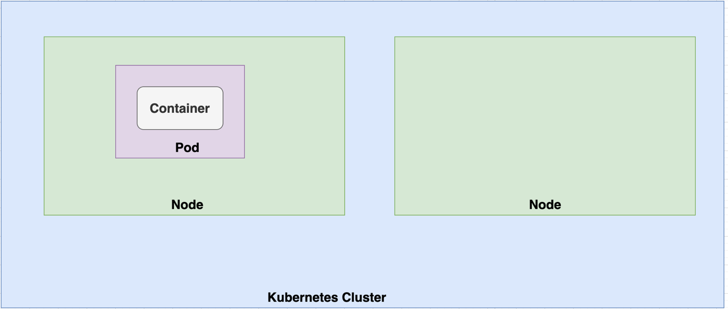
Pod

Slide 6
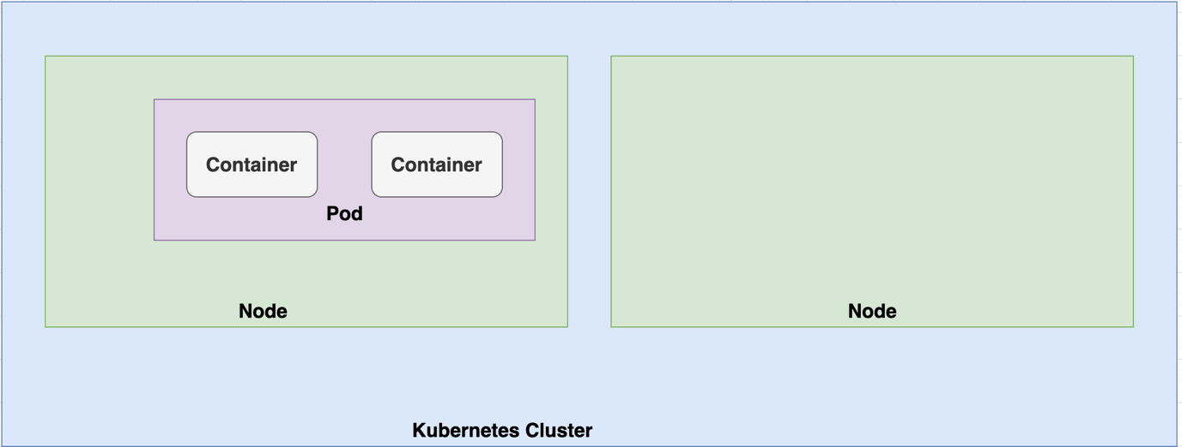
Can a single Pod encapsulate multiple containers

Slide 7
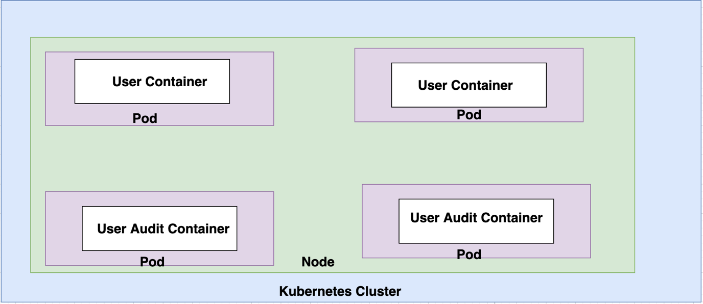
Use case of single pod with multiple containers

Slide 8
Pod Demo
podDemo1

Slide 9
PodDemo2 : via yml definition file
Key Sections applicable for all the objects
apiVersion
kind
Metadata
Spec

Slide 10
apiVersion for different objects
Kind | apiVersion
Pod | v1
Service | v1
ReplicationController | v1
ReplicaSet | apps/v1
Deployment | apps/v1

Slide 11
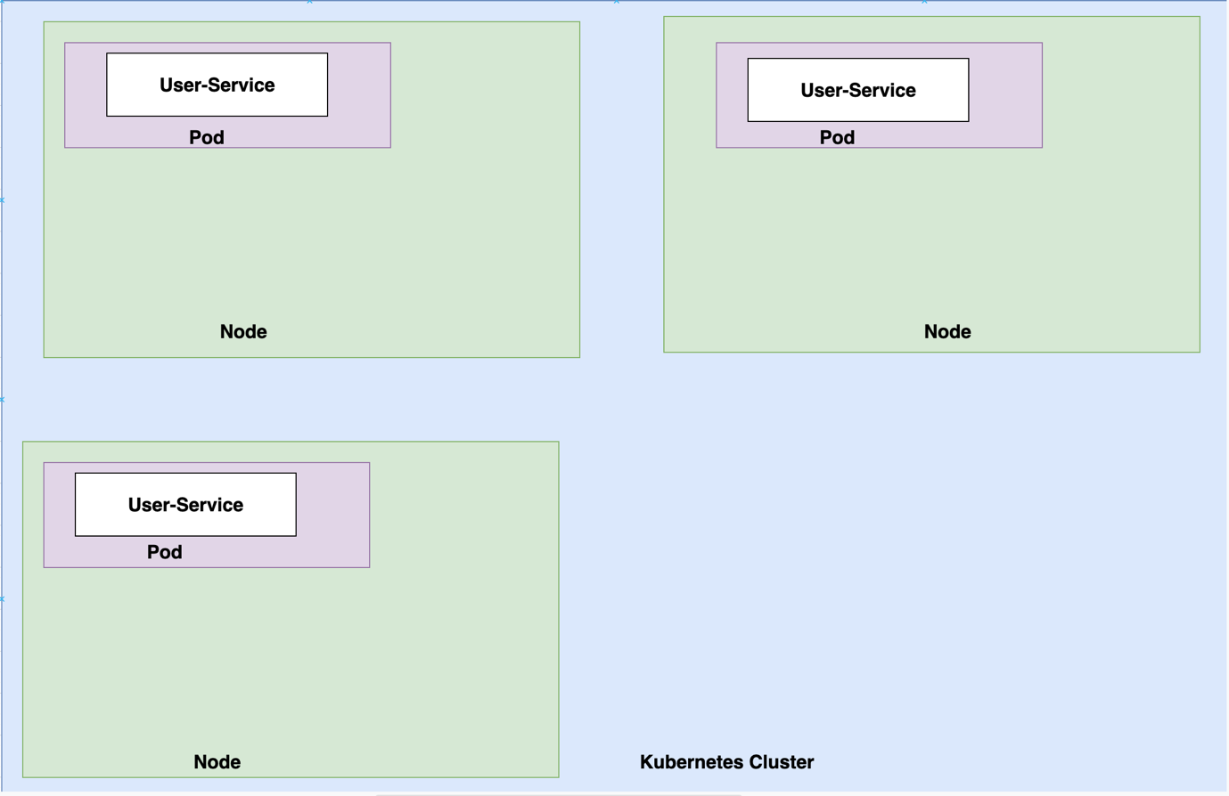
Replication Controller and Replica Set

Slide 12
Replication Controller Demo…
replicationControllerDemo

Slide 13
ReplicaSet
replicaSetDemo

Slide 14
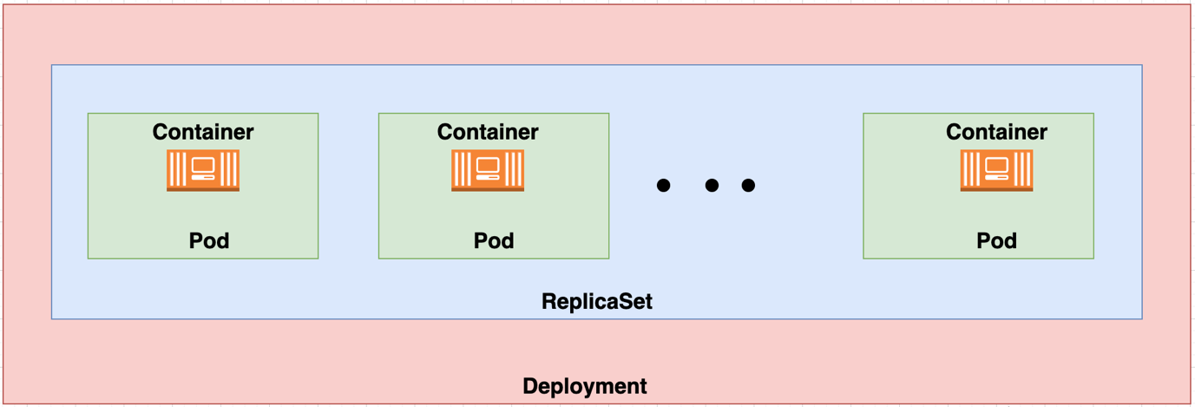
Deployments
Used to handle rollbacks and upgradations.
In real time you do not deal with Pods, Replicasets. You deal with Deployments only.

Slide 15
Deployment Demo
deploymentDemo

Slide 16
Deployment Strategies
Recreate
Rolling Update

Slide 17
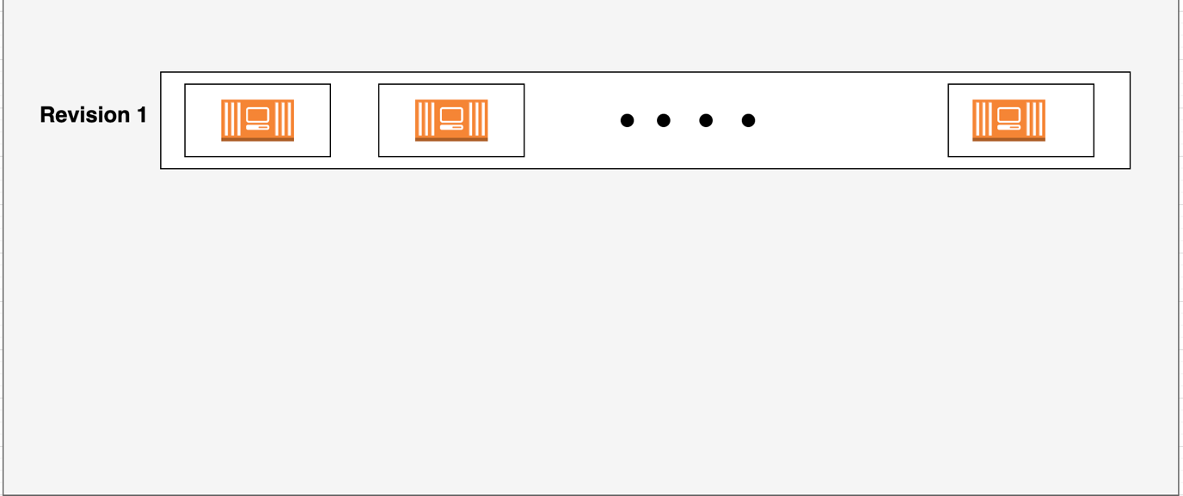
Revision
Whenever you create new deployment new revision is created.

Slide 18
Upgrading and rollbacks
upgradationsDemo

Slide 19
Services
serviceDemo

Slide 20
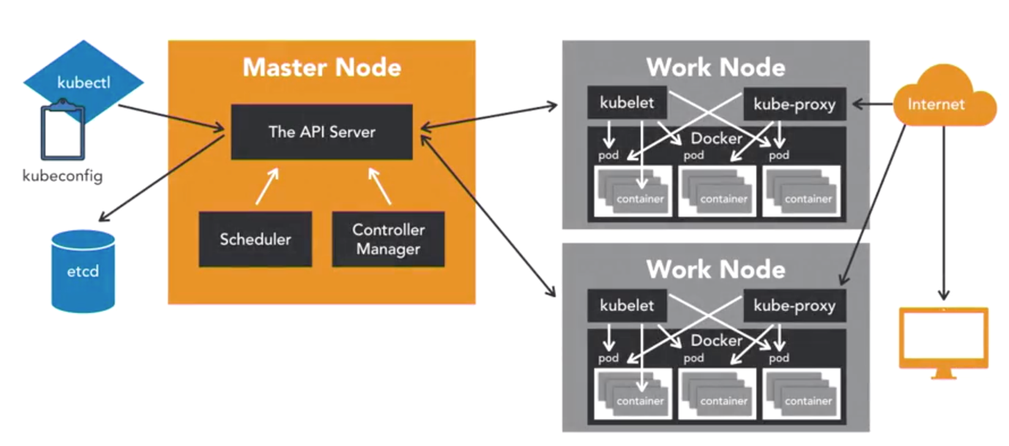
Kubernetes Architecture

