Slide 1
SPI PROTOCOL
Nanochip solutions
Serial Peripheral Interface

Slide 2
SPI Protocol Fundamentals
Definition: SPI (Serial Peripheral Interface) is a synchronous, full-duplex, master-slave communication protocol.
Core Concept: A high-speed interface where a master device controls the clock and communication with one or more slave devices.
Data Flow: Uses a 4-wire interface (MOSI, MISO, SCLK, SS).
Standard Compliance: SPI does not conform to a single industry standard but is widely adopted for "glueless" chip-to-chip communication.

Slide 3
SPI Hardware Signals (Architecture)
MOSI (Master Out Slave In): Data path from Master to Slave.
MISO (Master In Slave Out): Data path from Slave to Master.
SCLK (Serial Clock): Clock generated by the Master to synchronize data bits.
SS/CS (Slave Select): Active-low signal; enables communication with a specific slave device.
Full-Duplex Mode: Data is shifted in and out simultaneously between master and slave.

Slide 4
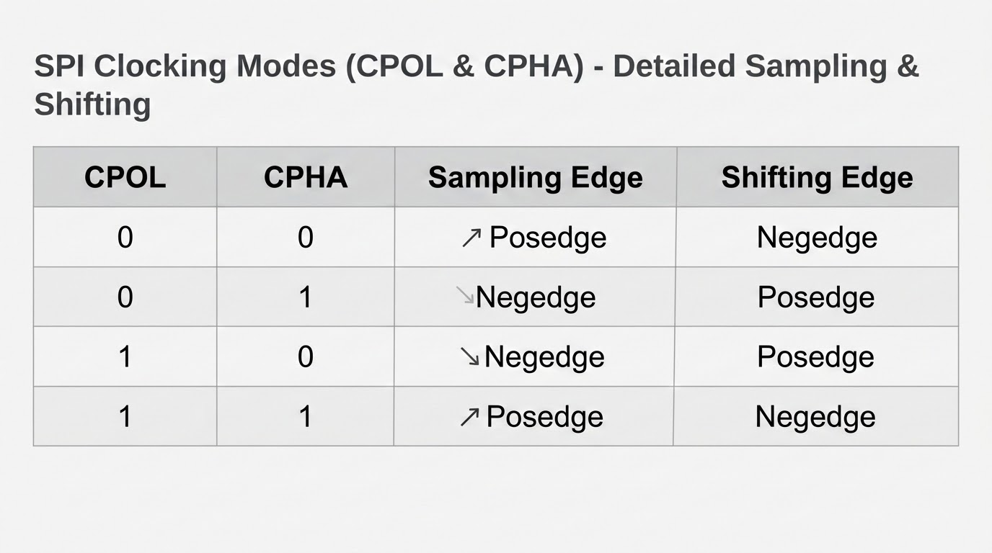
SPI Clocking Modes (CPOL & CPHA)
CPOL (Clock Polarity):
  CPOL = 0: SCLK is low when idle.
  CPOL = 1: SCLK is high when idle.
CPHA (Clock Phase):
  CPHA = 0: Data is sampled on the first clock edge.
  CPHA = 1: Data is sampled on the second clock edge.

Slide 5
SPI Importance & Applications
Why use SPI: Offers high-speed, full-duplex communication with minimal hardware complexity and low overhead.
Key Advantages: Simple interface, high throughput, and efficient point-to-point data exchange.
Typical Applications: Data transfer between microcontrollers and peripherals like flash memory, ADCs, sensors, and displays.
External Slave Examples:
  Flash Memory (EEPROM/NOR Flash)
  Temperature & Pressure Sensors
  Analog-to-Digital Converters (ADC)
  LCD/OLED Display Drivers

Slide 6
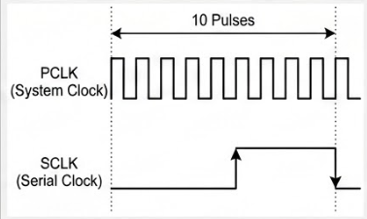
SCLK Generation & Clock Calculations
SCLK Generation: Master divides the system clock (pclk) to produce the Serial Clock (SCLK).
Calculation Formula:
SCLK frequency = [System Clock] / (2 * DIV)
DIV Value Determination:
The DIV parameter determines the scaling factor needed to match the required slave device frequency.
Clock Synchronization:
In the Transfer state, the Master toggles SCLK based on the calculated DIV value to ensure precise synchronization with the slave device.

Slide 7
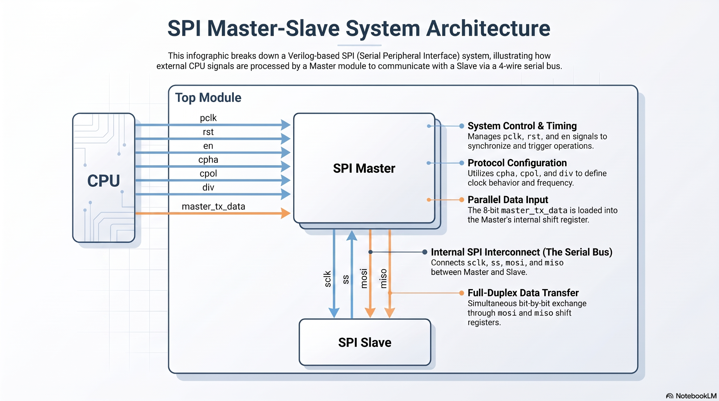
Architecture of SPI

Slide 8
SPI Architecture Overview
Master Interface:
  Inputs: pclk, rst, en, master_tx_data, cpha, cpol, miso, div
  Outputs: ss, mosi, sclk
Slave Interface:
  Inputs: sclk, rst, mosi, ss
  Outputs: miso
Architecture Note: The Master generates the clock and control signals, while the Slave responds based on the Slave Select (SS) signal and internal shift registers.
Block Diagram: [Insert architectural block diagram here showing Master connecting to Slave via 4 lines: MOSI, MISO, SCLK, SS]

Slide 9
SPI Master FSM (Finite State Machine)
State Definitions:
  IDLE: Initial state; SS = 1, waiting for en signal.
  LOAD: SS = 0; loads master_tx_data into master_tx_shift_reg.
  TRANSFER: SS = 0; main operation where SCLK toggles and data is shifted/sampled.
  DONE: Final state; signals completion before returning to IDLE.
State Transitions:
  Next state logic follows a sequential flow: IDLE -> LOAD -> TRANSFER -> DONE -> IDLE.
  Transitions are controlled by the en signal, count value, and clock edge detections.

Slide 10
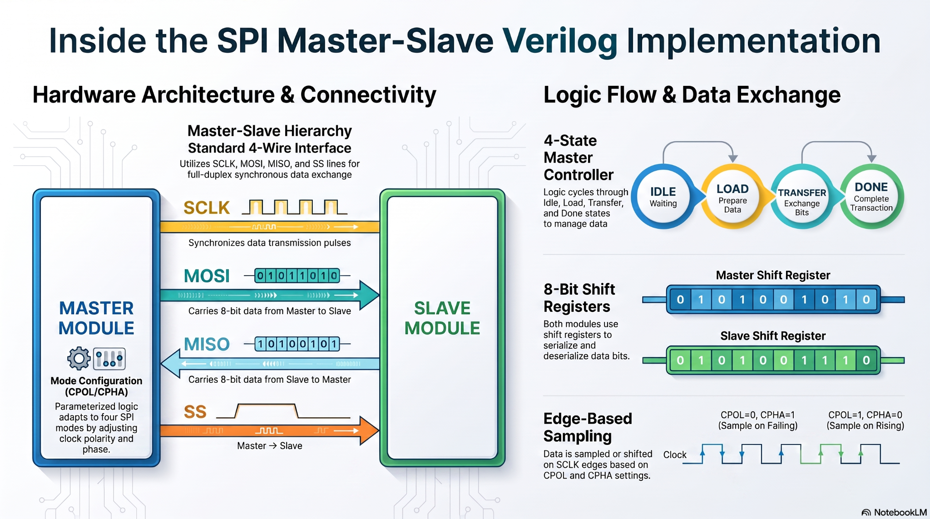
FSM states

Slide 11
Detailed FSM State Logic
IDLE State:
  The default reset state where the SPI interface is inactive.
  Slave Select (SS) is held High (inactive) to ensure no communication.
LOAD State:
  Triggered by the enable signal (en).
  SS is pulled Low (active) to select the slave device.
  Data is transferred from the input master_tx_data into master_tx_shift_reg for parallel-to-serial conversion.
TRANSFER State:
  The core operational phase.
  SCLK toggles continuously to synchronize data shifting and sampling.
  Remains in this state for 8 clock cycles (or as configured) until the counter completes.
DONE State:
  Signifies the end of the transmission.
  Returns control to the IDLE state, resetting the SS signal to High.

Slide 12
Master Logic: Sampling & Shifting Enable
Clock Edge Detection:
  Uses sclk_d (delayed clock) to detect posedge_sclk and negedge_sclk.
Sample Enable (sample_en):
  Determined by CPOL/CPHA configuration.
  Ensures the master samples incoming data (MISO) at the correct, stable edge of SCLK.
Shift Enable (shift_en):
  Triggered to output data bits (MOSI) at the correct phase relative to SCLK.
Logic Purpose:
  These signals guarantee compatibility with all 4 SPI modes (0,0; 0,1; 1,0; 1,1) by dynamically choosing the correct clock edge for interaction.

Slide 13
Master Data Logic: Shifting & Sampling
Sampling Logic:
master_rx_shift_reg <= {miso, master_rx_shift_reg[7:1]};
  Triggered when sample_en is high; captures the incoming miso bit into the register while shifting previous data.
Shifting Logic:
mosi <= master_tx_shift_reg[6];
master_tx_shift_reg <= {master_tx_shift_reg[6:0], 1'b0};
  Triggered when shift_en is high; drives the mosi pin with the next bit and shifts the transmit register left.
Operational Flow:
  Both operations occur strictly within the TRANSFER state.
  The synchronization provided by sample_en and shift_en ensures data integrity across all 4 SPI modes by aligning transitions with the appropriate SCLK edge.

Slide 14
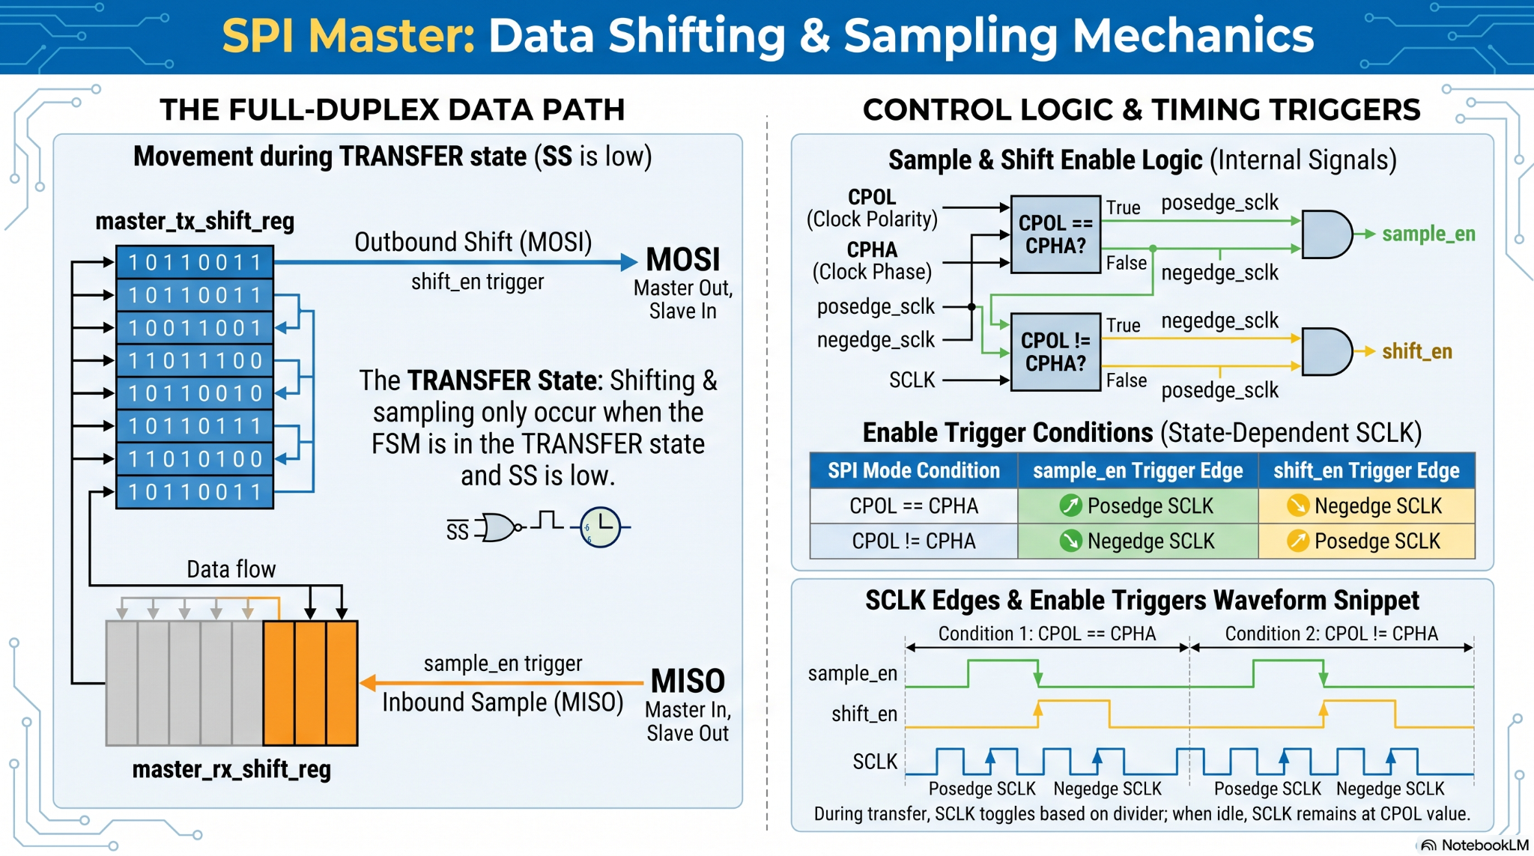
Shifting and Sampling in master side

Slide 15
Slave Module Design Strategy
Architectural Approach: The slave module is parameterized (CPOL, CPHA) to adapt to different master clock configurations.
Design Challenge: Avoiding multi-driven ports, which are common synthesis errors when logic is combined into a single block.
Solution - Dual Always Blocks:
  Implemented two separate always blocks for shifting and sampling logic.
  One block manages the logic for one polarity/phase combination, and the second manages the other.
Output Multiplexing:
  Used an assign statement: assign miso=(cpol==cpha)?miso2:miso1;
  This dynamically selects the correct output signal (miso1 or miso2) based on the active mode, ensuring clean, synthesis-friendly code.

Slide 16
Slave Shifting & Sampling Logic
Sampling Logic (Input from Master):
  Triggered when !ss is asserted.
  Uses slave_rx_shift_reg to capture mosi data bit-by-bit.
  If cpha == cpol, sampling happens on specific edges as defined by the SPI mode.
Shifting Logic (Output to Master):
  Triggered when !ss is asserted.
  Data is shifted out onto the miso line from slave_tx_shift_reg.
  Counter logic (count1, count2) ensures precisely 8 bits are transmitted.
Mode Adaptation:
  The logic separates miso1 and miso2 based on the CPOL/CPHA settings.
  This ensures that regardless of the Master's mode (0, 1, 2, or 3), the slave responds with data at the correct clock phase/edge.

Slide 17
Slave Implementation: Avoiding Multi-Driven Ports
Design Challenge: In Verilog, driving the same register from multiple always blocks creates "multi-driven port" synthesis errors.
The Conflict: Modes 1/3 and Modes 0/2 have different timing requirements for shifting and sampling relative to clock edges (e.g., shifting on posedge vs. negedge).
Our Solution:
  Created two distinct sets of registers (tx1/rx1 and tx2/rx2) within two separate always blocks.
  This physically isolates the logic paths, preventing synthesis errors.
Execution:
  One block handles Mode 1/3 requirements.
  The second block handles Mode 0/2 requirements.
Final Output: Used an assign statement (assign miso=(cpol==cpha)?miso2:miso1;) to multiplex the output, ensuring only one logic path drives the miso line at any given time.

Slide 18
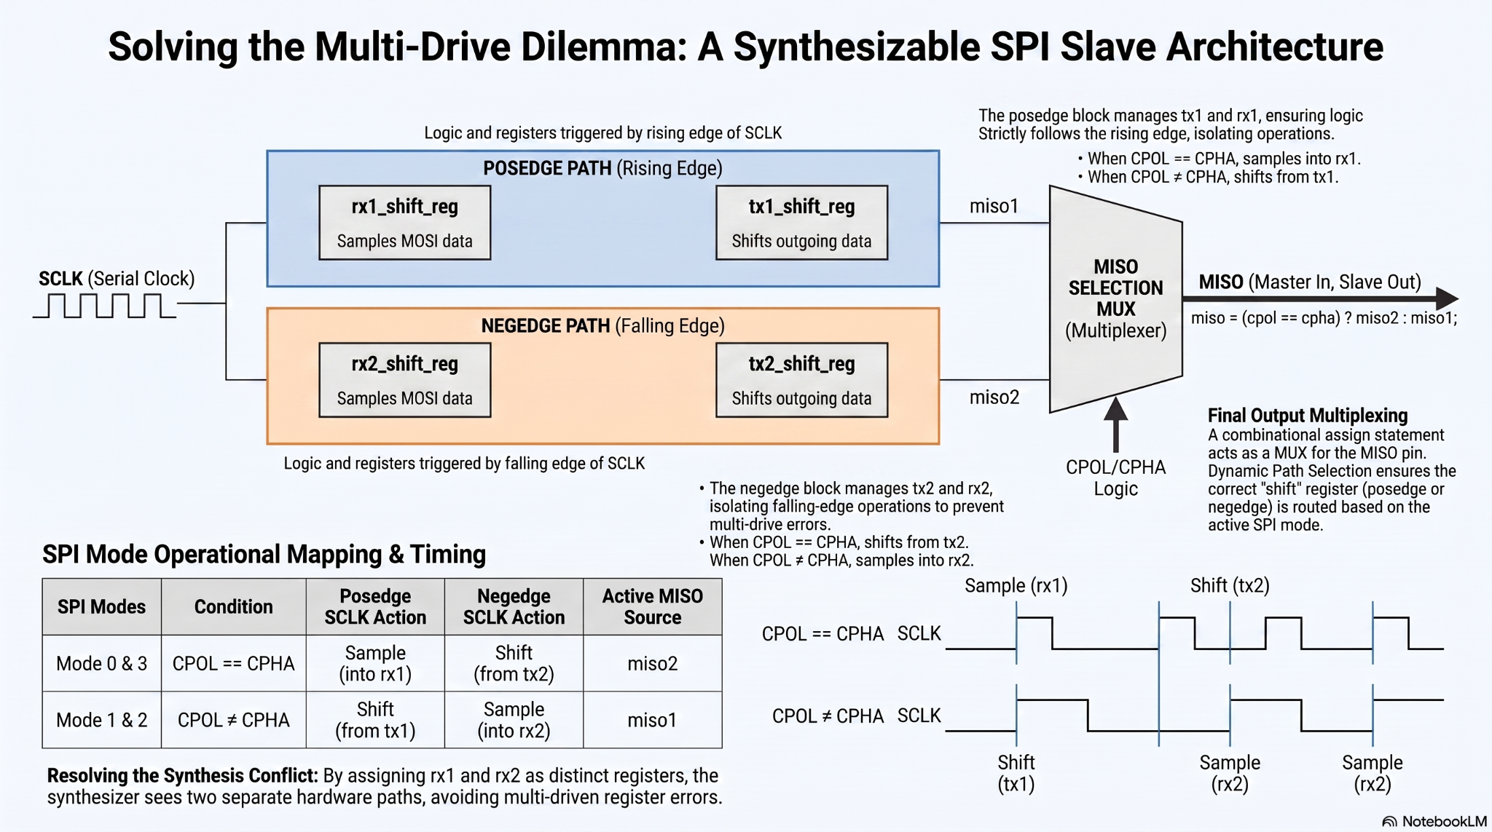
How the data will flow from master to slave

Slide 19
Conclusion & Key Takeaways
Protocol Reliability: SPI is a robust, synchronous protocol ideal for high-speed, short-distance chip-to-chip communication.
Parameterized Flexibility: The Verilog implementation provided is adaptable for various system clock speeds and supports all four SPI modes (0, 1, 2, and 3).
Data Integrity: Correct implementation of clock polarity (CPOL) and clock phase (CPHA) logic is critical for successful sampling and shifting.
Modular Design: The separation of Master and Slave FSM logic allows for scalable, synthesis-friendly architecture that can be easily integrated into complex System-on-Chips (SoCs).

