Slide 1
Secure Data Hiding in Image Using Steganography
Presented By: Harikrishna Latkari
Student Name : Harikrishna Latkari
College Name & Department : Malla Reddy Institute Of Technology, B.Tech(CSE)

Slide 2
OUTLINE
Problem Statement
Technology used
Wow factor
End users
Result
Conclusion
Git-hub Link

Slide 3
Problem Statement
Traditional encryption makes hidden data detectable, posing security risks. Steganography conceals data within images to ensure confidentiality, but challenges like maintaining image quality, imperceptibility, and robustness remain. This project aims to develop a secure and efficient steganographic technique for data hiding.

Slide 4
Technology used
Python
OpenCV

Slide 5
Wow factors
Direct Pixel Manipulation
Custom Character Encoding & Decoding
Pixel Traversal Pattern
Simple Password-Based Authentication:
Automation Warning for Oversized Messages:
Handling of Image Bounds:
Modified Image is Auto-Opened:

Slide 6
End users
The end users of this project and code can include individuals and organizations that require secure, covert communication and data protection.

Slide 7
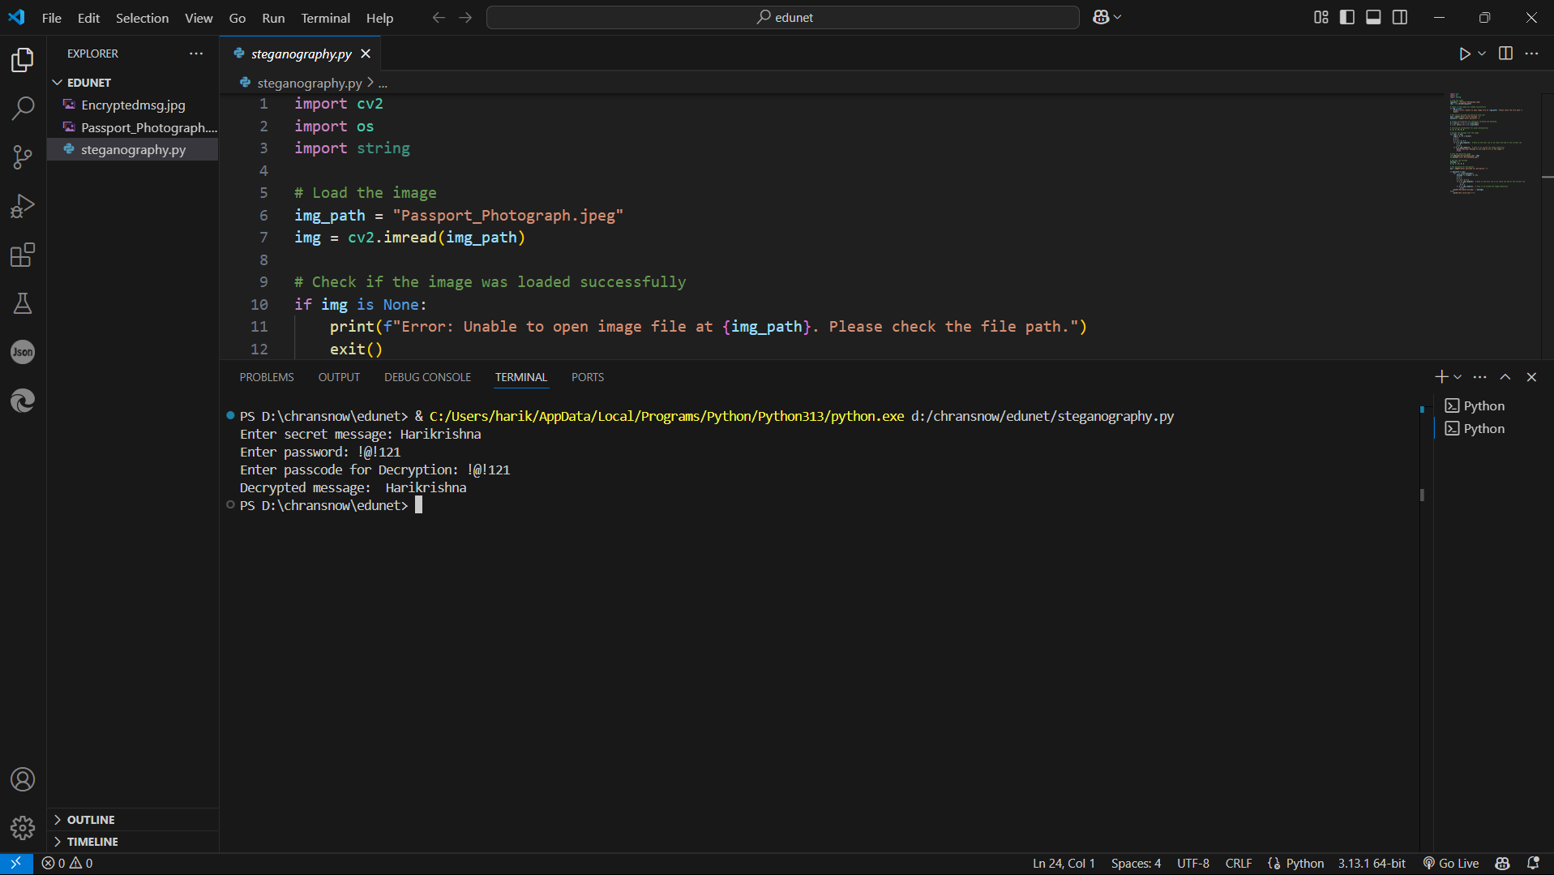
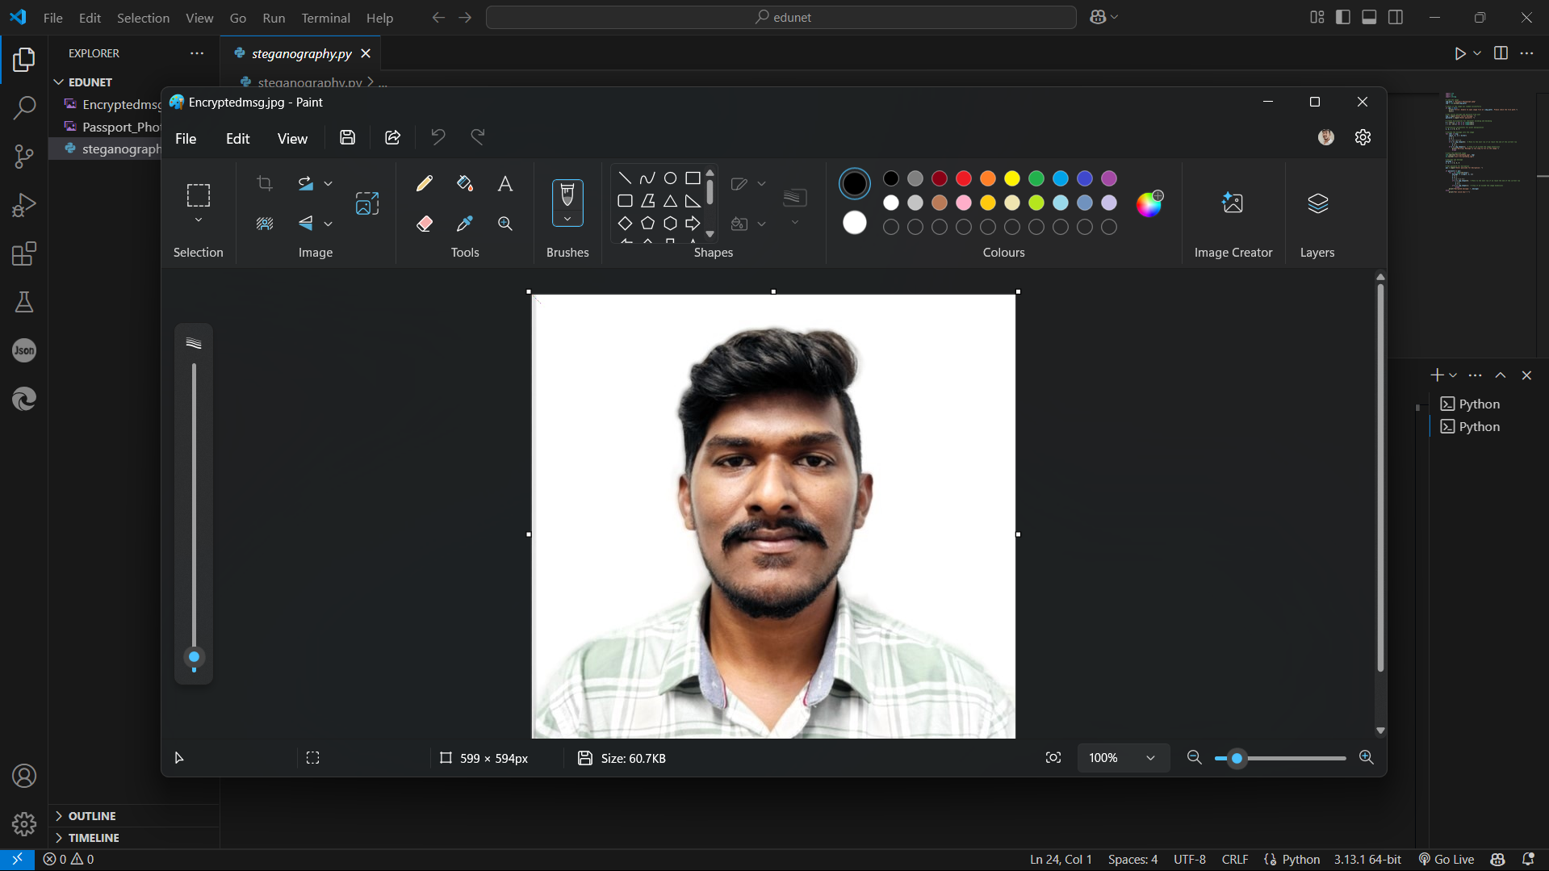
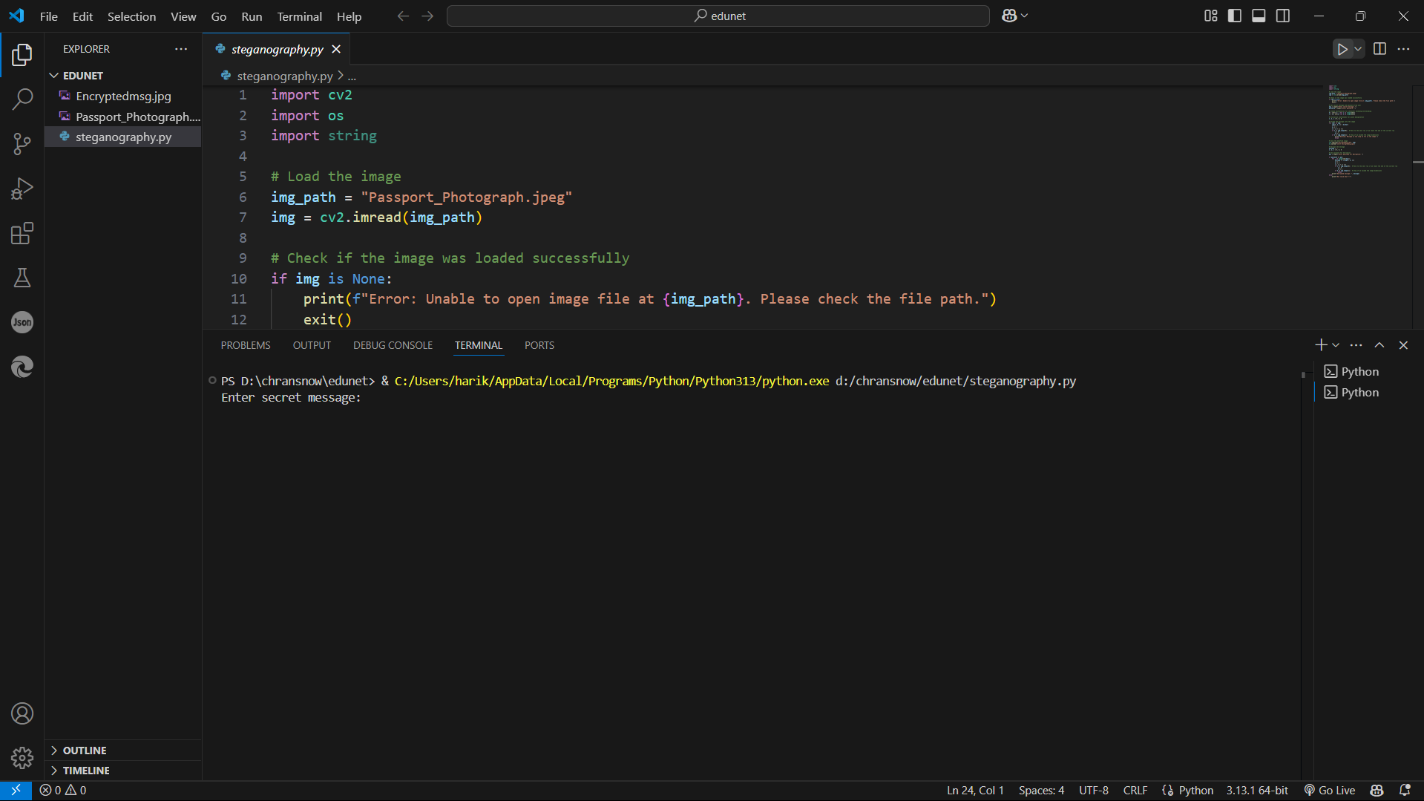
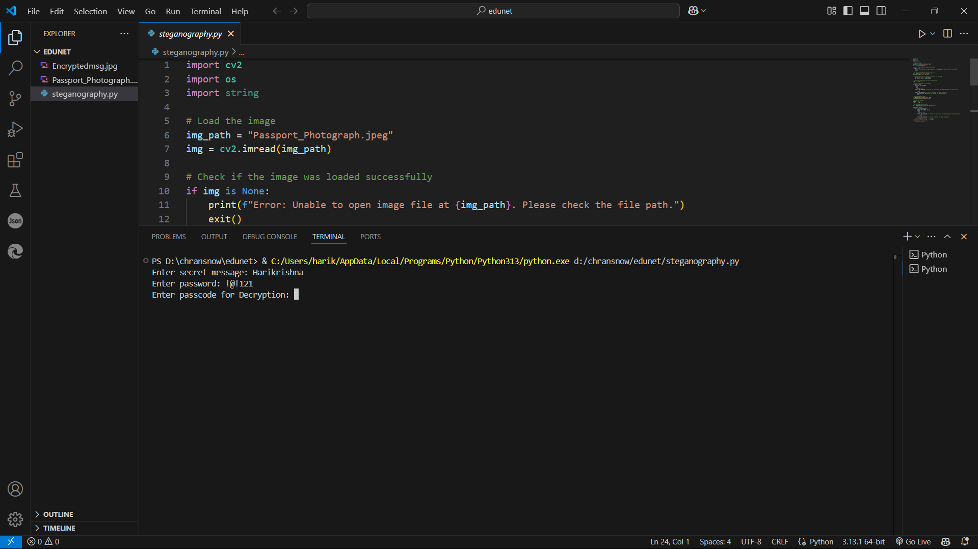
Results

Slide 8
Conclusion
This project successfully implements a secure data hiding technique using steganography, ensuring confidential communication. By embedding messages within images, it provides an undetectable and password-protected method for data security. The approach maintains image quality while preventing unauthorized access to hidden information. It is useful for various applications, including cybersecurity, journalism, and corporate data protection. Overall, this technique enhances secure communication by combining steganography with encryption principles.

Slide 9
GitHub Link
https://github.com/harikrishnalhk/EdunetSkillbuild.git

Slide 10
THANK YOU

