Slide 1
Secure Data Hiding in Image Using Steganography
CAPSTONE PROJECT
Presented By : Harikrishna Limmada
Student Name : Harikrishna Limmada
College Name : Kakinada Sri Aditya Degree College
Department : Bachelor of Computer Applications

Slide 2
OUTLINE
Problem Statement
Technology used
Wow factor
End users
Result
Conclusion
Git-hub Link
Future scope

Slide 3
Problem Statement
1. Enhancing Image Steganography Security Against Attacks
Many existing steganographic techniques are prone to steganalysis attacks that can detect hidden data. There is a need for an improved algorithm that enhances security, imperceptibility, and robustness against detection tools and machine learning-based steganalysis.

Slide 4
Problem Statement
2. Efficient Data Hiding with Minimal Image Distortion
Hiding data in images often leads to noticeable distortions or quality degradation, making them susceptible to detection. Developing an optimized steganographic method that embeds data without compromising visual quality or increasing image size significantly is crucial for practical applications.

Slide 5
Problem Statement
3. Prevention of Unauthorized Data Extraction
Sensitive data, when stored or transmitted, is vulnerable to unauthorized access and forensic analysis. A robust steganographic approach is required to prevent malicious actors from detecting, extracting, or modifying hidden data within images, ensuring secure storage and transmission.

Slide 6
Problem Statement
4. Data Privacy in Digital Communication
With the rise of cyber threats and data breaches, traditional encryption methods are often susceptible to detection and interception. There is a need for an invisible yet secure method to hide sensitive information within digital images to ensure covert communication and data confidentiality.

Slide 7
Technology used
🖥️ Programming Language Used
The code is written in Python, a popular programming language known for its simplicity and strong support for image processing and security applications.

Slide 8
Technology used
1️⃣ OpenCV (cv2)
OpenCV is a powerful library for image processing and computer vision tasks.
It allows reading (cv2.imread()), modifying, and saving (cv2.imwrite()) images efficiently.
In this project, it is used to embed secret messages in image pixels by modifying their RGB values.
OpenCV supports multiple image formats (JPG, PNG, BMP) and provides fast pixel manipulation.
It is widely used in steganography, AI, face recognition, and object detection applications.

Slide 9
Technology used
2️⃣ OS (Operating System) Module
The OS module enables Python to interact with the operating system and execute system commands.
In this project, os.system("start encryptedImage.jpg") is used to open the encrypted image automatically.
It helps in file handling, directory navigation, and automation of system tasks.
The module provides cross-platform compatibility and allows execution of shell commands within Python.
It is useful for managing files, processes, and system operations programmatically.

Slide 10
Technology used
3️⃣ String Module
The string module provides predefined character sets and text manipulation utilities.
It contains constants like string.ascii_letters, string.digits, and string.punctuation for easy text processing.
This module can be useful for validating, filtering, and formatting secret messages
before embedding them.
4.It helps in tasks like removing whitespace, checking character types, and encoding messages.
5. Although not explicitly used in the code, it can improve message encryption and input validation.

Slide 11
Wow factors
1️⃣ Hidden Data Inside Images (Steganography)
This project uses image pixels to secretly store data, making it invisible to the human eye.
Unlike encryption, where data looks scrambled, steganography keeps the image looking normal.
The secret message is embedded into RGB values of pixels, making it highly discreet.
Attackers cannot detect the hidden message without knowing how and where it is stored.
It is widely used in cybersecurity, watermarking, and secure communication.

Slide 12
Wow factors
2️⃣ Password-Protected Decryption
The hidden message can only be retrieved using the correct password, adding security.
If an unauthorized user tries to decrypt it, they won’t be able to see the secret message.
This feature makes it safer than traditional steganography, which lacks access control.
It can be improved by adding encryption before embedding, making it even more secure.
Password-based access ensures only intended recipients can decode the hidden data.

Slide 13
Wow factors
3️⃣ Practical Real-World Applications
This technique is used in military, journalism, and espionage for secure message passing.
It helps bypass censorship by embedding messages inside innocent-looking images.
Companies use it for digital watermarking to prevent image and document piracy.
Cybercriminals sometimes use steganography to hide malware or secret commands inside images.
It is an essential tool for covert communication in cybersecurity and intelligence fields.

Slide 14
Wow factors
4️⃣ Simple Yet Powerful with Python
The project is implemented using Python and OpenCV, making it lightweight and efficient.
It doesn’t require special hardware and works on any computer with basic image processing capabilities.
The logic is simple, but the concept is powerful and widely used in cybersecurity.
Python’s flexibility allows for easy integration with encryption techniques for added security.
It is an excellent learning project for understanding steganography, cryptography, and image processing.

Slide 15
End users
1. Government & Intelligence Agencies
Used for covert communication and espionage.
Intelligence agencies use it to hide messages in images, audio, or video files to avoid detection.
Example: The CIA, NSA, and other intelligence bodies have used steganography in classified communications.

Slide 16
End users
2. Cybersecurity & Ethical Hackers
Penetration testers and security professionals use steganography for data hiding techniques and red teaming exercises.
Used to test data exfiltration in cybersecurity research.
Example: Ethical hackers analyze steganographic methods to detect cyber threats.

Slide 17
End users
3. Digital Forensics & Law Enforcement
Used by forensic investigators to analyze hidden messages in digital evidence.
Helps in tracking illegal activities and decoding hidden information in seized devices.
Example: The FBI uses forensic tools to detect steganographic data in cybercrime investigations.

Slide 18
End users
4. Military & Defense Organizations
Used in covert operations to send hidden commands and data.
Secure communication methods during military intelligence operations.
Example: The U.S. Department of Defense has explored steganography for classified data transmission.

Slide 19
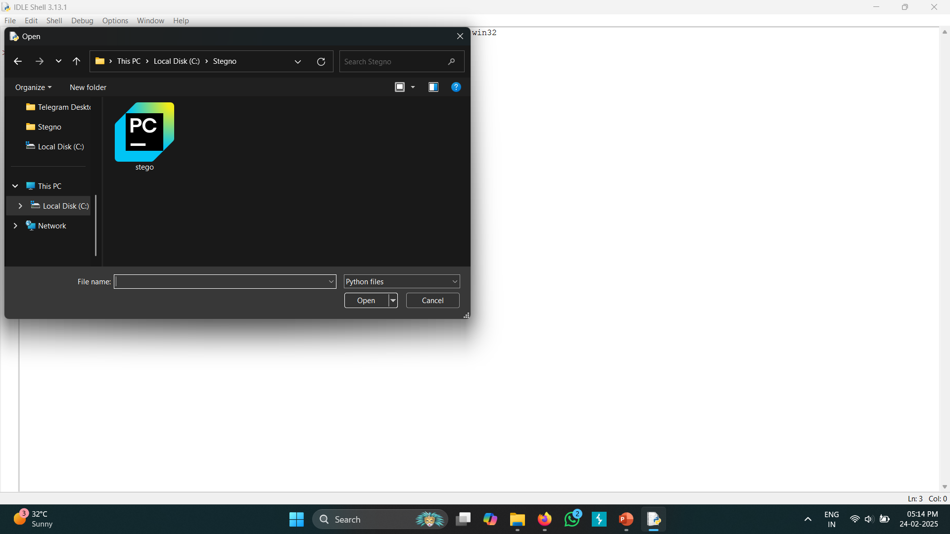
Results

Slide 20
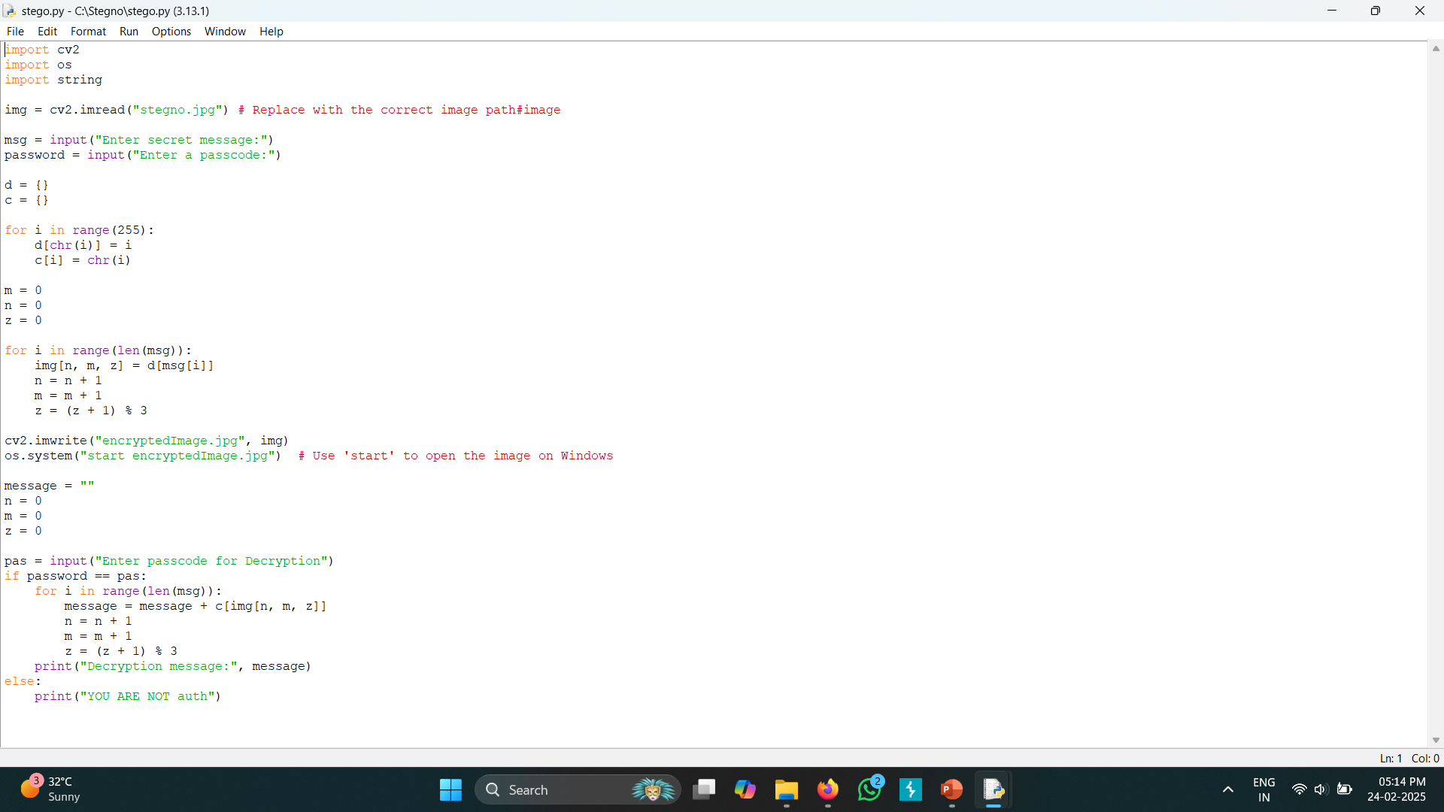
Results

Slide 21
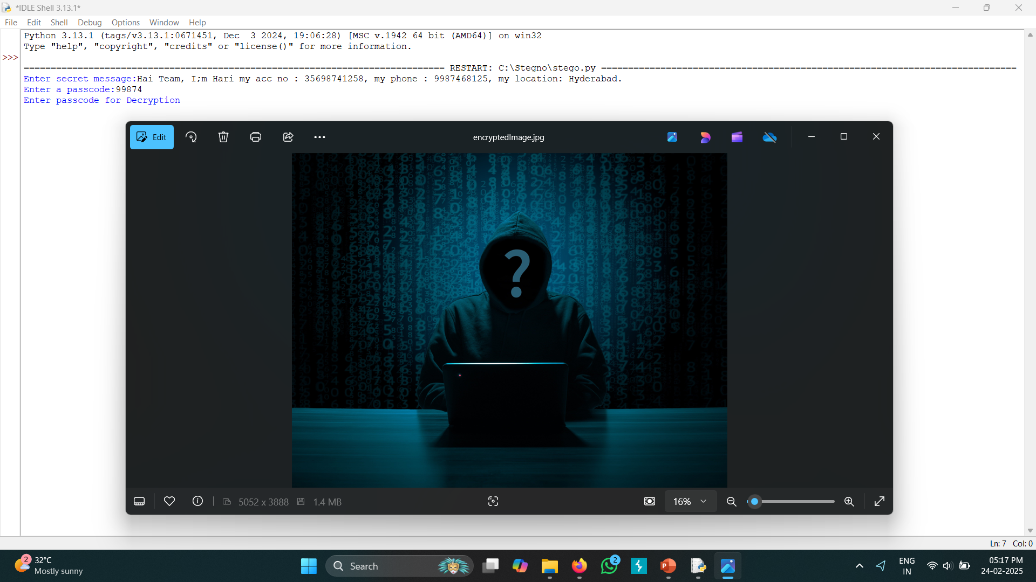
Results

Slide 22
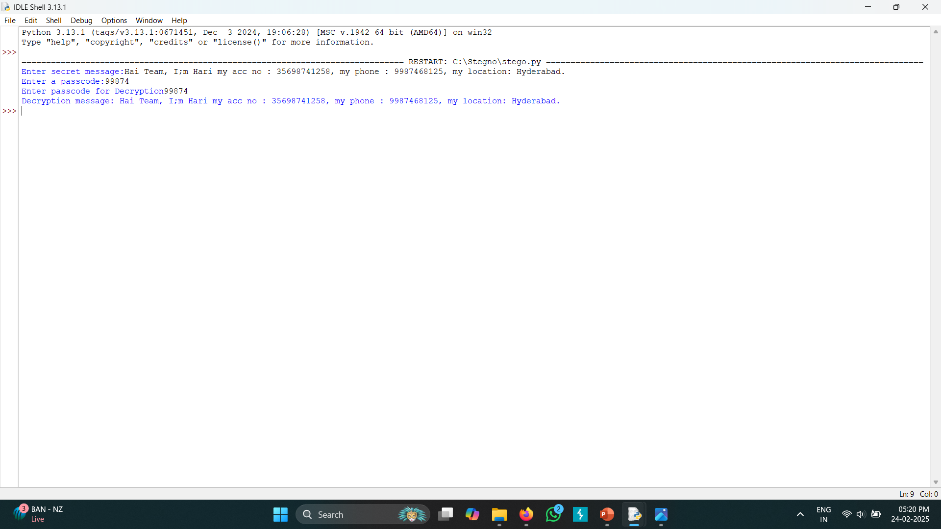
Results

Slide 23
Conclusion
In a world where data security and privacy are paramount, steganography offers a powerful yet discreet solution for secure communication.
This project successfully hides sensitive information inside images without altering their visual appearance, making it nearly undetectable.
Unlike traditional encryption, which can attract unwanted attention, steganography keeps data hidden in plain sight, ensuring covert communication.
The implementation of password-protected decryption adds an extra layer of security, restricting unauthorized access.
By leveraging Python and OpenCV, the project demonstrates an efficient and accessible approach to digital data concealment.

Slide 24
GitHub Link
https://github.com/harikrishnalimmada

Slide 25
Future scope
1️⃣ Advanced Cryptographic Integration
Combining steganography with AES or RSA encryption enhances security.
Encrypted data can be embedded inside images, making it nearly impossible to detect or decrypt without the key.
This method is useful for highly confidential data transfers in cybersecurity and espionage.
Blockchain technology can be integrated to verify and track hidden messages securely.
Future advancements may include quantum cryptography-based steganography for ultra-secure communication.

Slide 26
Future scope
2️⃣ AI-Powered Steganalysis and Detection Resistance
AI and deep learning are being used to detect steganography-based attacks in cybersecurity.
Advanced algorithms can help optimize data hiding techniques to avoid detection by modern tools.
Generative AI models can dynamically modify pixel patterns, making hidden messages undetectable.
Future steganography techniques may adapt to different image formats dynamically to avoid steganalysis.
AI-driven steganography can create self-learning systems for adaptive, undetectable data hiding.

Slide 27
Future scope
3️⃣ Steganography in IoT & Cloud Security
IoT devices can use steganography for secure firmware updates and command transmission.
Cloud security can benefit from embedding sensitive metadata inside multimedia files to prevent leaks.
Steganography can help prevent man-in-the-middle (MITM) attacks by hiding authentication data.
Secure cloud storage can use steganography to hide confidential files inside innocuous-looking media.
Future developments may include AI-based adaptive steganography for IoT security.

Slide 28
THANK YOU

