Slide 1

EV Battery Thermal Run Away Early Detection Node
Presented by : Team Vision X
Team Members:
Srimathi M
Sri Gayatri G
Hari Krishnan M
Udaya Sankar K
“A battery can appear normal on the outside while dangerous heat develops inside.”

Slide 2
Problem Statement
Lithium-ion batteries are widely used in electric vehicles.
Abnormal heating can indicate a developing battery problem.
Thermal runaway is a serious condition involving uncontrolled self-heating.
Basic temperature alarms may not identify every abnormal temperature pattern.
A monitoring system is needed to track readings and provide timely warnings.
In one lithium-ion battery ageing study, increasing storage temperature from 25°C to 42.5°C caused the battery to reach 85% state of health approximately six times faster.

Slide 3
EXISTING TECHNOLOGIES AND PROPOSED SOLUTION
Use an ESP32 to collect readings from three temperature sensors.
Monitor temperature differences and changes over time.
Send live readings to a web dashboard through Wi-Fi.
Classify the monitored condition into three levels: NORMAL, WARNING, and HIGH RISK.
Integrate a machine learning model if suitable training data and deployment requirements are met.
Display alerts and record events for analysis.

Slide 4
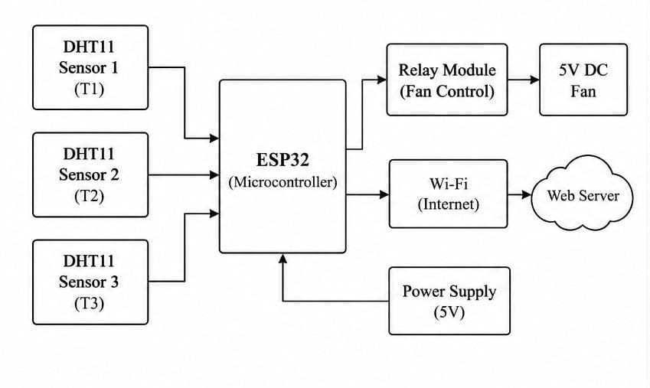
BLOCK DIAGRAM

Slide 5
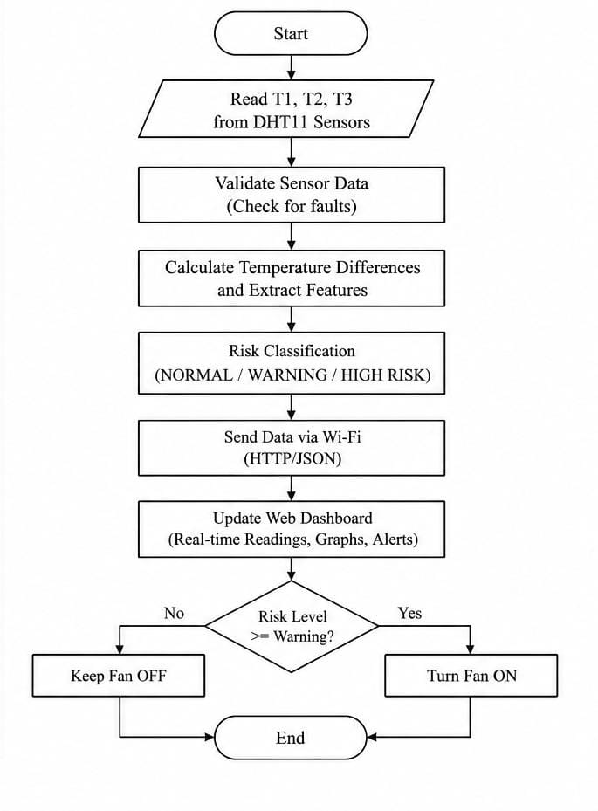
FLOW DIAGRAM
The system reads and validates sensor data, checking for missing or invalid readings.
It calculates temperature differences and analyses the readings using configured rules or an integrated ML model to determine the risk category.
The dashboard displays live readings and alerts, while the fan responds according to the configured control logic.

Slide 6
AI-Based Risk Classification and Real-Time Dashboard
Machine Learning
Inputs: T1, T2, T3 and temperature differences.
Train a model using suitable labelled data.
Classify conditions into NORMAL, WARNING, HIGH RISK.
2. Risk Alert System
NORMAL — Readings within configured limits.
WARNING — Abnormal temperature or trend detected.
HIGH RISK — Configured critical condition detected.
3. Live Web Dashboard
Real-time temperature and humidity readings.
Temperature graphs and risk-status indicators.
ESP32 connection and fan status.

Slide 7
WORKING PRINCIPLE
Three sensors collect ambient temperature and humidity readings.
The ESP32 checks whether the sensor data is valid.
The system calculates temperature differences and monitors trends.
A configured rule-based system or integrated ML model determines the risk category.
ESP32 sends the readings and status to the website through Wi-Fi.
The dashboard updates the readings, graphs, risk label, and alert history.
The relay controls the demonstration fan according to configured prototype rules.

Slide 8
EXPECTED OUTCOMES
Continuous monitoring of sensor readings.
Clear risk-level visualization.
Faster visibility of configured abnormal conditions.
A foundation for evaluating ML-based battery monitoring.

Slide 9
CONCLUSION AND FUTURE SCOPE
Our project combines sensor monitoring, ESP32 connectivity, risk classification, and a web dashboard.
It provides three clear risk levels: NORMAL, WARNING, and HIGH RISK.
Use suitable battery-surface or cell-temperature sensors.
Train and validate the ML model.

